Slide 1
LIBAAZ - THE COUTURE SALES & PERFORMANCE REPORT
PREPARED BY
NABEEL GHALIB

Slide 2

Introduction
About Libaaz the Couture: A designer and bespoke apparel studio specializes in creating custom-made dresses exclusively for women and girls.
Objective of the Report: To provide a comprehensive analysis of sales, profit, and revenue trends between 2013 and 2024, with a focus on product performance, sales channels, referral sources, and customer demographics.

Slide 3

Executive Summary
Total Sales: 74 sales
Top Product: Blouse, Blouse with aari work
Sales Channels: Offline sales lead, online sales are increasing
Referral Sources: Studio and WhatsApp drive most sales
Total Profit: ₹22,712

Slide 4

Total Sales overview
2013–2017
51 sales
2022–2024
23 sales

Slide 5

Total Profit, Income and Revenue
Total Profit
2013-2024: ₹22,712
2013-2017: ₹19,850
2022-2024: ₹2,862
Total Income:
2013-2024: ₹82,612
2013-2017: ₹64,900
2022-2024: ₹17,712
Total Revenue:
2013-2024: ₹1,35,650
2013-2017: ₹1,08,450
2022-2024: ₹27,200

Slide 6
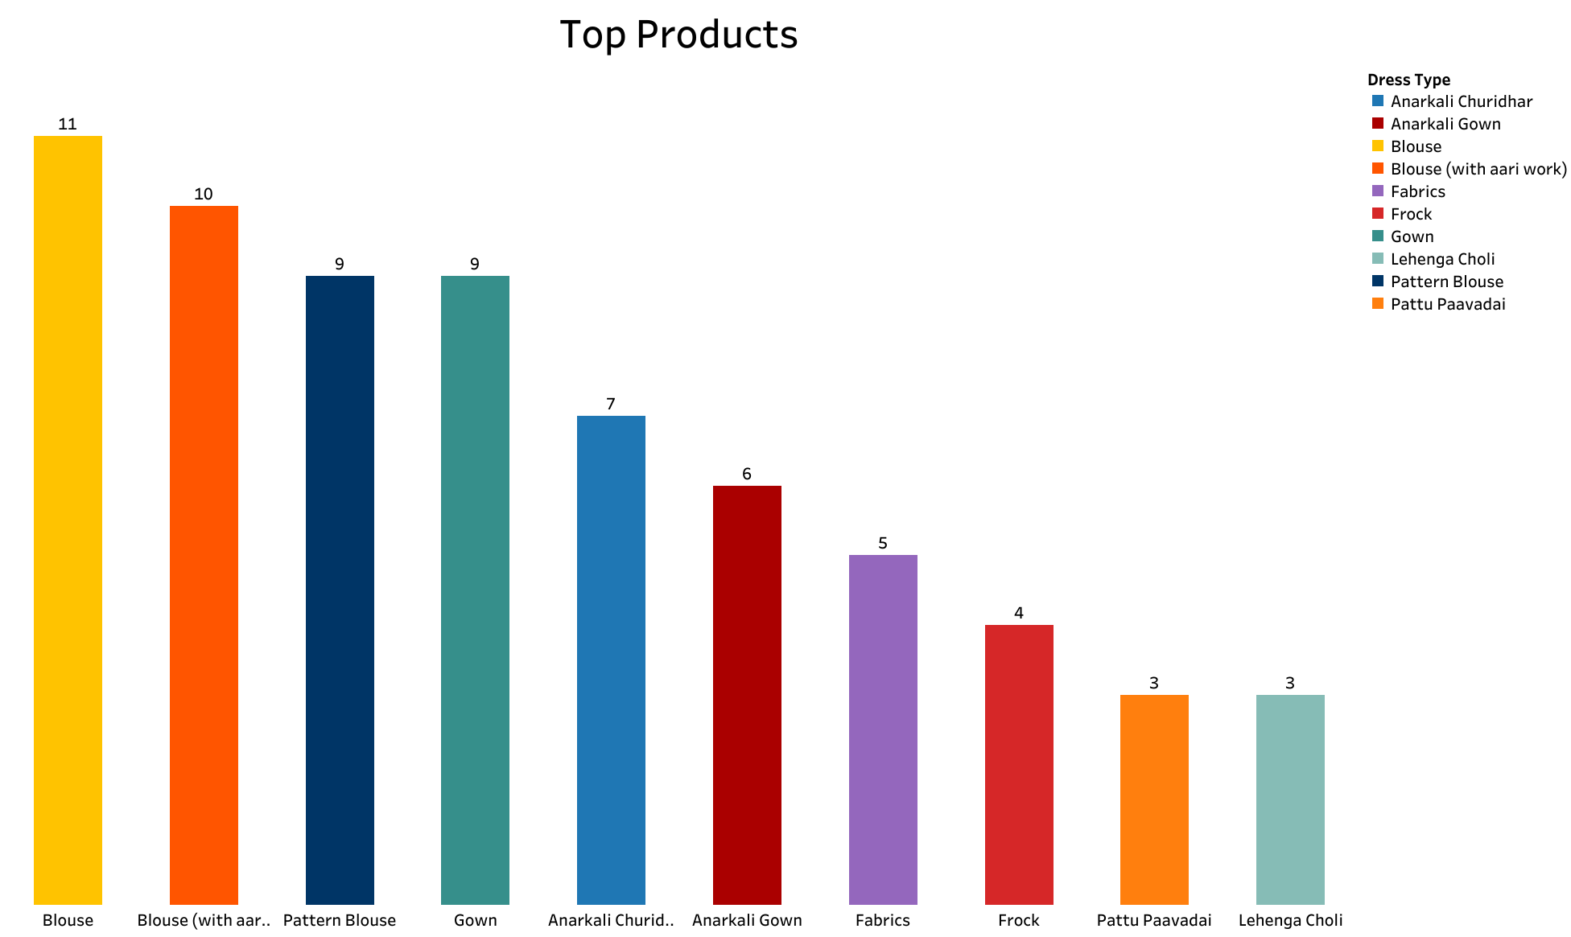
Best Selling Products
Highest Sold Product:
2017-2024: Blouse
2013-2017: Blouse (with aari work)
2022-2024: Blouse
Top Product by Profit:
2013-2017: Blouse (with aari work)
2022-2024: Blouse

Slide 7
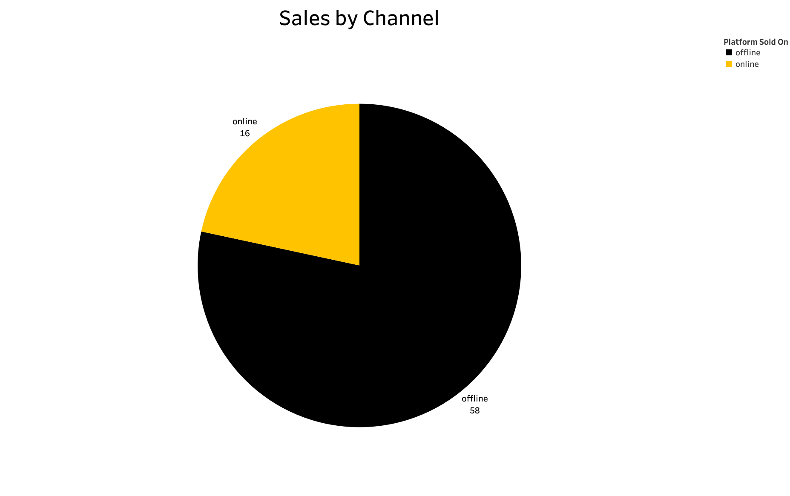
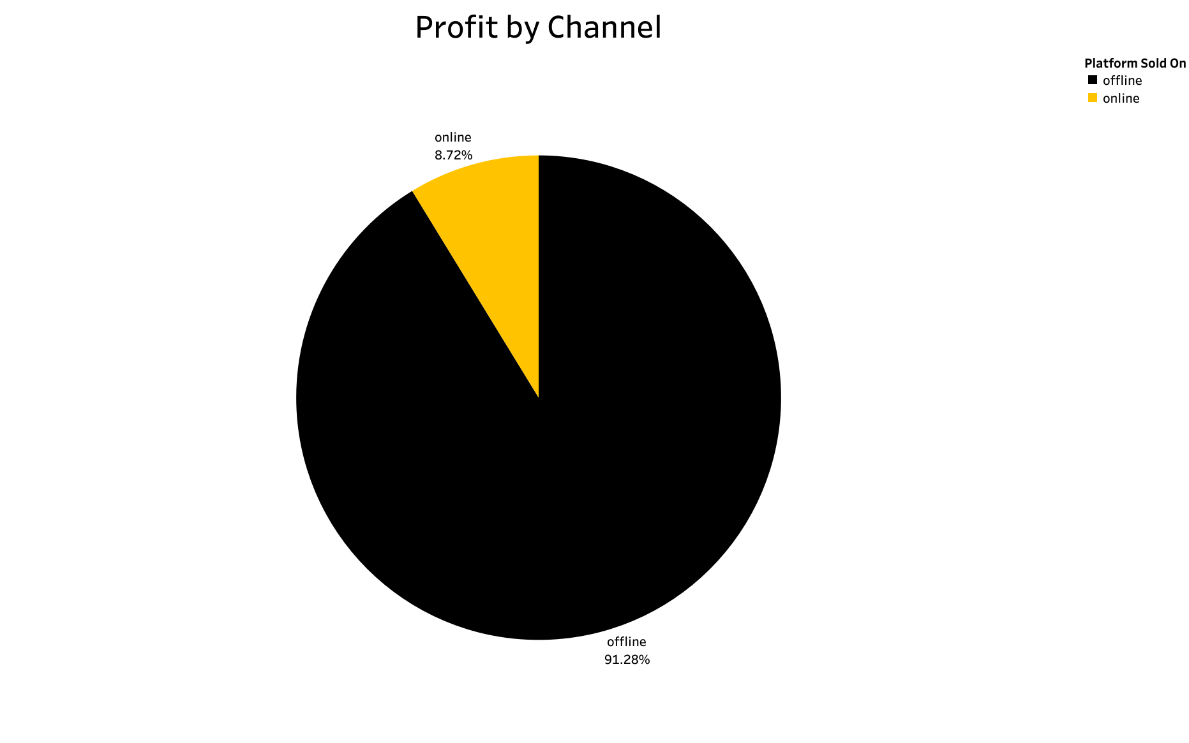
Sales & Profit by Channels (Offline vs Online)
Sales:
2013-2017:
Offline – 49 sales, Online – 2 sales
2022-2024:
Offline – 9 sales, Online – 14 sales
Profit:
2013-2017:
Offline - ₹19350, Online - ₹500
2022-2024:
Offline – ₹1382, Online - ₹1480

Slide 8
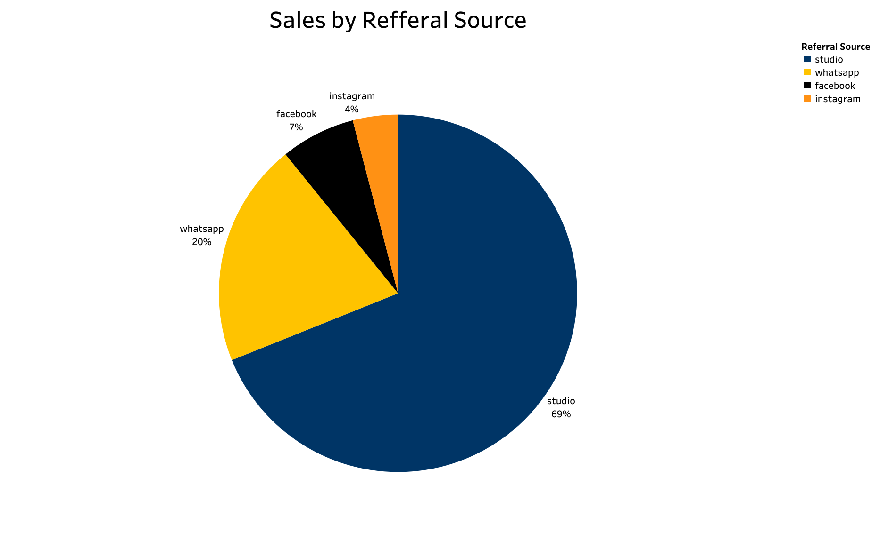
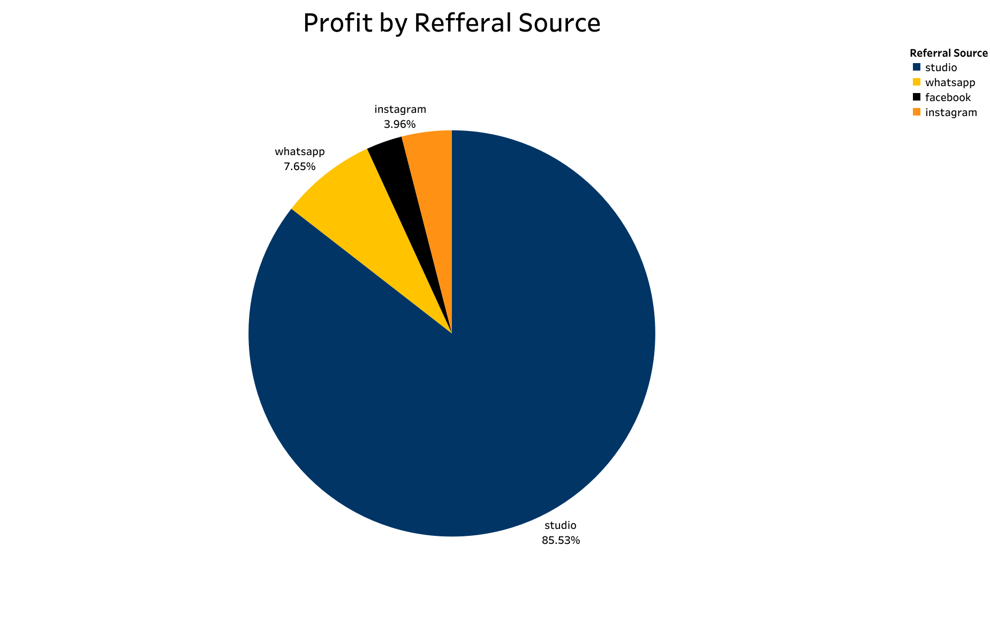
Sales & Profit by Referral Source
Studio: 51 sales, ₹19,425 profit
WhatsApp: 15 sales, ₹1,737 profit
Facebook: 5 sales, ₹650 profit
Instagram: 3 sales, ₹900 profit

Slide 9
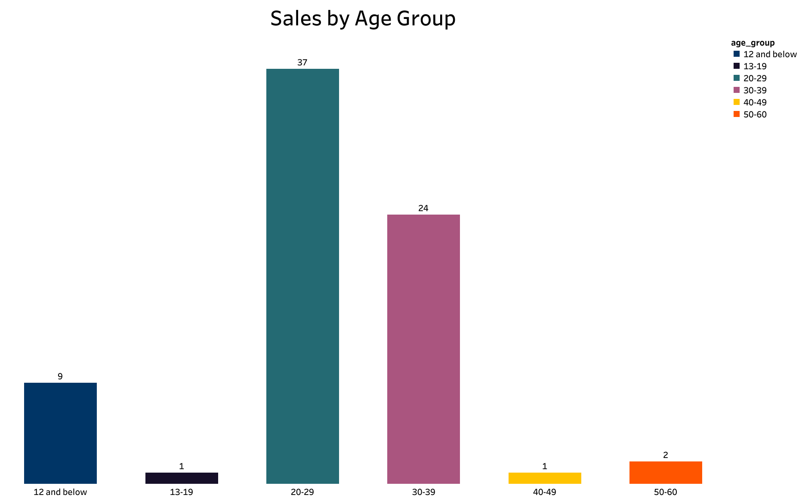
Customer Age Group Distribution
Top 3 age groups:
30-39
20-29
12 and below

Slide 10
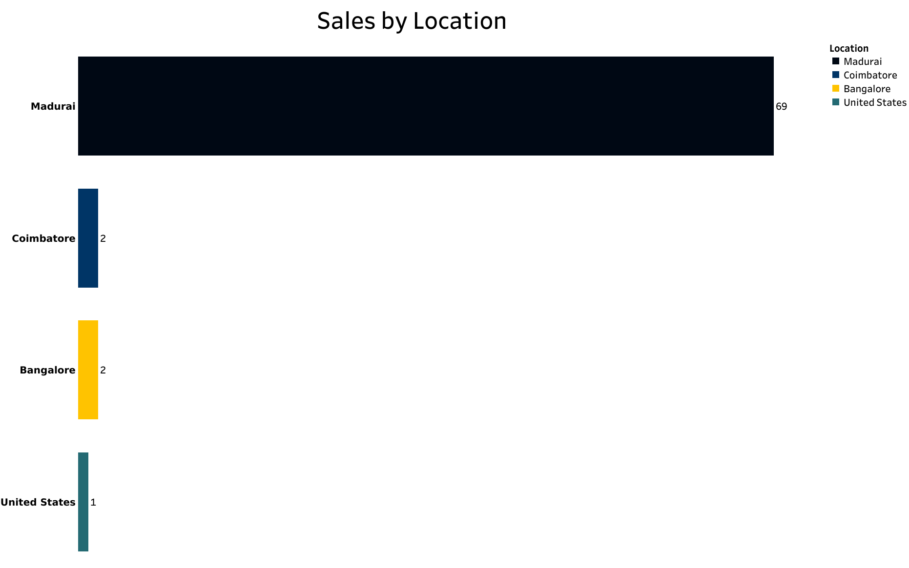
Location-Based Sales Performance
Madurai: 69 sales, ₹22,012 profit
Coimbatore: 2 sales, ₹250 profit
Bangalore: 2 sales, ₹200 profit
United States: 1 sale, ₹250 profit

Slide 11
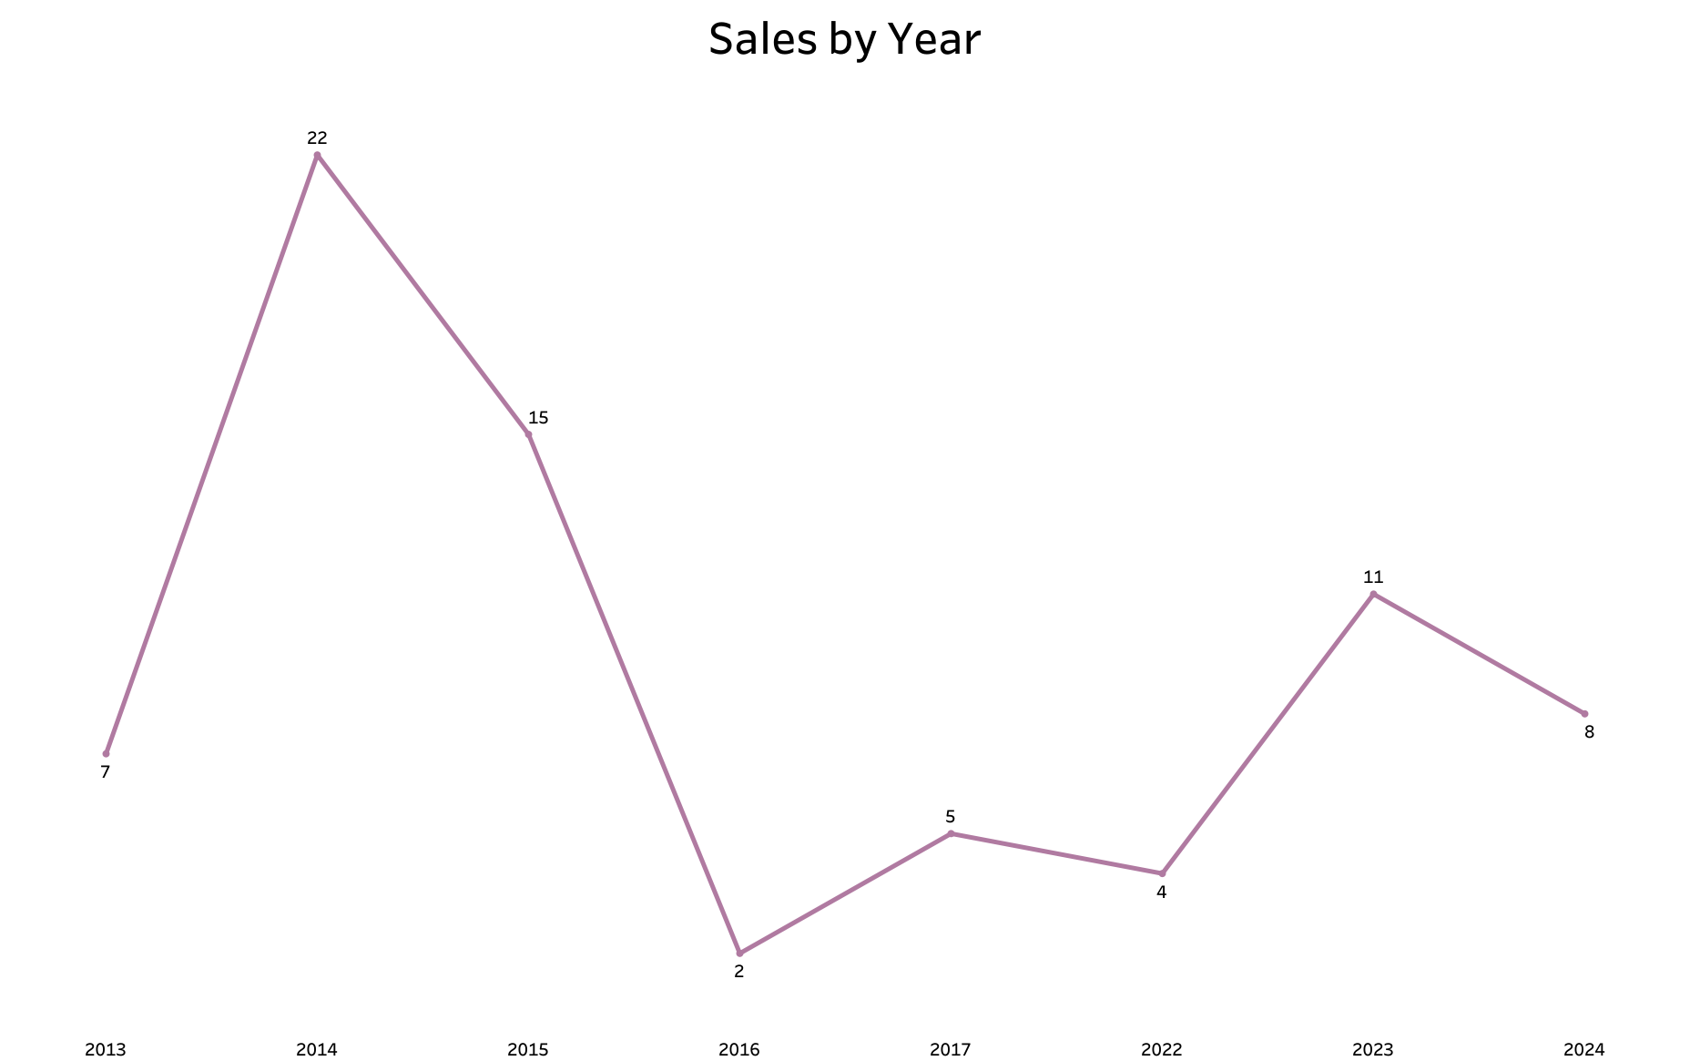
Yearly Sales Trends
Between the year 2013-2017:
The most sales happened in the Year 2014 followed by 2015
Between the year 2022-2024:
The most sales happened in the Year 2023 followed by 2024

Slide 12
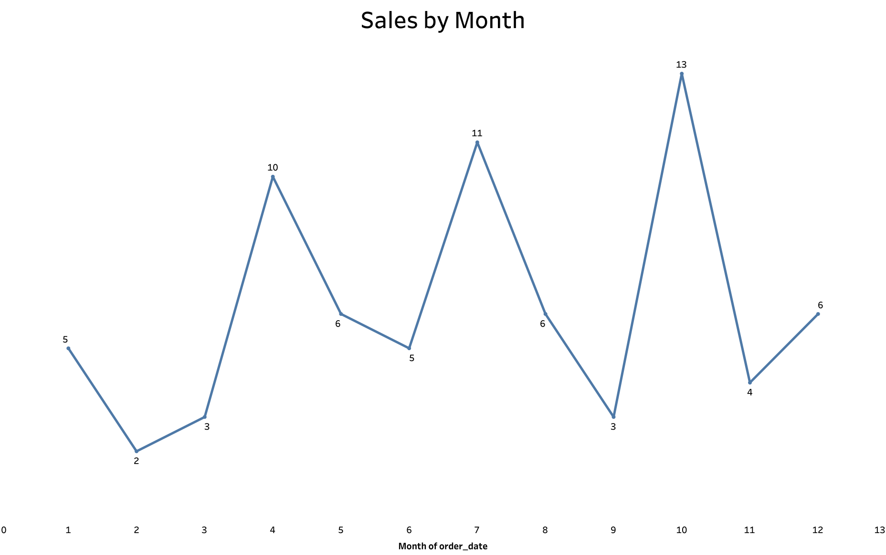
Sales by Month
The top month in sales between the year,
2013-2017:
April: 9 sales
July: 9 sales
2022-2024:
October: 11 sales

Slide 13

Top Customers
2013-2017:
cust008
cust017
cust015
2022-2024:
cust008
cust005
cust004

Slide 14
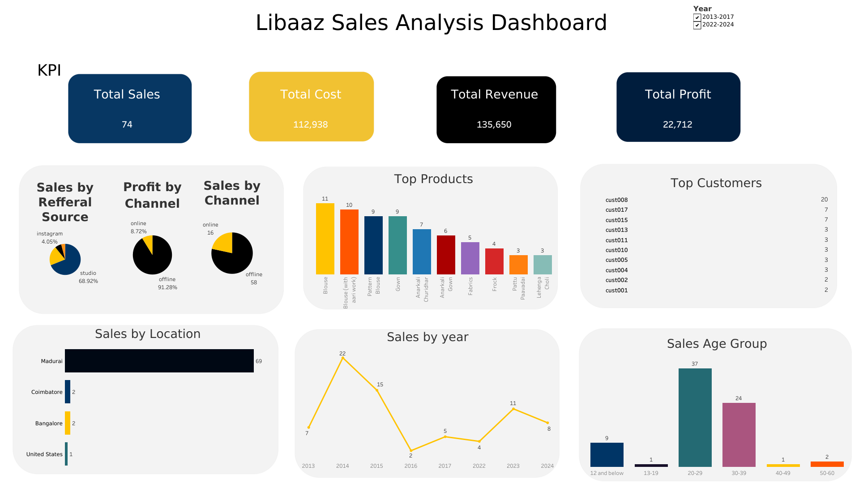
DASHBOARD

Slide 15
Conclusion
Overall Sales: Sales decreased from 51 (2013-2017) to 23 (2022-2024). Profit dropped significantly, indicating a need for improved strategies.
Product Performance: Blouse remains the top-selling product, though sales declined. Introducing new styles could attract more customers.
Sales Channels: A shift from offline to online sales (WhatsApp, Instagram, Facebook) highlights the need for a stronger digital presence.
Regional Insights: Madurai is the top market, but emerging sales in Bangalore, Coimbatore, and the U.S. suggest opportunities for expansion.
Customer Demographics: Sales are shifting from the 20-29 age group to 30-39, indicating a change in target audience.
Seasonality: Peak sales in April, July, and October suggest the need for targeted promotions during these months.

