Slide 1
INTRUSION DETECTOR
If we use CC camera for monitoring the intrusion then surely it would be very inefficient.
As it will continously consume the energy for regular functioning and also waste the memory for storing the footages of the time when there would be no intrusion.
Hence, there is a solution, which triggers the functioning of the camera only when there is someone detected in the room, and also notify you along with the fotage of the room during his/her presence
And it is our INTRUSION DETECTOR.

Slide 2
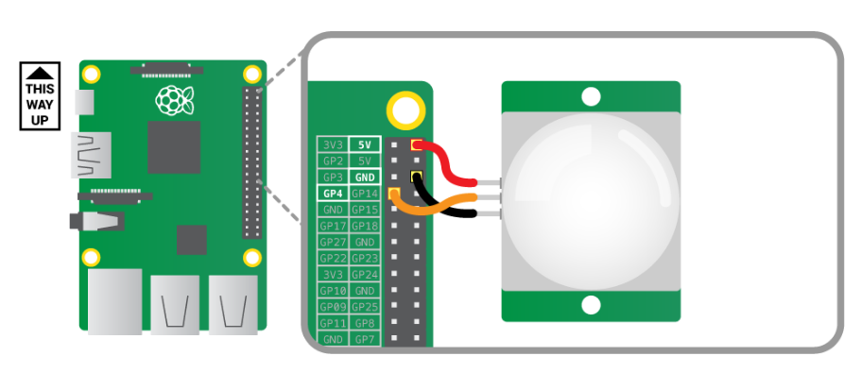
Connection of PIR motion sensor : -

Slide 3
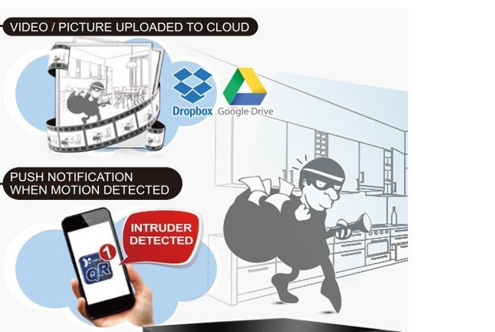
IT’S FUNCTIONING
On detecting the motion it will instantly notify you via e-mail and also update the footage to your dropbox. It is depected in the following image :

