Slide 1

Digital Chef: Collaborative Filtering in the Kitchen
Members:
Dhruv Gairola Project Manager
Robert Miles Technical Director
Amy Jane Wesson Documentation Manager
Chenjue Xu Design Manager
Christopher Head Quality Assurance Officer

Slide 2
Problem Addressed
Software kitchen assistant tool
Basic level:
  Search
Lack of crowd sourcing techniques
  The have this data which they aren’t using
  Exciting technologies which use data to give recommendations

Slide 3
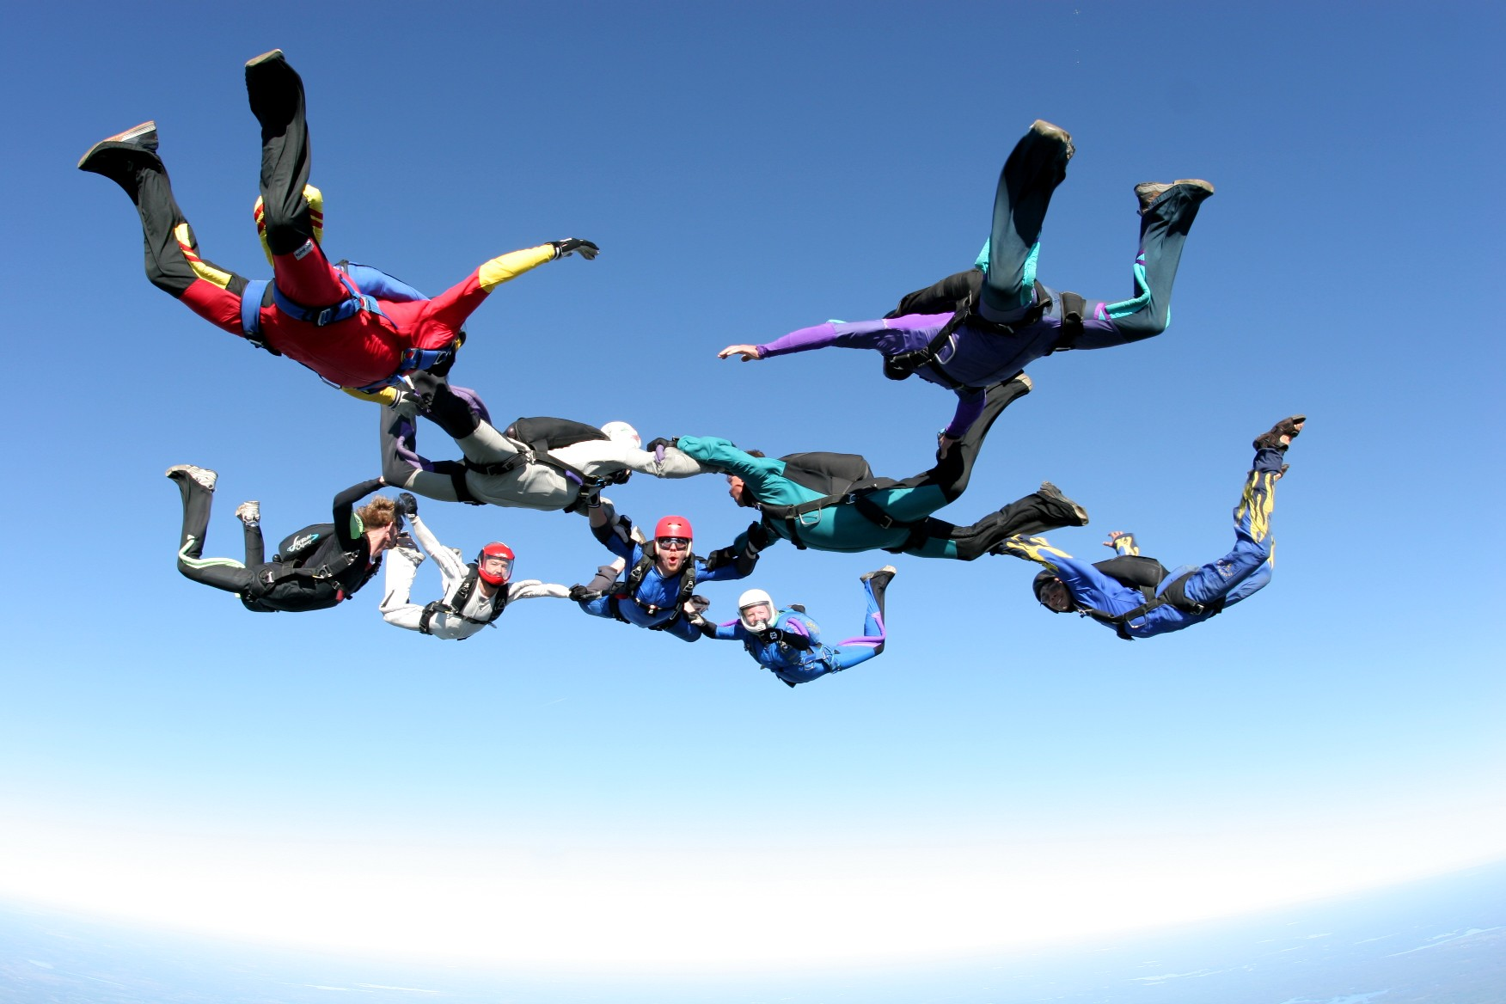
Project Principles
Extreme Programming
  Short, frequent releases
  Milestones
  Pair Programming
Maximize code reuse
  Used lots of third party modules
        EXTREME!
……..….programming

Slide 4

“Digichef”
Basic features
  Search for recipes
  Rank returned recipes
Advanced features
  Collaborative filtering technology?
  Huge, expandable database
  User profiles

Slide 5
The “DigiChef” Edge
3D ADVANTAGE!
  Discovery
  Depth
  Design

Slide 6
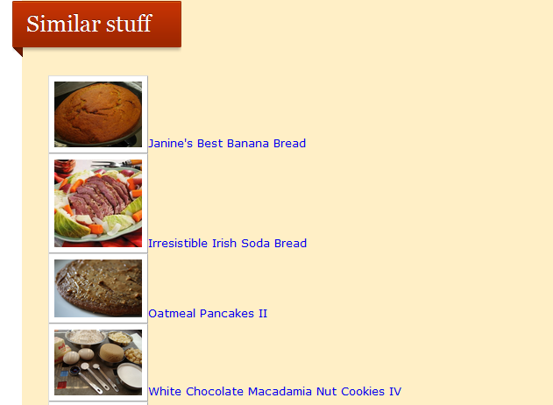
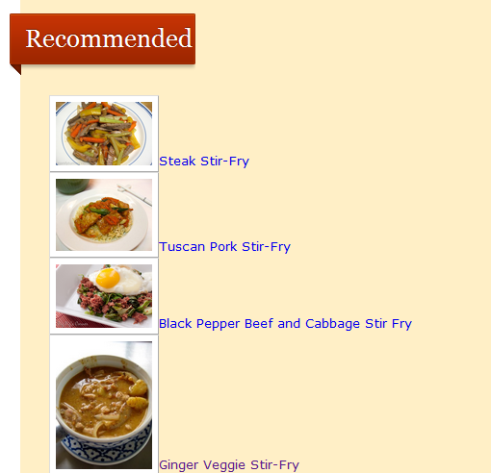
Discovery
Similar recipes suggestion
Sophisticated recommendation
  Other websites don’t do this

Slide 7
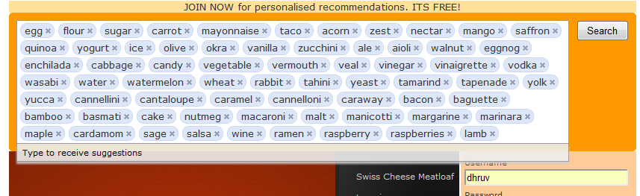
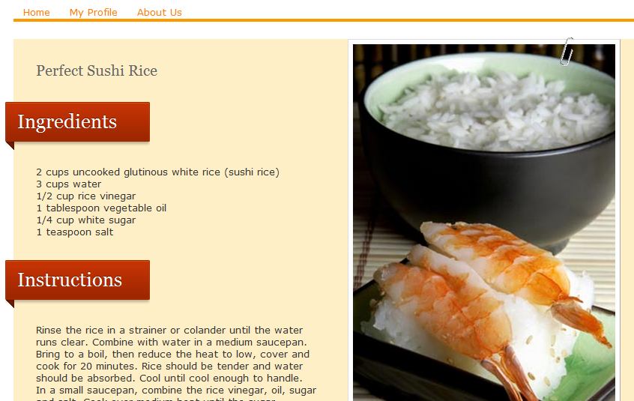
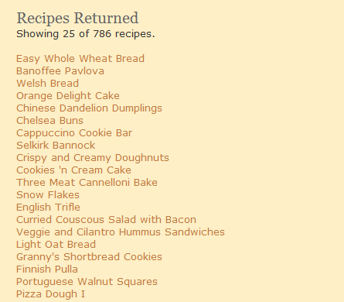
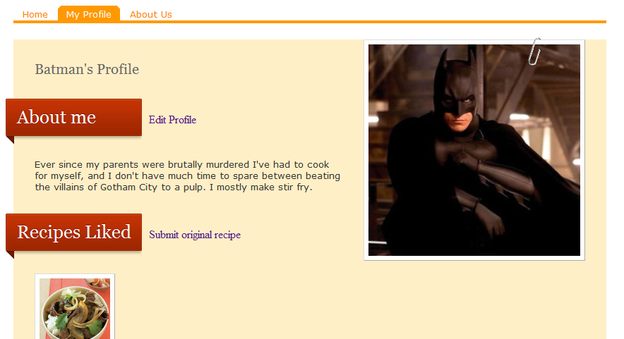
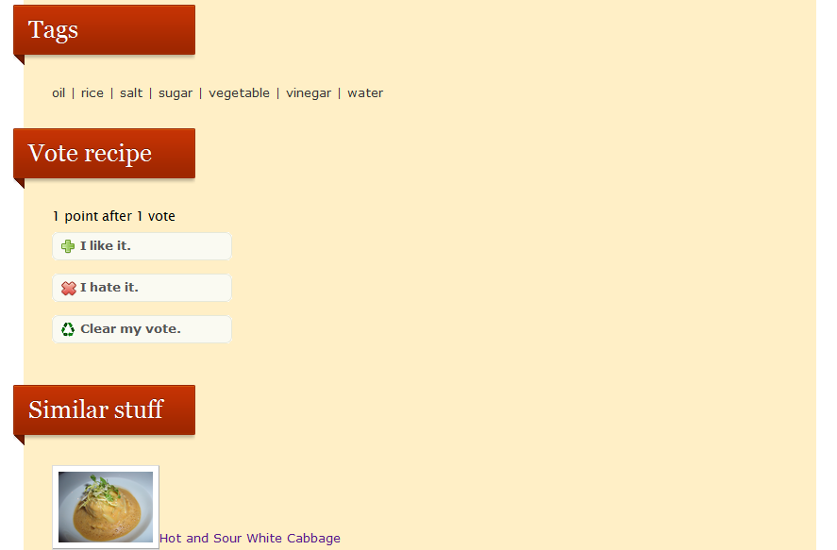
Depth
User profile
  Edit profile
  Create own recipes
  Recipes liked
Recipe page
  Like recipes
  Similar recipes
No limitations to ingredients

Slide 8
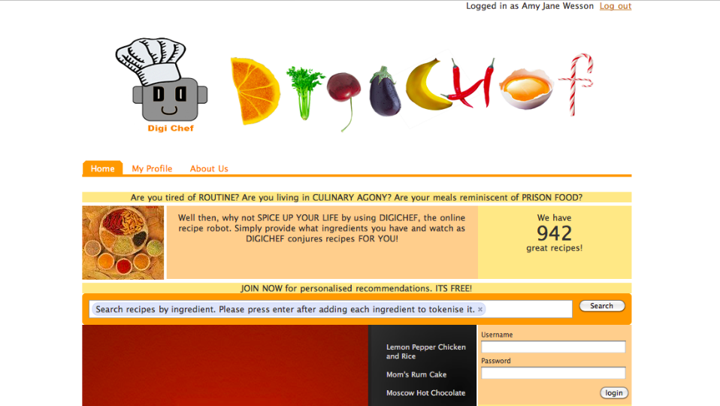
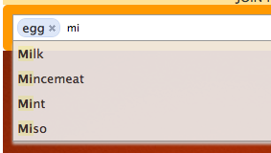
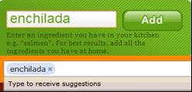

Design
Scientific
  Orange
Sleek
Mascot
  Leverage on marketing to promote product
  Other website don’t do this

Slide 9
3D ADVANTAGE
Discovery + Depth + Design
DELICIOUS!

Slide 10
Business Potential
Digichef edge
Monetizing
  Targeted advertising
  Tried and tested business model

Slide 11



Technologies
Django Modules
Recommender, Voting, Tagging, Auth, Registration, Profiles, etc.
OS
Linux, Unix, Windows, Mac
Database
MySQL, SQLite, PostgreSQL, etc.

Slide 12
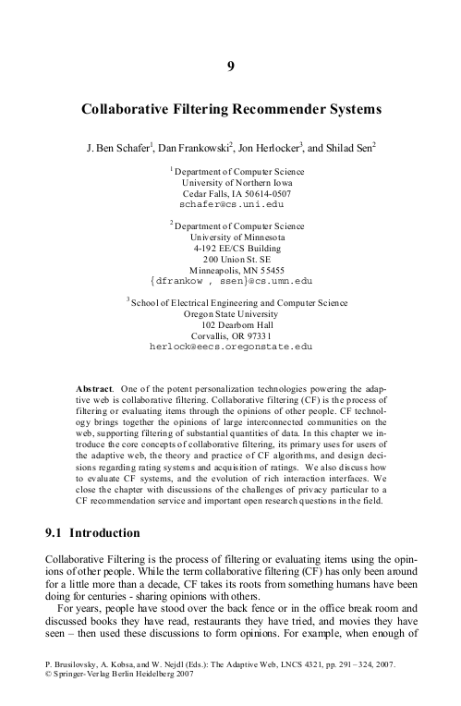
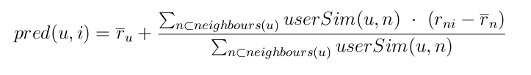
Collaborative Filtering
Built on existing resources
  Third party modules
    django-recommender
  Scientific Literature
    User Based Nearest Neighbour Algorithm

Slide 13
Project Reflection
Product reflection
  Implemented features of the ideal version
  Competitive advantage
Teamworking reflection
  Clear hierarchy
  Version control
  Milestones

Slide 14
Conclusion
Technical Success
Business Success
Group work Success

Slide 15
THANK YOU!

