Slide 1

Digital Chef: Collaborative Filtering in the Kitchen
Members:
Dhruv Gairola Project Manager
Robert Miles Technical Director
Amy Jane Wesson Documentation Manager
Chenjue Xu Design Manager
Christopher Head Quality Assurance Officer

Slide 2

Problem Addressed
Software kitchen assistant tool
Basic level:
  Database of recipes
  Search database by ingredients
  Rank the returned recipes
Numerous avenues for improvement
  Collaborative filtering?

Slide 3
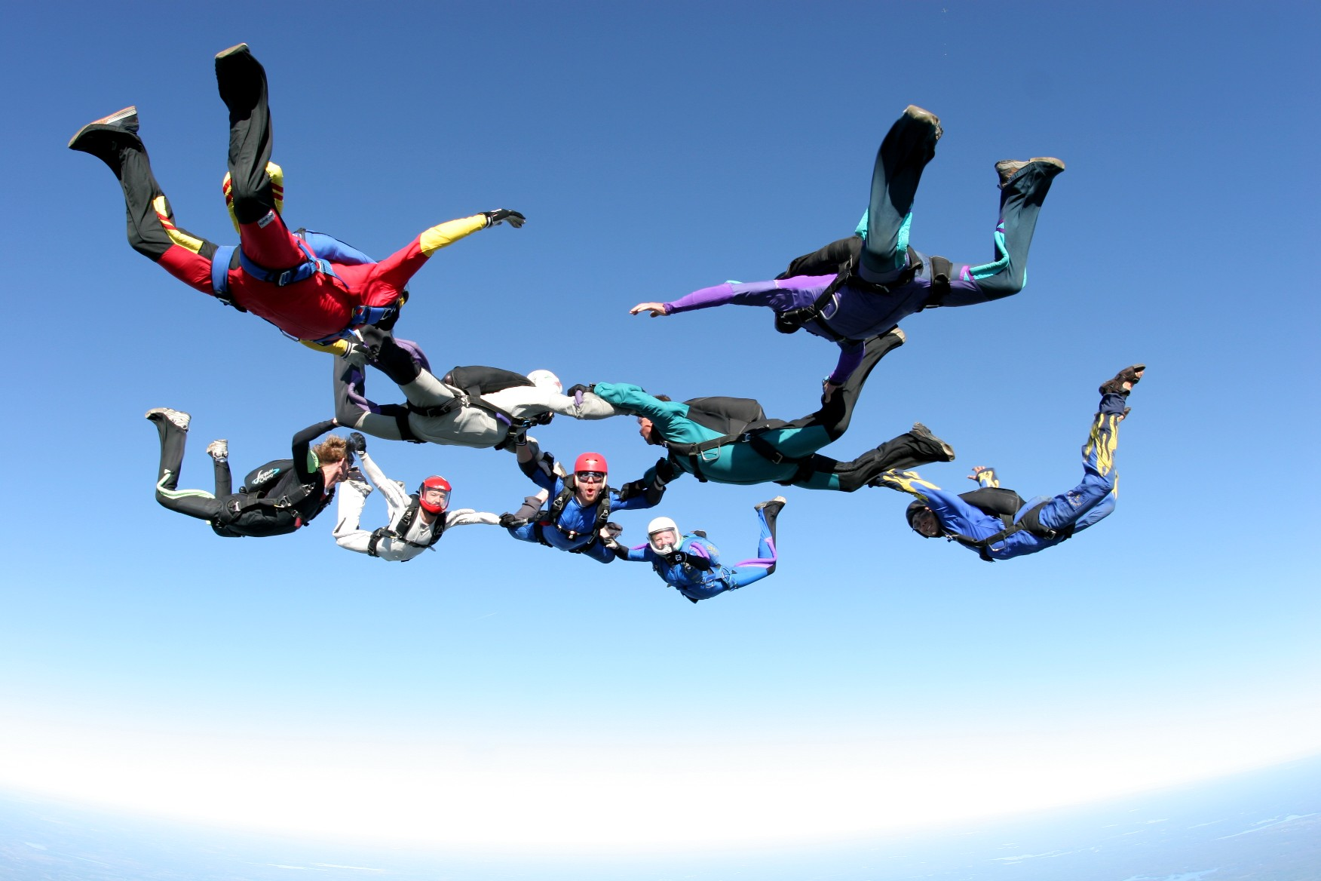
Project Principles
Extreme Programming
  Short, frequent releases
  Milestones
  Pair Programming
Maximize code reuse
  Django template inheritance
  Javascript for website
        EXTREME!
……..….programming

Slide 4
“Digichef”
Basic features
  Search for recipes
  Rank returned recipes
Advanced features
  Huge, expandable database
  Collaborative filtering technology
  User profiles

Slide 5
The “DigiChef” Edge
3D ADVANTAGE!
  Discovery
  Depth
  Design

Slide 6
3D ADVANTAGE
Discovery+Depth+Design=DELICIOUS!

Slide 7
Project Reflection
Product reflection
  Implemented features of the ideal version
  Competitive advantage
Teamworking reflection
  Clear heirachy
  Version control
  Milestones

Slide 8
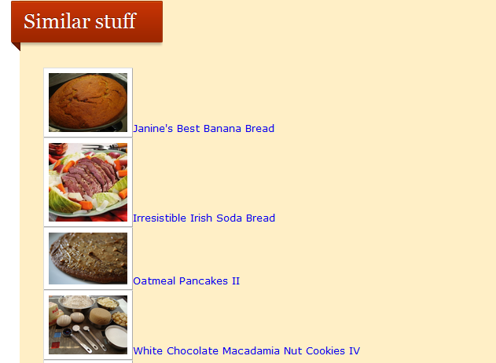
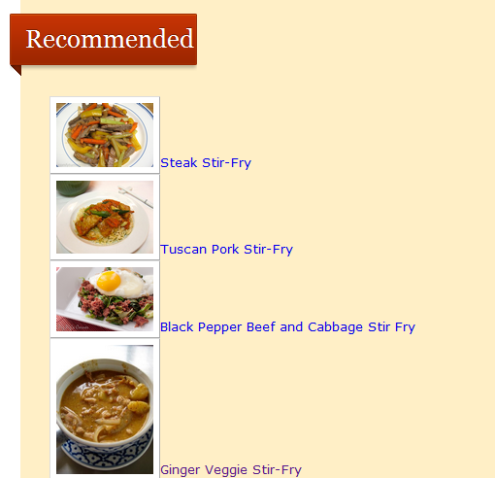
Discovery
Similar recipes suggestion
Sophisticated recommendation
  Other websites don’t do this
    back

Slide 9
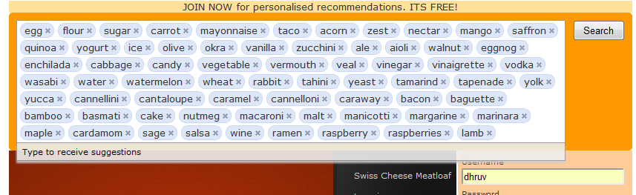
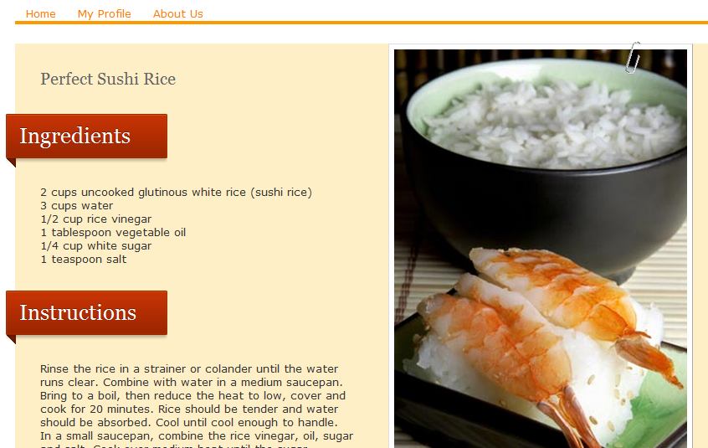
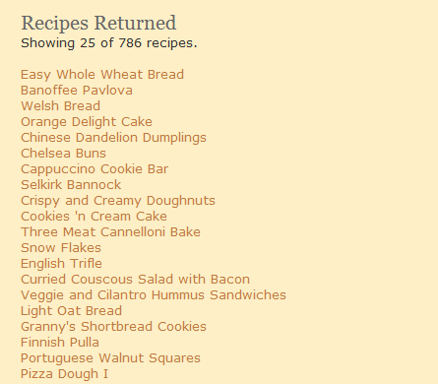
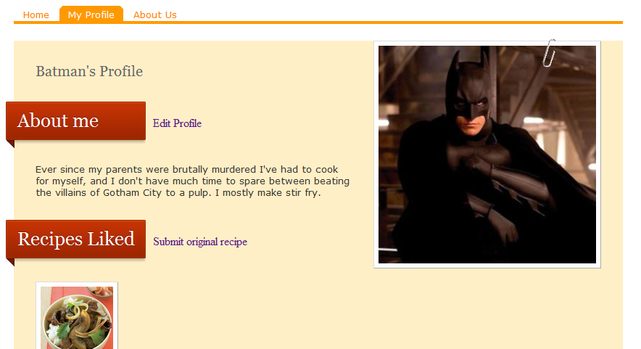
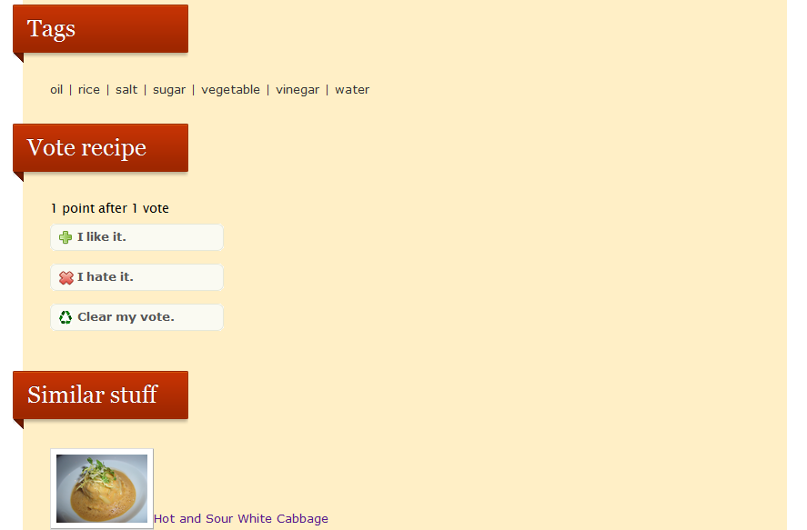
Depth
User profile
  Edit profile
  Create own recipes
  Recipes liked
Recipe page
  Rate recipes
  Similar recipes
No limitations to ingredients
    back

Slide 11
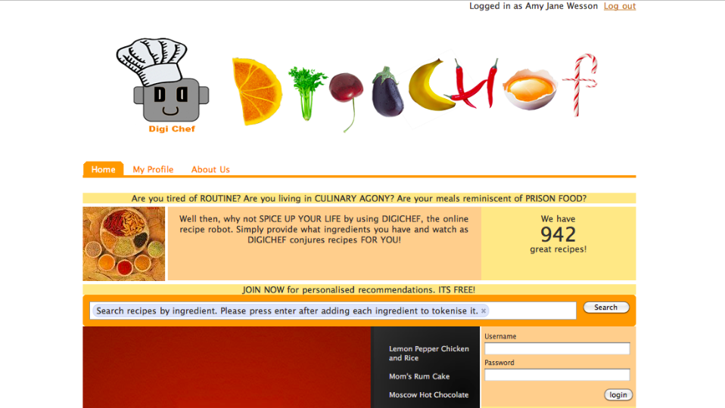
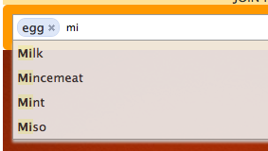
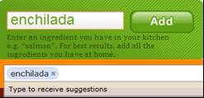

Design
Scientific
  Orange
Sleek
Mascot
  Leverage on marketing to promote product
  Other website don’t do this
    back

