Slide 1

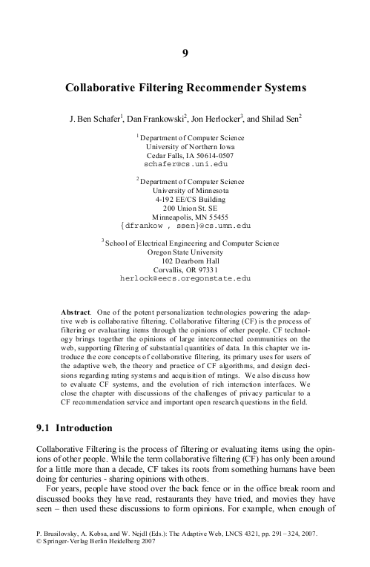
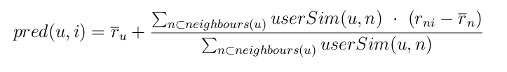
Collaborative Filtering
Built on existing resources
  Third party modules
    django-recommender
  Scientific Literature
    User Based Nearest Neighbour Algorithm

