Slide 1




Technologies
Django Modules
Recommender, Voting, Tagging, Auth, Registration, Profiles, etc.
OS
Linux, Unix, Windows, Mac
Database
MySQL, SQLite, PostgreSQL, etc.

Slide 2
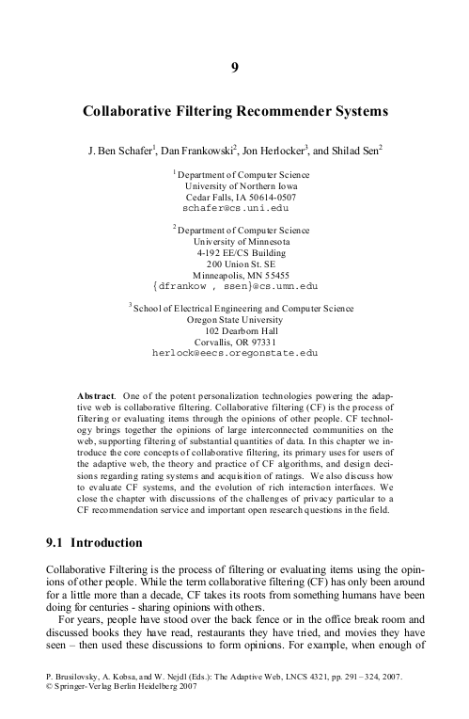
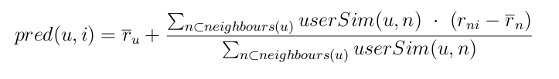
Collaborative Filtering
Built on existing resources
  Third party modules
    django-recommender
  Scientific Literature
    User Based Nearest Neighbour Algorithm

