Slide 1


Slide 2
CONTENT
INTRODUCTION
what is it and it’s importance
working
Project code
Uses
Conclusion

Slide 3
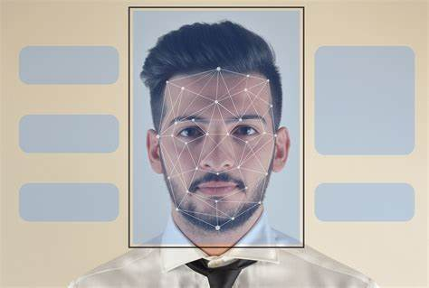
introduction
Bhoomi Gupta
Nabhanya Singh
Mohit Mendiratta
Aman Phaltankar
Aditya Singh Sikarwar
Face recognition attendance system
“Gangadhar Hi Shakti Man Hai”

Slide 4

What is it and
Its importance
In order to determine classroom attendance, face detection and face recognition are performed. Face detection is used to determine the location of the faces in the classroom image and extract sub images for each face. Then, in face recognition, the face images detected will be compared with the data base consisting of images of students in the class, and attendance will be recorded accordingly.
Traditionally attendance is marked manually by teachers and they must make sure correct attendance is marked for respective student.
This whole process wastes some of lecture time and part of correct information is missed due to fraudulent and proxy cases.

Slide 5

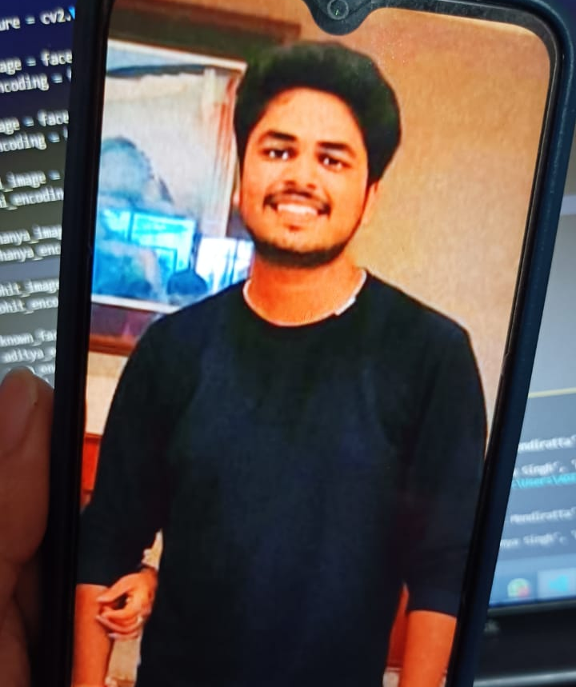
working
Working of this project is very simple. When we will execute our python program our camera will open and we have to show our faces or photos of students

Slide 6


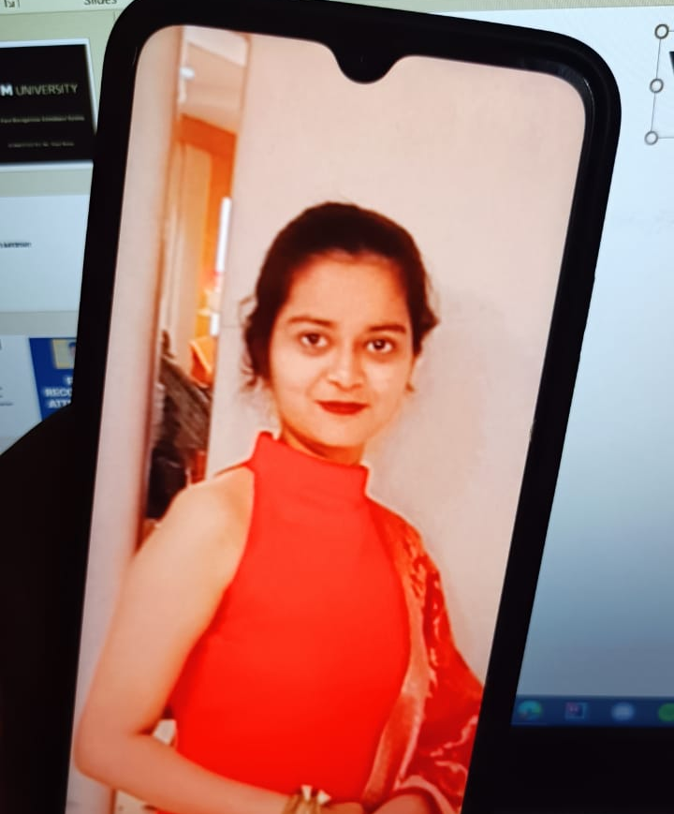
When all students are once captured
Or Present students are captured then press “Q” for quit or terminate program

Slide 7

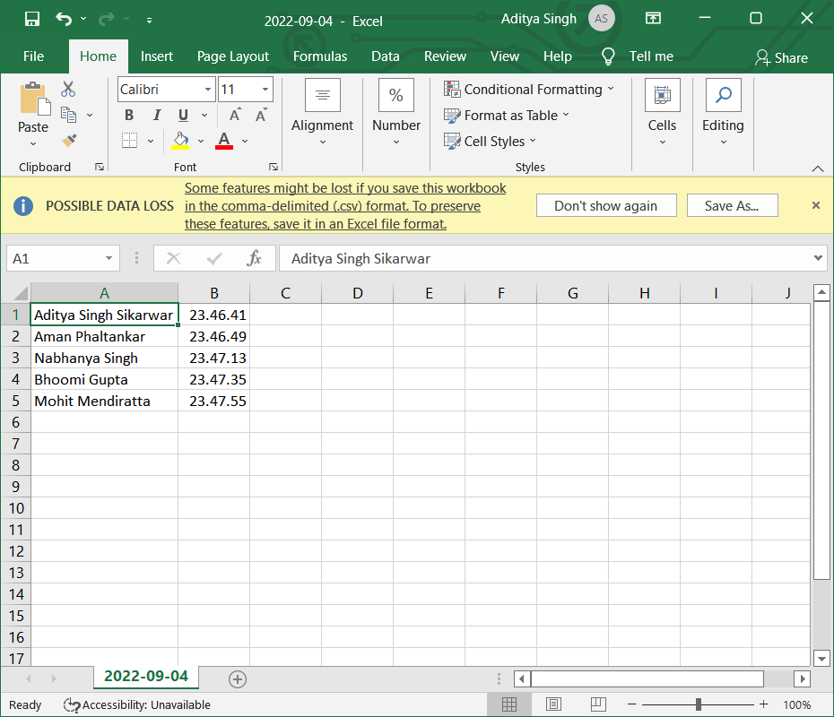
It will create a Excel file Named Current Date
It will Mark Attendance and time. When Student Enter in class

Slide 8
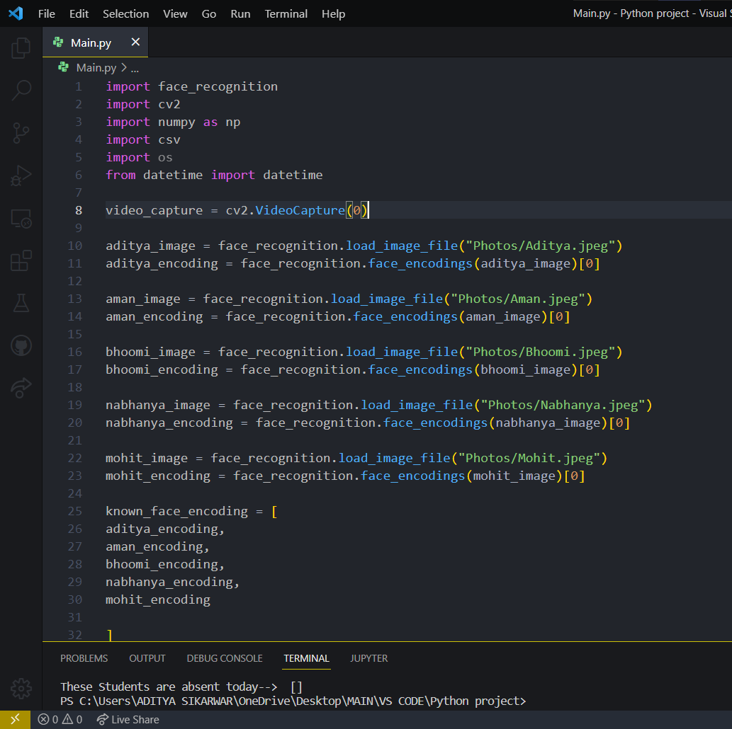
Project code
IMPORTANT POINTS
Installing necessary packages
Saving images of students in database
Encoding the face coordinates

Slide 9
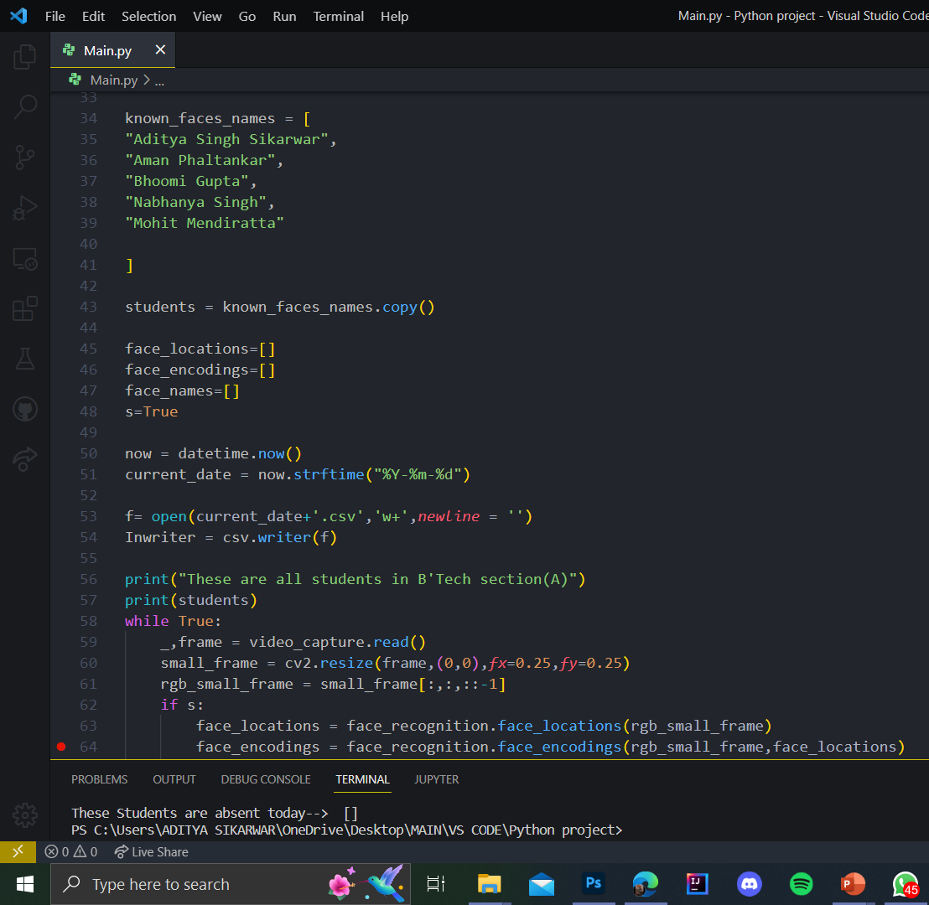
Creating csv file
Saving the file name as present date
Writing the names of students that are present in csv file
Taking input from webcam
Decreasing the frame size, cropping the image to the size of the face
Converting the image to RGB as cv2 takes input in form of BGR

Slide 10
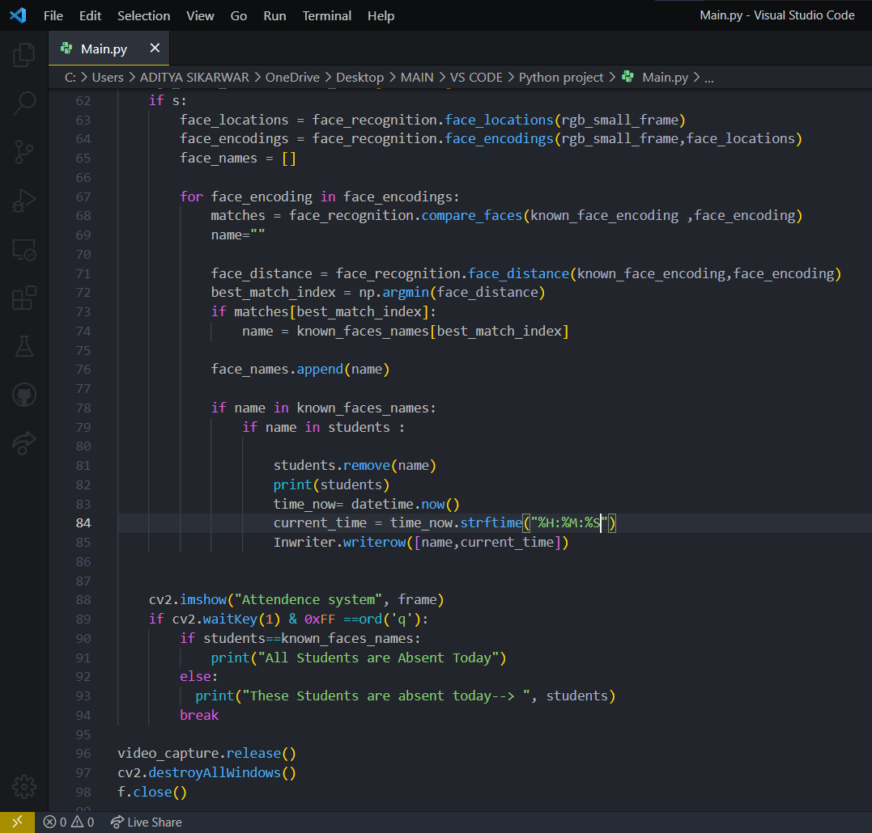
Matching the input of image with the saved pictures.
Taking the best fit of the image using argmin method
Appending the values in csv file
Identifying name of the image
Writing the current time of the attendance marked
Removing the name of student from the lost if the attendance is marked so that it does not mark the attendance of the same student multiple times in the same frame
Finally closing all the windows

Slide 11
Uses
Real-time analysis of video from the camera. Compare the similarity between the face found in the crowd and the faces in the watch list
The main objective of this work is to make the attendance marking and management system efficient, time saving, simple and easy.
Attendance marking in a classroom during a lecture is not only a onerous task but also a time consuming one at that.

Slide 12
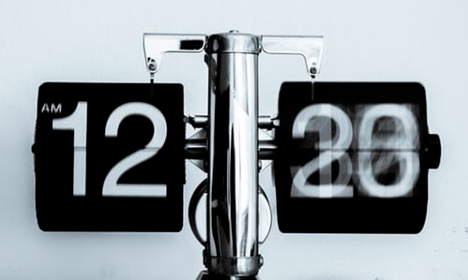
Due to an unusually high number of students present during the lecture there will always be a probability of proxy attendance(s).
Attendance systems allow you to quickly and accurately identify when someone takes too long of a break, arrive late or leave early, and not even arrive at all.

Slide 13
Conclusion
we learned about the concept of face detection using Open CV in Python. There are a number of detectors other than the face, which can be found in the library.
Facial recognition system have been associated generally with very costly top secure application.
Today the core technologies have evolved and the cost of equipment is going down. Certain applications of face recognition technology are now cost effective, reliable and highly accurate.
Fast and convenient in identifying a person. Great use in society, crime detection, security use and many other aspects.

Slide 14
THANKYOU

