Slide 1
Formal Languages and Compiler
CSE - 4129

Slide 2
What is this course about?
Formal Languages (Automata)
Compiler

Slide 3
Compiler
To learn the whole process of translating a modern high-level language to executable code.

Slide 4
The Course covers
Lexical Analysis
Syntax Analysis
Semantic Analysis
Intermediate Code Generation
Code Optimization
Code Generation

Slide 5
Pre-requisite Courses
Good programming background in C, C++ or Java
Good background on Automata Theory
Assembly Language Programming and Machine Architecture

Slide 6
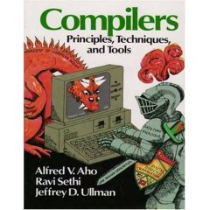
Recommended Books
1. Aho, Sethi, Ullman:
Compilers: Principles, Techniques and Tools.

Slide 7
Thanks!!!

