Slide 1
Digital computer organization
MCA (6-YEARS) (III-SEM)
SECTION “A”
SUBMITTED TO: SUBMITTED BY:
Dr. Shaligram Prajapat Mohammad Nabihasan

Slide 2
UNIT : 1 INTRODUCTION
INRODUCTION TO COMPUTER ORGANIZATION
Computer architecture refers to those attributes of a system visible to a program or, put another way, those attributes that have a direct impact on the logical execution of a program. Computer organization refers to the operational units and their interconnections that realize the architectural specifications. Examples of architectural attributes include the instruction set, the number of bits used to represent various data types (e.g., numbers, characters), I/O mechanisms, and techniques for addressing memory. Organizational attributes include those hardware details transparent to the programmer, such as control signals; interfaces between the computer and peripherals; and the memory technology used.
For example, it is an architectural design issue whether a computer will have a multiply instruction. It is an organizational issue whether that instruction will be implemented by a special multiply unit or by a mechanism that makes repeated use of the add unit of the system .The organizational decision may be based on the anticipated frequency of use of the multiply instruction, the relative speed of the two approaches, and the cost and physical size of a special multiply unit.

Slide 3
Structure and function
At each level, the system consists of a set of components and their interrelationships .The behavior at each level depends only on a simplified, abstracted characterization of the system at the next lower level. At each level, the designer is concerned with structure and function:
Structure: The way in which the components are interrelated
Function: The operation of each individual component as part of the structure
In terms of description, we have two choices: starting at the bottom and building up to a complete description, or beginning with a top view and decomposing the system into its subparts. Evidence from a number of fields suggests that the top down approach is the clearest and most effective [WEIN75].

Slide 4
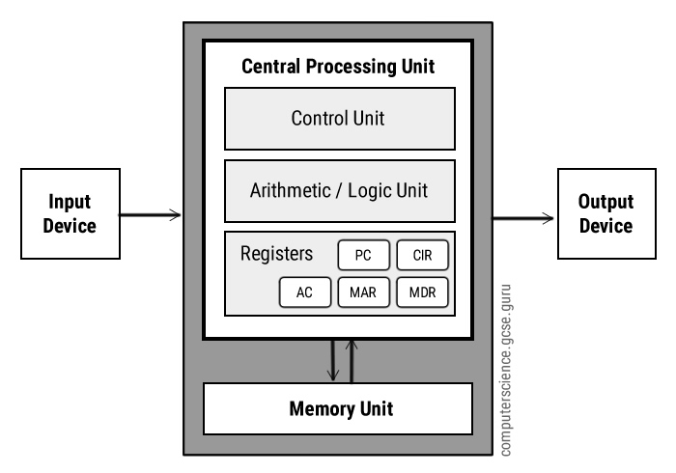
VON NEUMANN ARCHITECTURE

Slide 5
Von Neumann architecture was first published by John von Neumann in 1945.
His computer architecture design consists of a Control Unit, Arithmetic and Logic Unit (ALU), Memory Unit, Registers and Inputs/Outputs.
Von Neumann architecture is based on the stored-program computer concept, where instruction data and program data are stored in the same memory.

Slide 6
Central processing unit (cpu)
The Central Processing Unit (CPU) is the electronic circuit responsible for executing the instruction of the computer program .
It is sometimes referred to as the microprocessor or processor.
The CPU contains the ALU, CU and a variety of registers.

Slide 7
REGISTERs
Registers are the high speed storage areas in the CPU. All data must be stored in a register before it can be processed .
MAR :- Memory Address Register holds the memory location of data that needs to be accessed.
MDR :-Memory Data Register holds data that is being transferred to or from memory.
AC :-Accumulator where intermediate arithmetic and logical results are stored.
PC :-Program Counter contains the address of the next instruction to be executed.
CIR :-Current Instruction Register contains the current instruction during processing.

Slide 8
ARITHMETIC AND LOGICAL UNIT (ALU)
The ALU allows arithmetic (add, subtract etc) and logical (AND, OR, NOT etc)operations to be carried out.
Control unit (cu)
The control unit controls the operation of the computer’s ALU, memory and input/output devices, telling them how to respond to the program instructions it has just read and interpreted from the memory unit.
The control unit also provides the timing and control signals required by other computer components.

Slide 9
buses
A bus is a communication pathway connecting two or more devices. A key characteristic of a bus is that it is a shared transmission medium. Multiple devices connect to the bus, and a signal transmitted by any one device is available for reception by all other devices attached to the bus
A standard CPU system bus is comprised of :-
1) Address Bus
2) Data Bus
3) System Bus

Slide 10
Address bus
Identify the source or destination of data
e.g. CPU needs to read an instruction (data) from a given location in memory
Bus width determines maximum memory capacity of system
e.g. 8080 has 16 bit address bus giving 64k address space

Slide 11
Data bus
Carries data between the processor , the memory unit and the input/output devices.
Remember that there is no difference between “data” and “instruction” at this level.
Width is a key determinant of performance
eg :- 8, 16, 32, 64 bit

Slide 12
Control bus
The control lines are used to control the access to and the use of the data and address lines.
The data and address lines are shared by all components.
Control and timing information
Memory read/write signal
Interrupt request
Clock signals

Slide 13
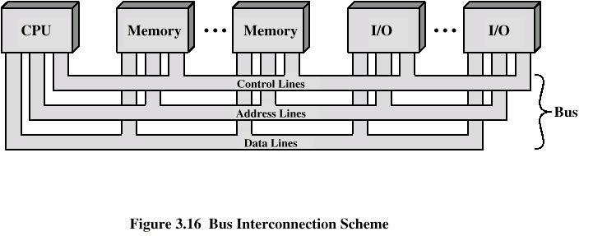
Bus interconnection scheme

Slide 14
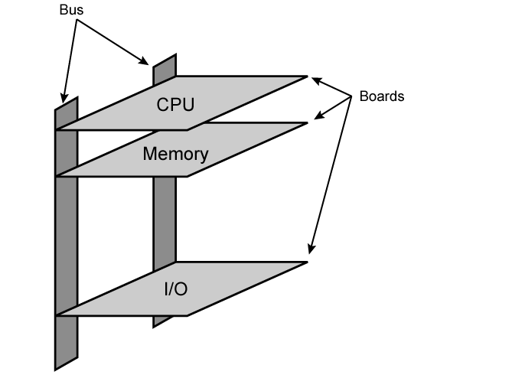
Physical Realization of Bus architecture

Slide 15
Single bus problems
Lots of devices on one bus leads to:
Propagation delays
Long data paths mean that co-ordination of bus use can adversely affect performance
If aggregate data transfer approaches bus capacity
Most systems use multiple buses to overcome these problems

Slide 16
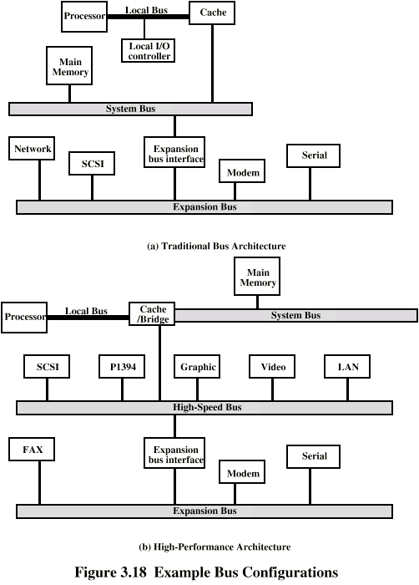
Traditional (ISA) (with cache)

Slide 17
High Performance Bus

Slide 18
Types of buses
Dedicated Bus
Permanently assigned either to one function or to a physical subset of computer components.
Separate data & address lines.
Multiplexed Bus
Shared lines
Address valid or data valid control line
Advantage - fewer lines
Disadvantages
More complex control
Ultimate performance

Slide 19
method of Arbitration
More than one module controlling the bus.
e.g. CPU and DMA controller
Only one module may control bus at one time
Arbitration may be centralised or distributed

Slide 20
Centralized or distributed arbitration
Centralised Arbitration
Single hardware device controlling bus access
Bus Controller
Arbiter
May be part of CPU or separate
Distributed Arbitration
Each module may claim the bus
Control logic on all modules

Slide 21
timing
Timing refers to the way in which events are coordinated on the bus.
Synchronous Timing
Events determined by clock signals
Control Bus includes clock line
A single 1-0 is a bus cycle
All devices can read clock line
Usually sync on leading edge
Usually a single cycle for an event

Slide 22
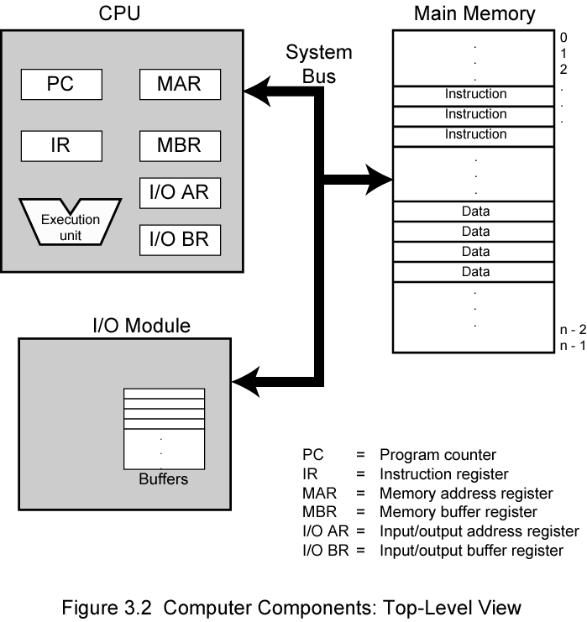
Top level view

Slide 23
Interconnection structures
The collection of paths connecting the various modules is called the interconnection structure.
The design of this structure will depend on the exchanges that must be made among modules.
Memory Connection
Receives and sends data
Receives addresses (of locations)
Receives control signals
Read
Write
Timing

Slide 24
input/output module
Similar to memory from computer’s viewpoint
Output
Receive data from computer
Send data to peripheral
Input
Receive data from peripheral
Send data to computer

Slide 25
Receive control signals from computer
Send control signals to peripherals
e.g. spin disk
Receive addresses from computer
e.g. port number to identify peripheral
Send interrupt signals (control)

Slide 26
Cpu interconnection
Reads instruction and data
Writes out data (after processing)
Sends control signals to other units
Receives (& acts on) interrupts

Slide 27
The interconnection structure must support the following types of transfers:
Memory to processor: The processor reads an instruction or a unit of data from memory.
Processor to memory:- The processor writes a unit of data to memory.
I/O to processor:- The processor reads data from an I/O device via an I/O module.
Processor to I/O:- The processor sends data to the I/O device.
I/O to or from memory:- For these two cases, an I/O module is allowed to exchange data directly with memory, without going through the processor, using direct memory access (DMA).

Slide 28
UNIT 2 Input output organization:
Input output organization:
I/O interface models of transfer,
interrupt driven I/O,
Priority
interrupt,
DMA,
I/O processor and serial communication,
Synchronous data transfer ,
Asynchronous data transfer,
strobe control,
handshaking,
PCI, working mechanism of Peripherals:
Keyboard,
Mouse,
Scanners ,
Video Display,
Touch Screen panel etc.(features and principles)

Slide 29
INPUT-OUTPUT ORGANIZATION
The Input / output organization of computer depends upon the size of computer and the peripherals connected to it. The I/O Subsystem of the computer, provides an efficient mode of communication between the central system and the outside environment The most common input output devices are:
i) Monitor
ii) Keyboard
iii) Mouse
iv) Printer
v) Magnetic tapes

Slide 30
Input - Output Interface
Input Output Interface provides a method for transferring information between internal storage and external I/O devices. Peripherals connected to a computer need special communication links for interfacing them with the central processing unit.
I/O BUS and Interface Module It defines the typical link between the processor and several peripherals. The I/O Bus consists of data lines, address lines and control lines. The I/O bus from the processor is attached to all peripherals interface. To communicate with a particular device, the processor places a device address on address lines. Each Interface decodes the address and control received from the I/O bus, interprets them for peripherals and provides signals for the peripheral controller. It is also synchronizes the data flow and supervises the transfer between peripheral and processor. Each peripheral has its own controller. For example, the printer controller controls the paper motion, the print timing The control lines are referred as I/O command. The commands are as following: Control command- A control command is issued to activate the peripheral and to inform it what to do. Status command- A status command is used to test various status conditions in the interface and the peripheral. Data Output command- A data output command causes the interface to respond by transferring data from the bus into one of its registers. Data Input command- The data input command is the opposite of the data output. In this case the interface receives on item of data from the peripheral and places it in its buffer register. I/O Versus Memory Bus

Slide 31
Interrupt driven I/O
Interrupt driven I/O is an alternative scheme dealing with I/O. Interrupt I/O is a way of controlling input/output activity whereby a peripheral or terminal that needs to make or receive a data transfer sends a signal. This will cause a program interrupt to be set. At a time appropriate to the priority level of the I/O interrupt. Relative to the total interrupt system, the processors enter an interrupt service routine. The function of the routine will depend upon the system of interrupt levels and priorities that is implemented in the processor. The interrupt technique requires more complex hardware and software, but makes far more efficient use of the computer’s time and capacities.
For input, the device interrupts the CPU when new data has arrived and is ready to be retrieved by the system processor. The actual actions to perform depend on whether the device uses I/O ports or memory mapping. For output, the device delivers an interrupt either when it is ready to accept new data or to acknowledge a successful data transfer. Memory-mapped and DMA-capable devices usually generate interrupts to tell the system they are done with the buffer

Slide 32
Advantages & Disadvantages of Interrupt Drive I/O
Advantages
- fast
- efficient
Disadvantages
- can be tricky to write if using a low level language
- can be tough to get various pieces to work well together
- usually done by the hardware manufacturer / OS maker, e.g. Microsoft

Slide 33
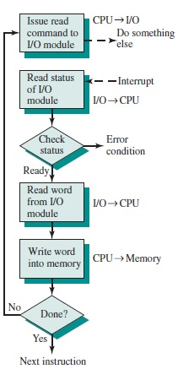
Interrupt Processing

Slide 34
PRIORITY INTERRUPT
In a typical application, a number of I/O devices are attached to computer, with each device being able to originate an interrupt request, so to provide services to device which initiate interrupt request, the task of interrupt system is to identify the source(device) of interrupt and then provide services to them.
But, in most cases there is a possibility that several sources will request service simultaneously.So, in this case, the interrupt system must also need to decide which device to service first.But, these simple interrupt system are not able for that, so, another system known as Priority interrupt system is provided.

Slide 35
Priority Interrupt are systems, that establishes a Priority over the various sources(interrupt devices) to determine which condition is to be serviced first when two or more requests arrive simultaneously.This system may also determine which condition are permitted to interrupt to the computer while another interrupt is being serviced.
Usually, in Priority Systems, higher-priority interrupt levels are served first, as if they delayed or interrupted, could have serious consequences. And the devices with high-speed transfer such as magnetic disks are given high-priority, and slow devices such as keyboards receives low-priority.

Slide 36
Establishing Priority of Simultaneous Interrupt:
The priority of simultaneous interrupts can be established either by software method or hardware.
The software method which gives priority to simultaneous interrupt is:
Polling
And the hardware method which gives priority to simultaneous interrupt is:
Daisy-Chaining Priority
Now, we will explore to each one of them one by one.

Slide 37
1. Polling:
Polling is the software method of establishing priority of simultaneous interrupt.In this method, when the processor detects an interrupt, it branches to an interrupt service routine whose job is to pull each I/O module to determine which module caused the interrupt.
The poll could be in the form of separate command line(e.g., Test I/O).In this case, the processor raises the Test I/O and places the address of particular I/O module on the address line.If it has interrupt that is, if interrupt is identified in it.

Slide 38
And, it is the order in which they are tested i.e., the order in which they appear on address line(Service Routine) determine the priority of each interrupt.As while testing, highest priority source(devices) are tested first then lower-priority devices.
This is very simple method of establishing priority on simultaneous interrupt.But the disadvantage opolling is that it is very time consuming.
2. Daisy-Chaining Priority:
The Daisy–Chaining method of establishing priority on interrupt sources uses the hardware i.e., it is the hardware means of establishing priority.
In this method, all the device, whether they are interrupt sources or not, connected in a serial manner.Means the device with highest priority is placed in the first position, which is followed by lowest priority device.And all device share a common interrupt request line, and the interrupt acknowledge line is daisy chained through the modules.

Slide 39
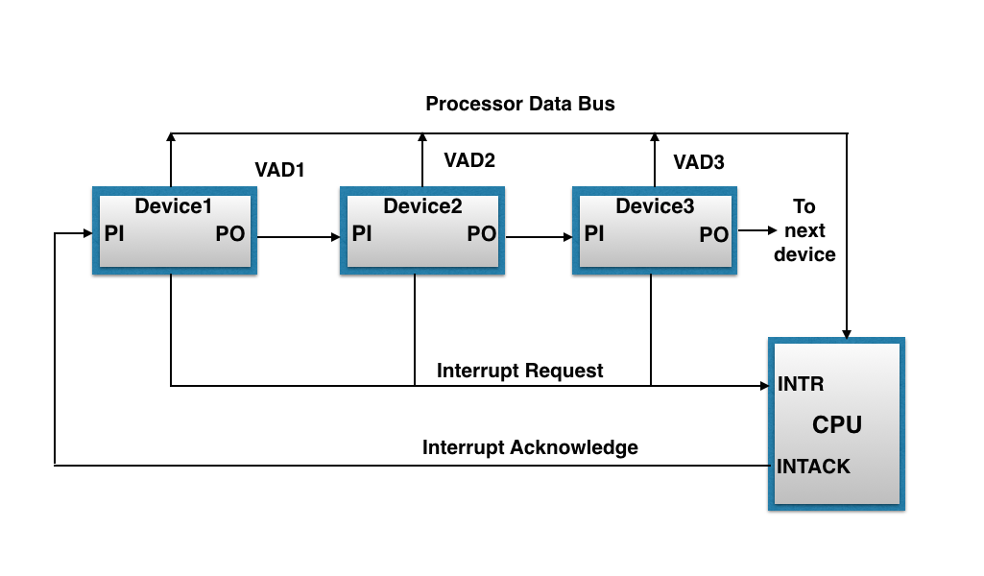
The figure shown below, this method of connection with three devices and the CPU.

Slide 40
It works as follows:
When any device raise an interrupt, the interrupt request line goes activated, the processor when sense it, it sends out an interrupt acknowledge which is first received by device1.If device1 does not need service, i.e., processor checks, whether the device has pending interrupt or initiate interrupt request, if the result is no, then the signal is passed to device2 by placing 1 in the PO(Priority Out) of device1.And if device need service then service is given to them by placing first 0 in the PO of 1 device1, which indicate the next-lower-priority device that acknowledge signal has been blocked.And device that have processor responds by inserting its own interrupt vector address(VAD) into the data bus for the CPU to use during interrupt cycle.
In this way, it gave services to interrupt source according to their priority.And thus, we can say that, it is the order of device in chain that determine the priority of interrupt sources.

Slide 41
DMA
Stands for "Direct Memory Access." DMA is a method of transferring data from the computer's RAM to another part of the computer without processing it using the CPU. While most data that is input or output from your computer is processed by the CPU, some data does not require processing, or can be processed by another device. In these situations, DMA can save processing time and is a more efficient way to move data from the computer's memory to other devices.
For example, a sound card may need to access data stored in the computer's RAM, but since it can process the data itself, it may use DMA to bypass the CPU. Video cards that support DMA can also access the system memory and process graphics without needing the CPU. Ultra DMA hard drives use DMA to transfer data faster than previous hard drives that required the data to first be run through the CPU.

Slide 42
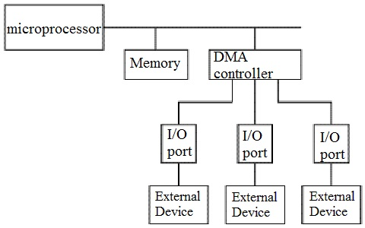

Slide 43
I/O Processor and serial communication
An input-output processor (IOP) is a processor with direct memory access capability. In this, the computer system is divided into a memory unit and number of processors.
Each IOP controls and manage the input-output tasks. The IOP is similar to CPU except that it handles only the details of I/O processing. The IOP can fetch and execute its own instructions. These IOP instructions are designed to manage I/O transfers only.

Slide 44
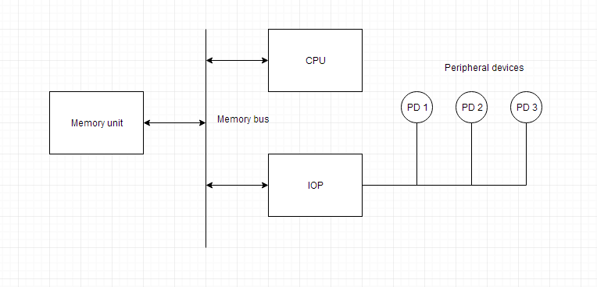
Block Diagram Of I/O Processor

Slide 45
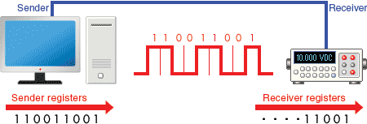
Serial Communication
Serial communication is a communication method that uses one or two transmission lines to send and receive data, and that data is continuously sent and received one bit at a time.Since it allows for connections with few signal wires, one of its merits is its ability to hold down on wiring material and relaying equipment costs.

Slide 46
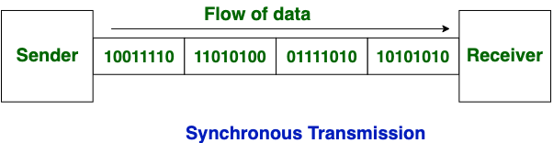
Synchronous data transfer
In Synchronous Transmission, data is sent in form of blocks or frames. This transmission is the full duplex type. Between sender and receiver the synchronization is compulsory. In Synchronous transmission, There is no gap present between data. It is more efficient and more reliable than asynchronous transmission to transfer the large amount of data.

Slide 47
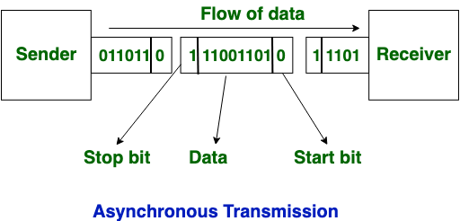
Asynchronous data transfer
This Scheme is used when speed of I/O devices do not match with microprocessor, and
timing characteristics of I/O devices is not predictable. In this method, process initiates the
device and check its status. As a result, CPU has to wait till I/O device is ready to transfer
data. When device is ready CPU issues instruction for I/O transfer. In this method two types
of techniques are used based on signals before data transfer.
i.Strobe Control
ii. Handshaking

Slide 48
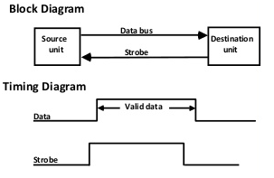
Strobe Control
The strobe control method of Asynchronous data transfer employs a single control line to
time each transfer. The strobe may be activated by either the source or the destination unit.
Data Transfer Initiated by Source Unit:
Source initiated strobe for data transfer

Slide 49
In the block diagram fig. 1 the data bus carries the binary information from source to
destination unit. Typically, the bus has multiple lines to transfer an entire byte or word. The
strobe is a single line that informs the destination unit when a valid data word is available.
The timing diagram fig. 2 the source unit first places the data on the data
bus. The information on the data bus
Data Transfer Initiated by Destination Unit:
In this method, the destination unit activates the strobe pulse, to informing the source to
provide the data. The source will respond by placing the requested binary information on the
data bus.
The data must be valid and remain in the bus long enough for the destination
unit to accept it. When accepted the destination unit then disables the strobe and the source
unit removes the data from the bus.

Slide 50
Handshaking
The handshaking method solves the problem of strobe method by introducing a second
control signal that provides a reply to the unit that initiates the transfer.
Principle of Handshaking:
The basic principle of the two-wire handshaking method of data transfer is as follow:
One control line is in the same direction as the data flows in the bus from the source to
destination. It is used by source unit to inform the destination unit whether there a valid data
in the bus. The other control line is in the other direction from the destination to the source.

Slide 51
it is used by the destination unit to inform the source whether it can accept the data. The
sequence of control during the transfer depends on the unit that initiates the transfer.
Source Initiated Transfer using Handshaking:
The sequence of events shows four possible states that the system can be at any given time.
The source unit initiates the transfer by placing the data on the bus and enabling its data valid
signal. The data accepted signal is activated by the destination unit after it accepts the data
from the bus. The source unit then disables its data accepted signal and the system goes into
its initial state.

Slide 52
PCI
Stands for "Peripheral Component Interconnect." PCI is a hardware bus used for adding internal components to a desktop computer. For example, a PCI card can be inserted into a PCI slot on a motherboard, providing additional I/O ports on the back of a computer.
The PCI architecture, also known as "conventional PCI," was designed by Intel and introduced in 1992. Many desktop PCs from the early 1990s to the mid 2000s had room for two to five PCI cards. Each card required an open slot on the motherboard and a removable panel on the back of the system unit. Adding PCI cards was an easy way to upgrade a computer, since you could add a better video card, faster wired or wireless networking, or add new ports, like USB 2.0.

Slide 53
The original 32-bit, 33 MHz PCI standard supported data transfer rates of 133 megabytes per second. An upgraded 64-bit, 66 MHz standard was created a few years later and allowed for much faster data transfer rates up to 533 MHz. In 1998, IBM, HP, and Compaq introduced PCI-X (or "PCI eXtended"), which was backwards compatible with PCI. The 133 MHz PCI-X interface supported data transfer rates up to 1064 MHz.
Both PCI and PCI-X were superseded by PCI Express, which was introduced in 2004.

Slide 54
WORKING MECHANISM OF PERIPHERALS
Working Principle of a Keyboard:-
Inside the keyboard, there are metallic
plate, circuit board and processor, which are responsible for transferring
information from the keyboard to the computer. Depending upon the
working principle, there are two main types of keys, namely, capacitive and

Slide 55
hard-contact. Let's discuss in brief about the functioning of capacitive and
a gentle pressure to the circuit board. The pressure is identified by the
hard contact key.When a capacitive key is pressed, the metal plunger applies
computer and the circuit flow is initiated, resulting in the transfer of
information from the circuit to the currently installed software.
The key identifying to computer is identified using a keyboard driver and
finding the preferred key called
source code.

Slide 56
WORKING MECHANISM OF MOUSE
• Working of a mouse---
> With most of the system you will find mechanical mouse.The primary mechanical part of a
mouse is a ball on the bottom of the mouse. There are these little wheels which turn/rotate
when the ball moves against them. The wheels are monitored electronically. When they trun
or rotate they transmit how much they have turned to the computer. Out of these three wheels
the two wheels perpendicular to each other are used for tracking the motion on X-axis and Y-
axis. The third one just balances the two.
When the mouse is moved on a flat surface the roller ball moves in the locking ring. When the
mouse is positioned on the desktop the actuators register the mouse balls movement in X-axis
and Y-axis direction. The sensors attached to it generate a series of pulses representing
movement on both axis. The pulse generated are in same ratio as the mouse movement i.e.a

Slide 57
More pulse mean more movement.
Normally a mouse is used along with a mouse pad. Place the mouse pad on a flat surface and
place the mouse on it. Move the mouse pad and the pointer moves in the direction of the
movement of mouse.
--Various terms related to the use of mouse are :-
> Click
> Double click
> Drag
1. When the left button of mouse is pressed and released quickly then this we can say '
clicking the mouse '.
2. The double clicking is used to initiate some action on the selected item. Basically it selects

Slide 58
WORKING OF SCANNER
A scanner is a device that is used for producing an exact digital image
replica of a photo, text written in paper, or even an object. This digital
image can be saved as a file to your computer and can be used to
alter/enhance the image or apply it to the web. The most comonly
used scanner is the flatbed scanner, in which you keep the object on
top of the glass window. The scanned output will be obtained in your
computer. The image and text are obtained exactly through the
process of optical character recognition [OCR].
Handheld scanners use the same basic technology as a flatbed scanner, but rely on the user to move them

Slide 59
instead of a motorized belt. This type of scanner typically does not provide good image quality. However, it can
be useful for quickly capturing text.
• Drum scanners are used by the publishing industry to capture incredibly detailed images. They use a
technology called a photomultiplier tube (PMT). In PMT, the document to be scanned is mounted on a glass
cylinder. At the center of the cylinder is a sensor that splits light bounced from the document into three beams.
Each beam is sent through a color filter into a photomultiplier tube where the light is changed into an electrical
signal.
• The basic principle of a scanner is to analyze an image and process it in some way. Image and text capture
(optical character recognition or OCR) allow you to save information to a file on your computer.

Slide 60
WORKING OF VIDEO DISPLAY
Video display device means an electronic device with an output surface that
displays, or is capable of displaying, moving graphical images or a visual
representation of image sequences or pictures, showing a number of quickly
changing images on a screen in fast succession to create the illusion of motion,
including, if applicable, a device that is an integral part of the display, in that it
cannot be easily removed from the display by the consumer, that produces the
moving image on the screen. A video display device may use, but is not limited to, a
cathode ray tube (CRT), liquid crystal display (LCD), gas plasma, digital light
processing, or other image projection technology.
device means a printer or a unit capable of presenting images
electronically on a screen, with a video display greater than four inches
when measured diagonally, that are viewed by the user, and includes
televisions, computer monitors, laptop computers, cathode ray tubes,
plasma displays, liquid crystal displays, rear and front enclosed projection
devices, and other similar displays that may be developed.

Slide 61
WORKING OF TOUCH SCREEN PANNEL
Different kinds of touchscreen work in different ways. Some can sense
only one finger at a time and get extremely confused if you try to press
in two places at once. Others can easily detect and distinguish more
than one key press at once. These are some of the main
technologies:
• Resistive
• Resistive touchscreens (currently the most popular technology) work a
bit like "transparent keyboards" overlaid on top of the screen. There's
a flexible upper layer of conducting polyester plastic bondedd to a
rigid lower layer of conducting glass and separated by an insulating
membrane. When you press on the screen, you force the polyester to
touch the glass and complete a circuit—just like pressing the key on a
keyboard. A chip inside the screen figures out the coordinates of the
place you touched.

Slide 62
Capacitive
• These screens are made from multiple layers of glass. The inner layer
conducts electricity and so does the outer layer, so effectively the screen
behaves like two electrical conductors separated by an insulator—in other
words, a capacitor.When you bring your finger up to the screen, you alter the
electrical field by a certain amount that varies according to where your hand
is. Capacitive screens can be touched in more than one place at once.
Unlike most other types of touchscreen, they don't work if you touch them
with a plastic stylus (because the plastic is an insulator and stops your hand
from affecting the electric field).
Infrared
• Just like the magic eye beams in an intruder alarm, an infrared touchscreen
uses a grid pattern of LEDs and light-detector photocells arranged on
opposite sides of the screen. The LEDs shine infrared light in front of the
screen—a bit like an invisible spider's web. If you touch the screen at a
certain point, you interrupt two or more beams. A microchip inside the screen
can calculate where you touched by seeing which beams you interrupted.
The touchscreen on Sony Reader ebooks (like the one pictured in our top
photo) works this way. Since you're interrupting a beam, infrared screens
work just as well whether you use your finger or a stylus

Slide 63
Surface Acoustic Wave
• Surprisingly, this touchscreen technology detects your fingers using
• Sound instead of light. Ultrasonic sound waves (too high pitched for
humans to hear) are generated at the edges of the screen and reflected
back and forth across its surface. When you touch the screen, you interrupt
the sound beams and absorb some of their energy. The screen's microchip
controller figures out from this where exactly you touched the screen.

Slide 64
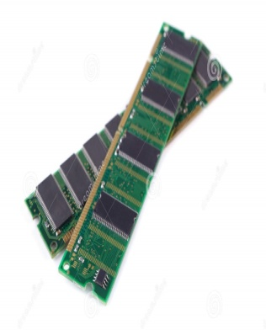

UNIT – 3

Slide 65
THE MEMORY HIERARCHY
The memory in a computer can be divided into five hierarchies based on the speed as well as use. The processor can move from one level to another based on its requirements:-
PRIMARY MEMORY:-
It is also called as internal memory. It includes main memory, cache & registers.
SECONDARY MEMORY:-
It is also called external memory and this is accessible by the processor through an input/output module. This memory includes an optical disk, magnetic disk, and magnetic tape.

Slide 66
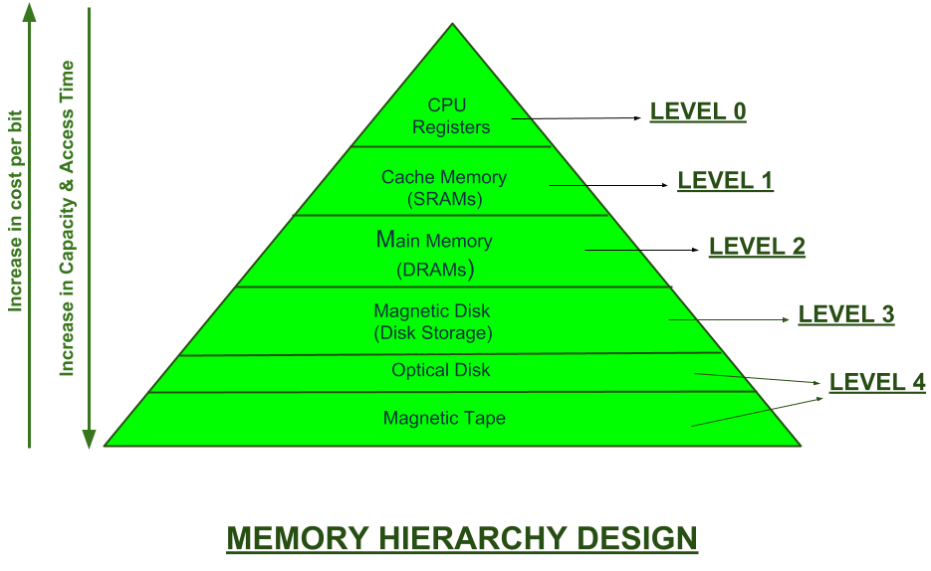

Slide 67
Characteristics of memory hierarchy
PERFORMANCE
Previously, the designing of a computer system was done without memory hierarchy, and the speed gap among the main memory as well as the CPU registers enhances because of the huge disparity in access time, which will cause the lower performance of the system. So, the enhancement was mandatory. The enhancement of this was designed in the memory hierarchy model due to the system’s performance increase.

Slide 68
Ability
The ability of the memory hierarchy is the total amount of data the memory can store. Because whenever we shift from top to bottom inside the memory hierarchy, then the capacity will increase.
ACCESS TIME
The access time in the memory hierarchy is the interval of the time among the data availability as well as request to read or write. Because whenever we shift from top to bottom inside the memory hierarchy, then the access time will increase

Slide 69
COST PER BIT
When we shift from bottom to top inside the memory hierarchy, then the cost for each bit will increase which means an internal Memory is expensive compared with external memory.
THE MEMORY HIERARCHY DESIGN
REGISTERS:-Usually, the register is a static RAM or SRAM in the processor of the computer which is used for holding the data word which is typically 64 or 128 bits. The program counter register is the most important as well as found in all the processors. Most of the processors use a status word register as well as an accumulator.

Slide 70
CACHE MEMORY:-Cache memory can also be found in the processor, however rarely it may be another IC (integrated circuit)which is separated into levels. The cache holds the chunk of data which are frequently used from main memory.

Slide 71
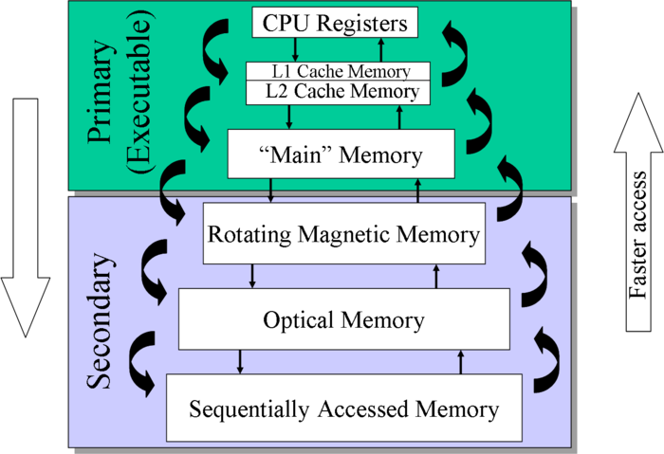
Memory management

Slide 72
MAIN MEMORY
The main memory in the computer is nothing but, the memory unit in the CPU that communicates directly. It is the main storage unit of the computer. This memory is fast as well as large memory used for storing the data throughout the operations of the computer. This memory is made up of RAM as well as ROM.
Magnetic disk
The magnetic disks in the computer are circular plates fabricated of plastic otherwise metal by magnetized material. All the disks in computer turn jointly at high speed. The tracks in the computer are nothing but bits which are stored within the magnetized plane in spots next to concentric circles. These are usually separated into sections which are named as sectors.
MAGNETIC TAPE
MAGNETIC TAPE:-This tape is a normal magnetic recording which is designed with a slender magnetizable covering on an extended, plastic film of the thin strip. This is mainly used to back up huge data. The access time of memory will be slower within magnetic strip as well as it will take a few minutes for accessing a strip.

Slide 73
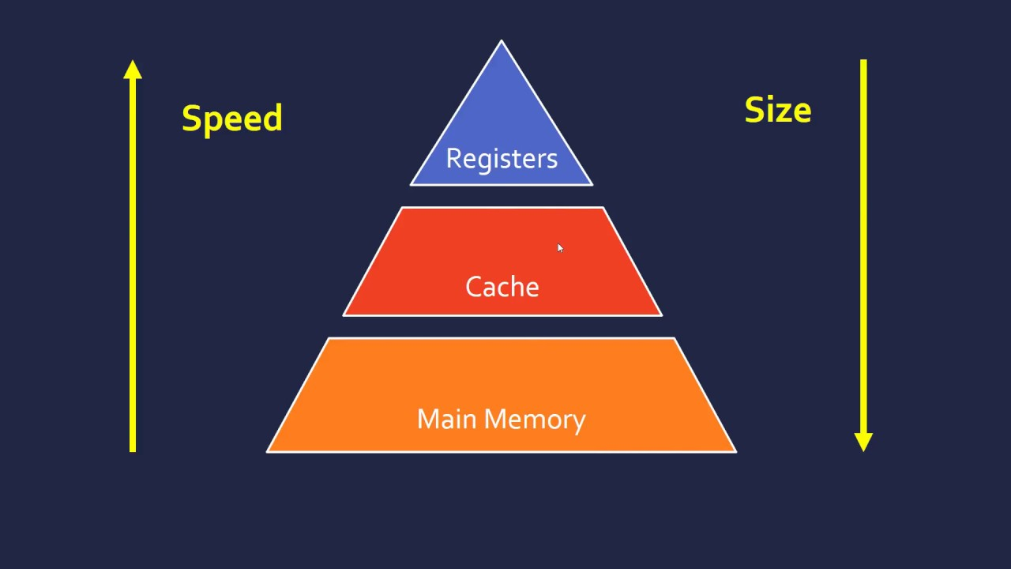
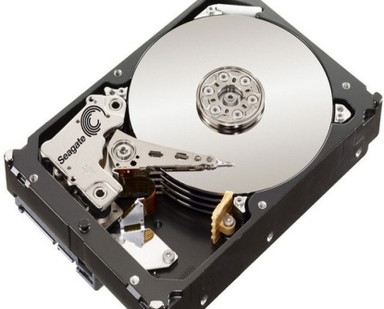
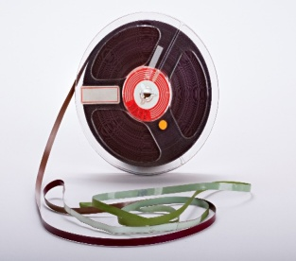
Main memory
MAGNETIC DISKS
MAGNETIC TAPE

Slide 74
Advantages of Memory Hierarchy
The need for a memory hierarchy includes the following.
Memory distributing is simple and economical.
Removes external destruction.
Data can be spread all over.
Permits demand paging & pre-paging.
Swapping will be more proficient.

Slide 75
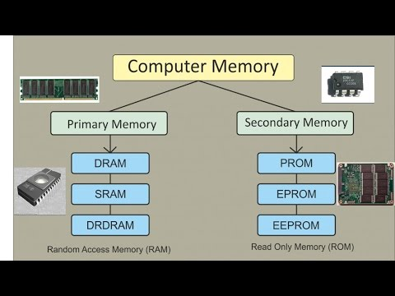

Slide 76
Internal Memory
In computer, all of the storage spaces that are accessible by a processor without the use of computer input/output channels.
Internal Memory usually includes several types of storage such as main storage, cache storage, cache memory and special registers, all of which can be directly accessed by the processor.
It typically refers to the main memory(RAM) but may also refer to ROM and Flash Memory. In either case, internal memory generally refers to chips rather than disks or tapes.
It often refers to simply as memory, is the only one directly accessible to the CPU.

Slide 77
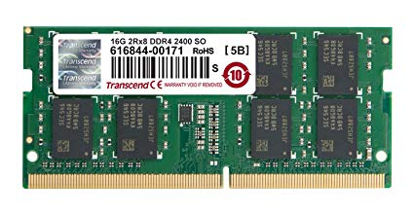
Internal memory

Slide 78
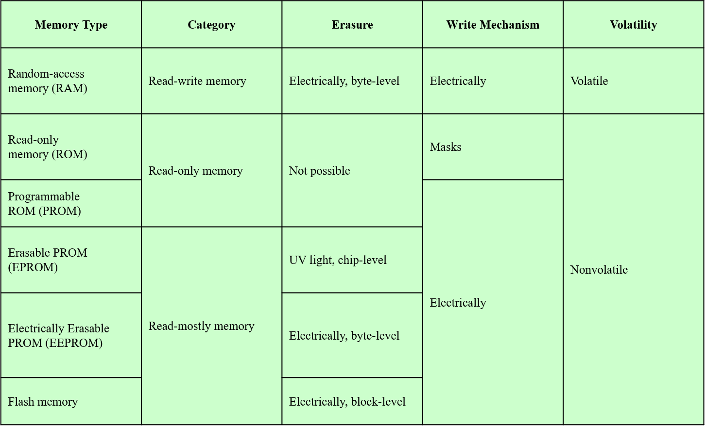
Types of secondary memory

Slide 79
RAM-RANDOM ACCESS MEMORY
Misnamed as all semiconductor memory is random access
Read/Write
Volatile
Temporary storage
Static or dynamic

Slide 80
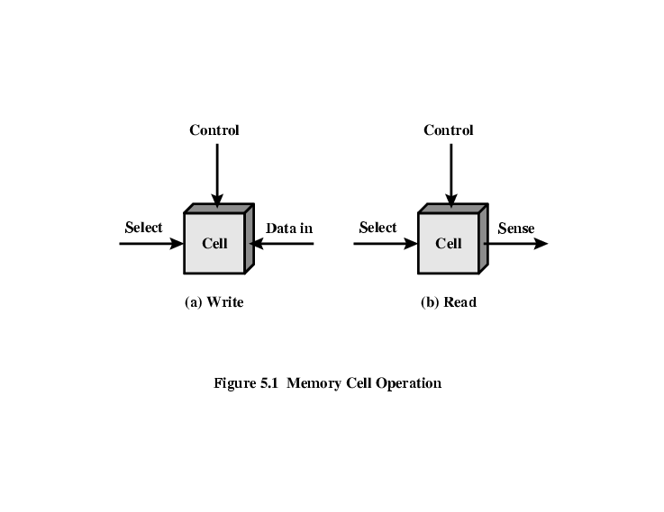
Memory cell operation

Slide 81
Dynamic RAM
Bits stored as charge in capacitors
Charges leak.
Need refreshing even when powered
Simpler construction
Smaller per bit
Less expensive
Need refresh circuits
Slower
Main memory
Essentially analogue

Slide 82
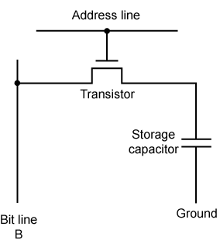
Structure of Dynamic RAM

Slide 83
STATIC RAM
Bits stored as on/off switches
No charges to leak
No refreshing needed when powered
More complex construction
Larger per bit
More expensive
Does not need refresh circuits
Faster
Cache
Digital
Uses flip-flops

Slide 84
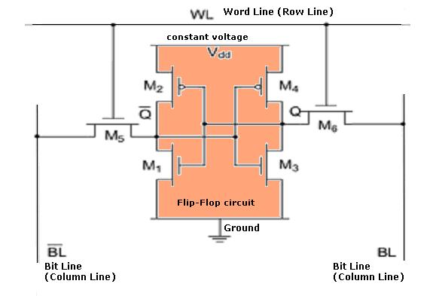
Structure of Static RAM

Slide 85
Difference between SRAM & DRAM
SRAM
Faster.
Expensive.
Small.
Single memory block requires six transistor.
Low power consumption.
Therefore static RAM is used to create the CPU's speed-sensitive cache.
DRAM
Slower.
Cheaper.
Large.
Single memory block requires only one transistors.
High power consumption.
Dynamic RAM forms the larger system RAM space.

Slide 86
Synchronous DRAM(SDRAM)
Access is synchronized with an external clock.
Address is presented to RAM.
RAM finds data (CPU waits in conventional DRAM)
Since SDRAM moves data in time with system clock, CPU knows when data will be ready
CPU does not have to wait, it can do something else
Burst mode allows SDRAM to set up stream of data and fire it out in block
DDR-SDRAM sends data twice per clock cycle (leading & trailing edge)

Slide 87
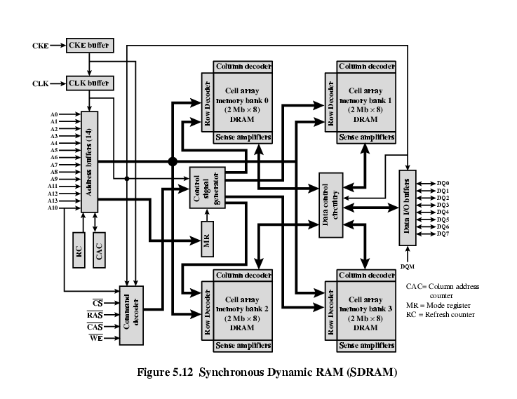
Structure of SDRAM

Slide 88
RAMBUS
Adopted by Intel for Pentium & Itanium
Main competitor to SDRAM
Vertical package – all pins on one side
Data exchange over 28 wires < cm long
Bus addresses up to 320 RDRAM chips at 1.6Gbps
Asynchronous block protocol
480ns access time
Then 1.6 Gbps

Slide 89
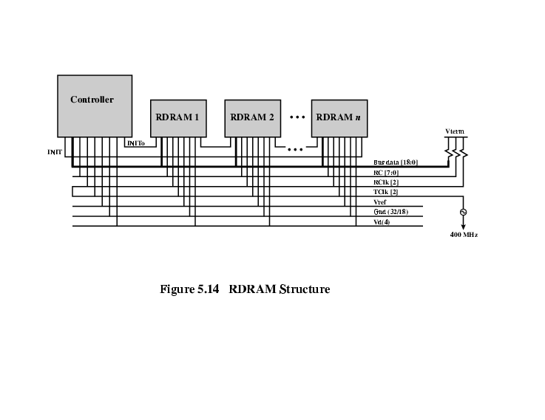
Structure of RAMBUS

Slide 90
ROM(READ ONLY MEMORY)
Permanent storage.
Nonvolatile.
Retain data even without electricity flow i.e. power off.
Pre-written(holds code for booting-up the computer).
Systems programs (BIOS).
Data in unchangeable in this.

Slide 91
Types of ROM
ROM.
PROM.
EPROM.
EEPROM.
Flash memory.

Slide 92
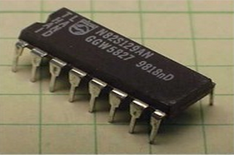
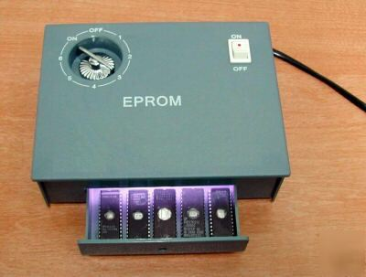
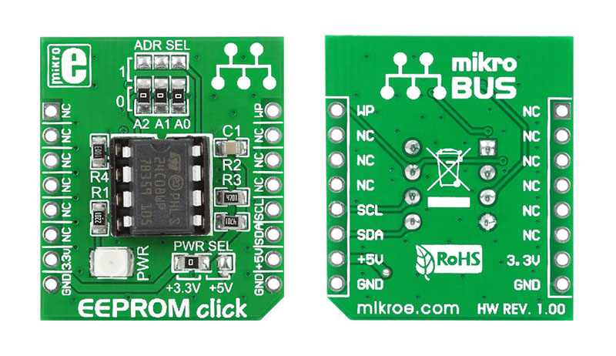
PROM : Short for programmable read-only memory, a memory chip on which data can be written only once. Once a program has been written onto a PROM, it remains there forever. Unlike RAM, PROMs retain their contents when the computer is turned off. The difference between a PROM and a ROM (read-only memory) is that a PROM is manufactured as blank memory, whereas a ROM is programmed during the manufacturing process. To write data onto a PROM chip, you need a special device called a PROM programmer or PROM burner. The process of programming a PROM is sometimes called burning the PROM.
EPROM : Acronym for erasable programmable read-only memory, and pronounced ee-prom, EPROM is a special type of memory that retains its contents until it is exposed to ultraviolet light. The ultraviolet light clears its contents, making it possible to reprogram the memory. To write to and erase an EPROM, you need a special device called a PROM programmer or PROM burner.
EEPROM : Short form of electrically erasable programmable read-only memory. EEPROM is a special type of PROM that can be erased by exposing it to an electrical charge. Like other types of PROM, EEPROM retains its contents even when the power is turned off. Also like other types of ROM, EEPROM is not as fast as RAM.

Slide 93
External Memory
An external storage device, also referred to as auxiliary storage and secondary storage, is a device that contains all the addressable data storage that is not inside a computer's main storage or memory. An external storage device can be removable or non-removable, temporary or permanent, and accessible over a wired or wireless network.
Magnetic Disk
RAID
Removable
Optical
CD-ROM
CD-Recordable (CD-R)
CD-R/W
DVD
Magnetic Tape
TYPES

Slide 94
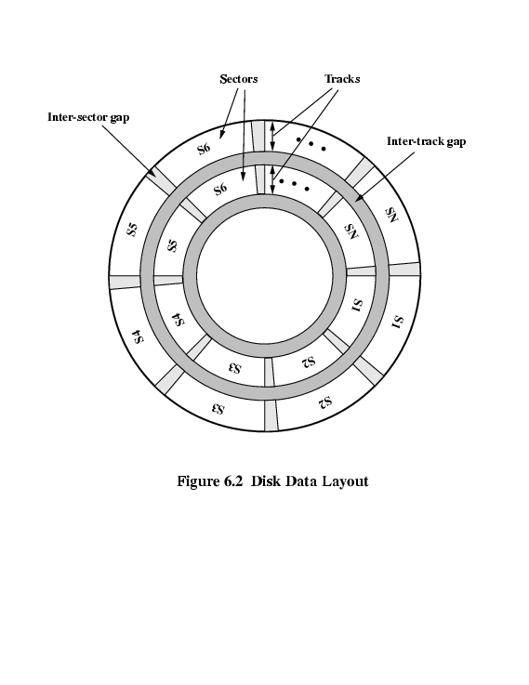
MAGNETIC DISK:-A magnetic disk is a storage device that uses a magnetization process to write, rewrite and access data. It is covered with a magnetic coating and stores data in the form of tracks, spots and sectors. Hard disks, zip disks and floppy disks are common examples of magnetic disks.
-The Disk substrate coated with magnetizable material (iron oxide…rust).
-Before, the Substrate used to be aluminium but now its glass.
-The surface uniformity is improved which increases reliability.
-Reduction in surface defects(Reduced read/write errors).
-Lower flight heights (See later)

Slide 95
Optical CD-ROM
It is originally for audio
650Mbytes giving over 70 minutes audio
It is Polycarbonate coated with highly reflective coat, usually aluminium.
Data stored as pits.
Read by reflecting laser.
Constant packing density.
Constant linear velocity.

Slide 96
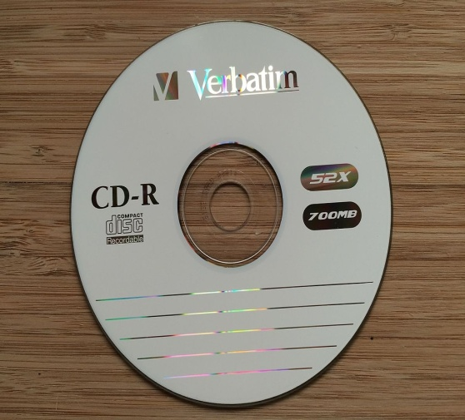
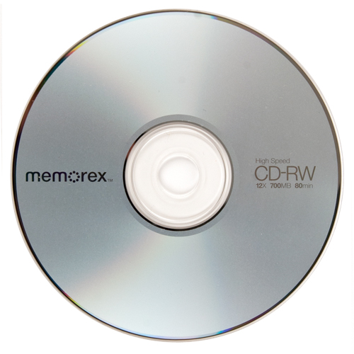
CD-Recordable (CD-R)
WORM.
Now affordable.
Compatible with CD-ROM drives.
CD-RW
Erasable.
Getting cheaper.
Mostly CD-ROM drive is compatible.
Phase change.
Material has two different reflectivities in different phase states.

Slide 97

DVD
A DVD is a type of optical media used for storing digital data. It is the same size as a CD, but has a larger storage capacity. Some DVDs are formatted specifically for video playback, while others may contain different types of data, such as software programs and computer files.
Digital Video Disk
Used to indicate a player for movies
Only plays video disks
Digital Versatile Disk
Used to indicate a computer drive
Will read computer disks and play video disks
PROPERTIES:-
It is Multi-layer
Very high capacity (4.7G per layer)
Full length movie on single disk.
Using MPEG compression.
Finally standardized.
Movies carry regional coding.
Players only play correct region films.
Can be “fixed”.

Slide 98
High definition Optical Disk
Designed for high definition videos
Much higher capacity than DVD
Shorter wavelength laser
Blue-violet range
Smaller pits
HD-DVD
15GB single side single layer
Blue-ray
Data layer closer to laser
Tighter focus, less distortion, smaller pits
25GB on single layer
Available read only (BD-ROM), Recordable once (BR-R) and re-recordable (BR-RE)

Slide 99
Cache Memory
It is very special high speed memory. It is used to speed up and synchronizing with high speed CPU.
Cache memory is costlier than main memory or disk memory but economical than CPU registers.
Cache memory is an extremely fast memory type that acts as a buffer between RAM and the CPU.
It holds frequently requested data and instruction so that they are immediately available to the CPU when needed.

Slide 100
LOCATION:-
CPU
Internal
External
ACCESS METHOD:-
Sequential
eg:-Tape
Direct
eg:-Disk
Random
eg:-RAM
Associative
eg:-CACHE
CAPACITY:-
Word size
The natural unit of organisation.
Number of words(or bytes).
UNIT OF TRANSFER:-
Internal
Usually governed by data bus width
External
Usually a block which is much larger than a word
Addressable unit
Smallest location which can be uniquely addressed

Slide 101
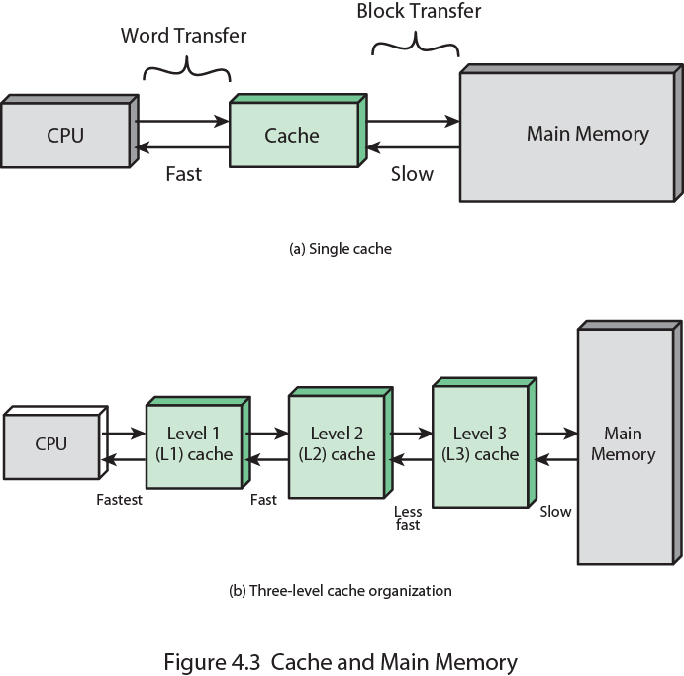
Cache and Memory

Slide 102
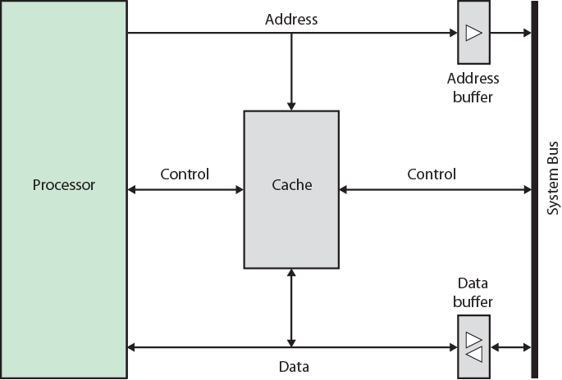
Cache organization

Slide 103
Pentium-4 Cache
80386 – no on chip cache
80486 – 8k using 16 byte lines and four way set associative organization.
Pentium (all versions) – two on chip L1 caches
Data & instructions
Pentium III – L3 cache added off chip
Pentium 4
L1 caches
8k bytes
64 byte lines
four way set associative
L2 cache
Feeding both L1 caches
256k
128 byte lines
8 way set associative
L3 cache on chip

Slide 104
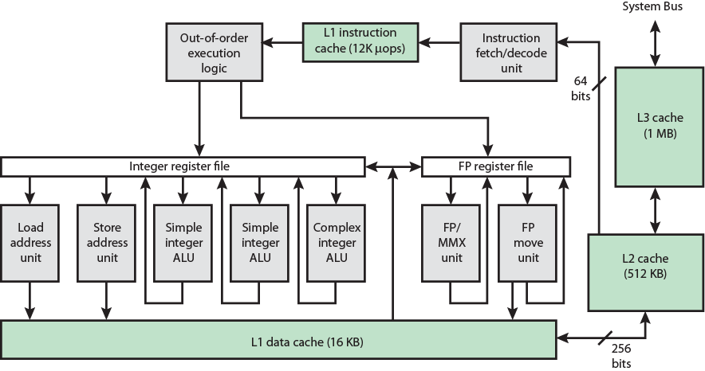
Data cache

Slide 105
ARM Cache
Small FIFO write buffer
Enhances memory write performance
Between cache and main memory
Small c.f. cache
Data put in write buffer at processor clock speed
Processor continues execution
External write in parallel until empty
If buffer full, processor stalls
Data in write buffer not available until written
So keep buffer small

Slide 106
UNIT - 4

Slide 107
CPU ORGANISATION
CPU Acts as the brain of computer.
Performs all the calculations & controls all the components. Carries out the instructions of a computer program, performs the basic arithmetical, logical, and input and output operations of the system.
CPU Has Two Main Components Control Unit (CU), Arithmetic & Logic Unit (ALU).
Control Unit Selects program instructions & coordinates their execution. Regulates timing of processor. Sends control signal to and receives control signal from peripheral devices. Acts as central nervous system for all other components. It obtains instruction from memory, interprets the instruction & issues signals to the required units to carry out the execution.
ALU Actual execution of instruction takes place in ALU. It consists of a complicated set of logic circuit, registers and accumulator to carry out all operations. Depends on the commands given by the Control Unit.

Slide 108
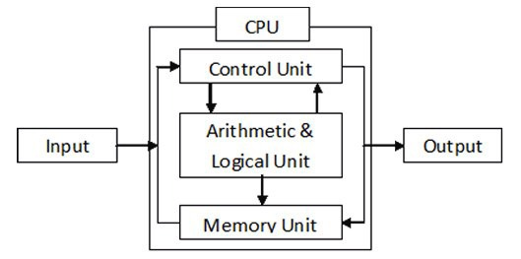
CPU ORGANISATION
The major components of the processor are an arithmetic and logic unit(ALU) and a control unit(CU). The ALU does the actual computation or processing of data. The control unit controls the movement of data and instructions into and out of the processor and controls the operation of the ALU.

Slide 109
REGISTER ORGANISATION
When we are using multiple general purpose registers, instead of single accumulator register, in the CPU Organization then this type of organization is known as General register based CPU Organization.
In this type of organization, computer uses two or three address fields in their instruction format. Each address field may specify a general register or a memory word.
If many CPU registers are available for heavily used variables and intermediate results, we can avoid memory references much of the time, thus vastly increasing program execution speed, and reducing program size.

Slide 110
ADVANTAGES –
Efficiency of CPU increases as there are large number of registers are used in this organization.
Less memory space is used to store the program since the instructions are written in compact way.
DISADVANTAGES –
Care should be taken to avoid unnecessary usage of registers. Thus, compilers need to be more intelligent in this aspect.
Since large number of registers are used, thus extra cost is required in this organization.

Slide 111
The registers in the processor perform two roles:
User-visible registers : Enable the machine- or assembly language programmer to minimize main memory references by optimizing use of registers.
Control and status registers : Used by the control unit to control the operation of the processor and by privileged, operating system programs to control the execution of programs.

Slide 112
User-visible registers :
A user-visible register is one that may be referenced by means of the machine language that the processor executes. We can characterize these in the following categories:
General purpose
Data
Address
Condition codes
General-purpose registers can be assigned to a variety of functions by the programmer. Sometimes their use within the instruction set is orthogonal to the operation.

Slide 113
Data registers may be used only to hold data and cannot be employed in the calculation of an operand address . Address registers may themselves be somewhat general purpose, or they may be de-voted to a particular addressing mode.
Address registers:
Address registers may themselves be somewhat general purpose, or they may be de-voted to a particular addressing mode.
Condition codes: A final category of registers, which is at least partially visible to the user, holds condition codes. Condition codes are bits set by the processor hardware as the result of operations.

Slide 114
Control register:
There are a variety of processor registers that are employed to control the operation of the processor. Most of these, on most machines, are not visible to the user. Some of them may be visible to machine instructions executed in a control or operating system mode. different machines will have different register organizations and use different terminology. The four essential registers are:
Program counter (PC): Contains the address of an instruction to be fetched
Instruction register (IR): Contains the instruction most recently fetched
Memory address register (MAR): Contains the address of a location in memory
Memory buffer register (MBR): Contains a word of data to be written to memory or the word most recently read

Slide 115
STACK ORGANISATION
A useful feature that is included in the CPU of most computers is a stack or last-in, first-out (LIFO) list. A stack is a storage device that stores information in such a manner that the item stored last is the first item retrieved. The operation of a stack can be compared to a stack of trays. The last tray placed on top of the stack is the first to be taken off. The stack in digital computers is essentially a memory unit with an address register that can count only (after an initial value is loaded into it). The register that holds the address for the stack is called a stack pointer (SP) because its value always points at the top item in the stack. Contrary to a stack of trays where the tray itself may be taken out or inserted, the physical registers of a stack are always available for reading or writing. It is the content of the word that is inserted or deleted.
The two operations of a stack are the insertion and deletion of items. The operation of insertion is called push (or push-down) because it can be through of as the result of pushing a new item on top. The operation of deletion is called pop (or pop-up) because it can be thought of as the result of removing one item so hat the stack pops up.

Slide 116
INSTRUCTION FORMATS
A computer will usually have a variety of instruction code formats. It is the function of the control unit within the CPU to interpret each instruction code and provide the necessary control functions needed to process the instruction.
The format of an instruction is usually depicted in a rectangular box symbolizing the bits of the instruction as they appear in memory words or in a control register. The bits of the instruction are divided into groups called fields. The most common fields found in instruction formats are:
1. An operation code field that specifies the operation to be performed.
2. An address field that designates a memory address or a processor register.
3. A mode field that specifies the way the operand or the effective address is determined.

Slide 117
THREE-ADDRESS INSTRUCTIONS
Computers with three-address instruction formats can use each address field to specify either a processor register or a memory operand. The program in assembly language that evaluates X =(A + B) ∗ (C + D) is shown below, together with comments that explain the register transfer operation of each instruction.
ADD R1, A, B R1 ← M [A] + M [B]
ADD R2, C, D R2 ← M [C] + M [D]
MUL X, R1, R2 M [X] ← R1 ∗ R2
It is assumed that the computer has two processor registers, R1 and R2. The symbol M [A] denotes the operand at memory address symbolized by A.

Slide 118
TWO-ADDRESS INSTRUCTIONS
Two address instructions are the most common in commercial computers. Here again each address field can specify either a processor register or a memory word. The program to evaluate X = (A + B) ∗ (C + D) is as follows:
MOV R1, A R1 ← M [A]
ADD R1, B R1 ← R1 + M [B]
MOV R2, C R2 ← M [C]
ADD R2, D R2 ← R2 + M [D]
MUL R1, R2 R1 ← R1 ∗ R2
MOV X, R1 M [X] ← R1
The MOV instruction moves or transfers the operands to and from memory and processor registers. The first symbol listed in an instruction is assumed to be both a source and the destination where the result of the operation is transferred.

Slide 119
ONE-ADDRESS INSTRUCTIONS
One-address instructions use an implied accumulator (AC) register for all data manipulation. For multiplication and division there is a need for a second register. However, here we will neglect the second and assume that the AC contains the result of tall operations. The program to evaluate X = (A + B) ∗ (C + D) is
LOAD A AC ← M [A]
ADD B AC ← A [C] + M [B]
STORE T M [T] ← AC
LOAD C AC ← M [C]
ADD D AC ← AC + M [D]
MUL T AC ← AC ∗ M [T]
STORE X M [X] ← AC
All operation are done between the AC register and a memory operand. T is the address of a temporary memory location required for storing the intermediate result.

Slide 120
ZERO-ADDRESS INSTRUCTIONS
A stack-organized computer does not use an address field for the instructions ADD and MUL.
The PUSH and POP instructions, however, need an address field to specify the operand that
communicates with the stack. The following program shows how X = (A + B) ∗ (C + D) will be
written for a stack organized computer. (TOS stands for top of stack)
PUSH A TOS ← A
PUSH B TOS ← B
ADD TOS ← (A + B)
PUSH C TOS ← C
PUSH D TOS ← D
ADD TOS ← (C + D)
MUL TOS ← (C + D) ∗ (A + B)
POP X M [X] ← TOS
To evaluate arithmetic expressions in a stack computer, it is necessary to convert the expression into reverse Polish notation. The name “zero-address” is given to this type of computer because of the absence of an address field in the computational instructions

Slide 121
ADDRESSING NODES
The operation field of an instruction specifies the operation to be performed. This operation must
be executed on some data stored in computer registers or memory words. The way the operands
are chosen during program execution in dependent on the addressing mode of the instruction.
To understand the various addressing modes to be presented in this section, it is imperative that we understand the basic operation cycle of the computer. The control unit of a computer is designed to go through an instruction cycle that is divided into three major phases:
1. Fetch the instruction from memory
2. Decode the instruction.
3. Execute the instruction.

Slide 122
Immediate Mode :
In this mode the operand is specified in the instruction itself. In
other words, an immediate-mode instruction has an operand field rather than an address field. The operand field contains the actual operand to be used in conjunction with the operation specified in the instruction. Immediate-mode instructions are useful for initializing registers to a constant value.
It was mentioned previously that the address field of an instruction may specify either a memory word or a processor register. When the address field specifies a processor register, the instruction is said to be in the register mode.
Register Mode :
In this mode the operands are in registers that reside within the CPU. The particular register is selected from a register field in the instruction. A k-bit field can specify any one of 2k registers.

Slide 123
Register Indirect Mode :
In this mode the instruction specifies a register in the CPU whose contents give the address of the operand in memory. In other words, the selected register contains the address of the operand rather than the operand itself. Before using a register indirect mode instruction, the programmer must ensure that the memory address of the operand is placed in the processor register with a previous instruction. A reference to the register is then equivalent to specifying a memory address. The advantage of a register indirect mode instruction is that the address field of the instruction sues fewer bits to select a register than would have been required to specify a memory address directly.

Slide 124
Direct Address Mode:
In this mode the effective address is equal to the address part of the instruction. The operand resides in memory and its address is given directly by the address field of the instruction. In a branch-type instruction the address field specifies the actual branch address.
Indirect Address Mode:
In this mode the address field of the instruction gives the address where the effective address is stored in memory. Control fetches the instruction from memory and uses its address part to access memory again to read the effective address.

Slide 125
Indexed Addressing Mode:
In this mode the content of an index register is added to the address part of the instruction to obtain the effective address. The index register is a special CPU register that contains an index value. The address field of the instruction defines the beginning address of a data array in memory. Each operand in the array is stored in memory relative to the beginning address. The distance between the beginning address and the address of the operand is the index value stores in the index register. Any operand in the array can be accessed with the same instruction provided that the index register contains the correct index value..

Slide 126
PROGRAMME CONCEPT
A program is a specific set of ordered operations for a computer to perform.
In each step an arithmetic or logical operation is done on every instruction
In the modern computer that John von Neumann outlined in 1945, the program contains a one-at-a-time sequence of instructions that the computer follows.
The computer gets one instruction and performs it and then gets the next instruction.

Slide 127
COMPONENTS OF CPU
The two typical components of a CPU include the following:
The arithmetic logic unit(ALU), which performs arithmetic and logical operations.
The control unit(CU), which extracts instructions from memory and decodes and executes them, calling on the ALU when necessary.

Slide 128
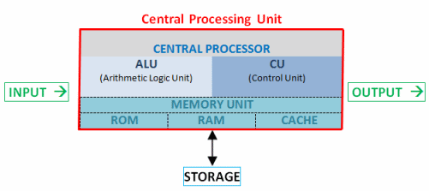

Slide 129
CONTROL UNIT & FUNCTION
The control unit (CU) is a component of a computer's central processing unit (CPU) that directs the operation of the processor.
It tells the computer's memory, arithmetic and logic unit and input and output devices how to respond to the instructions that have been sent to the processor.
It directs the operation of the other units by providing timing and control signals.
The Control unit (CU) is digital circuitry contained within the processor that coordinates the sequence of data movements into, out of, and between a processor's many sub-units

Slide 130
ARITHMETIC LOGICAL UNIT
An arithmetic logic unit (ALU) is a digital circuit used to perform arithmetic and logic operations.
It represents the fundamental building block of the central processing unit (CPU) of a computer.
Modern CPUs contain very powerful and complex ALUs. In addition to ALUs, modern CPUs contain a control unit.

Slide 131
COMPUTER COMPONENTS TOP LEVEL VIEW

Slide 132
INSTRUCTION CYCLE
An instruction cycle, also known as fetch-decode-execute cycle is the basic operational process of a computer.
This process is repeated continuously by CPU from boot up to shut down of computer.
A program residing in the memory unit of a computer consists of a sequence of instructions. These instructions are executed by the processor by going through a cycle for each instruction.
In a basic computer, each instruction cycle consists of the following phases:
Fetch instruction from memory.
Decode the instruction.
Read the effective address from memory.
Execute the instruction.

Slide 133
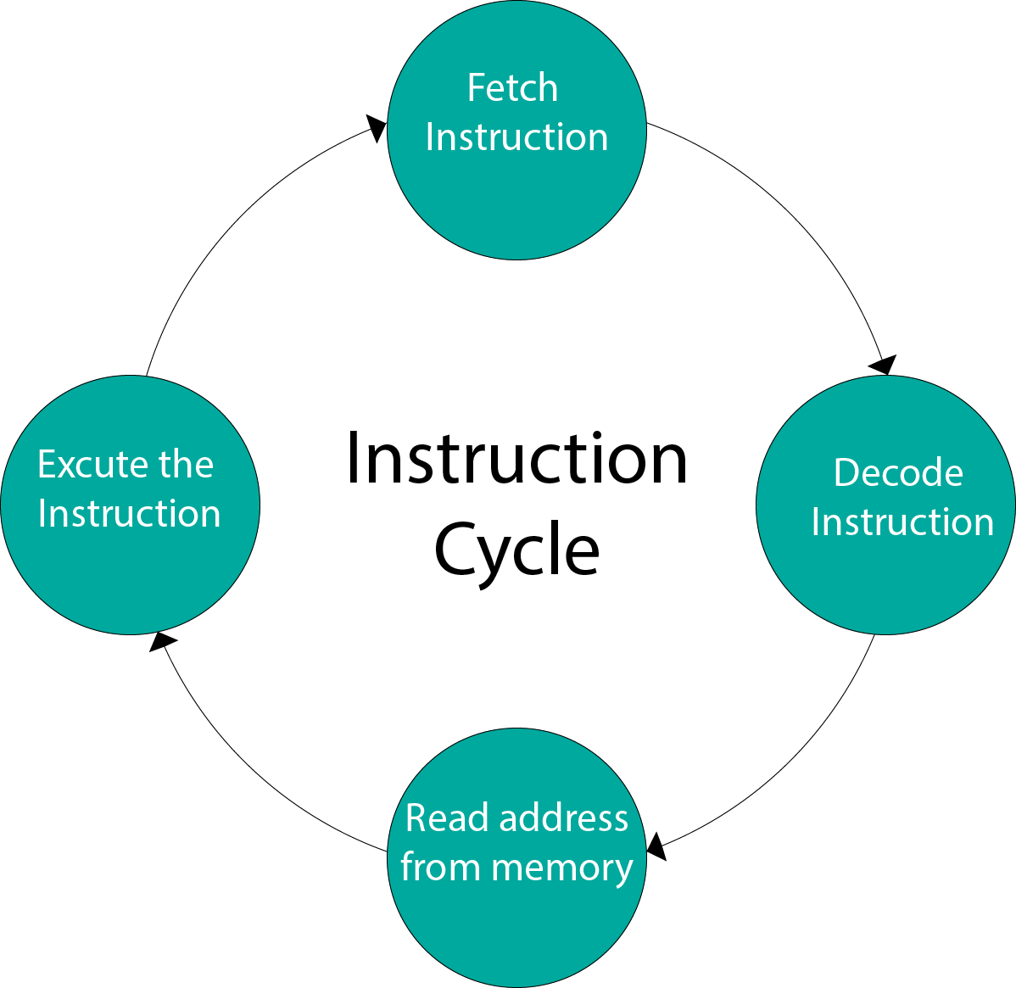

Slide 134
REGISTERS
A processor register (CPU register) is one of a small set of data holding places that are part of the computer processor.
A register may hold an instruction, a storage address, or any kind of data (such as a bit sequence or individual characters).
Some instructions specify registers as part of the instruction

