Slide 1
ANY-15
C-PROJECT

Slide 2
PROJECTED BY:-
>> NRIPESH NEWPANE
>> DAMODAR ACHARYA
>> SAMRAT KC
>> NABIN BHANDARI

Slide 3
Some terminology used:-
Setcolor(color name+BLINK) --To set the text color and blink for blink
property.
delay(int); --To delaly the current process.
settextstyle(); --To change the font shape and size.
Cprintf -- c is added before the printf section to live
the setcolor instruction in run time

Slide 4
SECTION IN ANY 15 :-
HOME
Help
Login panel
Register
Login
Game dashboard
Check section
Game result

Slide 5
HOME SECTION
IN HOME Section graphics is used
settextstyle(10,0,4); line is used to change the text font and size.
FOR LOADING SECTION
settextstyle(DEFAULT_FONT,HORIZ_DIR,7); is used for text “LOADING”
outtextxy(80,50,"LOADING...");
delay(100); is used to delay the motion of motion graphics.

Slide 6
How to play section or help section
IN This part every button on the key is used to change the color of text in run time.
Every keyword has their own ascii value so in every time when key is pressed then the text change their color according to related values.
Note: This is not right way to change the color in run time because colors work on the number 0-15 so that some key word has ascii value greater then 15.
To exit from this section backspace key should be pressed.

Slide 7
Login dashboard
In this part user can register their name if he/she is new user by pressing ‘R’ key from the keyboard.
Old user can directly login to this game bye pressing ‘l’ key from the keyboard.
Tips:-user can terminated this game bye pressing
‘t’ key from the keyboard.

Slide 8
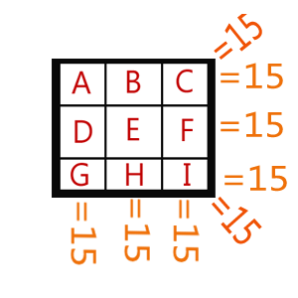
HOW TO WIN
TO WIN THIS GAME :-
A+B+C=15
D+E+F=15
G+H+I=15
A+D+G=15
B+E+H=15
C+F+I=15
A+E+I=15
G+E+C=15

Slide 9
ANY QUESTIONS?

Slide 10
THANK Q

