Slide 1
Dart

Slide 2
Intro
Dart is a general-purpose, high-level modern programming language which is originally developed by Google.
New programming language emerged in 2011, but its stable version was released in June 2017.
It is a dynamic, class-based, object-oriented programming language with closure and lexical scope. Syntactically, it is quite similar to Java, C, and JavaScript.
Dart is an open-source programming language which is widely used to develop the mobile application, modern web-applications, desktop application, and the Internet of Things (IoT) using by Flutter framework.

Slide 3
Compiled language
Supports two types of compilation techniques
AOT (Ahead of Time) - It converts the Dart code in the optimized JavaScript code with the help of the dar2js compiler and runs on all modern web-browser. It compiles the code at build time.
JOT (Just-In-Time) - It converts the byte code in the machine code (native code)

Slide 4
Why Dart?
Dart is a platform-independent language and supports all operating systems such as Windows, Mac, Linux, etc.
It is an open-source language, which means it available free for everyone.
An object-oriented programming language supports all features of oops such as inheritance, interfaces, and optional type features.
Useful in building real-time applications because of its stability.
The stand-alone Dart VM permits Dart code to run in a command-line interface environment.

Slide 5
Points to remember
Everything in Dart is treated as an object including, numbers, Boolean, function, etc. like Python. All objects inherit from the Object class.
Dart tools can report two types of problems while coding, warnings and errors. Warnings are the indication that your code may have some problem, but it doesn't interrupt the code's execution, whereas error can prevent the execution of code.
Dart supports generic types, like List<int>(a list of integers) or List<dynamic> (a list of objects of any type).

Slide 6
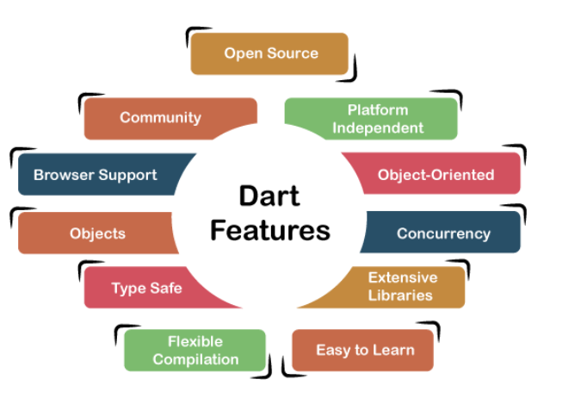
Supports an extensive range of programming utilities such as interface, collections, classes, dynamic and optional typing. It is developed for the server as well as the browser.

Slide 7
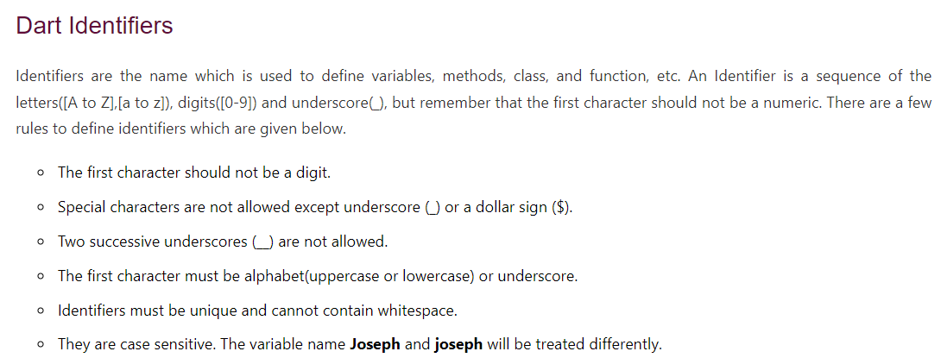

Slide 8
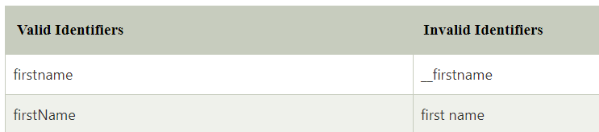
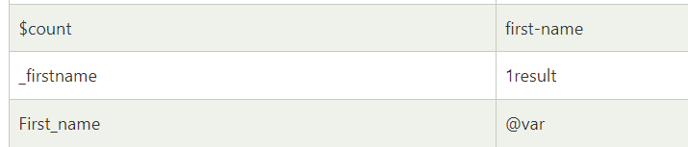

Slide 9

Here is the first program

Slide 10
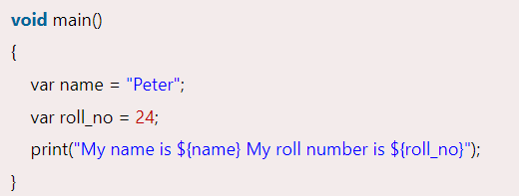
Dart Printing and String Interpolation

Slide 11
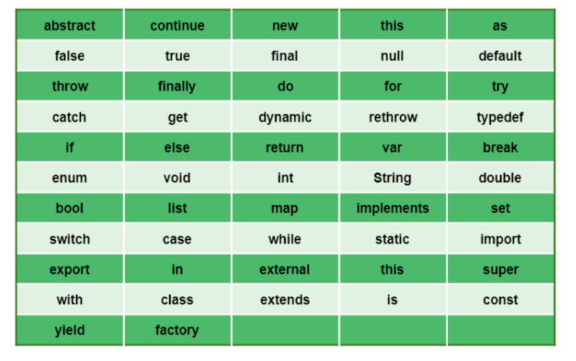
Keywords

Slide 12
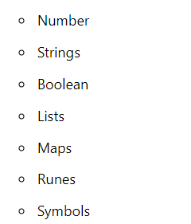
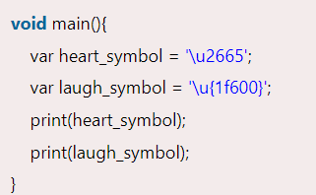

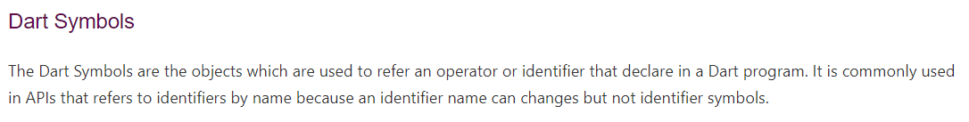
Data Types

Slide 13


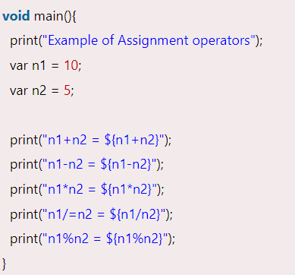
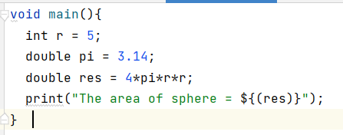
Final and const

Slide 14
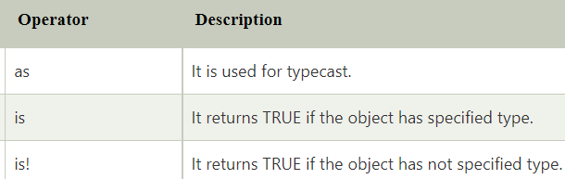
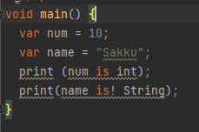

Test Operators

Slide 15
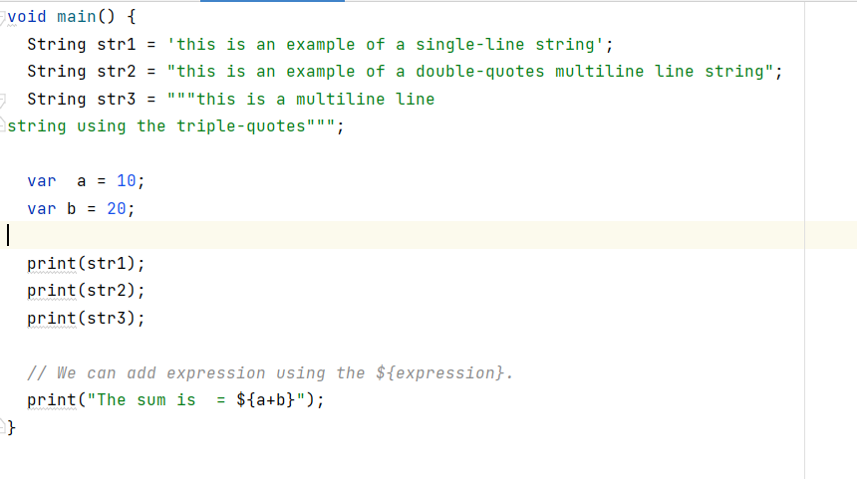
String

Slide 16
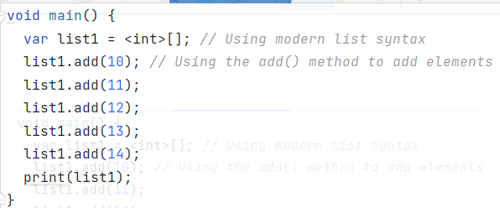
List

Slide 17
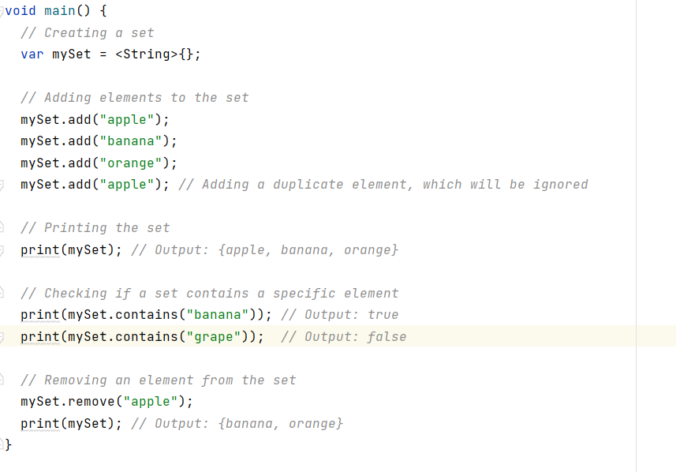
Set

Slide 18
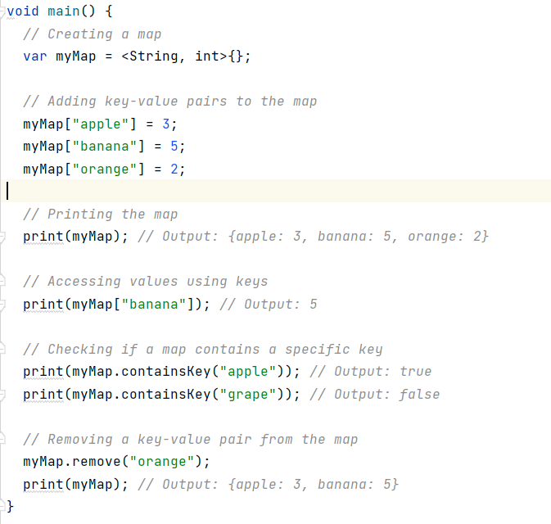
Map

Slide 19
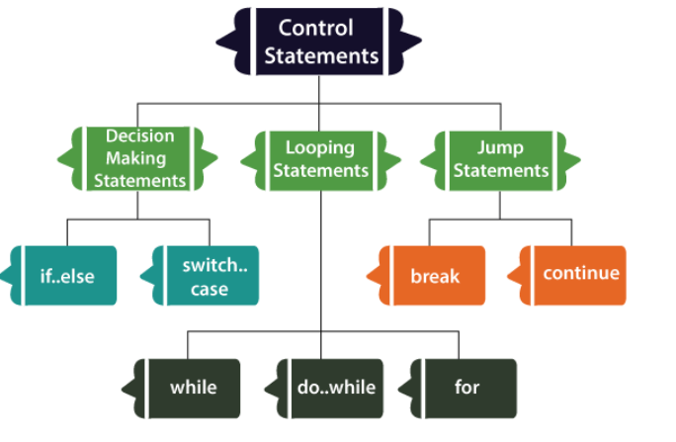
Decision making

Slide 20
Exercise
Find a given number is even or odd
Print the result based on the student’s grades (>85 excellent, between good, <60 fail)
Find the largest of three numbers

Slide 21
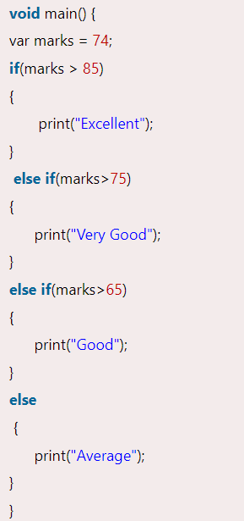
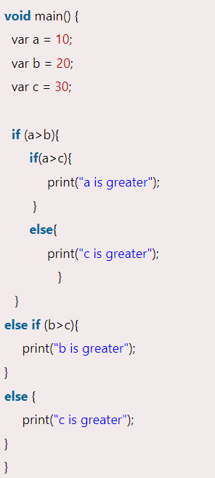
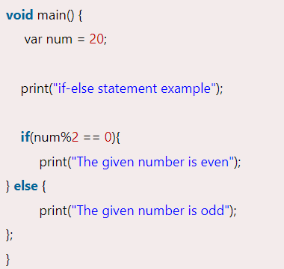

Slide 22
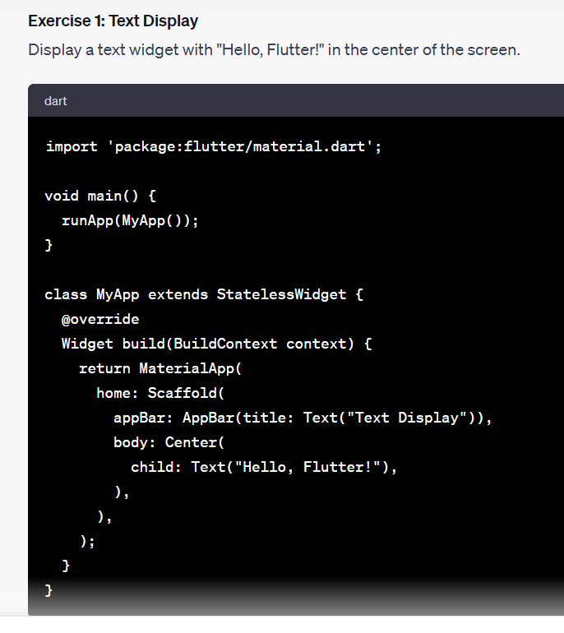
Flutter first program

Slide 23
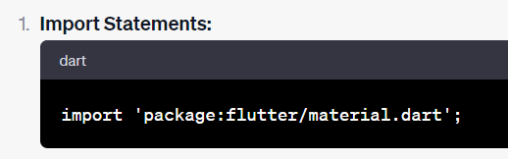
This line imports the necessary libraries from the Flutter framework. It includes widgets and classes required for building Flutter apps.

Slide 24
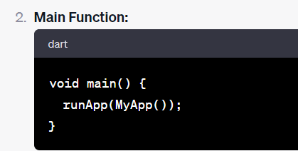
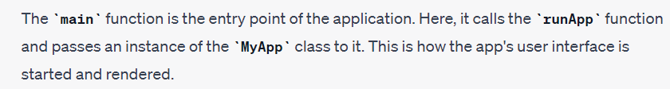

Slide 25
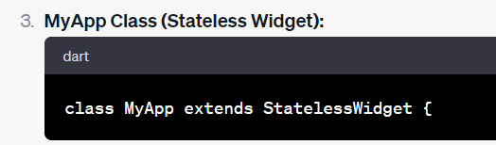

Slide 26
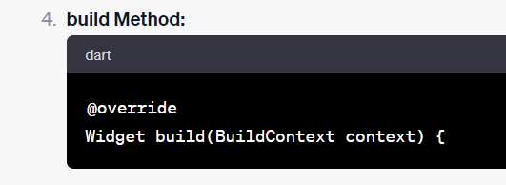

Slide 27
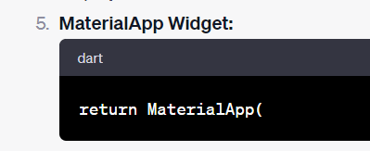


Slide 28
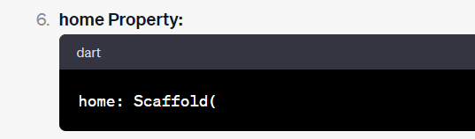

Slide 29
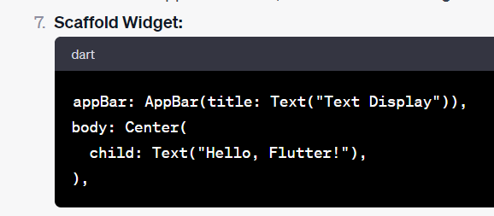
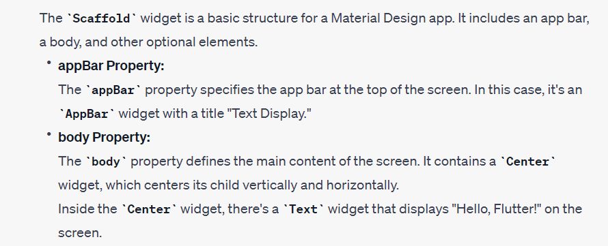

Slide 30
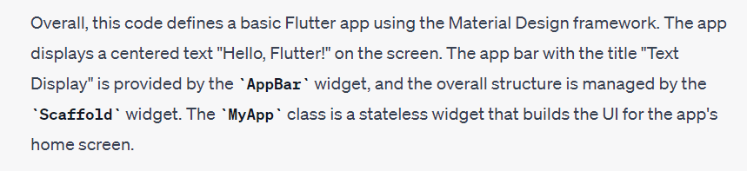

Slide 31
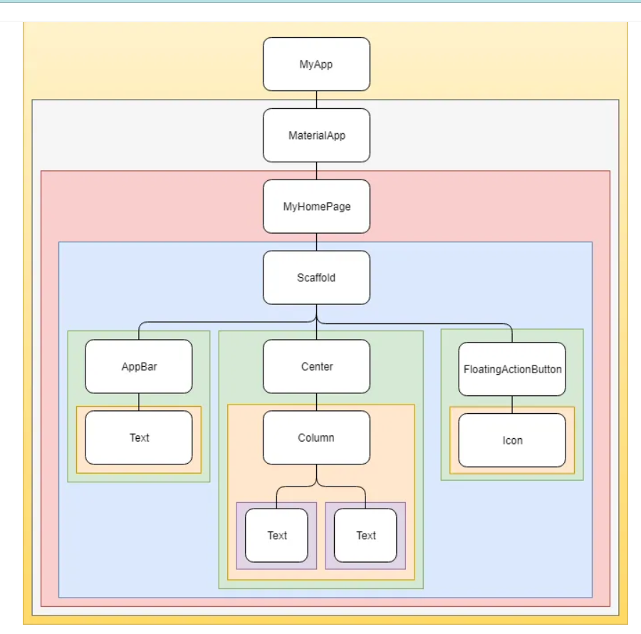
Widget hierarchy

Slide 32
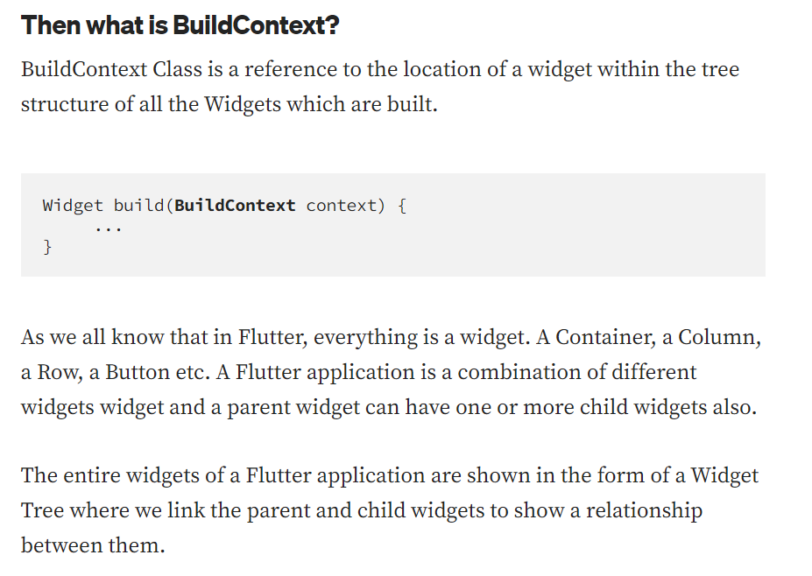

Slide 33
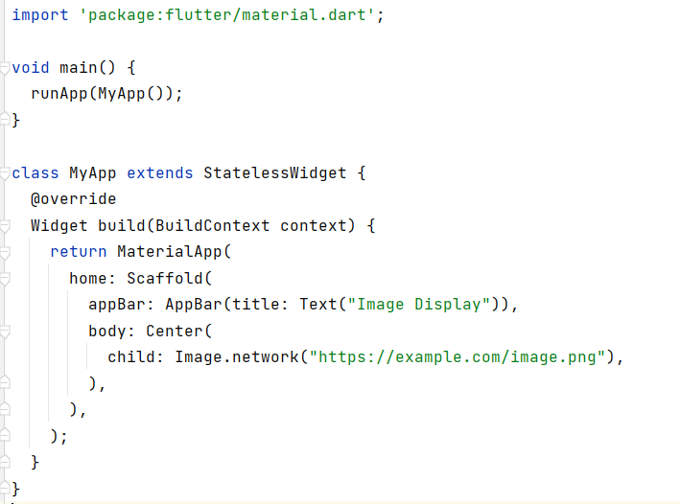
Second program : Image display

Slide 34
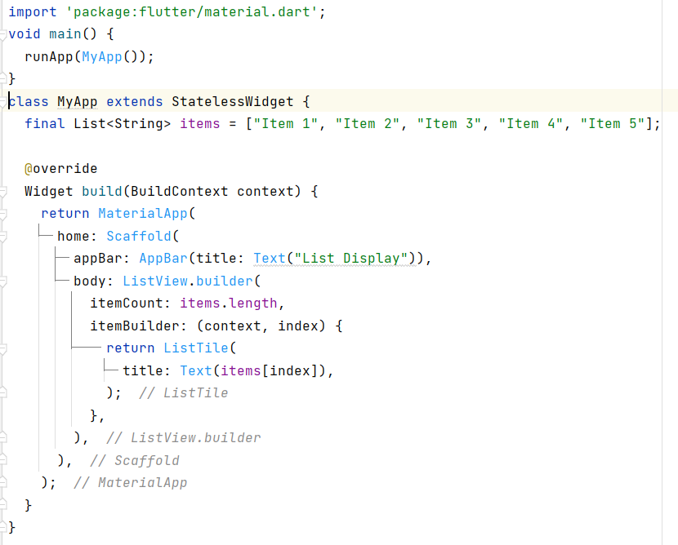
Third program : List view

Slide 35
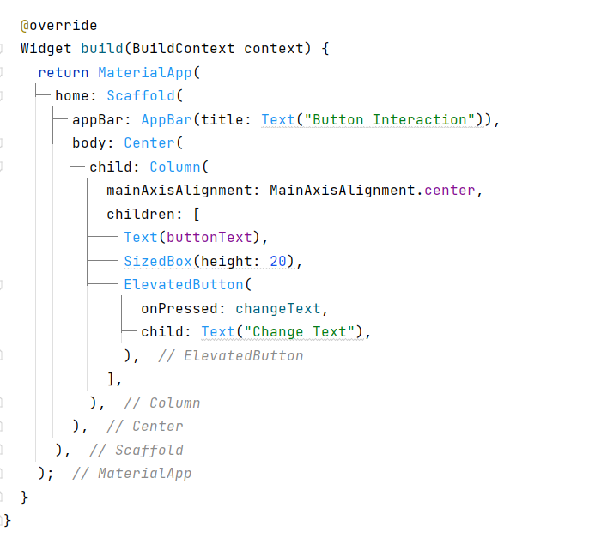
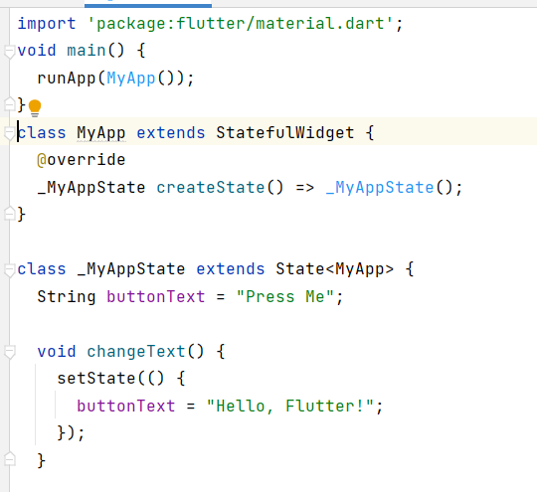
Fourth App : Button click

