Slide 1
Flutter Data Sharing

Slide 2
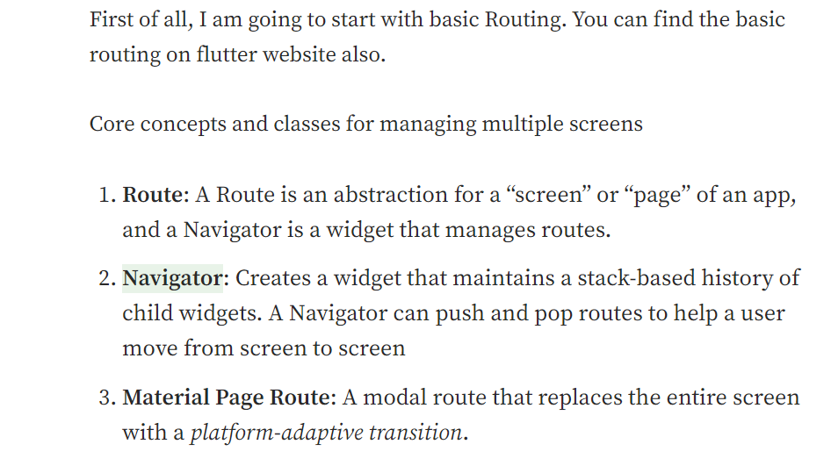

Slide 3
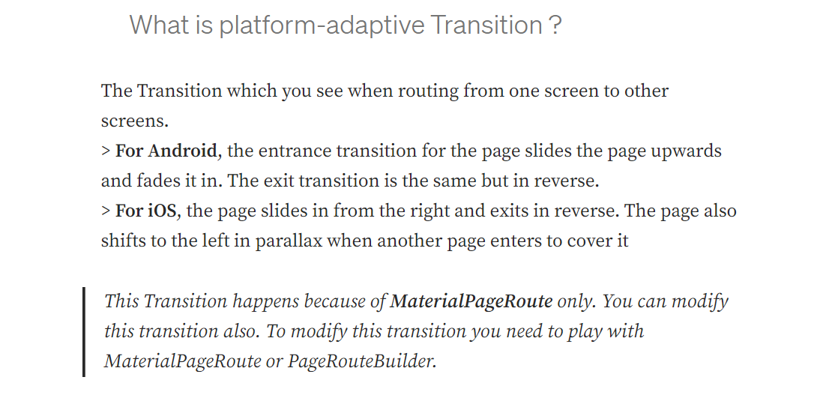

Slide 4
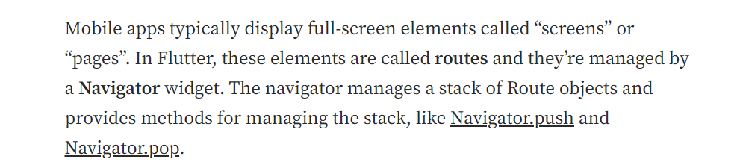

Slide 5
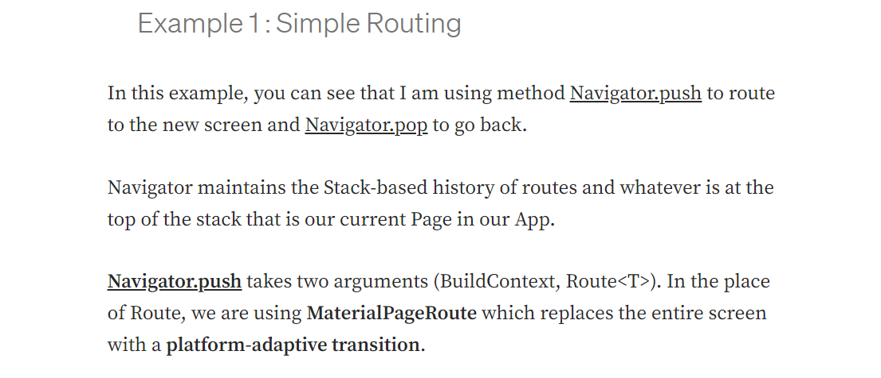

Slide 6
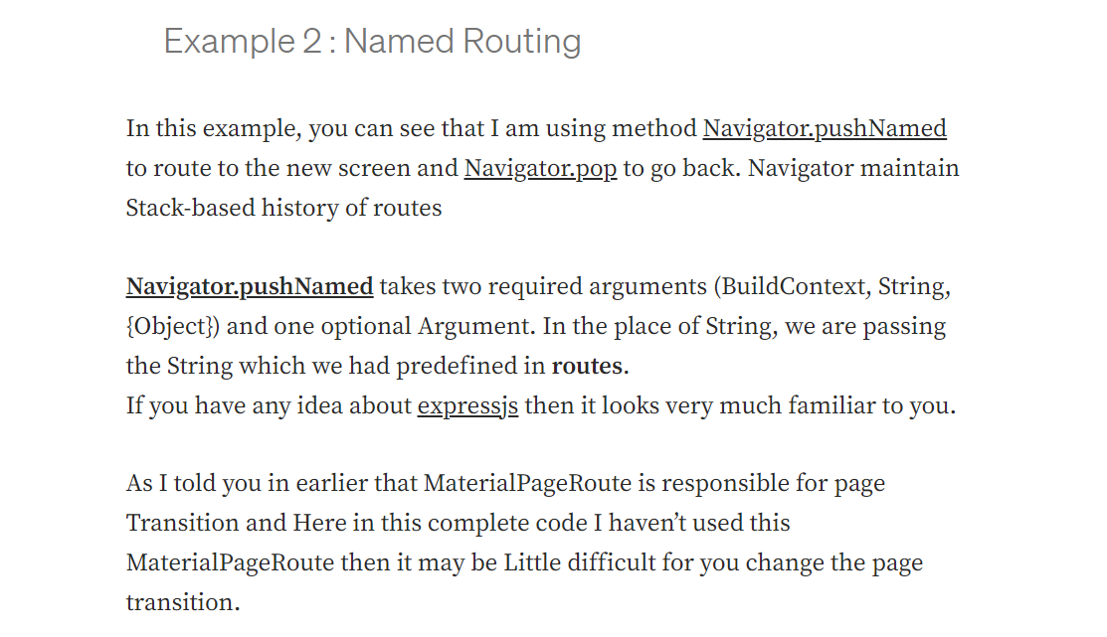

Slide 7
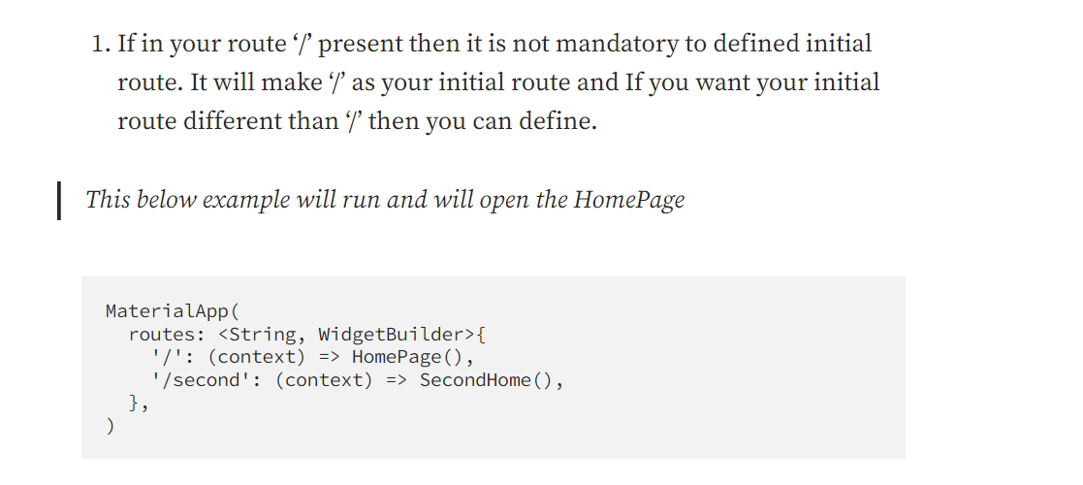

Slide 8
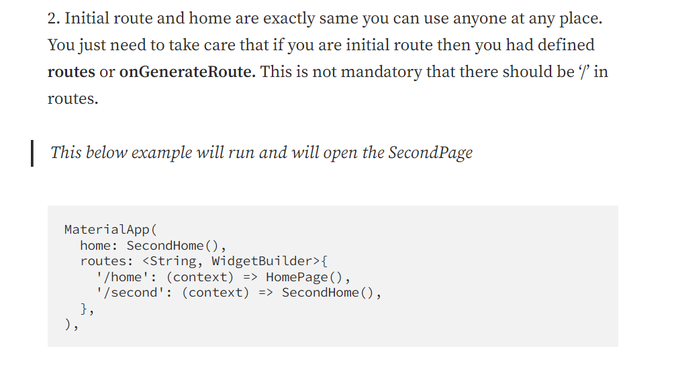

Slide 9
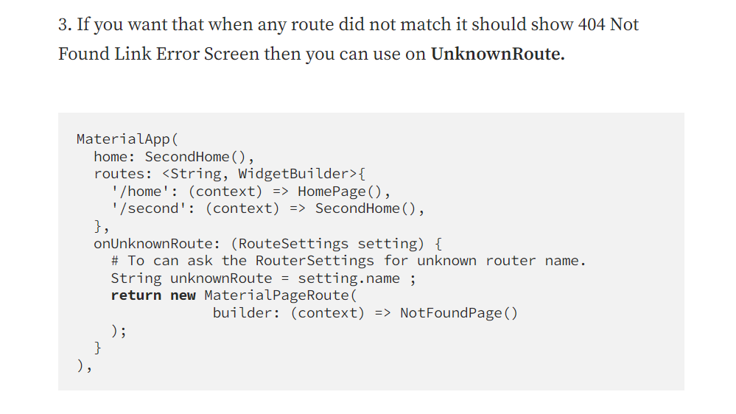

Slide 10
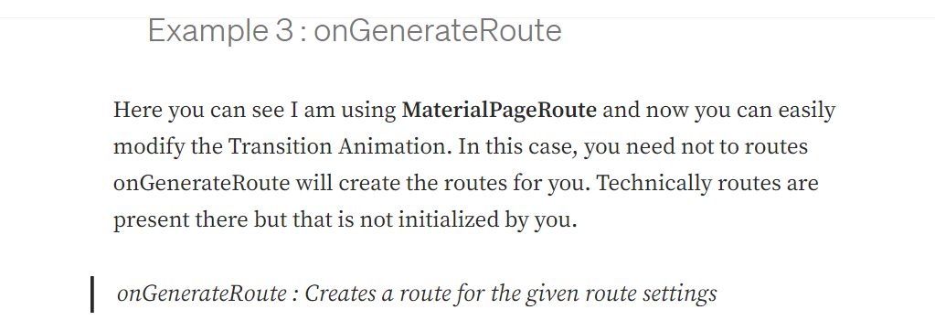

Slide 11
Sharing of data is very much important when we are moving from one to another screen. We see the medium article and we click on the author name we move to the author profile. How the profile pages know that for which author you have requested? These all are done using the data which is being shared while moving to the other page. There could be data or some object whatever you want to share you can share in a flutter application.

Slide 12
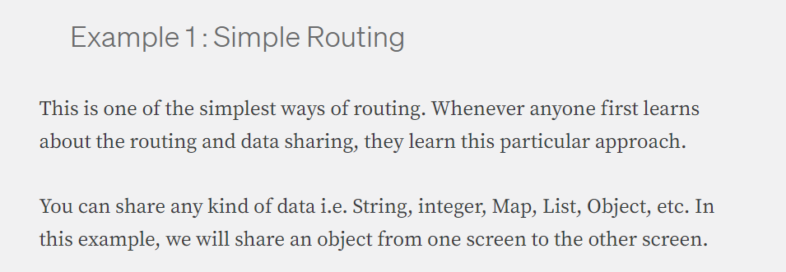

Slide 13
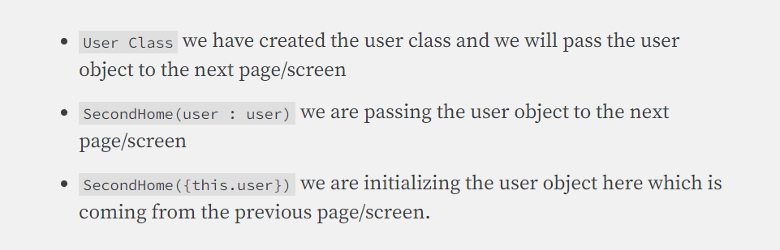

Slide 14

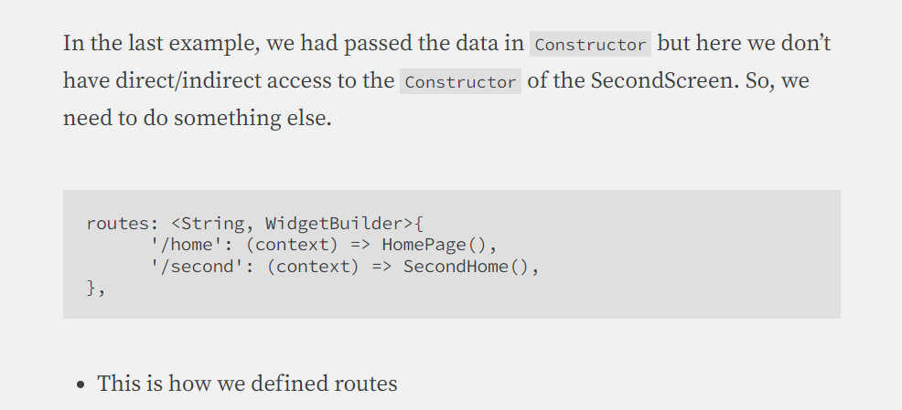

Slide 15
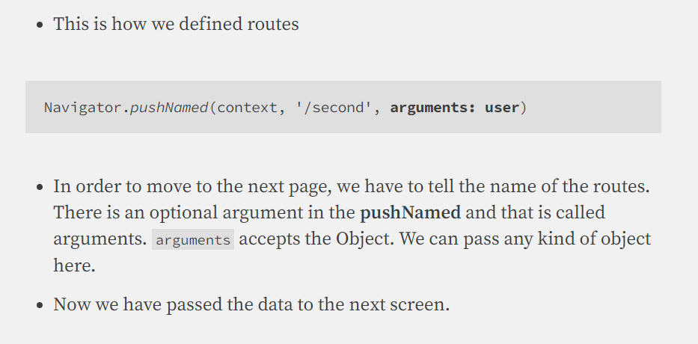

Slide 16
