Slide 1
Segmentation, Subnetting and Supernetting
By Djohara Benyamina
Notes:
Segmentation and Subnetting
Segmentation
Dividing a network into multiple smaller networks
Traffic on one network is separated from another network’s traffic
Each network is its own broadcast domain
Accomplish the following:
Enhance security
Improve performance
Simplify troubleshooting

Slide 2
How a Computer Uses a Subnet Mask
IPv4 address is divided into two parts:
Network ID and host ID
Subnet mask is used so devices can determine which part of an IP address is network ID and which part is the host ID
Number of 1s in the subnet mask determines the number of bits in the IP address belong to the network ID
Notes:
How a Computer Uses a Subnet Mask
IPv4 address is divided into two parts:
Network ID and host ID
Subnet mask is used so devices can determine which part of an IP address is network ID and which part is the host ID
Number of 1s in the subnet mask determines the number of bits in the IP address belong to the network ID

Slide 3
How a Computer Uses a Subnet Mask
On a network with an
IP address of 140.133.28.72 (10001100 10000101 0001110001001000) and a subnet mask of 255.248.0.0 (11111111 11111000 0000000000000000),
what is the network ID?
a. 140.128.0.0 (or 10001100 10000000 00000000 00000000)
b. 140.248.0.0 (or 10001100 11111000 00000000 00000000)
c. 140.133.20.0 (or 10001100 10000101 00010100 00000000)
d. 255.248.0.1 (or 11111111 11111000 00000000 00000001)

Slide 4
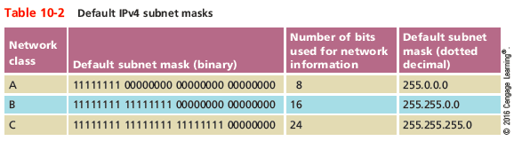
How a Computer Uses a Subnet Mask
Notes:
How a Computer Uses a Subnet Mask

Slide 5
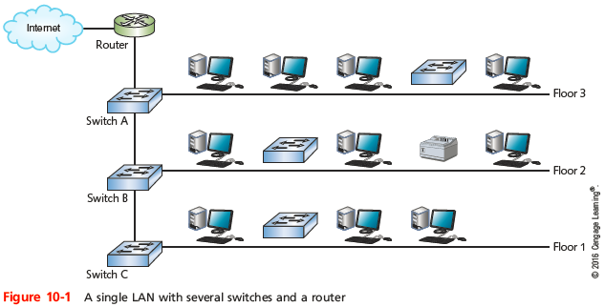
Why Subnets?
Example: A business has grown from 20-30 computers to having a few hundred computers on three floors
There is only a single LAN or broadcast domain
One router serves as the default gateway for the entire network
Notes:
Why Subnets?
Example: A business has grown from 20-30 computers to having a few hundred computers on three floors
There is only a single LAN or broadcast domain
One router serves as the default gateway for the entire network
To better manage network traffic, segment the network so that each floor contains one LAN, or broadcast domain

Slide 6
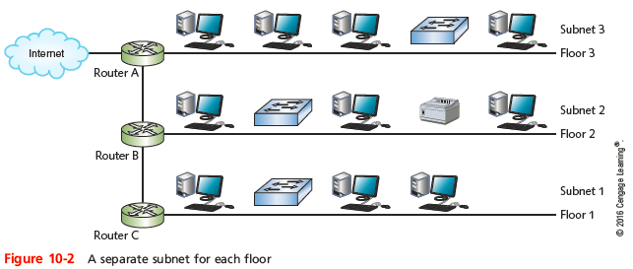
Why Subnets?
To better manage network traffic, segment the network so that each floor contains one LAN, or broadcast domain
Notes:
Why Subnets?

Slide 7
Segmentation and Subnetting
Segmentation
Dividing a network into multiple smaller networks
Traffic on one network is separated from another network’s traffic
Each network is its own broadcast domain
Accomplish the following:
Enhance security
Improve performance
Simplify troubleshooting
Notes:
Segmentation and Subnetting
Segmentation
Dividing a network into multiple smaller networks
Traffic on one network is separated from another network’s traffic
Each network is its own broadcast domain
Accomplish the following:
Enhance security
Improve performance
Simplify troubleshooting

Slide 8
Subnetting
Classful addressing in IPv4
First, simplest IPv4 addressing type
Adheres to network class distinctions
Recognizes Class A, B, C addresses
Drawbacks
Fixed network ID size limits number of network hosts
Difficult to separate traffic from various parts of a network

Slide 9
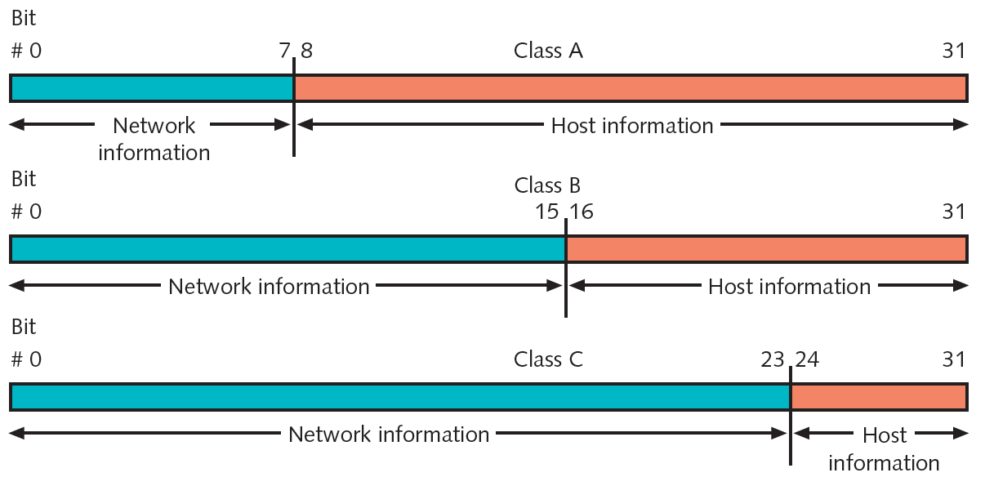
Subnetting (cont’d.)
Figure 9-1 Network and host information in classful IPv4 addressing
Courtesy Course Technology/Cengage Learning

Slide 10
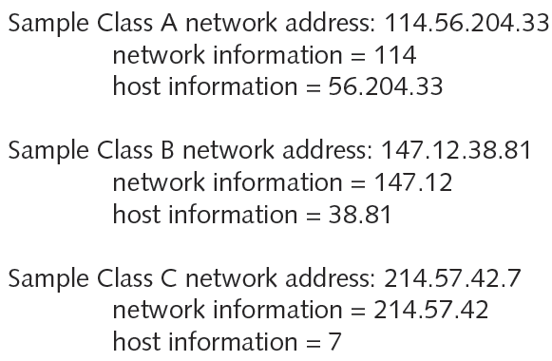
Subnetting (cont’d.)
Figure 9-2 Sample IPv4 addresses with classful addressing
Courtesy Course Technology/Cengage Learning

Slide 11
Subnetting (cont’d.)
Special addresses
Cannot be assigned to node network interface
Used as subnet masks
Examples of special addresses
Network ID
Broadcast address

Slide 12
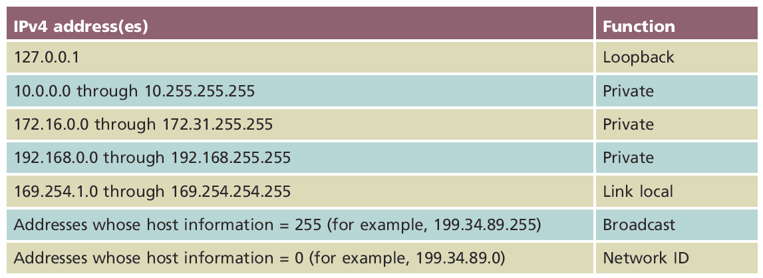
Table 9-3 IPv4 addresses reserved for special functions
Courtesy Course Technology/Cengage Learning

Slide 13
Subnetting (cont’d.)
IPv4 subnetting techniques
Subnetting alters classful IPv4 addressing rules
IP address bits representing host information change to represent network information
Reduces usable host addresses per subnet
Number of hosts, subnets available after subnetting depend on host information bits borrowed

Slide 14
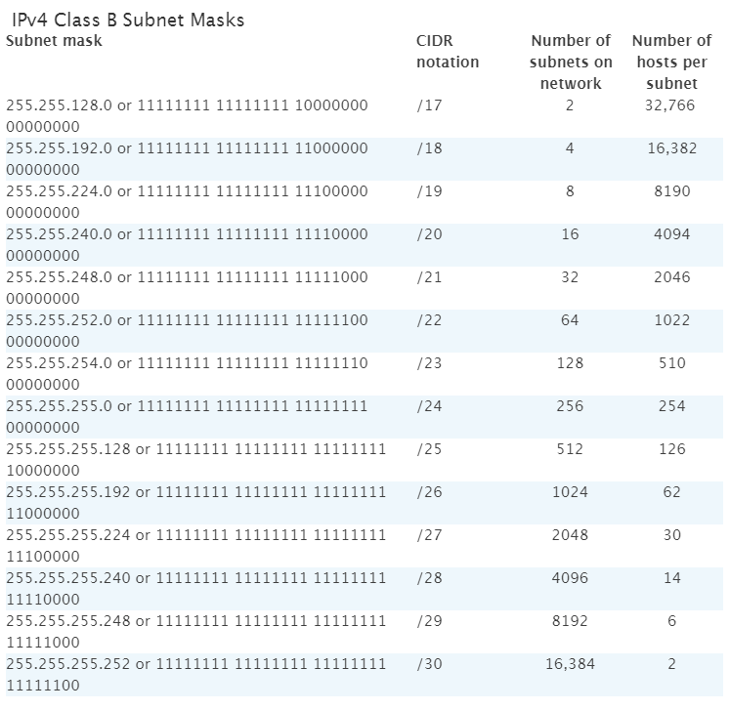
Table 9-4 Class B subnet masks
Courtesy Course Technology/Cengage Learning

Slide 15
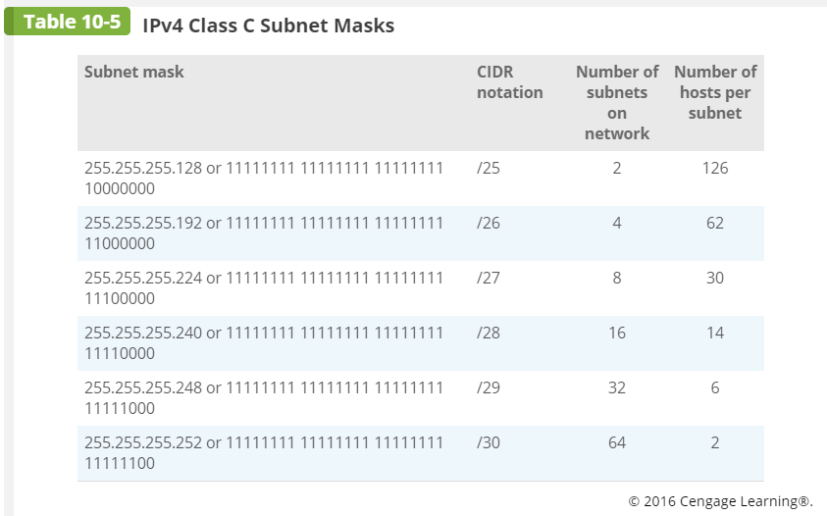
Table 9-5 IPv4 Class C subnet masks
Courtesy Course Technology/Cengage Learning

Slide 16
Subnetting (cont’d.)
Calculating IPv4 Subnets
Formula: 2^{n} =Y
n: number of subnet mask bits needed to switch from 0 to 1
Y: number of resulting subnets
Number of resulting hosts/subnet is 2^{m} -2=X where m: number of host mask bits (the zero bits)
Example
Class C network
Network ID: 199.34.89.0
Want to divide into six subnets

Slide 17
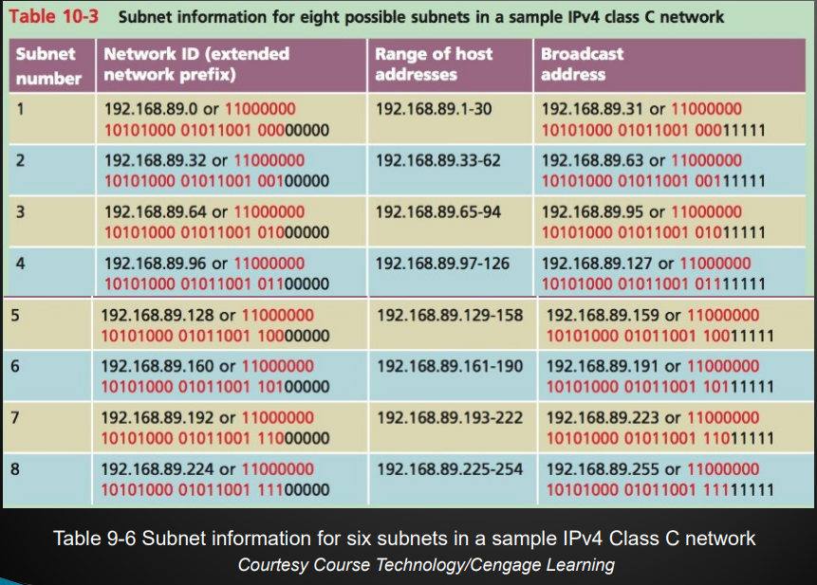

Slide 18
Subnetting (cont’d.)
Class A, Class B, and Class C networks
Can be subnetted
Each class has different number of host information bits usable for subnet information
Varies depending on network class and the way subnetting is used
LAN subnetting
LAN’s devices interpret device subnetting information
External routers
Need network portion of device IP address

Slide 19
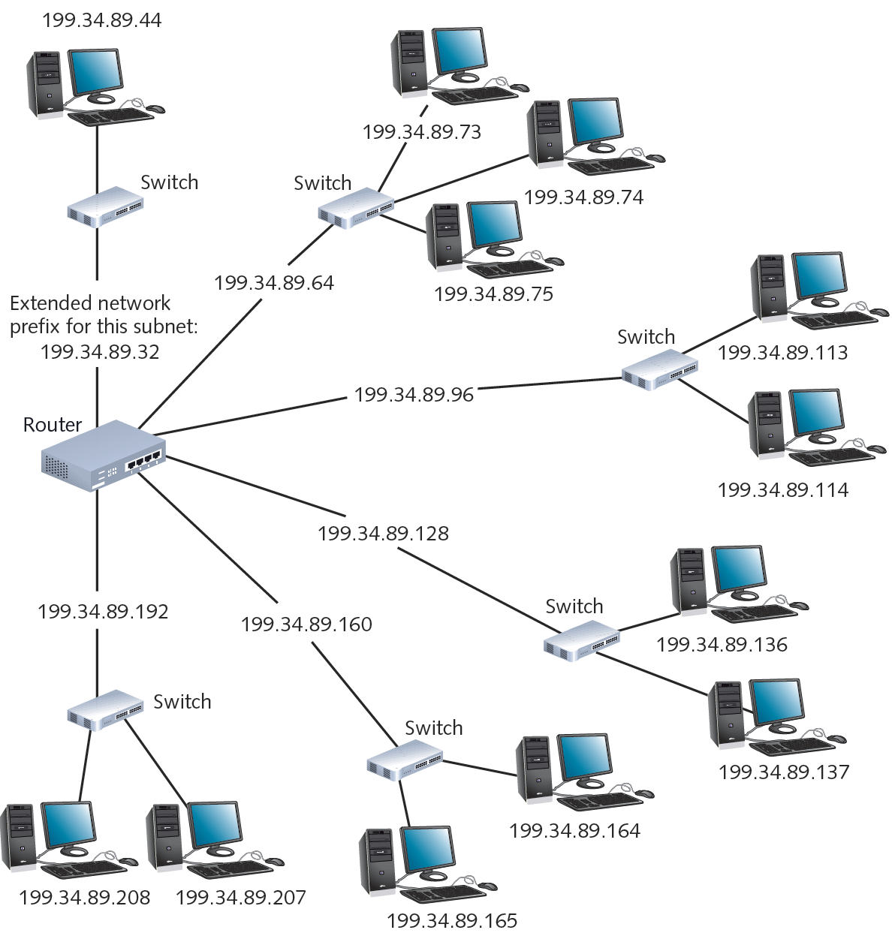
Figure 9-4 A router connecting several subnets
Courtesy Course Technology/Cengage Learning

Slide 20
CIDR (Classless Interdomain Routing)
Also called classless routing or supernetting
Not exclusive of subnetting
Provides additional ways of arranging network and host information in an IP address
Conventional network class distinctions do not exist
192.168.89.127/24
24 represents the number of 1s in the subnet mask and the number of bits in the network ID
Known as a CIDR block

Slide 21
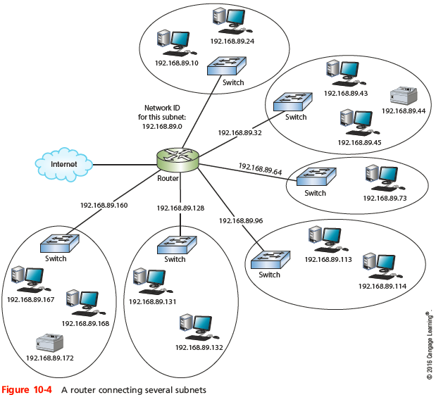
Subnet Mask Tables
Notes:
Subnet Mask Tables

Slide 22
Supernetting
Supernetting
Combine contiguous networks that all use the same CIDR block into one supernet
Also called classless routing or IP address segmentation
Supernetting is helpful for routing:
Reduce the number of routing table entries by combining several entries
Notes:
Supernetting
Supernetting
Combine contiguous networks that all use the same CIDR block into one supernet
Also called classless routing or IP address segmentation
Supernetting is helpful for two reasons:
Reduce the number of routing table entries by combining several entries
Allow a company to create a single network made up of more than one Class C license

Slide 23
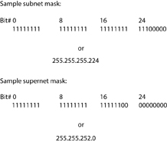
Supernetting
Supernet is defined by a supernet mask
Moves the network prefix to the left
Figure 10-6 Subnet mask and supernet mask for a Class C network
Notes:
Supernetting
Supernet is defined by a supernet mask
Moves the network prefix to the left

Slide 24
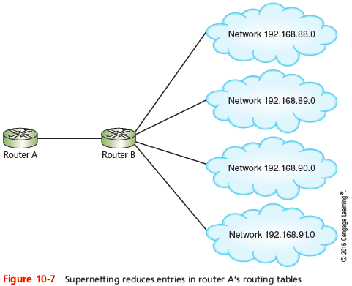
Supernetting
Notes:
Supernetting

Slide 25
Supernetting
Replace the four entries in routing tables,
192.168.88.0/24
192.168.89.0/24
192.168.90.0/24
192.168.91.0/24
By only one entry 192.168.88.0/22
192.168.88.0 or 11000000.10101000.01011000.00000000 192.168.89.0 or 11000000.10101000.01011001.00000000 192.168.90.0 or 11000000.10101000.01011010.00000000 192.168.91.0 or 11000000.10101000.01011011.00000000

Slide 26
Subnetting in IPv6
Each ISP can offer customers an entire IPv6 subnet
Subnetting in IPv6
Simpler than IPv4
Classes not used
Subnet masks not used
Subnet represented by leftmost 64 bits in an address
Route prefix
Slash notation is used

Slide 27
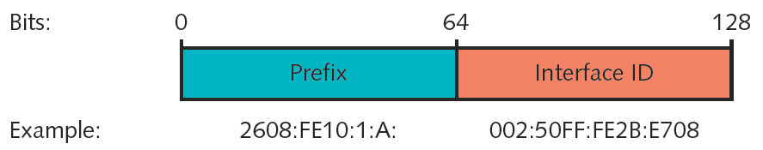
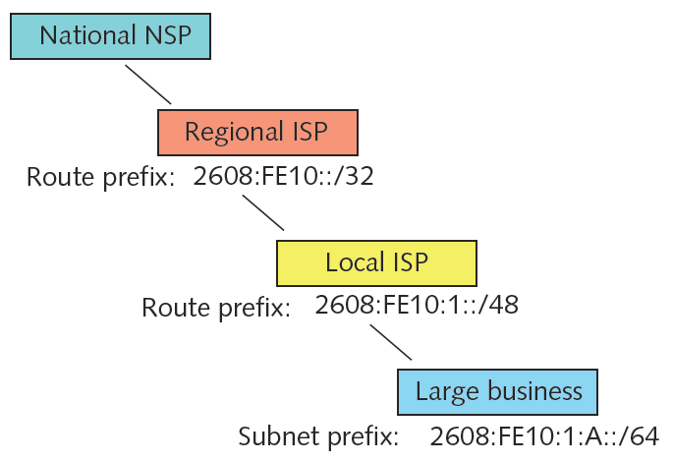
Figure 9-7 Subnet prefix and interface ID in an IPv6 address
Courtesy Course Technology/Cengage Learning
Figure 9-8 Hierarchy of IPv6 routes and subnets
Courtesy Course Technology/Cengage Learning

Slide 28
Internet Gateways
Combination of software and hardware
Enables different network segments to exchange data
Default gateway
Interprets outbound requests to other subnets
Interprets inbound requests from other subnets
Network nodes
Allowed one default gateway
Assigned manually or automatically (DHCP)

Slide 29
Internet Gateways (cont’d.)
Gateway interface on router
Advantages
One router can supply multiple gateways
Gateway assigned own IP address
Default gateway connections
Multiple internal networks
Internal network with external networks
WANs, Internet
Router used as gateway
Must maintain routing tables

Slide 30
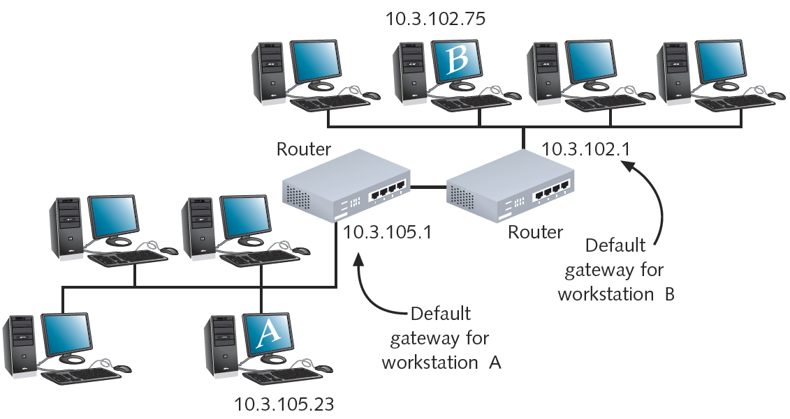
Figure 9-9 The use of default gateways
Courtesy Course Technology/Cengage Learning

Slide 31
Answer the questions
1. Which subnet mask should you assign to a computer that is in a subnet that has 30 possible addresses that can be assigned to hosts?
a.255.255.255.32 b. 255.255.255.224 c. 255.255.255.248 d. 255.255.240.0
2. If you subdivide your Class B network into 30 subnets, what is the maximum number of hosts you can assign to any single subnet?
a. 255 b. less than 1000 c. more than 1000 d.6
3. You have a router that is connected to networks 192.168.0.0/24, 192.168.1.0/24, 192.168.2.0./24, and 192.168.3.0. What is the appropriate CIDR notation to summarize or supernet those routes?
a.192.168.4.0.26 b. 192.168.0.0/26 c. 192.168.0.0/22 d. 192.168.4.0/22

Slide 32
For next class
Please watch the video on Cisco Packet Tracer | Everything You Need to Know At https://www.youtube.com/watch?v=qZB_biPOBwA
Follow the steps from the video to create an account with Network Academy and download packet Tracer. We will use it starting from next week.

Slide 33
Summary
Separating traffic by subnets or VLANs helps enhance security, improve network performance, and simplify troubleshooting
CIDR notation takes the network ID or a host’s IP address and follows it with a forward slash (/) followed by the number of bits used for network ID
To create a subnet, borrow bits that would represent host information in classful addressing
Supernetting allows you to combine contiguous networks that all use the same CIDR block into one supernet
Subnetting in IPv6 is simpler than subnetting in IPv4
Gateways facilitate communication between subnets

