Slide 1
How Data Is Transported Over Networks

Slide 2
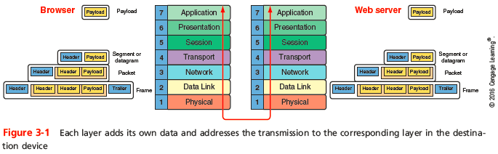
TCP/IP Core Protocols
TCP/IP - a suite of protocols including:
TCP, IP, UDP, ARP, and many others
TCP/IP is open and routable
Protocols add a header to data inherited from the layer above it
Notes:
TCP/IP Core Protocols
TCP/IP - a suite of protocols including:
TCP, IP, UDP, ARP, and many others
TCP/IP is open and routable
Protocols add a header to data inherited from the layer above it

Slide 3
TCP/IP Core Protocols
Layers 7, 6, and 5 - Data and instructions, known as payload, are generated by applications running on source host
Layer 4 - Usually TCP or UDP adds a header to the payload
Includes a port number to identify the receiving app
Layer 3 - Network layer adds it own header and becomes a packet
Layer 2 - packet is passed to Data Link layer on NIC, which encapsulates data with its own header and trailer, creating a frame
Notes:
TCP/IP Core Protocols
Layers 7, 6, and 5 - Data and instructions, known as payload, are generated by applications running on source host
Layer 4 - Usually TCP or UDP adds a header to the payload
Includes a port number to identify the receiving app
Layer 3 - Network layer adds it own header and becomes a packet
Layer 2 - packet is passed to Data Link layer on NIC, which encapsulates data with its own header and trailer, creating a frame

Slide 4
TCP/IP Core Protocols
Layer 1 - Physical layer on the NIC receives the frame and places the transmission on the network
Receiving host de-encapsulates the message at each layer in reverse order and presents payload to the receiving applications
Connectivity devices are specialized devices that allow two or more networks or multiple parts of one network to connect and exchange data
Known by the highest OSI layer they read and process
Notes:
TCP/IP Core Protocols
Layer 1 - Physical layer on the NIC receives the frame and places the transmission on the network
Receiving host de-encapsulates the message at each layer in reverse order and presents payload to the receiving applications
Connectivity devices are specialized devices that allow two or more networks or multiple parts of one network to connect and exchange data
Known by the highest OSI layer they read and process

Slide 5
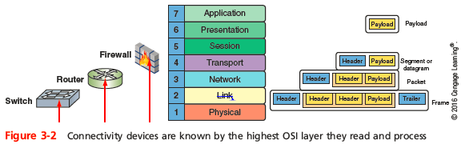
TCP/IP Core Protocols
Notes:
TCP/IP Core Protocols

Slide 6
TCP (Transmission Control Protocol)
TCP operates in the Transport layer of OSI model
Three characteristics of TCP
Connection-oriented protocol - TCP ensures that a connection or session is established by using a three-step process called a three-way handshake
Sequencing and checksums - TCP sends a character string called a checksum that is checked by the destination host along with a sequence number for each segment
Flow control - scale rate of transmission based on how quickly recipient can accept data
Notes:
TCP (Transmission Control Protocol)
TCP operates in the Transport layer of OSI model
Three characteristics of TCP
Connection-oriented protocol - TCP ensures that a connection or session is established by using a three-step process called a three-way handshake
Sequencing and checksums - TCP sends a character string called a checksum that is checked by the destination host along with a sequence number for each segment
Flow control - gauges rate of transmission based on how quickly recipient can accept data

Slide 7
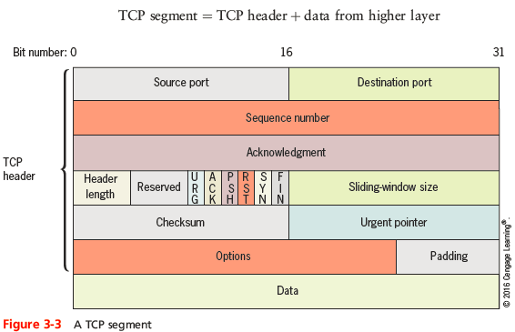
Fields in a TCP Segment
Notes:
Fields in a TCP Segment

Slide 8
TCP Three-Way Handshake
Three transmission sent before data transmission:
Step 1 - request for a connection (SYN)
Step 2 - response to the request (SYN/ACK)
Step 3 - connection established (ACK)
After the three initial messages, the payload or data is sent
Sequence numbers will be increased by the number of bits included in each received segment
Confirms the correct length of message was received
Notes:
TCP Three-Way Handshake
Three transmission sent before data transmission:
Step 1 - request for a connection (SYN)
Step 2 - response to the request (SYN/ACK)
Step 3 - connection established (ACK)
After the three initial messages, the payload or data is sent
Sequence numbers will be increased by the number of bits included in each received segment
Confirms the correct length of message was received

Slide 9
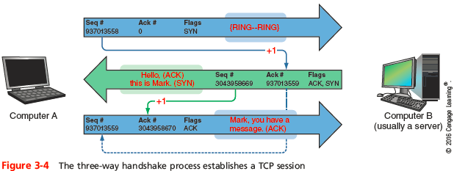
TCP Three-Way Handshake
Notes:
TCP Three-Way Handshake

Slide 10
UDP (User Datagram Protocol)
UDP provides no error checking or sequencing
Makes UDP more efficient than TCP
Useful for live audio or video transmissions over the Internet
Also more efficient for carrying messages that fit within one data packet
A UDP header contains only four fields: Source port, Destination port, Length, and Checksum
Use of Checksum field in UDP is optional in IPv4, but required in IPv6
Notes:
UDP (User Datagram Protocol)
UDP provides no error checking or sequencing
Makes UDP more efficient than TCP
Useful for live audio or video transmissions over the Internet
Also more efficient for carrying messages that fit within one data packet
A UDP header contains only four fields: Source port, Destination port, Length, and Checksum
Use of Checksum field in UDP is optional in IPv4, but required in IPv6

Slide 11
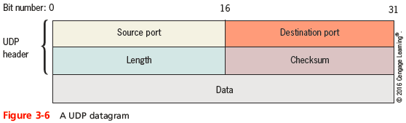
UDP (User Datagram Protocol)
Notes:
UDP (User Datagram Protocol)

Slide 12
IP (Internet Protocol)
IP operates at the Network layer of the OSI model
Specifies how and where data should be delivered
IP enables TCP/IP to internetwork
Traverse more than one LAN segment and more than one type of network through a router
IP is an unreliable, connectionless protocol
Means that IP does not guarantee delivery of data and no connection is established before data is transmitted
IP depends on TCP to ensure data packets are delivered to the right address
Notes:
IP (Internet Protocol)
IP operates at the Network layer of the OSI model
Specifies how and where data should be delivered
IP enables TCP/IP to internetwork
Traverse more than one LAN segment and more than one type of network through a router
IP is an unreliable, connectionless protocol
Means that IP does not guarantee delivery of data and no connection is established before data is transmitted
IP depends on TCP to ensure data packets are delivered to the right address

Slide 13
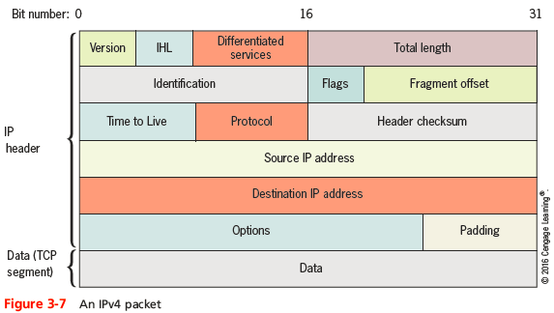
IPv4 Packets
Notes:
IPv4 Packets

Slide 14
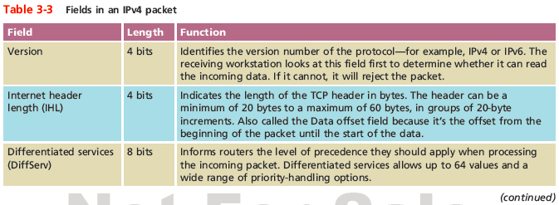
IPv4 Packets
Notes:
IPv4 Packets

Slide 15
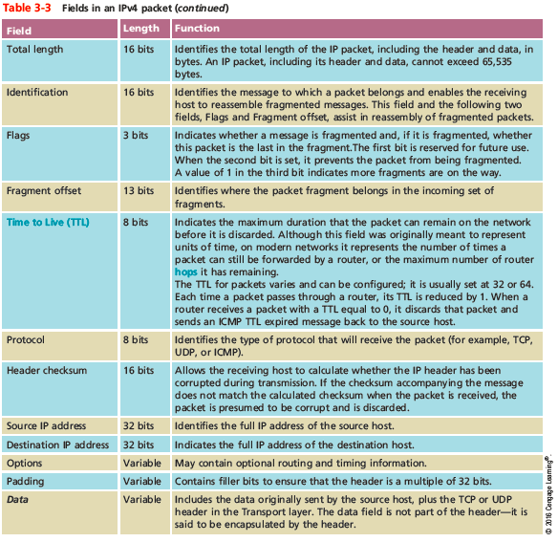
IPv4 Packets
Notes:
IPv4 Packets

Slide 16
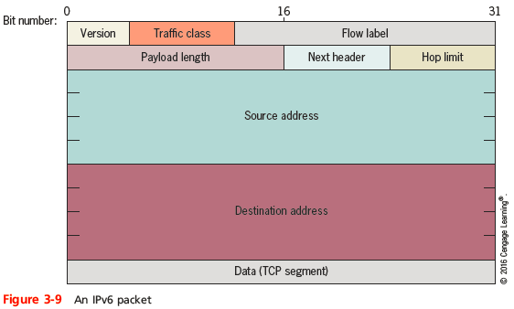
IPv6 Packets
Notes:
IPv6 Packets

Slide 17
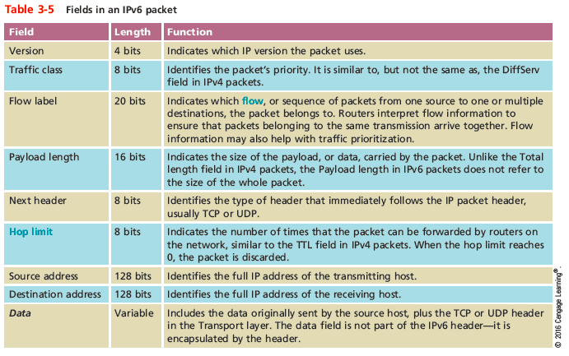
IPv6 Packets
Notes:
IPv6 Packets

Slide 18
ICMP (Internet Control Message Protocol)
ICMP - a Network layer core protocol that reports one the success or failure of data delivery
ICMP can indicate when:
Part of a network is congested
Data fails to reach its destination
Data has been discarded when the TTL has expired
ICMP announces transmission failures to sender but does not correct errors it detects
ICMPv6 on IPV6 networks performs the functions of IGMP and ARP on IPv4 networks
Notes:
ICMP (Internet Control Message Protocol)
ICMP - a Network layer core protocol that reports one the success or failure of data delivery
ICMP can indicate when:
Part of a network is congested
Data fails to reach its destination
Data has been discarded when the TTL has expired
ICMP announces transmission failures to sender but does not correct errors it detects
ICMPv6 on IPV6 networks performs the functions of IGMP and ARP on IPv4 networks

Slide 19
IGMP (Internet Group Management Protocol) on IPv4 Networks
IGMP operates at the Network layer of OSI model to manage multicasting
Multicasting can be used for teleconferencing or videoconferencing over the Internet
Routers use IGMP to determine which nodes belong to a certain multicast group
And to transmit data to all nodes in that group
Network nodes use IGMP to join or leave multicast groups at any time
Notes:
IGMP (Internet Group Management Protocol) on IPv4 Networks
IGMP operates at the Network layer of OSI model to manage multicasting
Multicasting can be used for teleconferencing or videoconferencing over the Internet
Routers use IGMP to determine which nodes belong to a certain multicast group
And to transmit data to all nodes in that group
Network nodes use IGMP to join or leave multicast groups at any time

Slide 20
ARP (Address Resolution Protocol) on IPv4 Networks
ARP works in conjunction with IPv4 to discover the MAC address of a host or node on the local network
And to maintain a database that maps IP addresses to MAC addresses on the local network
ARP is a Layer 2 protocol that uses IP in Layer 3
Operates only within its local network
ARP relies on broadcasting
ARP table - the database of IP-to-MAC address mappings
Notes:
ARP (Address Resolution Protocol) on IPv4 Networks
ARP works in conjunction with IPv4 to discover the MAC address of a host or node on the local network
And to maintain a database that maps IP addresses to MAC addresses on the local network
ARP is a Layer 2 protocol that uses IP in Layer 3
Operates only within its local network
ARP relies on broadcasting
ARP table - the database of IP-to-MAC address mappings

Slide 21
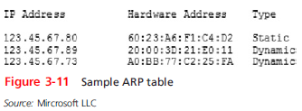
ARP (Address Resolution Protocol) on IPv4 Networks
Notes:
ARP (Address Resolution Protocol) on IPv4 Networks

Slide 22
ARP (Address Resolution Protocol) on IPv4 Networks
An ARP table can contain two types of entries:
Dynamic - created when a client makes an ARP request that could not be satisfied by data already in the ARP table
Static - those someone entered manually using the ARP utility (arp command)
To view a Window’s workstation’s ARP table, enter the command:
arp -a
Notes:
ARP (Address Resolution Protocol) on IPv4 Networks
An ARP table can contain two types of entries:
Dynamic - created when a client makes an ARP request that could not be satisfied by data already in the ARP table
Static - those someone entered manually using the ARP utility (arp command)
To view a Window’s workstation’s ARP table, enter the command:
arp -a

Slide 23
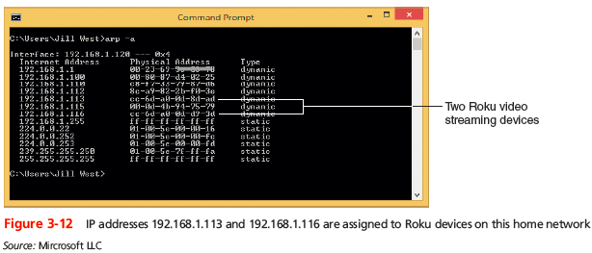
ARP (Address Resolution Protocol) on IPv4 Networks
Notes:
ARP (Address Resolution Protocol) on IPv4 Networks

Slide 24
Routers and How They Work
A router joins two or more networks and passes packets from one network to another
Routers can do the following:
Connect dissimilar networks (LANs and WANs)
Interpret Layer 3 and often Layer 4 addressing
Determine the best path for data to follow from point A to point B
Reroute traffic if the path of first choice is down but another path is available
Notes:
Routers and How They Work
A router joins two or more networks and passes packets from one network to another
Routers can do the following:
Connect dissimilar networks (LANs and WANs)
Interpret Layer 3 and often Layer 4 addressing
Determine the best path for data to follow from point A to point B
Reroute traffic if the path of first choice is down but another path is available

Slide 25
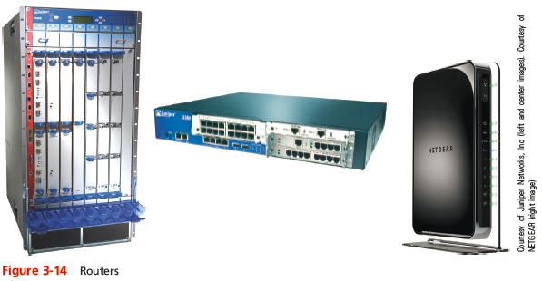
Routers and How They Work
Notes:
Routers and How They Work

Slide 26
Routers and How They Work
Routers may perform any of the following optional functions:
Filter broadcast transmissions
Prevent certain types of traffic from getting to a network
Support simultaneous local and remote connectivity
Provide high network fault tolerance through redundant components such as power supplies
Monitor network traffic and report statistics
Diagnose internal or other connectivity problems and trigger alarms
Notes:
Routers and How They Work
Routers may perform any of the following optional functions:
Filter broadcast transmissions
Prevent certain types of traffic from getting to a network
Support simultaneous local and remote connectivity
Provide high network fault tolerance through redundant components such as power supplies
Monitor network traffic and report statistics
Diagnose internal or other connectivity problems and trigger alarms

Slide 27
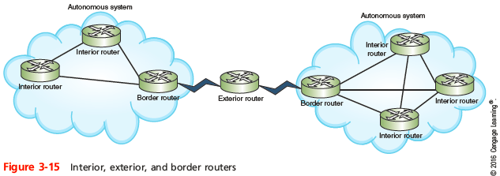
Routers and How They Work
Router categories:
Interior routers - direct data between networks within the same autonomous system
Border routers - connect an autonomous system with an outside network
Exterior routers - direct data between autonomous systems
Notes:
Routers and How They Work
Router categories:
Interior routers - direct data between networks within the same autonomous system
Border routers - connect an autonomous system with an outside network
Exterior routers - direct data between autonomous systems

Slide 28
Multilayer Switches
Layer 3 switch - capable of interpreting Layer 3 data and works much like a router
Primary difference is the way the hardware is built and they are faster and less expensive than routers
Layer 4 switch - capable of interpreting Layer 4 data
Also known as content or application switches
Enables switch to perform advanced filtering, keep statistics, and provide security functions
Typically used as part of a network’s backbone
Notes:
Multilayer Switches
Layer 3 switch - capable of interpreting Layer 3 data and works much like a router
Primary difference is the way the hardware is built and they are faster and less expensive than routers
Layer 4 switch - capable of interpreting Layer 4 data
Also known as content or application switches
Enables switch to perform advanced filtering, keep statistics, and provide security functions
Typically used as part of a network’s backbone

Slide 29
Routing Tables
Routing table - a database that maintains information about where hosts are located and the most efficient way to reach them
Routers rely on them to identify which router is the next hop to reach a particular destination host
Routing tables contain IP addresses and network masks that identify a network that a host or another router belongs to
Notes:
Routing Tables
Routing table - a database that maintains information about where hosts are located and the most efficient way to reach them
Routers rely on them to identify which router is the next hop to reach a particular destination host
Routing tables contain IP addresses and network masks that identify a network that a host or another router belongs to

Slide 30
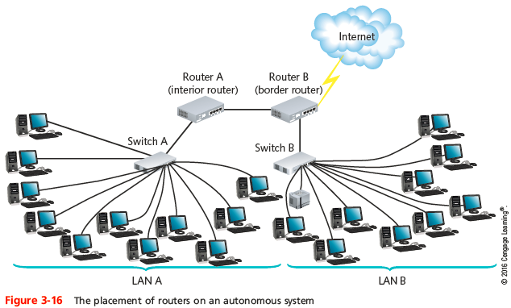
Routing Tables
Notes:
Routing Tables

Slide 31
Static or Dynamic Routing
Static routing - network administrators configures a routing table to direct messages along specific paths
Example - a static route between a small business and its ISP
Dynamic routing - automatically calculates the best path between two networks and maintains this information in a routing table
Router can detect problems with failed or congested routes and reroute messages through a different path
Gateway of last resort - a router that accepts all unroutable messages from other routers
Notes:
Static or Dynamic Routing
Static routing - network administrators configures a routing table to direct messages along specific paths
Example - a static route between a small business and its ISP
Dynamic routing - automatically calculates the best path between two networks and maintains this information in a routing table
Router can detect problems with failed or congested routes and reroute messages through a different path
Gateway of last resort - a router that accepts all unroutable messages from other routers

Slide 32
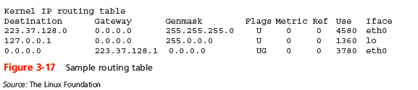
The route Command
The route command allows you to view a host’s routing table
On a Windows-based system, use the command route print
On a Cisco-brand router, use the command show ip route
Notes:
The route Command
The route command allows you to view a host’s routing table
On a Windows-based system, use the command route print
On a Cisco-brand router, use the command show ip route

Slide 33
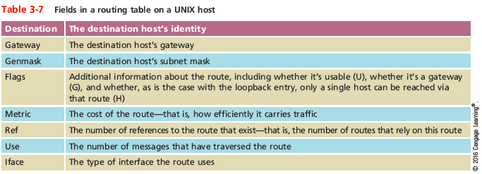
The route Command
Notes:
The route Command

Slide 34
Routing Metrics
Routing metrics - properties of a route used by routers to determine the best path to a destination:
Hop count
Theoretical bandwidth and actual throughput
Delay, or latency, on a potential path
Load, or the traffic or processing burden
MTU (maximum transmission unit), or the largest IP packet size in bytes allowable without fragmentation
Routing cost, or a value assigned to a particular route
Reliability of a potential path
Topology of a network
Notes:
Routing Metrics
Routing metrics - properties of a route used by routers to determine the best path to a destination:
Hop count
Theoretical bandwidth and actual throughput
Delay, or latency, on a potential path
Load, or the traffic or processing burden
MTU (maximum transmission unit), or the largest IP packet size in bytes allowable without fragmentation
Routing cost, or a value assigned to a particular route
Reliability of a potential path
Topology of a network

Slide 35
Routing Protocols
Routing protocols - used by routers to communicate with each other to determine the best path
Routers rate the reliability and priority of a routing protocol’s data based on these criteria:
Administrative distance (AD) - a number indicating the protocol’s reliability
Convergence time - time it takes to recognize a best path in the event of a change or network outage
Overhead - the burden placed on the underlying network to support the protocol
Notes:
Routing Protocols
Routing protocols - used by routers to communicate with each other to determine the best path
Routers rate the reliability and priority of a routing protocol’s data based on these criteria:
Administrative distance (AD) - a number indicating the protocol’s reliability
Convergence time - time it takes to recognize a best path in the event of a change or network outage
Overhead - the burden placed on the underlying network to support the protocol

Slide 36
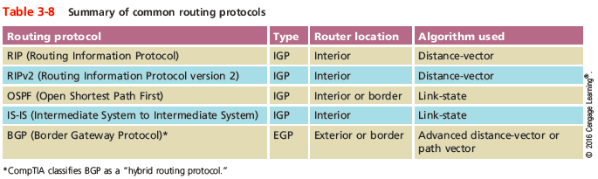
Routing Protocols
Notes:
Routing Protocols

Slide 37
Interior and Exterior Gateway Routing Protocols
IGP (interior gateway protocols) - used by interior routers and border routers within autonomous systems and are often grouped according to the algorithms they use to calculate best paths:
Distance-vector routing protocols
Link-state routing protocols
EGP (exterior gateway protocols) - used by border routers and exterior routers to distribute data outside of autonomous systems
The only EGP currently in use is BGP
Notes:
Interior and Exterior Gateway Routing Protocols
IGP (interior gateway protocols) - used by interior routers and border routers within autonomous systems and are often grouped according to the algorithms they use to calculate best paths:
Distance-vector routing protocols
Link-state routing protocols
EGP (exterior gateway protocols) - used by border routers and exterior routers to distribute data outside of autonomous systems
The only EGP currently in use is BGP

Slide 38
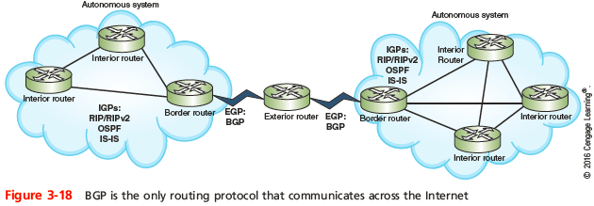
Interior and Exterior Gateway Routing Protocols
Notes:
Interior and Exterior Gateway Routing Protocols

Slide 39
Interior and Exterior Gateway Routing Protocols
OSPF (Open Shortest Path First) - an IGP and a link-state protocol used on interior or border routers
Introduced as an improvement to RIP
Imposes no hop limits (unlike RIP)
Uses a more complex algorithm for determining best paths
Demands more memory and CPU power than RIP, but keeps network bandwidth to a minimum and provides a very fast convergence time
Notes:
Interior and Exterior Gateway Routing Protocols
OSPF (Open Shortest Path First) - an IGP and a link-state protocol used on interior or border routers
Introduced as an improvement to RIP
Imposes no hop limits (unlike RIP)
Uses a more complex algorithm for determining best paths
Demands more memory and CPU power than RIP, but keeps network bandwidth to a minimum and provides a very fast convergence time

Slide 40
Interior and Exterior Gateway Routing Protocols
IS-IS (Intermediate System to Intermediate System) - an IGP and link-state routing protocol
Uses a best-path algorithm similar to OSPF’s
Is designed for use on interior routers only (unlike OSPF)
Not handcuffed to IPv4 (like OSPF) so it’s easy to adapt to IPv6
Service providers generally prefer IS-IS because it’s more scalable than OSPF
Notes:
Interior and Exterior Gateway Routing Protocols
IS-IS (Intermediate System to Intermediate System) - an IGP and link-state routing protocol
Uses a best-path algorithm similar to OSPF’s
Is designed for use on interior routers only (unlike OSPF)
Not handcuffed to IPv4 (like OSPF) so it’s easy to adapt to IPv6
Service providers generally prefer IS-IS because it’s more scalable than OSPF

Slide 41
Interior and Exterior Gateway Routing Protocols
BGP (Border Gateway Protocol) - the only current EGP and is known as the “protocol of the Internet”
Can span multiple autonomous systems
A path-vector routing protocol that communicates via BGP-specific messages that travel between routers
Can be configured to follow policies that might avoid a certain router or instruct a group of routers to prefer a particular route
The most complex of the routing protocols
Uses an autonomous system number (ASN) to identify networks
Notes:
Interior and Exterior Gateway Routing Protocols
BGP (Border Gateway Protocol) - the only current EGP and is known as the “protocol of the Internet”
Can span multiple autonomous systems
A path-vector routing protocol that communicates via BGP-specific messages that travel between routers
Can be configured to follow policies that might avoid a certain router or instruct a group of routers to prefer a particular route
The most complex of the routing protocols
Uses an autonomous system number (ASN) to identify networks

Slide 42
Summary
TCP is an OSI Transport layer, connection-oriented protocol that provides reliability through checksum, flow control, and sequencing information
UDP is a Transport layer and connectionless protocol that provides no delivery guarantees
IP operates at the Network layer of the OSI model
ARP operates at the Data Link layer and obtains the MAC address of a host
ICMP is a Network layer core protocol that reports on the success or failure of data delivery
Notes:
Summary
TCP is an OSI Transport layer, connection-oriented protocol that provides reliability through checksum, flow control, and sequencing information
UDP is a Transport layer and connectionless protocol that provides no delivery guarantees
IP operates at the Network layer of the OSI model
ARP operates at the Data Link layer and obtains the MAC address of a host
ICMP is a Network layer core protocol that reports on the success or failure of data delivery

Slide 43
Summary
A router is a multiport device that can connect dissimilar LANs and WANs running at different transmission speeds, using a variety of protocols
Static routing is when a network administrator programs a router to use specific paths between nodes
To determine best path, routers communicate with each other through routing protocols
Routing metrics may factor in the number of hops between nodes, throughput, delay, MTU, cost, load, and reliability
Notes:
Summary
A router is a multiport device that can connect dissimilar LANs and WANs running at different transmission speeds, using a variety of protocols
Static routing is when a network administrator programs a router to use specific paths between nodes
To determine best path, routers communicate with each other through routing protocols
Routing metrics may factor in the number of hops between nodes, throughput, delay, MTU, cost, load, and reliability

Slide 44
Summary
RIP, a distance-vector routing protocol, is the slowest and least secure routing protocol
OSPF is a link-state routing protocol used on interior or border routers
IS-IS uses virtually the same methods as OSPF to calculate paths but is less common
BGP uses the most complex best-path calculation of all commonly used routing protocols
Notes:
Summary
RIP, a distance-vector routing protocol, is the slowest and least secure routing protocol
OSPF is a link-state routing protocol used on interior or border routers
IS-IS uses virtually the same methods as OSPF to calculate paths but is less common
BGP uses the most complex best-path calculation of all commonly used routing protocols
The netstat utility displays TCP/IP statistics and the state of current TCP/IP components

