Slide 1
How Data Is Transported Over Networks Part2 Troubleshooting Router Issues
Notes:
Troubleshooting Router Issues
TCP/IP comes with a set of utilities that can help track down most TCP/IP related problems
You should be familiar with the following tools and their parameters:
netstat
nbtstat
tracert or traceroute
pathping

Slide 2
Troubleshooting Router Issues
TCP/IP comes with a set of utilities that can help track down most TCP/IP related problems
You should be familiar with the following tools and their parameters:
netstat
nbtstat
tracert or traceroute
pathping
Notes:
Troubleshooting Router Issues
TCP/IP comes with a set of utilities that can help track down most TCP/IP related problems
You should be familiar with the following tools and their parameters:
netstat
nbtstat
tracert or traceroute
pathping

Slide 3
Troubleshooting Tools
netstat - displays TCP/IP statistics and details about TCP/IP components/connections on a host
Information that can be obtained from the netstat command includes:
The port on which a particular TCP/IP service is running
Which network connections are currently established for a client
How many messages have been handled by a network interface since it was activated
How many data errors have occurred on a particular network interface
Notes:
Troubleshooting Tools
netstat - displays TCP/IP statistics and details about TCP/IP components/connections on a host
Information that can be obtained from the netstat command includes:
The port on which a particular TCP/IP service is running
Which network connections are currently established for a client
How many messages have been handled by a network interface since it was activated
How many data errors have occurred on a particular network interface

Slide 4
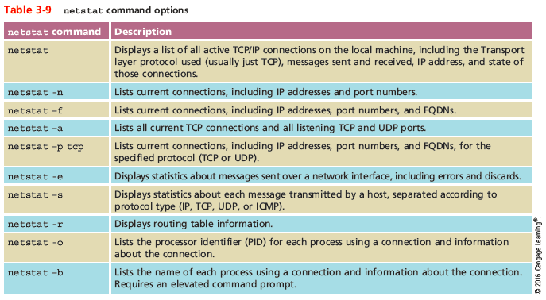
Troubleshooting Tools
Notes:
Troubleshooting Tools

Slide 5
Troubleshooting Tools
nbtstat - provides information about NetBIOS statistics and resolve NetBIOS names to their IP addresses
If you know the NetBIOS name of a workstation, you can use nbtstat to determine its IP address
NetBIOS is a Windows protocol that was once an alternative to TCP/IP
Mostly used by legacy applications
Notes:
Troubleshooting Tools
nbtstat - provides information about NetBIOS statistics and resolve NetBIOS names to their IP addresses
If you know the NetBIOS name of a workstation, you can use nbtstat to determine its IP address
NetBIOS is a Windows protocol that was once an alternative to TCP/IP
Mostly used by legacy applications

Slide 6
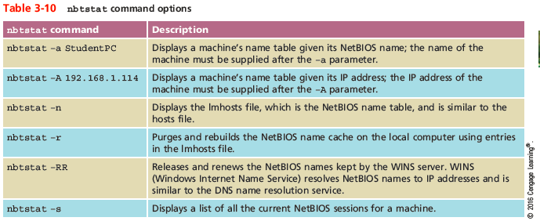
Troubleshooting Tools
Notes:
Troubleshooting Tools

Slide 7
Troubleshooting Tools
tracert or traceroute -
Windows tracert utility uses ICMP echo requests to trace the path from one networked node to another, identifying all intermediate hops between the nodes
Linux, UNIX, and OS X system use the traceroute utility to send UDP messages to a random port on the destination node (concept is the same as tracert)
Both utilities employ a trial-and-error approach to discover the nodes at each hop from source to destination
Notes:
Troubleshooting Tools
tracert or traceroute -
Windows tracert utility uses ICMP echo requests to trace the path from one networked node to another, identifying all intermediate hops between the nodes
Linux, UNIX, and OS X system use the traceroute utility to send UDP messages to a random port on the destination node (concept is the same as tracert)
Both utilities employ a trial-and-error approach to discover the nodes at each hop from source to destination

Slide 8
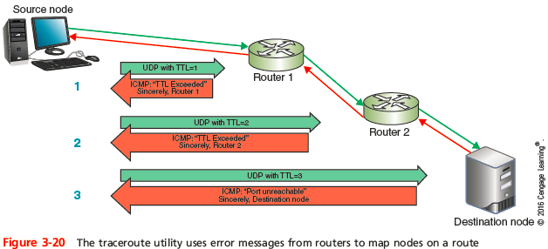
Troubleshooting Tools
Notes:
Troubleshooting Tools

Slide 9
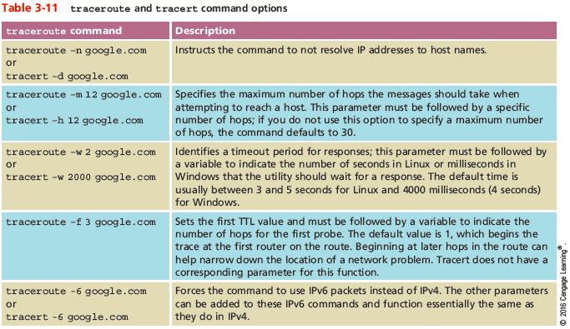
Troubleshooting Tools
Notes:
Troubleshooting Tools

Slide 10
Troubleshooting Tools
tracert or traceroute (cont’d) -
A trace test might stop before reaching the destination for one of three reasons:
The device the trace is attempting to reach is down
It’s too busy to process lower-priority messages such as UDP or ICMP
It does not accept the UDP or ICMP transmissions being sent because a firewall blocks these types of messages
A trace cannot detect router configuration problems or predict variations of routes over a period of time
Notes:
Troubleshooting Tools
tracert or traceroute (cont’d) -
A trace test might stop before reaching the destination for one of three reasons:
The device the trace is attempting to reach is down
It’s too busy to process lower-priority messages such as UDP or ICMP
It does not accept the UDP or ICMP transmissions being sent because a firewall blocks these types of messages
A trace cannot detect router configuration problems or predict variations of routes over a period of time

Slide 11
Troubleshooting Tools
pathping - a Windows utility that combines elements of both ping and tracert to provide deeper information about network issues along a route
Sends multiple pings to each hope along a route, then compiles information into a single report
A disadvantage of pathping is the amount of time it takes to run
Shorten running type by limiting the number of queries per hop with the -q parameter
Notes:
Troubleshooting Tools
pathping - a Windows utility that combines elements of both ping and tracert to provide deeper information about network issues along a route
Sends multiple pings to each hope along a route, then compiles information into a single report
A disadvantage of pathping is the amount of time it takes to run
Shorten running type by limiting the number of queries per hop with the -q parameter

Slide 12
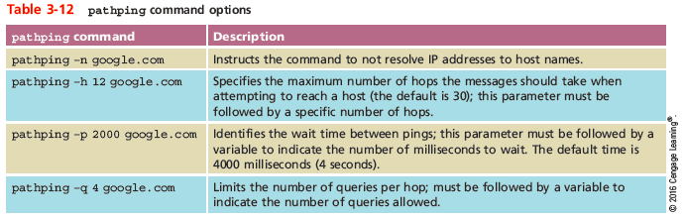
Troubleshooting Tools
Notes:
Troubleshooting Tools

Slide 13
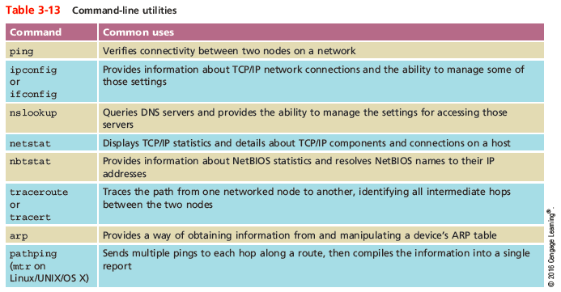
Solving Common Routing Problems
Notes:
Solving Common Routing Problems

Slide 14
Solving Common Routing Problems
Interface Errors - occur when a logical (not physical) connection between a node and a network is malfunctioning
Two important guidelines when dealing with this problem:
The ping command is a great place to start
The netstat command can give you a list of interfaces on a device, and then can be used to troubleshoot network interface errors
Notes:
Solving Common Routing Problems
Interface Errors - occur when a logical (not physical) connection between a node and a network is malfunctioning
Two important guidelines when dealing with this problem:
The ping command is a great place to start
The netstat command can give you a list of interfaces on a device, and then can be used to troubleshoot network interface errors

Slide 15
Solving Common Routing Problems
Hardware Failure - when a router, switch, NIC, or other hardware goes down
Use tracert or traceroute to track down malfunctioning routers and other devices on larger networks
Get more accurate trace feedback on a questionable router by targeting a node on the other side of that router, rather than aiming for that router itself
Notes:
Solving Common Routing Problems
Hardware Failure - when a router, switch, NIC, or other hardware goes down
Use tracert or traceroute to track down malfunctioning routers and other devices on larger networks
Get more accurate trace feedback on a questionable router by targeting a node on the other side of that router, rather than aiming for that router itself

Slide 16
Solving Common Routing Problems
Discovering Neighbor Devices - a process used by routers to learn about all of the devices on their networks
On IPv4 networks, neighbor discovery is managed by ARP with help from ICMP
IPv6 devices use Neighbor Discovery Protocol (NDP) to automatically detect neighboring devices and automatically adjust when neighboring nodes fail or are removed
Eliminates the need for ARP and ICMP functions in IPv6 networks
Notes:
Solving Common Routing Problems
Discovering Neighbor Devices - a process used by routers to learn about all of the devices on their networks
On IPv4 networks, neighbor discovery is managed by ARP with help from ICMP
IPv6 devices use Neighbor Discovery Protocol (NDP) to automatically detect neighboring devices and automatically adjust when neighboring nodes fail or are removed
Eliminates the need for ARP and ICMP functions in IPv6 networks

Slide 17
Solving Common Routing Problems
Path MTU Black Hole - messages are being lost for no apparent reason
If suspected, use the ping command to determine the largest size message that can successfully traverse a path to its destination
Adjust the buffer size of the ICMP echo message
Start with a smaller buffer and work your way up to determine the largest MTU the route can handle
Notes:
Solving Common Routing Problems
Path MTU Black Hole - messages are being lost for no apparent reason
If suspected, use the ping command to determine the largest size message that can successfully traverse a path to its destination
Adjust the buffer size of the ICMP echo message
Start with a smaller buffer and work your way up to determine the largest MTU the route can handle

Slide 18
Solving Common Routing Problems
Missing IP Routes - certain routes must be statically routed, such as gateway of last resort, routes to networks directly connected to the local network
Sometimes these routes can become corrupted, outdated, or lost from the routing table
Use the netstat -r command to display routing table
Check that IP addresses are configured correctly for all interfaces
Confirm that none of the affected routers are in passive-interface mode
Notes:
Solving Common Routing Problems
Missing IP Routes - certain routes must be statically routed, such as gateway of last resort, routes to networks directly connected to the local network
Sometimes these routes can become corrupted, outdated, or lost from the routing table
Use the netstat -r command to display routing table
Check that IP addresses are configured correctly for all interfaces
Confirm that none of the affected routers are in passive-interface mode

Slide 19
Summary
A router is a multiport device that can connect dissimilar LANs and WANs running at different transmission speeds, using a variety of protocols
Static routing is when a network administrator programs a router to use specific paths between nodes
To determine best path, routers communicate with each other through routing protocols
Routing metrics may factor in the number of hops between nodes, throughput, delay, MTU, cost, load, and reliability
Notes:
Summary
A router is a multiport device that can connect dissimilar LANs and WANs running at different transmission speeds, using a variety of protocols
Static routing is when a network administrator programs a router to use specific paths between nodes
To determine best path, routers communicate with each other through routing protocols
Routing metrics may factor in the number of hops between nodes, throughput, delay, MTU, cost, load, and reliability

Slide 20
Summary
RIP, a distance-vector routing protocol, is the slowest and least secure routing protocol
OSPF is a link-state routing protocol used on interior or border routers
IS-IS uses virtually the same methods as OSPF to calculate paths but is less common
BGP uses the most complex best-path calculation of all commonly used routing protocols
The netstat utility displays TCP/IP statistics and the state of current TCP/IP components
Notes:
Summary
RIP, a distance-vector routing protocol, is the slowest and least secure routing protocol
OSPF is a link-state routing protocol used on interior or border routers
IS-IS uses virtually the same methods as OSPF to calculate paths but is less common
BGP uses the most complex best-path calculation of all commonly used routing protocols
The netstat utility displays TCP/IP statistics and the state of current TCP/IP components

Slide 21
Summary
The nbtstat utility provides information about NetBIOS names and their addresses
The traceroute utility, known as tracert on Windows-based system, uses ICMP to trace the path from one networked node to another
The route command allows you to view a host’s routing table and add, delete, or modify preferred routes
Notes:
Summary
The nbtstat utility provides information about NetBIOS names and their addresses
The traceroute utility, known as tracert on Windows-based system, uses ICMP to trace the path from one networked node to another
The route command allows you to view a host’s routing table and add, delete, or modify preferred routes

