Slide 1
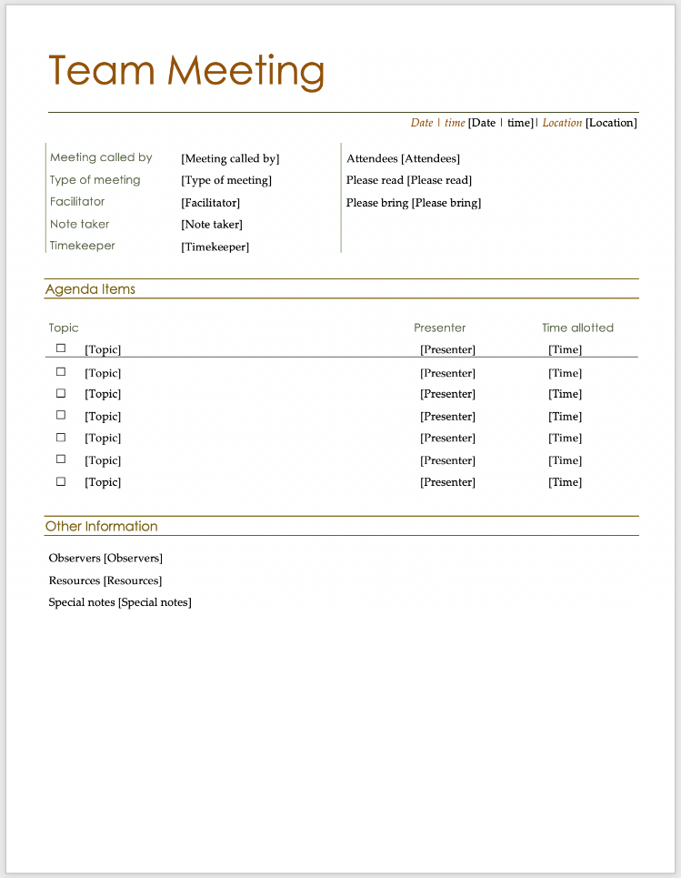
Agendas and minutes
Agenda
What is planned for the meeting
Minutes
What happened during the meeting
Notes:
Clearly, we need to organize ourselves if we are going to have fruitful meetings.
Any time you meet as a team it is important to have an agenda. Here is a typical agenda template or form. This one is from Microsoft, but there are literally thousands out there that you can use. If you go into Word, select New, and then search for agenda in the search box, you can find several templates for an agenda.
As you can see there are slots for various topics, with presenter names and suggested amounts of time for each topic. There are also fields for date, time and attendance. You can change this as you wish, and make the agenda more or less formal, as you wish. What is important, is that everyone knows what to expect BEFORE the meeting starts. No surprises.
The first item on an agenda is always, Approval of the agenda. You need to all agree what you are going to be talking about during the meeting. This is the time for members of the group to bring up new things they would like to be discussed during the meeting. Once everyone agrees on the agenda, the meeting can start.
While the meeting goes on, someone should be taking notes. These notes then become the minutes of the meeting, and as such are the team’s memory. By recording all the decisions, as well as who committed to doing what, there will be a record that can be accessed in the future in the case of disputes, or if a new person joins the team.
This is an example of minutes, which is on Léa. Actually, what is on Léa is an example Team Logbook. That document contains all the minutes of all the Team Meetings. Again start with a template: Google, Microsoft…
Take meeting minutes with concrete action items. Keep track of who is responsible for each specific task.

Slide 2
Clearly, we need to organize ourselves if we are going to have fruitful meetings.
Any time you meet as a team it is important to have an agenda. Here is a typical agenda template or form. This one is from Microsoft, but there are literally thousands out there that you can use. If you go into Word, select New, and then search for agenda in the search box, you can find several templates for an agenda.

Slide 3
As you can see there are slots for various topics, with presenter names and suggested amounts of time for each topic. There are also fields for date, time and attendance. You can change this as you wish, and make the agenda more or less formal, as you wish. What is important, is that everyone knows what to expect BEFORE the meeting starts. No surprises.
The first item on an agenda is always, Approval of the agenda. You need to all agree what you are going to be talking about during the meeting. This is the time for members of the group to bring up new things they would like to be discussed during the meeting. Once everyone agrees on the agenda, the meeting can start.

Slide 4
Communication & Meetings
Listen to all with concentration
See the value in every idea
Encourage discussion, debate, and diversity of ideas
Make sure everyone contributes
Share leadership responsibilities
Notes:
After you have agreed on the agenda, as I said, the meeting can start. Every time there is a group discussion, and especially during team meetings, it is important to have a chairperson for the period of discussion. In the teams in this course, that person will be the Team Leader. Their primary role during the discussions, or consultations, is to keep the discussion going, following in an ordered and orderly manner.
As you discuss the various items on the agenda, you will go through a process called consultation. This process requires a certain maturity and discipline. As individuals you must listen to what your teammates are saying with concentration. When you speak, it should be to express ideas, and not comments about individuals. This is not simply a conversation amongst friends; it is a structured discussion amongst professionals who respect each other and who value each other’s contributions. Do not prejudge any one’s contributions – we have a tendency to look at someone and say, “She always has good marks, and has good ideas, so whatever she says must be what we should do.” It may be that in this case, there are other options that might be better. Criticize the ideas, not the person. Try to see the value on every idea that is put forward. As you talk back and forth remember to concentrate on the idea, not the person expressing it. It is good to refer to ideas by what they are, not by who stated it; e.g., say, “the idea to meet every Wednesday makes sense since we all have free time then” rather than, “John’s idea about meeting on Wednesday is a good one.”
It is essential that everyone has an opportunity to express themselves. This is where the chairperson, sometimes called an animator, can play an important role. Some people are more willing to speak in a group than others, especially when they do not know each other very well. The chair should encourage those who have not spoken to express their opinion. Very often it is the person sitting quietly, perhaps taking notes, that makes a suggestion that no one else has thought of. If they area not encouraged to participate, that idea may be lost. Similarly, no individual should be allowed to dominate the meeting. The chair could gently remind them that ALL ideas are welcome. If the person dominating is the chair, or if the chair does not do this, then any member of the discussion should gently mention it.
I am also ensuring that each of you will have an opportunity to be the Team Leader by changing the leadership with each deliverable.

Slide 5
After you have agreed on the agenda, the meeting can start. Every time there is a group discussion, and especially during team meetings, it is important to have a chairperson for the period of discussion

Slide 6
In the teams in this course, that person will be the Team Leader. Their primary role during the discussions, or consultations, is to keep the discussion going, following in an ordered and orderly manner.

Slide 7
It is essential that everyone has an opportunity to express themselves. This is where the chairperson, sometimes called an animator, can play an important role. Some people are more willing to speak in a group than others, especially when they do not know each other very well. The chair should encourage those who have not spoken to express their opinion.

Slide 8
Very often it is the person sitting quietly, perhaps taking notes, that makes a suggestion that no one else has thought of. If they area not encouraged to participate, that idea may be lost. Similarly, no individual should be allowed to dominate the meeting.
The chair could gently remind them that ALL ideas are welcome. If the person dominating is the chair, or if the chair does not do this, then any member of the discussion should gently mention it.

Slide 9
I am also ensuring that each of you will have an opportunity to be the Team Leader by changing the leadership with each deliverable.

Slide 10
As you discuss the various items on the agenda, you will go through a process called consultation. This process requires a certain maturity and discipline. As individuals you must listen to what your teammates are saying with concentration.

Slide 11
When you speak, it should be to express ideas, and not comments about individuals. This is not simply a conversation amongst friends; it is a structured discussion amongst professionals who respect each other and who value each other’s contributions

Slide 12
Do not prejudge any one’s contributions – we have a tendency to look at someone and say, “She always has good marks, and has good ideas, so whatever she says must be what we should do.” It may be that in this case, there are other options that might be better. Criticize the ideas, not the person. Try to see the value on every idea that is put forward.

Slide 13
As you talk back and forth remember to concentrate on the idea, not the person expressing it. It is good to refer to ideas by what they are, not by who stated it; e.g., say, “the idea to meet every Wednesday makes sense since we all have free time then” rather than, “John’s idea about meeting on Wednesday is a good one.”

Slide 14
Communication & Meetings
Don’t make assumptions
Ask questions to clarify
When in doubt, communicate
Be sensitive to possible cultural and gender differences in team interactions.
Develop a shared understanding
Make sure there is consensus, then act
Decisions taken are those of the group – all must support them!
Notes:
As you talk about the various agenda items make sure you understand what your teammates are saying. Don’t make assumptions. Ask questions to clarify. Sometimes it is helpful to say, “As I understand it, you are suggesting that ...”. If you are correct, then you will get positive feedback. If not, then the other person should explain further until you have a shared understanding. You may still disagree with the idea, but at least you will have agreed on what it is you are talking about.
The teams in this course are a good reflection of the kinds of teams you will find in industry and in many companies in that they are divers. There are many different cultures represented in our class, and as a result it is important to be sensitive to cultural and gender differences among your teammates. If you listen attentively you will be less likely to misunderstand someone, and through your own ignorance, possibly injure them, or insult them.
What you are trying to do is to develop a shared understanding – first of the problem you are trying to solve, and then of the solution, or path to a solution. As you talk about the possible solutions, you will start to narrow down until you come to one or two possible ways forward. If you have only one idea, then that means there is consensus, and everyone agrees about how to proceed.
But what if there are two seemingly viable options? Then, if everyone has expressed their opinion, and it seems that more discussion will not result in a consensus, you should proceed to a vote amongst yourselves. If there is a majority, then that approach is undertaken. If there is a tie, then that is an indication that the matter has not been thoroughly researched enough. Come back to the question at the next meeting, after everyone has had a chance to examine the subject themselves. The truth will be made clear.
Once a decision has been taken by the group everyone must abide by it. That is, there should not be any grumbling or halfhearted support. This is crucial. Why?
Imagine that the group is split between deciding to use Ruby on Rails and C# to do the implementation. So, at a certain moment, when the time has come to start coding the implementation, both groups start writing code. Of course, it wont work, because the integration of the various components will be difficult, if not impossible. On the other hand, if everyone starts working in C# and then we find that the implementation is not working, then we know that we made the wrong choice, and we can now concentrate our efforts on the other option. I have seen this happen several times in the past. Make a decision, have everyone support it, and then the truth and validity of that decision will become clear.
Remember: Everyone must support the decisions of the group.

Slide 15
As you talk about the various agenda items make sure you understand what your teammates are saying. Don’t make assumptions. Ask questions to clarify. Sometimes it is helpful to say, “As I understand it, you are suggesting that ...”. If you are correct, then you will get positive feedback. If not, then the other person should explain further until you have a shared understanding. You may still disagree with the idea, but at least you will have agreed on what it is you are talking about.

Slide 16
The teams in this course are a good reflection of the kinds of teams you will find in industry and in many companies in that they are divers. There are many different cultures represented in our class, and as a result it is important to be sensitive to cultural and gender differences among your teammates. If you listen attentively you will be less likely to misunderstand someone, and through your own ignorance, possibly injure them, or insult them.

Slide 17
What you are trying to do is to develop a shared understanding – first of the problem you are trying to solve, and then of the solution, or path to a solution. As you talk about the possible solutions, you will start to narrow down until you come to one or two possible ways forward. If you have only one idea, then that means there is consensus, and everyone agrees about how to proceed.

Slide 18
But what if there are two seemingly viable options? Then, if everyone has expressed their opinion, and it seems that more discussion will not result in a consensus, you should proceed to a vote amongst yourselves. If there is a majority, then that approach is undertaken.

Slide 19
If there is a tie, then that is an indication that the matter has not been thoroughly researched enough. Come back to the question at the next meeting, after everyone has had a chance to examine the subject themselves. The truth will be made clear.

Slide 20
Once a decision has been taken by the group everyone must abide by it. That is, there should not be any grumbling or halfhearted support. This is crucial. Why?

Slide 21
Imagine that the group is split between deciding to use Ruby on Rails and C# to do the implementation. So, at a certain moment, when the time has come to start coding the implementation, both groups start writing code. Of course, it wont work, because the integration of the various components will be difficult, if not impossible.

Slide 22
On the other hand, if everyone starts working in C# and then we find that the implementation is not working, then we know that we made the wrong choice, and we can now concentrate our efforts on the other option. I have seen this happen several times in the past. Make a decision, have everyone support it, and then the truth and validity of that decision will become clear.
Remember: Everyone must support the decisions of the group.

Slide 23
Initial Team Meeting
Set agenda and time limits for the meeting
Get everyone’s commitment to required time
Define an expected average number of hours per week
The course is 2 lecture + 5 lab + 3 homework hours a week = 10 hours a week
Set meeting times outside of class times as well as lab times
Gather dates of planned absences
Notes:
What should you do in your first team meeting?
The team leader should put together the first agenda – It doesn’t matter who produces the first one, since you will all have to agree to it before you start the meeting. And, by the way, at the end of the meeting, make sure you have an idea about what will be on the agenda for the next meeting. You could even have a decision to that effect.
Set some time limits for the meeting – generally try to keep meetings to less than an hour. Working sessions can be much longer, of course.
Remember the amount of time you need to dedicate to this course. Sometimes students complain about how much work is required for this course. The fact is, that the work is not necessarily evenly distributed throughout the semester. There will be weeks where there is less work to do, and weeks where you are going to be working flat out. On average, it all works out. This too reflects what you will encounter in the commercial world.
Decide when you are going to have regular meetings – when is everyone available? When would you have extra meetings? Remember that in most lab times you could also have meetings. Decide what platform you are going to be using – I will be creating sub-teams in Teams for each of your teams. If anyone is going to be absent, make sure you know when, and for how long.

Slide 24
What should you do in your first team meeting?
The team leader should put together the first agenda – It doesn’t matter who produces the first one, since you will all have to agree to it before you start the meeting. And, by the way, at the end of the meeting, make sure you have an idea about what will be on the agenda for the next meeting. You could even have a decision to that effect.

Slide 25
Decide when you are going to have regular meetings – when is everyone available? When would you have extra meetings? Remember that in most lab times you could also have meetings. Decide what platform you are going to be using – I will be creating sub-teams in Teams for each of your teams. If anyone is going to be absent, make sure you know when, and for how long.

Slide 26
Set some time limits for the meeting – generally try to keep meetings to less than an hour. Working sessions can be much longer, of course.

Slide 27
Remember the amount of time you need to dedicate to this course. Sometimes students complain about how much work is required for this course. The fact is, that the work is not necessarily evenly distributed throughout the semester.
There will be weeks where there is less work to do, and weeks where you are going to be working flat out. On average, it all works out. This too reflects what you will encounter in the commercial world.

Slide 28
Initial Team Meeting
Take a realistic census of team skills
Common problem: inflated programming skill claims
Decide how team will communicate.
Establish team standards
Set goals for the next meeting
Notes:
As you are planning out your project, deciding who will be responsible for the different parts of the project, look at the skills inventory that you all filled out. Share it with your colleagues. But beware… we all tend to overestimate how well we do things. That is OK, but you must remember that you are still learning. In this course you will be learning a great deal; often from your colleagues, but also from your own individual research.
Decide how you will communicate with each other. Which platforms are you going to be using? Phone, Discord, Teams, Zoom, email, etc.
Decide how long you before you must answer an asynchronous message – same day? A couple of hours? The next day?
Decide what you will be using to produce documents: Word, Google docs, something else.
Decide on tools for group collaboration and discussion, such as GitHub, a wiki tool, Google tools, but do not use social media, such as Facebook. Facebook is not secure, is a commercial enterprise feeding off of its clients, and not a responsible organization.
Finally, set some goals for the next meeting. These will form the initial agenda for the next meeting.

Slide 29
As you are planning out your project, deciding who will be responsible for the different parts of the project, look at the skills inventory that you all filled out. Share it with your colleagues. But beware… we all tend to overestimate how well we do things.

Slide 30
That is OK, but you must remember that you are still learning. In this course you will be learning a great deal; often from your colleagues, but also from your own individual research.

Slide 31
Decide how you will communicate with each other. Which platforms are you going to be using? Phone, Discord, Teams, Zoom, email, etc.
Decide how long you before you must answer an asynchronous message – same day? A couple of hours? The next day?

Slide 32
Decide what you will be using to produce documents: Word, Google docs, something else.
Decide on tools for group collaboration and discussion, such as GitHub, a wiki tool, Google tools, but do not use social media, such as Facebook. Facebook is not secure, is a commercial enterprise feeding off of its clients, and not a responsible organization.

Slide 33
Finally, set some goals for the next meeting. These will form the initial agenda for the next meeting.

