Slide 1
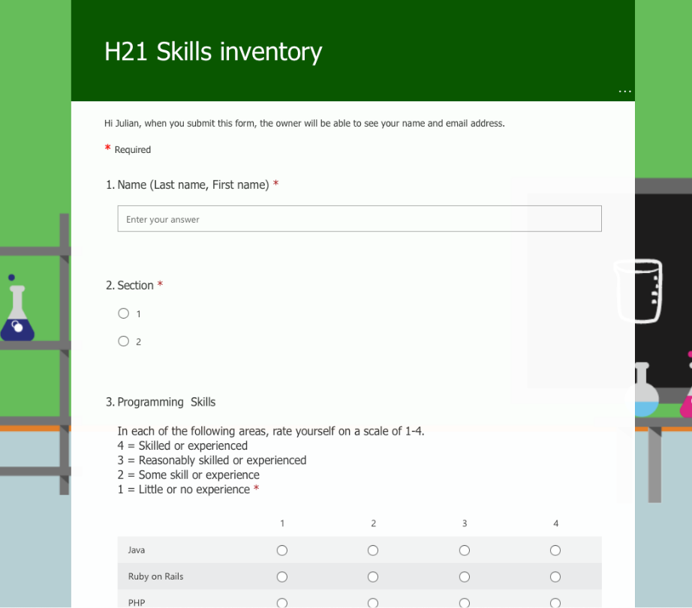
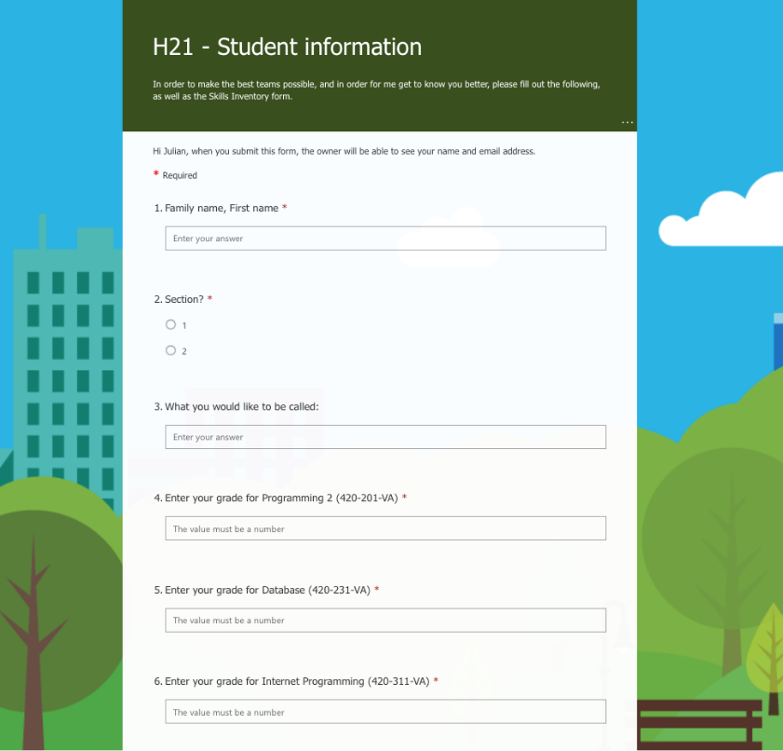
Getting to know you
Notes:
In order for me to get to know you a little I sent you a MIO asking you to fill out a student information form and a skills inventory. If you have not done it already, please do so by this evening. In addition to getting to know you, your answers will help me in putting together the teams you will be on for the remainder of the semester.
Right now, I would like to take attendance. Please turn your camera on now, and when I call your name answer me using your microphone. If you have a problem using either your camera or your microphone, send me a message in Teams – we will sort out the technology later.
-- call the names and record them

Slide 2
In order for me to get to know you a little I sent you a MIO asking you to fill out a student information form and a skills inventory. If you have not done it already, please do so by this evening. In addition to getting to know you, your answers will help me in putting together the teams you will be on for the remainder of the semester.
Right now, I would like to take attendance. Please turn your camera on now, and when I call your name answer me using your microphone. If you have a problem using either your camera or your microphone, send me a message in Teams – we will sort out the technology later.

Slide 3
Overview
Course outline
Schedule
System Development
Team Projects

Slide 4
This week I would like to go over several topics related to how the course is going to work.
First we will go through the course outline.
Then we will take a look at the schedule for the course.
Finally we will start looking at the System Development Team Projects document.
All of these documents, as well as many other useful bits of information, are available on Léa. It might be a good idea for you to get these documents from Léa and have them in front of you as I am talking.

Slide 5

Course outline
Course description planning, developing, and implementing
specification, analysis and design database application, and an appropriate user interface
Students will work in teams
Notes:
Let’s start with the Course Outline. I am not going to read the entire outline with you, but I will point out some highlights. I expect you to read it in detail. It is the contract between you and the College, so it is important that you understand what is expected of you when you start taking each course.
The course description is the official description of the course:
In this course, students study system development, which emphasizes the steps involved in planning, developing, and implementing a business information system including the specification, analysis and design of a database application, and an appropriate user interface. System development topics will include project management together with relevant topics for designing the database application such as information gathering, requirement specification, as well as data modelling and design.

Slide 6
Let’s start with the Course Outline. I am not going to read the entire outline with you, but I will point out some highlights. I expect you to read it in detail. It is the contract between you and the College, so it is important that you understand what is expected of you when you start taking each course.

Slide 7
The course description is the official description of the course:
In this course, students study system development, which emphasizes the steps involved in planning, developing, and implementing a business information system including the specification, analysis and design of a database application, and an appropriate user interface. System development topics will include project management together with relevant topics for designing the database application such as information gathering, requirement specification, as well as data modelling and design.

Slide 8
Course outline
Project team and project planning
Social responsibility
Use Cases and the UML to model an existing information system
Gather requirements using interviews and existing forms and documents
Record requirements in User Stories
Database design and ER diagrams
User interface design
Design and implement prototype of the application
Notes:
The various topics are listed, and we will cover them all. The intent is not to go into a huge amount of detail about each of the topics, but rather to expose you to what you might typically expect when developing an information system in a commercial or business environment.
You will learn about teams, planning and being socially responsible. You will learn about modelling and requirements, as well as database and user interface design. Finally, you will actually implement a prototype of the application.

Slide 9
The various topics are listed, and we will cover them all. The intent is not to go into a huge amount of detail about each of the topics, but rather to expose you to what you might typically expect when developing an information system in a commercial or business environment.
You will learn about teams, planning and being socially responsible. You will learn about modelling and requirements, as well as database and user interface design. Finally, you will actually implement a prototype of the application.

Slide 10
Course outline
Attendance
Competency: 00SY: Collaborate in the design of applications
Evaluation
Individual work:
Quizzes (10) 10%
Assignments (4) 20%
Personal journal 3%
Team leader presentations 1%
LIA Report 16%
Total individual work 50%
Notes:
I will be taking attendance at the start of every class and lab. If you are absent you are still responsible for whatever was covered during the class or lab that you missed. I may ask for a medical note.
In the course outline the section on evaluation is important. These are all the different components of the course and this is how you will be graded. What is most important is that the work that you do will either be considered individual work or teamwork. You need to pass both components of the course in order to pass the course. Failing either component will result in your final grade being the same as your failed component.
Individual work is work you do by yourself: Quizzes held almost every week, four assignments throughout the term, a personal journal about your involvement with the course, brief presentations you will make as a team leader, and the Learning Integration Assessment Report you will write towards the end of the course.

Slide 11
I will be taking attendance at the start of every class and lab. If you are absent you are still responsible for whatever was covered during the class or lab that you missed. I may ask for a medical note.
In the course outline the section on evaluation is important. These are all the different components of the course and this is how you will be graded. What is most important is that the work that you do will either be considered individual work or teamwork. You need to pass both components of the course in order to pass the course. Failing either component will result in your final grade being the same as your failed component.

Slide 12
Individual work is work you do by yourself: Quizzes held almost every week, four assignments throughout the term, a personal journal about your involvement with the course, brief presentations you will make as a team leader, and the Learning Integration Assessment Report you will write towards the end of the course.

Slide 13
Course outline
Teamwork:
Documentation Project mark 35%
Project logbook 1%
LIA Prototype 14%
Total teamwork 50%
Total 100%
Notes:
Teamwork is work you do as a member of your team. This includes the mark you get for the Documentation Project, the Project logbook and the Learning Integration Assessment Prototype, which is the actual implementation of the prototype your team developed for the client.
Together, the individual work and the teamwork marks give you the final grade for the course. As I said, you need to pass both components in order to pass the course.

Slide 14
Teamwork is work you do as a member of your team. This includes the mark you get for the Documentation Project, the Project logbook and the Learning Integration Assessment Prototype, which is the actual implementation of the prototype your team developed for the client.
Together, the individual work and the teamwork marks give you the final grade for the course. As I said, you need to pass both components in order to pass the course.

Slide 15
Course outline
Documentation Project
Deliverable | Value | Due week
1. Project plan | 10% | 4
2. Client, business domain summaries, questionnaire | 10% | 5
3. Analysis - Use cases, UML Diagrams | 15% | 7
4. Requirements - User stories | 15% | 9
5. Prototype User Interface | 15% | 11
6. DB design | 15% | 12
7. Implementation and client comments | 20% | 15
Total | 100%
Notes:
The Documentation Project is broken down into seven deliverables.
Each deliverable contributes to the Documentation Project mark according to the table.
The penalty for a late deliverable is 10% per school day.
Since this is a project course, you will be evaluated on the excellence of your projects and on your contribution to them. Each deliverable will receive a mark. Individual marks will then be calculated for each deliverable taking into account how well each member of the team performed, as determined by peer evaluations by the other members of the team, according to the formula in the course outline.

Slide 16
The Documentation Project is broken down into seven deliverables.
Each deliverable contributes to the Documentation Project mark according to the table.
The penalty for a late deliverable is 10% per school day.

Slide 17
Since this is a project course, you will be evaluated on the excellence of your projects and on your contribution to them. Each deliverable will receive a mark. Individual marks will then be calculated for each deliverable taking into account how well each member of the team performed, as determined by peer evaluations by the other members of the team, according to the formula in the course outline.

Slide 18
Course outline
Learning Integration Assessment
1) the prototype of the application developed in the context of this course and
2) a report about the process of developing this prototype.
Notes:
The LIA consists of 2 components: 1) the prototype of the application developed in the context of this course and 2) a report about the process of developing this prototype.

Slide 19
The LIA consists of 2 components: 1) the prototype of the application developed in the context of this course and
2) a report about the process of developing this prototype.

Slide 20
Course outline
Learning Integration Assessment prototype
Accurate analysis of client requests and requirements
Accurate analysis of the features of the computer equipment and applications
Choice of application development standards, methods, and best practices
Assessment of the software and hardware components to be used
Appropriateness of the design, solution, and implementation techniques
Compliance with application development standards, methods, and best practices
Accurate drafting of unit, integration, functional, or acceptance test plans
Notes:
These are the elements used to evaluate the LIA Prototype implementation.
Details of the prototype implementation are provided in the document, Team Projects, available on Léa.

Slide 21
These are the elements used to evaluate the LIA Prototype implementation.
Details of the prototype implementation are provided in the document, Team Projects, available on Léa.

Slide 22
Course outline
Learning Integration Assessment report
Level of detail in describing the process
Description of challenges and their solutions
Lessons learned
Integration of previous courses and knowledge
Observations about teamwork
Quality of writing
Notes:
These are the elements used to evaluate the LIA Report.
The details of the content and structure of this report are provided in the document, A21 Sys Dev LIA Report.docx, available on Léa.
For further details of the project deliverables, logbooks, and team functioning, see the document, Team Projects, available on Léa.
There is no specific textbook for this course. Chapters of a forthcoming textbook are available on Léa.
The next sections of the Course Outline list bibliographic material the you will find useful, some additional material you will need for this course and important rules of conduct, as well as information about Vanier College’s various policies.

Slide 23
These are the elements used to evaluate the LIA Report.
The details of the content and structure of this report are provided in the document, A21 Sys Dev LIA Report.docx, available on Léa.
For further details of the project deliverables, logbooks, and team functioning, see the document, Team Projects, available on Léa.
There is no specific textbook for this course. Chapters of a forthcoming textbook are available on Léa.

Slide 24
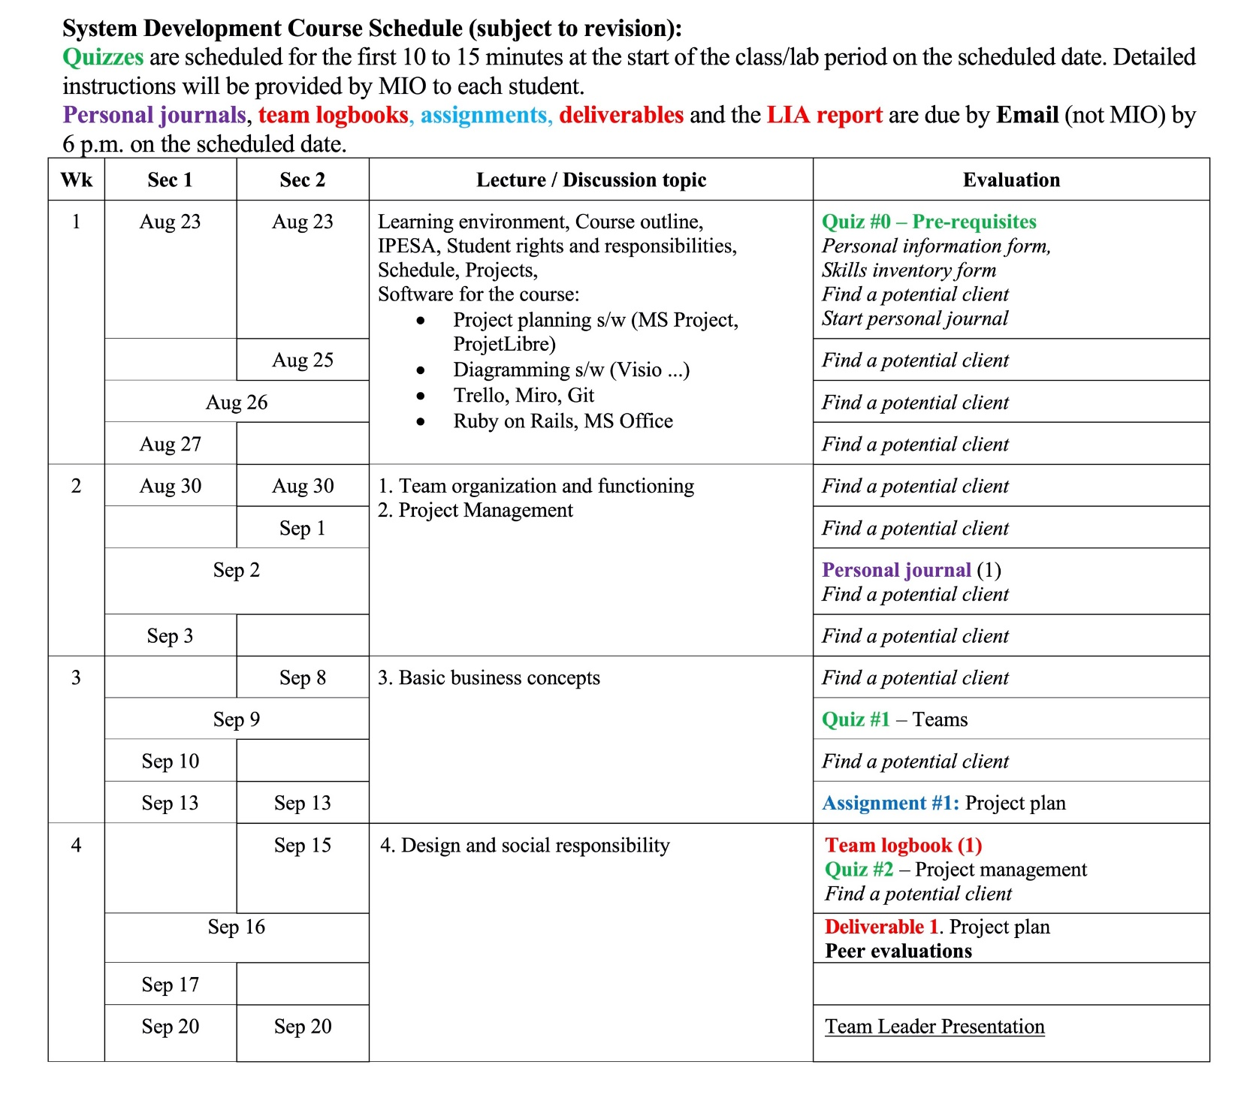
Schedule (subject to revision)
Notes:
The next part of the course outline is a schedule for the course. You need to take a close look at it, and maybe even copy some elements of it into your own personal agenda or calendar.
You can see that there are two sets of dates for the events, depending on which section you are in. The central column lists the topics that will be discussed during the lecture, or sometimes during a lab period. On the right are the various documents you need to produce or tasks you need to do.
For example, you will see that for the first couple of weeks you should be focusing on finding a potential client. We will talk some more about that in a little while in the coming labs and lectures.
On September 2nd you will submit a copy of your personal journal, on September 9th there will be a quiz on the subject of team functioning (not the software), and your first assignment is due on September 13th. Your first deliverable is due on September 16th, along with your peer evaluations.

Slide 25
The next part of the course outline is a schedule for the course. You need to take a close look at it, and maybe even copy some elements of it into your own personal agenda or calendar.
You can see that there are two sets of dates for the events, depending on which section you are in. The central column lists the topics that will be discussed during the lecture, or sometimes during a lab period. On the right are the various documents you need to produce or tasks you need to do.

Slide 26
For example, you will see that for the first couple of weeks you should be focusing on finding a potential client. We will talk some more about that in a little while in the coming labs and lectures.
On September 2nd you will submit a copy of your personal journal, on September 9th there will be a quiz on the subject of team functioning (not the software), and your first assignment is due on September 13th. Your first deliverable is due on September 16th, along with your peer evaluations.

Slide 27
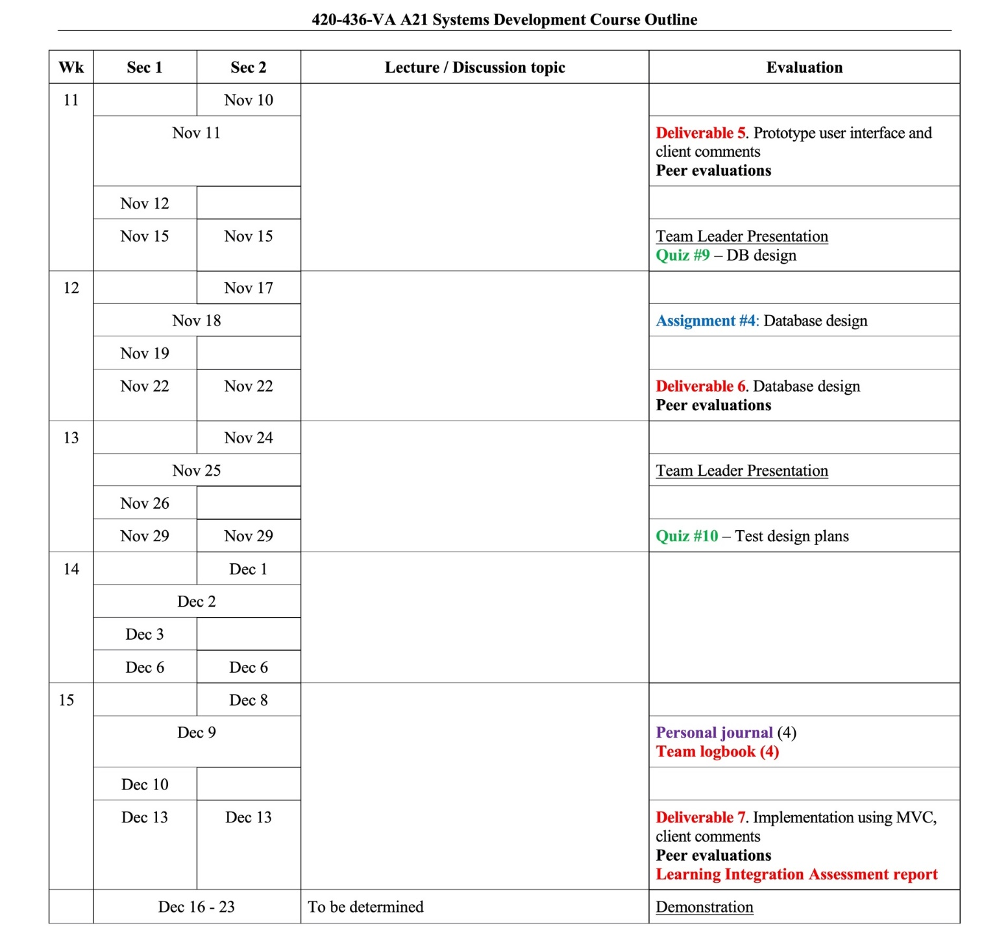
Schedule (subject to revision)
Notes:
Skipping to the end of the course, you will see that the final deliverable and the LIA Report are due on the day of the last class. The demonstration of the implementation will take place during the College’s exam period, and I will let you know the exact date and time once it has been scheduled. Do not make any travel plans for that period until you know when the demonstration is taking place, since you must be present in order to get any marks for it and that part of the LIA.
Questions?
We will now take a look at the System Development Team Projects document.

Slide 28
Skipping to the end of the course, you will see that the final deliverable and the LIA Report are due on the day of the last class. The demonstration of the implementation will take place during the College’s exam period, and I will let you know the exact date and time once it has been scheduled. Do not make any travel plans for that period until you know when the demonstration is taking place, since you must be present in order to get any marks for it and that part of the LIA.
We will now take a look at the System Development Team Projects document.

