Slide 1
Dart3

Slide 2
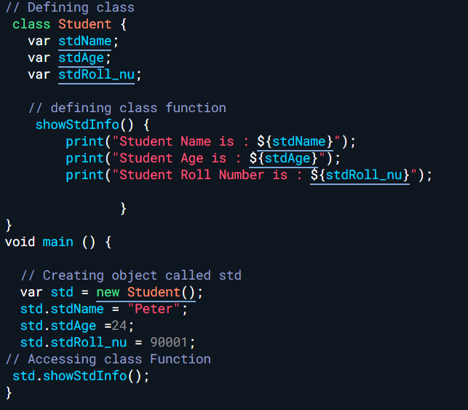
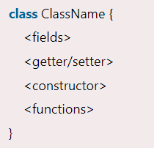
Class and Objects

Slide 3
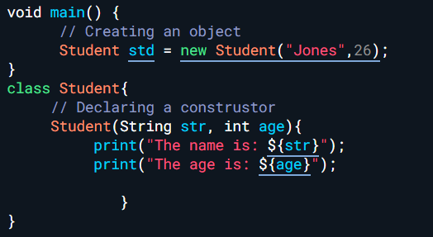
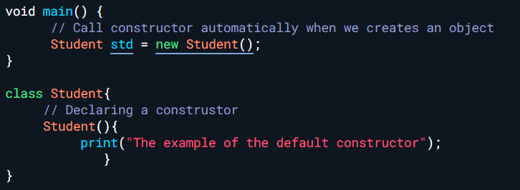
Constructor

Slide 4
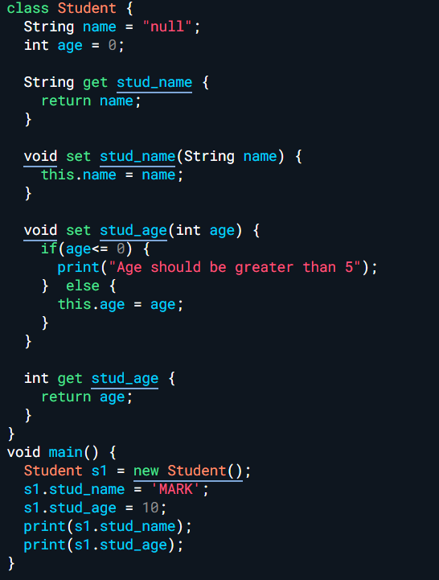

Slide 5
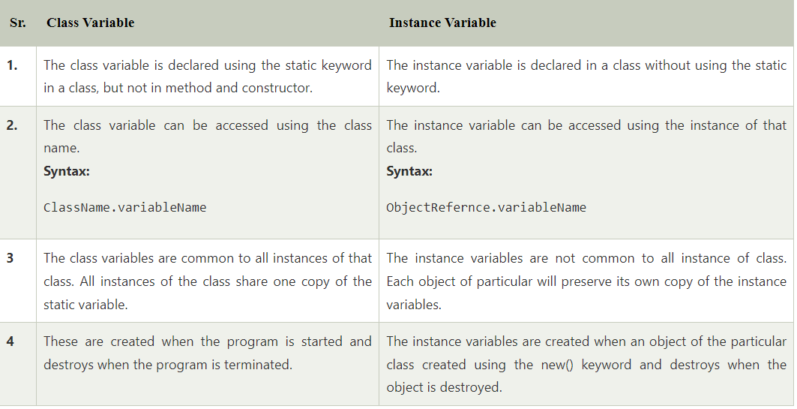
Difference Between Class Variable and Instance Variable

Slide 6
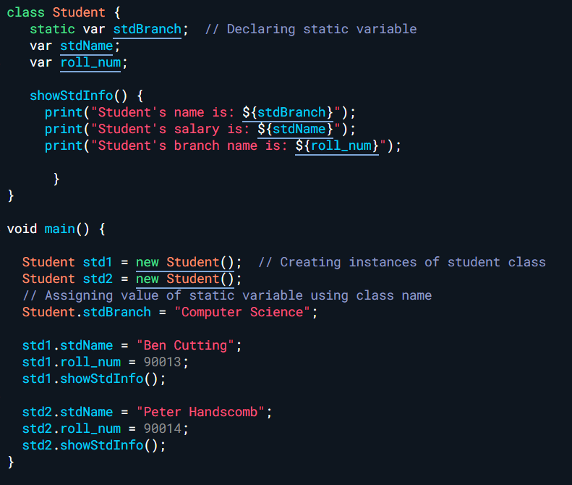
Static keyword

Slide 7
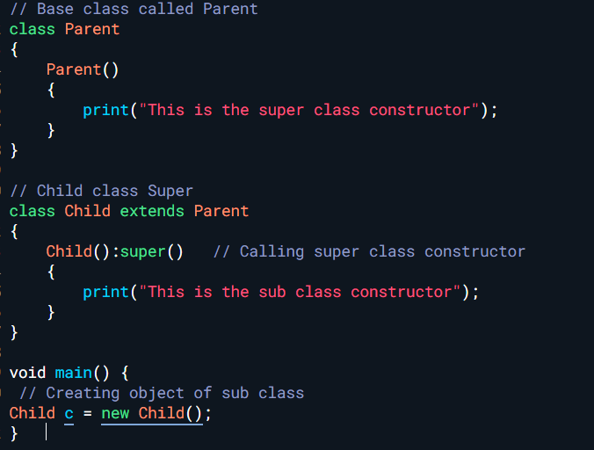
super

Slide 8
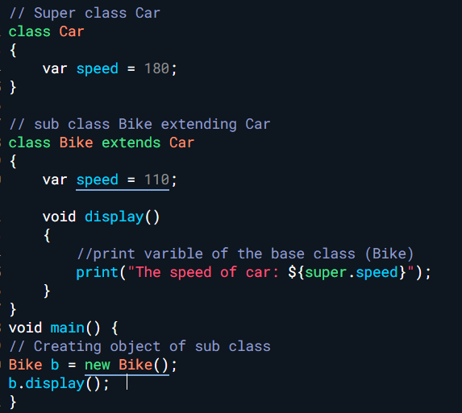
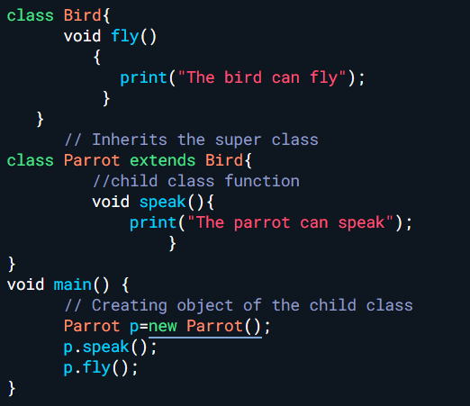
Inheritance

Slide 9
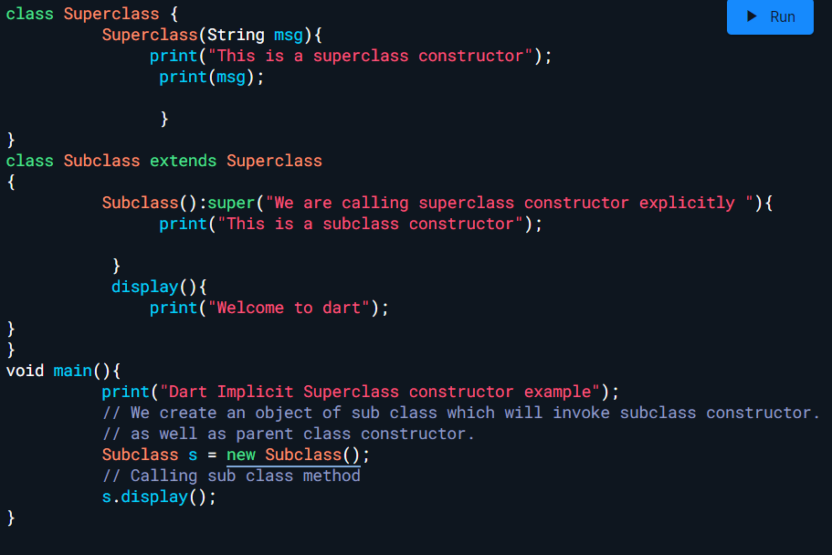
Cascading Super

Slide 10
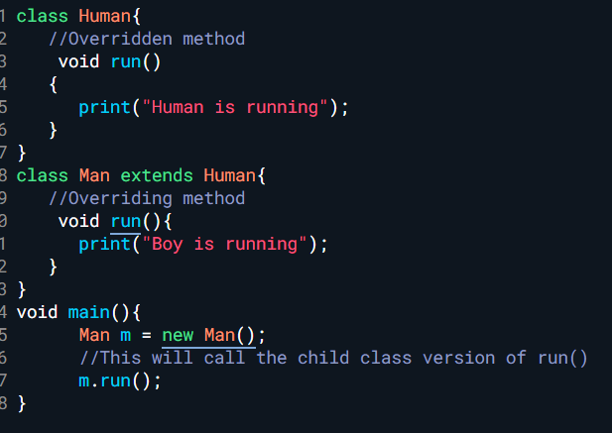
Method overriding

Slide 11
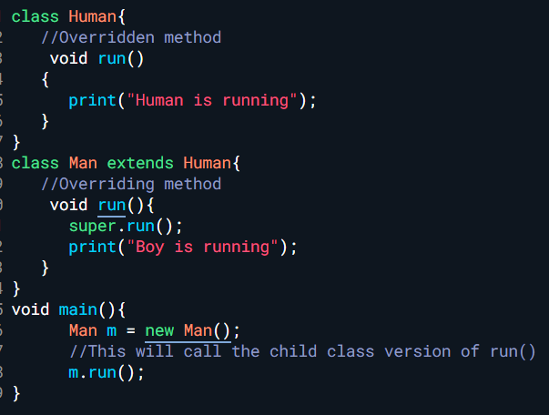
Look at super.run()

Slide 12
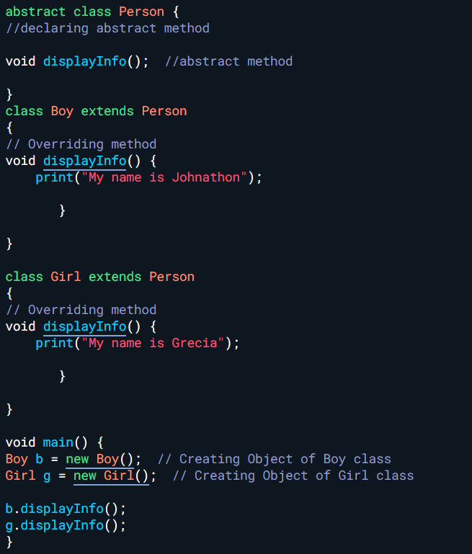
Abstract classes

Slide 13
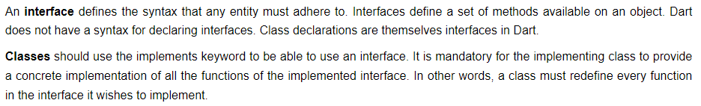
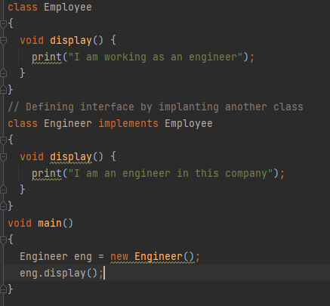
Interface

Slide 14
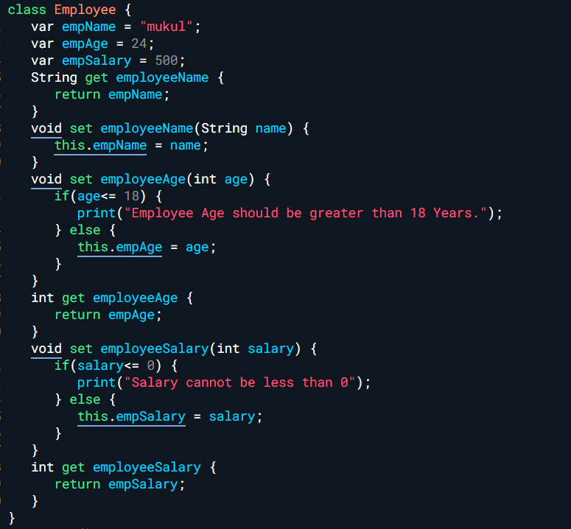
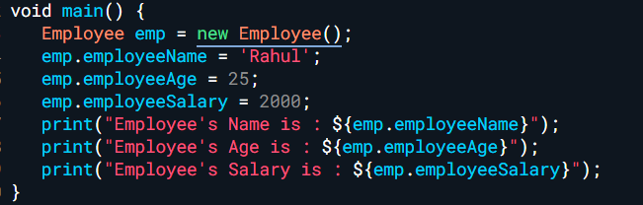
Getters and setters

Slide 15
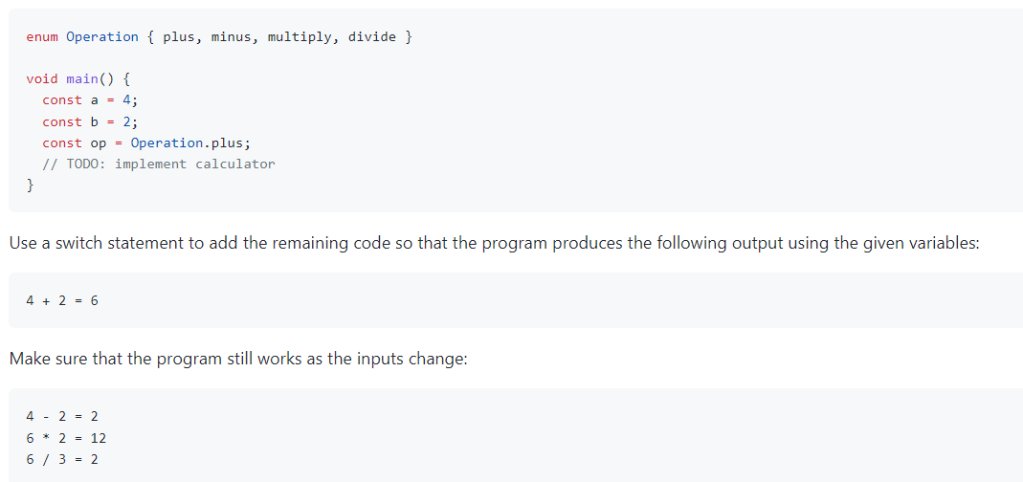
Basic calculator

Slide 16
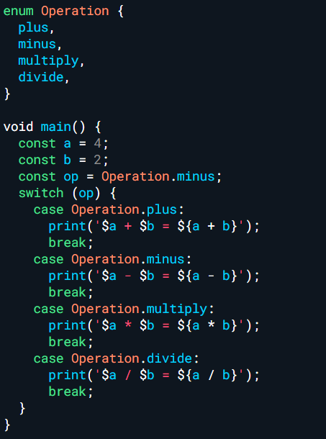

Slide 17
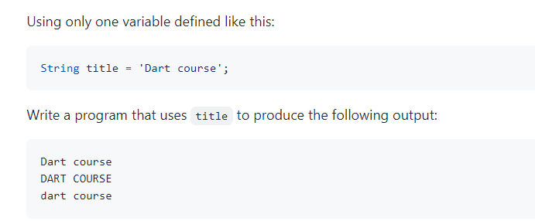
Uppercase to lowercase

Slide 18
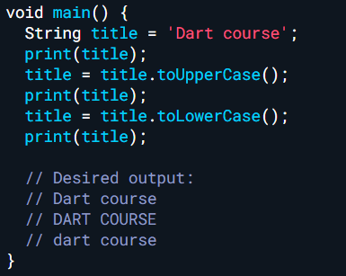

Slide 19
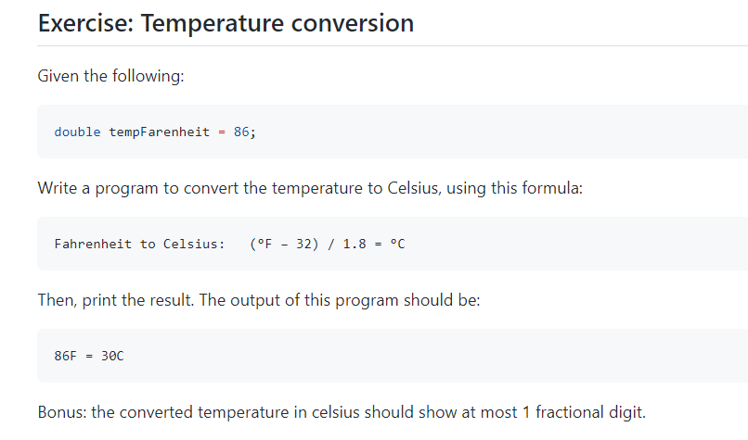

Slide 20
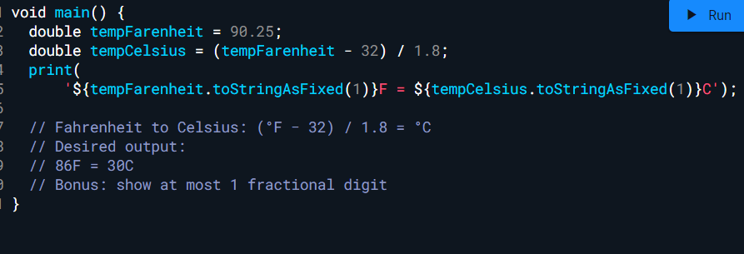

Slide 21
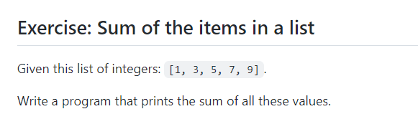

Slide 22
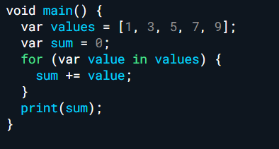

Slide 23
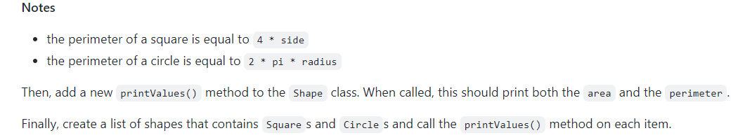
Call an Abstract class
Exercise: Area and Perimeter

Slide 24


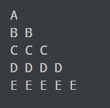
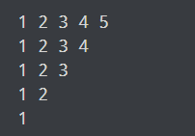
Exercise
From the given list of number, find the sum and average
Print the following triangles

Slide 25
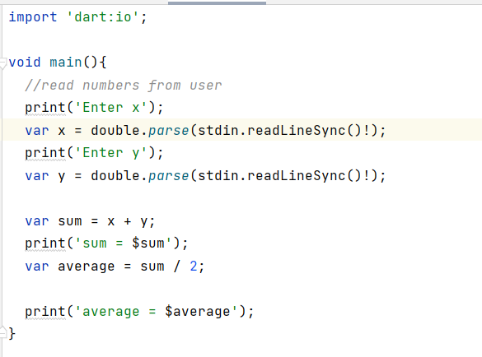

Slide 26
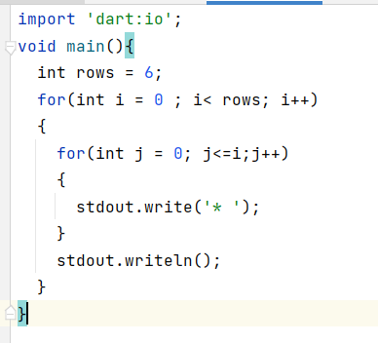

Slide 27
Dart Continued
Access Modifier
Class
Constructor
Null Safety
functions

Slide 28
Access Modifier
In Java, we can use public, protected, and private keywords to control the access scope for a property or method. However, Dart doesn't provide that kind of keywords. Instead, you can use _ (underscore) at the start of the name to make a data member of a class becomes private. So, a data member is either public (if not preceded by _) or private (if preceded by _)

Slide 29
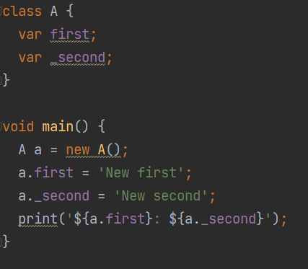
Example 1

Slide 30
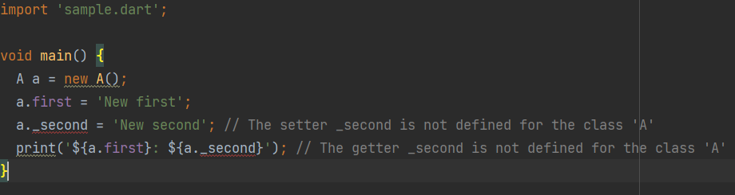
Example 2 . Try this

Slide 31
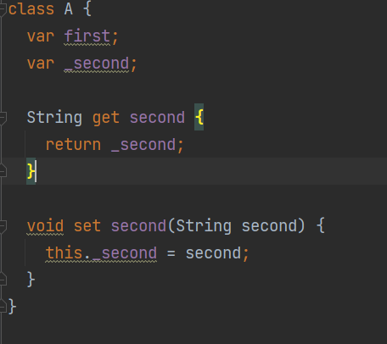
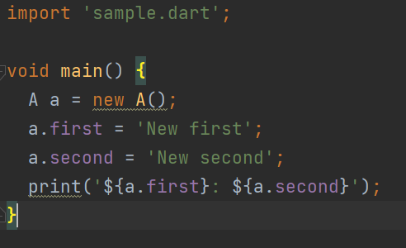
use the getter and setter to access the private members

Slide 32
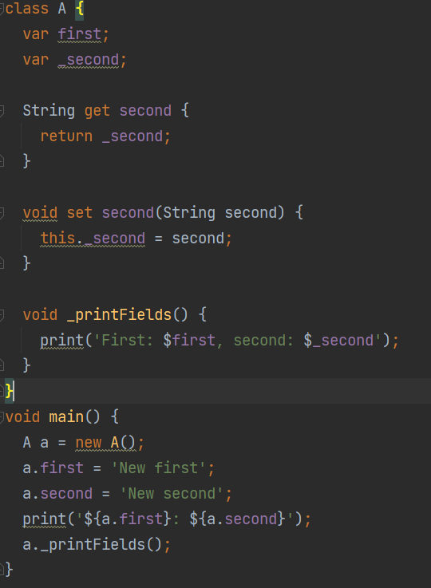
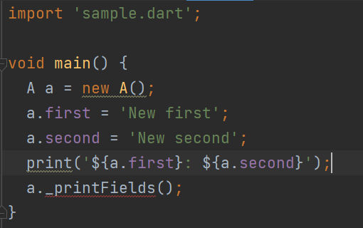
Same goes to private function.

Slide 33
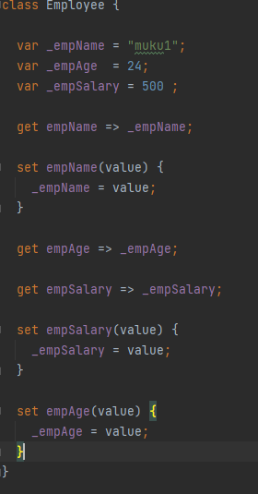
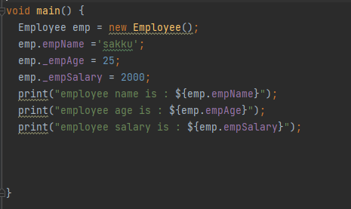
Getters and setters

Slide 34
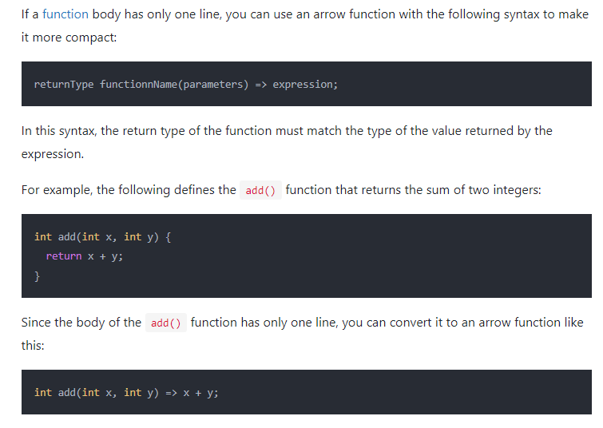
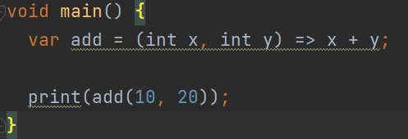
Dart Arrow Functions

Slide 35
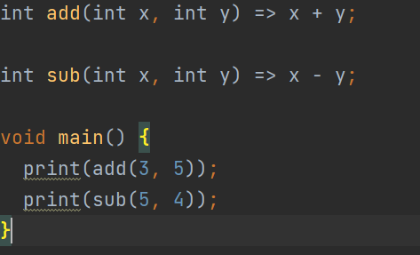

Slide 36
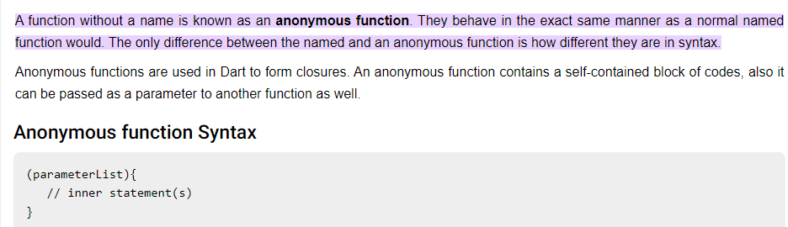
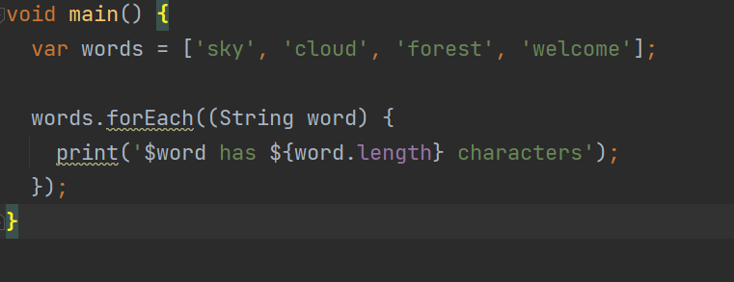
Dart anonymous function

Slide 37
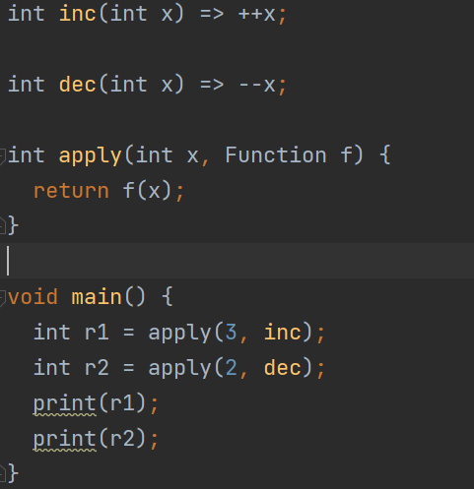
Dart function as parameter
A Dart function can be passed to other functions as a parameter. Such a function is called a higher-order function.

Slide 38
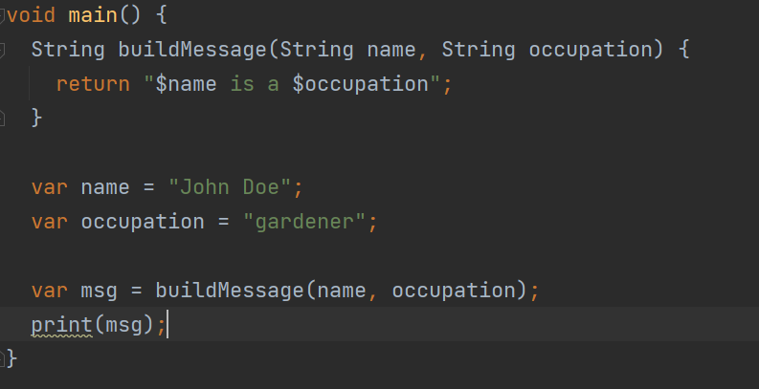
Dart nested function
A nested function, also called an inner function, is a function defined inside another function.

Slide 39
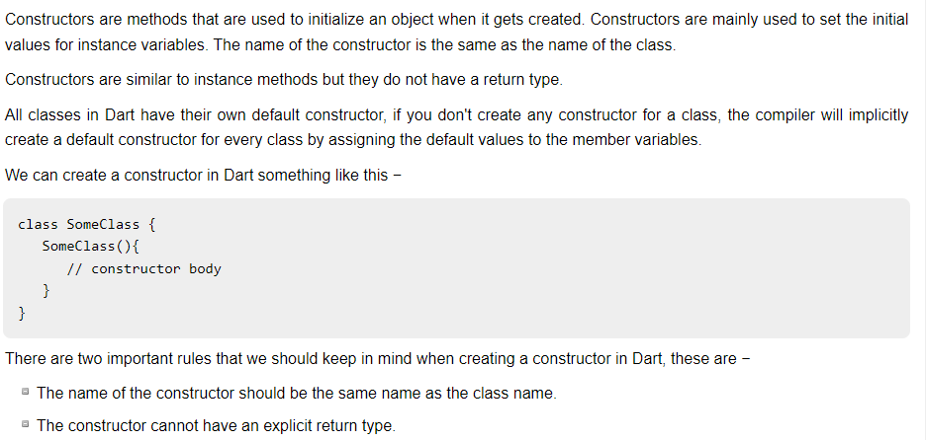
Constructors in Dart Programming

Slide 40
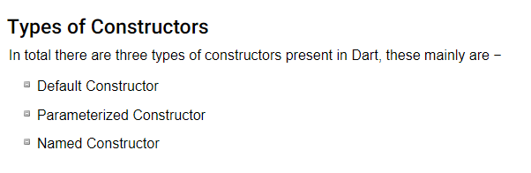

Slide 41
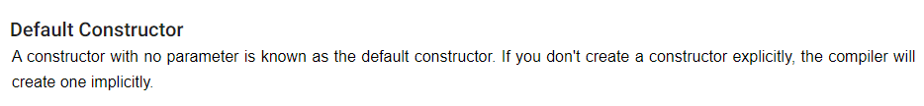
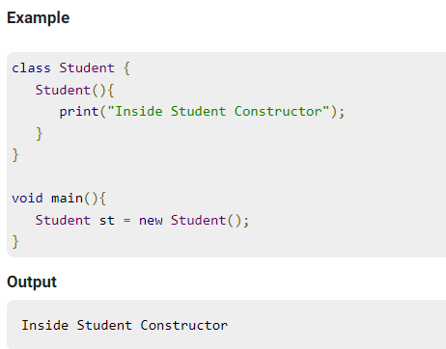

Slide 42



Slide 43


Slide 44


Example 1: Inheritance Of Constructor In Dart

Slide 45


Example 2: Inheritance Of Constructor With Parameters In Dart

Slide 46


Example 3: Inheritance Of Constructor

Slide 47


Example 4: Inheritance Of Constructor With Named Parameters In Dart

Slide 48


Example 5: Calling Named Constructor Of Parent Class In Dart

