Slide 1
Businesses & Organizations
Notes:
Since we are going to be interacting with real businesses, it is important to understand what a business is, how it functions, and some of the challenges that businesspeople face.

Slide 2
Since we are going to be interacting with real businesses, it is important to understand what a business is, how it functions, and some of the challenges that businesspeople face.

Slide 3
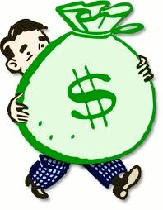
What is a business?
An organization that produces or sells goods or services to satisfy the needs, wants and demands of consumers
Any commercial activity that seeks profit by providing goods and services to others in exchange for money
Notes:
A business can be defined as
an organization that produces or sells goods or services to satisfy the needs, wants and demands of consumers.
OR as
Any commercial activity that seeks profit by providing goods and services to others in exchange for money.
Goods are physical products, and Services are tasks that businesses perform for consumers. Profit is money left over after a business has paid the cost of providing its goods or services. One goal may be to make a profit.
Note that the consumers may be other businesses.

Slide 4
A business can be defined as
an organization that produces or sells goods or services to satisfy the needs, wants and demands of consumers.
OR as
Any commercial activity that seeks profit by providing goods and services to others in exchange for money.
Goods are physical products, and Services are tasks that businesses perform for consumers. Profit is money left over after a business has paid the cost of providing its goods or services. One goal may be to make a profit.
Note that the consumers may be other businesses.

Slide 5
Profit, Non-profit, Not-for-profit
Profit
Profit (or loss) = Revenue – Expenses and Costs
Non-profit
Not-for-profit
Notes:
There are many ways of classifying businesses. We will now take a look at some of the different ways businesses and organizations are structured. It will become important for you to be able to place the business you are trying to help within a classification, so that you can identify some characteristics of the business – without having to pester your client for what to him or her are obvious details.
One of the ways of looking at businesses and organizations is to see if they are trying to make a profit or not.
What is meant by “profit”?
A For Profit organization’s goal is to make a profit by supplying goods or services to meet the demands of its clients or customers.
To determine whether a profit has been made, the following formula is used:
Profit (or loss) = Revenue – Expenses and Costs
What are some examples of revenue?
Fees, sales of goods
What is the difference between expenses and costs
Expenses are expenditures involved in running a business
Costs are the amount of money required for each stage of production or opoeration
What are some examples?
A Non-profit raises funds for a specific goal. These are typically charitable organizations.
And then there are not-for-profit organizations which are dedicated to raising funds for their membership, such as cooperatives for housing.

Slide 6
There are many ways of classifying businesses. We will now take a look at some of the different ways businesses and organizations are structured. It will become important for you to be able to place the business you are trying to help within a classification, so that you can identify some characteristics of the business – without having to pester your client for what to him or her are obvious details.
One of the ways of looking at businesses and organizations is to see if they are trying to make a profit or not.
What is meant by “profit”?
A For Profit organization’s goal is to make a profit by supplying goods or services to meet the demands of its clients or customers.
To determine whether a profit has been made, the following formula is used:
Profit (or loss) = Revenue – Expenses and Costs
What are some examples of revenue?
Fees, sales of goods
What is the difference between expenses and costs
Expenses are expenditures involved in running a business
Costs are the amount of money required for each stage of production or opoeration
What are some examples?
A Non-profit raises funds for a specific goal. These are typically charitable organizations.
And then there are not-for-profit organizations which are dedicated to raising funds for their membership, such as cooperatives for housing.

Slide 7
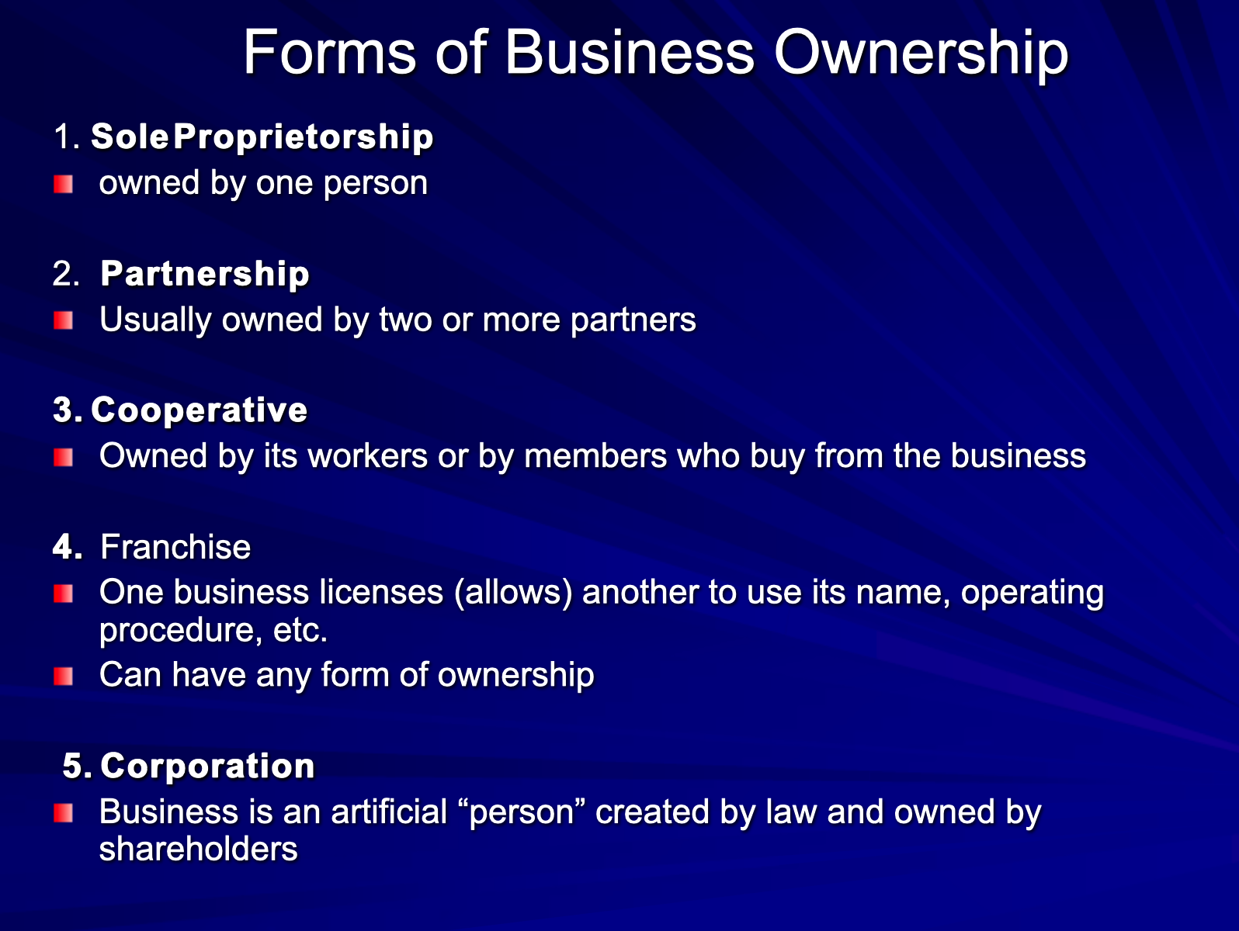
Five types of business ownership
Sole Proprietorships
Partnerships
Corporations
Cooperatives
Franchises
Notes:
Another way of looking at businesses and organizations is to classify them according to their proprietorships; that is, who owns them.
The simplest is the Sole Proprietorship. One person owns the company. Many small businesses are sole proprietorships.
Next we have partnerships. Very often people in a similar profession will band together and form a partnership. Professionals, such as doctors, lawyers, engineers, architects, amongst many others do this. No one partner is superior to another, but there can be exceptions.
Cooperatives are owned by their workers or members who buy from the business; e.g., Mountain Equipment Coop, Desjardins, Jake’s.
Franchises can have any form of ownership, but they use another business’s name and processes; e.g., Tim Horton’s
And finally, Corporations which are considered artificial persons and owned by shareholders.
Each form has its advantages and disadvantages, but we are not going onto that detail here.

Slide 8
Another way of looking at businesses and organizations is to classify them according to their proprietorships; that is, who owns them.
The simplest is the Sole Proprietorship. One person owns the company. Many small businesses are sole proprietorships.
Next we have partnerships. Very often people in a similar profession will band together and form a partnership. Professionals, such as doctors, lawyers, engineers, architects, amongst many others do this. No one partner is superior to another, but there can be exceptions.

Slide 9
Cooperatives are owned by their workers or members who buy from the business; e.g., Mountain Equipment Coop, Desjardins, Jake’s.
Franchises can have any form of ownership, but they use another business’s name and processes; e.g., Tim Horton’s
And finally, Corporations which are considered artificial persons and owned by shareholders.
Each form has its advantages and disadvantages, but we are not going onto that detail here.

Slide 10
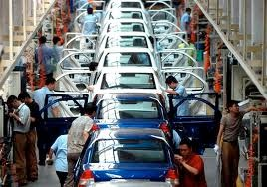
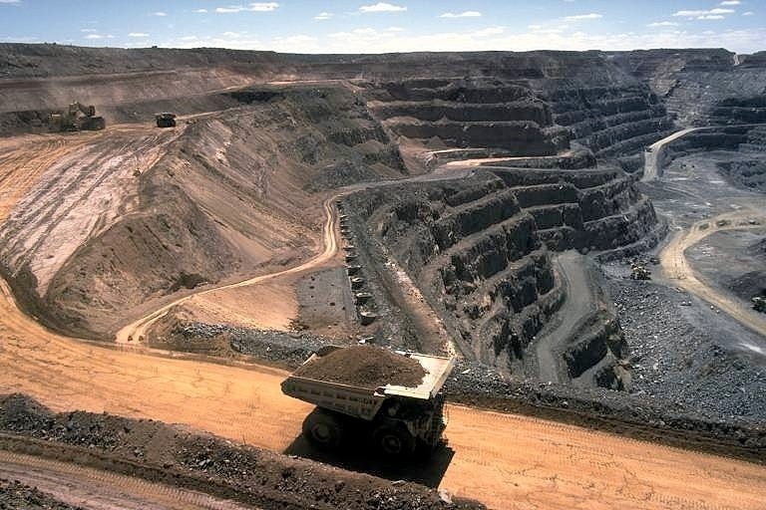
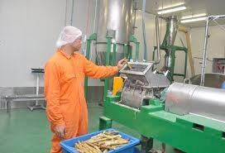
Types of Businesses
Producers
Processors
Manufacturers
Intermediaries & Wholesalers
Retailers & Service Businesses
Notes:
We can also classify businesses according to their type.
There are Producers:
A business that gathers raw goods
Examples: Agriculture, Mining, Fishing, Forestry
Then there are Processors, who change raw materials into more finished products.
Some examples are Sugar cane to Sugar, Crude oil to Gasoline, Iron to Steel
And Manufacturers who make finished products out of processed goods.
Examples of finished goods are Cars, DVD’s, Computers
There are Intermediaries & Wholesalers. An Intermediary is a business that moves goods from one business to another; they buy goods, store them, & resell them. A Wholesaler Distributes goods. For Example, they buy products in large quantities from manufacturers and sells smaller quantities to retailers.
Finally, we come to Retailers & Service Businesses. The Retailer purchases goods from a wholesaler and then sells them to consumers who are the final buyers of the goods, such as Auto dealers and Grocery stores. A service business performs tasks rather than providing goods, such as medical clinics, law firms and dog walkers.
It is worth noting that service-oriented and goods-producing (manufacturing) companies operate differently.

Slide 11
We can also classify businesses according to their type.
There are Producers:
A business that gathers raw goods
Examples: Agriculture, Mining, Fishing, Forestry
Then there are Processors, who change raw materials into more finished products.
Some examples are Sugar cane to Sugar, Crude oil to Gasoline, Iron to Steel
And Manufacturers who make finished products out of processed goods.
Examples of finished goods are Cars, DVD’s, Computers
There are Intermediaries & Wholesalers. An Intermediary is a business that moves goods from one business to another; they buy goods, store them, & resell them. A Wholesaler Distributes goods. For Example, they buy products in large quantities from manufacturers and sells smaller quantities to retailers.
Finally, we come to Retailers & Service Businesses. The Retailer purchases goods from a wholesaler and then sells them to consumers who are the final buyers of the goods, such as Auto dealers and Grocery stores. A service business performs tasks rather than providing goods, such as medical clinics, law firms and dog walkers.
It is worth noting that service-oriented and goods-producing (manufacturing) companies operate differently.

Slide 12
Business Sizes and Channels
Local, regional, and/or global
Most businesses are small to medium sized
Distribution channels
B2B or B2C or both
Bricks-and-mortar or eBusiness or both
Notes:
Another way of looking at businesses is according to their size.
Businesses can be local, regional, and/or global.
Most businesses are small to medium sized
They have fewer than 500 employees. There are more than 1 million such businesses in Canada, providing jobs for 60% of the Canadian workforce.
Businesses can also be characterized by their channels of distribution; that is, how they actually interact with their customers of clients.
They can operate as business to business, B2B, or business to consumer, B2C. They may have a physical presence, like a store, or bricks-and-mortar, or may exist only on the internet as an eBusiness. Some manage to do both.
B2B or B2C or both
Bricks-and-mortar or eBusiness or both

Slide 13
Another way of looking at businesses is according to their size.
Businesses can be local, regional, and/or global.
Most businesses are small to medium sized
They have fewer than 500 employees. There are more than 1 million such businesses in Canada, providing jobs for 60% of the Canadian workforce.
Businesses can also be characterized by their channels of distribution; that is, how they actually interact with their customers of clients.
They can operate as business to business, B2B, or business to consumer, B2C. They may have a physical presence, like a store, or bricks-and-mortar, or may exist only on the internet as an eBusiness. Some manage to do both.
B2B or B2C or both
Bricks-and-mortar or eBusiness or both

Slide 14
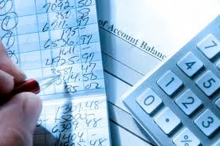

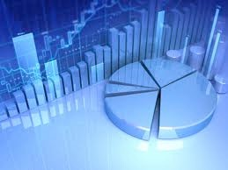
Common business functions
Production & Procurement, Operations
Marketing
Finance, Accounting
Human Resources
Information Technology
Notes:
There are certain functions that are common to most businesses.
Production & Procurement, or operations.
Production is the process of creating, expanding, manufacturing, or improving goods and services.
Procurement means buying and reselling goods that have already been produced.
For example, wholesalers buy goods from producers to resell to retailers and other wholesalers
Next is Marketing
Marketing is the process of planning, pricing, promoting, selling, and distributing ideas, goods, and services. It involves getting consumers to buy a product or service. To perform this function companies make decisions based on market research or established trends.
Every business needs to take care of finance and accounting.
Finance is the business or art of money management, which involves analyzing financial statements to make future decisions.
Accounting involves maintaining and checking records, handling bills, and preparing financial reports.
Human Resources
Since businesses all require people to function there has to be a function for hiring, training, supporting and firing employees. This is what HR does.
Information Technology
In many businesses where there are several computers, tablets, telephonesand so on, there are people who support and manage the information technology that tis so necessary to operating a business today.

Slide 15
There are certain functions that are common to most businesses.
Production & Procurement, or operations.
Production is the process of creating, expanding, manufacturing, or improving goods and services.
Procurement means buying and reselling goods that have already been produced.
For example, wholesalers buy goods from producers to resell to retailers and other wholesalers
Next is Marketing
Marketing is the process of planning, pricing, promoting, selling, and distributing ideas, goods, and services. It involves getting consumers to buy a product or service. To perform this function companies make decisions based on market research or established trends.

Slide 16
Every business needs to take care of finance and accounting.
Finance is the business or art of money management, which involves analyzing financial statements to make future decisions.
Accounting involves maintaining and checking records, handling bills, and preparing financial reports.
Human Resources
Since businesses all require people to function there has to be a function for hiring, training, supporting and firing employees. This is what HR does.
Information Technology
In many businesses where there are several computers, tablets, telephonesand so on, there are people who support and manage the information technology that tis so necessary to operating a business today.

Slide 17
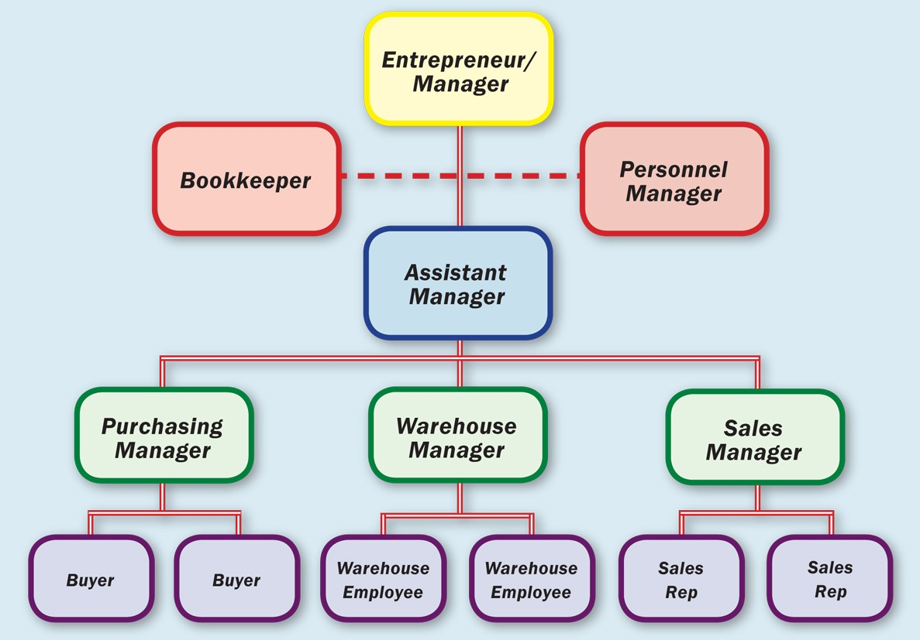
Management
What is management?
Four main functions
Planning
Organizing
Leading
Controlling
Levels of management
Inter-department dependency
Notes:
The other big function in a business is management. If you are working on a project in-house, and you require more resources either from within or outside the company, you will need to know who to talk to in your company to obtain the permission and perhaps funding to get those resources. These resources could be outside your area of expertise such as content, art, graphic design, and so on. This requires some understanding of how the management of your company operates.
Management is the process of achieving company goals by planning, organizing, leading, controlling, and evaluating the effective use of resources. It helps businesses focus on setting and meeting goals eﬃciently and eﬀectively so that a proﬁt can be made. If a ﬁrm has employees, then they must have management.
4 Functions of Management
Planning is the act or process of creating goals and objectives as well as the strategies to meet them. It involves ﬁguring out the resources that are needed and the standards that must be met.
Organizing. Managers organize and obtain resources in an orderly and functional manner so that goals and objectives can be accomplished. Managers organize people, work processes, equipment, hiring, ﬁring, and training.
Managers leadership by providing direction and vision. They also set standards (such as deadlines & sales quotas). They delegate work and enforce policies. They oversee time management and provide feedback on employees’ work. They also resolve various conﬂicts.
Finally, managers control various aspects of the functioning of the business so that the company is kept on track to meeting its goals. Managers control budgets, schedules, the quality of products and services, employee performance, and customer satisfaction.
In some organizations there are different levels of management. An organizational chart shows how the organization is structured and who is in charge of whom. You can learn a lot about a larger organization just by examining their Org chart.
The different functional areas of business depend on each other. For example, if sales are decreasing, accounting and finance can note the drop, and start the process for developing a new marketing plan. Similarly, if the price of products is set too high, new procedures may have to be instituted by management.

Slide 18
The other big function in a business is management. If you are working on a project in-house, and you require more resources either from within or outside the company, you will need to know who to talk to in your company to obtain the permission and perhaps funding to get those resources. These resources could be outside your area of expertise such as content, art, graphic design, and so on. This requires some understanding of how the management of your company operates.
Management is the process of achieving company goals by planning, organizing, leading, controlling, and evaluating the effective use of resources. It helps businesses focus on setting and meeting goals eﬃciently and eﬀectively so that a proﬁt can be made. If a ﬁrm has employees, then they must have management.
4 Functions of Management
Planning is the act or process of creating goals and objectives as well as the strategies to meet them. It involves ﬁguring out the resources that are needed and the standards that must be met.

Slide 19
Organizing. Managers organize and obtain resources in an orderly and functional manner so that goals and objectives can be accomplished. Managers organize people, work processes, equipment, hiring, ﬁring, and training.
Managers leadership by providing direction and vision. They also set standards (such as deadlines & sales quotas). They delegate work and enforce policies. They oversee time management and provide feedback on employees’ work. They also resolve various conﬂicts.
Finally, managers control various aspects of the functioning of the business so that the company is kept on track to meeting its goals. Managers control budgets, schedules, the quality of products and services, employee performance, and customer satisfaction.
In some organizations there are different levels of management. An organizational chart shows how the organization is structured and who is in charge of whom. You can learn a lot about a larger organization just by examining their Org chart.
The different functional areas of business depend on each other. For example, if sales are decreasing, accounting and finance can note the drop, and start the process for developing a new marketing plan. Similarly, if the price of products is set too high, new procedures may have to be instituted by management.

Slide 20
So, you want to be a manager
Required skills
Advantages
Disadvantages
Notes:
If you want to become a manager, you need to develop these skills:
Be task oriented. Learn how to prioritize work for both yourself and others. Learn how to keep accurate records. Be able to work under the constraints of both time and pressure. Be able to communicate and interact well with others, and finally, have a good understanding of both the company and the business world in general.
Some of the advantages of being a manager are that you may earn more money, you may be more respected, have some inﬂuence & authority and you may have greater control of your own time.
Some of the disadvantages are that managers are often blamed for mistakes and errors, and these can be costly for the company. In that sense, there is less job security than if, for example, you were a member of a union.

Slide 21
If you want to become a manager, you need to develop these skills:
Be task oriented. Learn how to prioritize work for both yourself and others. Learn how to keep accurate records. Be able to work under the constraints of both time and pressure. Be able to communicate and interact well with others, and finally, have a good understanding of both the company and the business world in general.
Some of the advantages of being a manager are that you may earn more money, you may be more respected, have some inﬂuence & authority and you may have greater control of your own time.
Some of the disadvantages are that managers are often blamed for mistakes and errors, and these can be costly for the company. In that sense, there is less job security than if, for example, you were a member of a union.

Slide 22
Or maybe an entrepreneur?
Entrepreneurs are
Risk-takers
Problem solvers
Self-confident
Innovative
Able to work alone
And also, able to manage others
Notes:
Perhaps you would rather be an entrepreneur; that is, someone who starts their own business.
What makes a good entrepreneur?
Entrepreneurs are
Risk-takers
Problem solvers
Self-confident
Innovative
Able to work alone
And also able to manage others
As an employee, or entrepreneur or as a manager, you need to be sensitive to both the negative and positive impacts of information systems for your firm, your employees, and your customers. You will also need to learn how to resolve ethical dilemmas involving information systems.

Slide 23
Perhaps you would rather be an entrepreneur; that is, someone who starts their own business.
What makes a good entrepreneur?
Entrepreneurs are
Risk-takers
Problem solvers
Self-confident
Innovative
Able to work alone
And also able to manage others
As an employee, or entrepreneur or as a manager, you need to be sensitive to both the negative and positive impacts of information systems for your firm, your employees, and your customers. You will also need to learn how to resolve ethical dilemmas involving information systems.

