Slide 1
Python Workshop Day 3
Micro-service Architecture, REST and Creating API’s in Python

Slide 2
How are Apps Built?

Slide 3
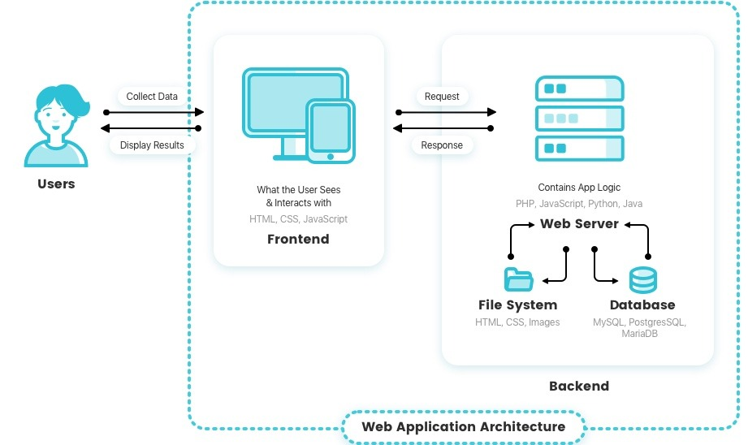
How are Apps Built?

Slide 4
Components of an application?

Slide 5
Components of an application?
To be very precise:
Frontend
Backend
Database

Slide 6
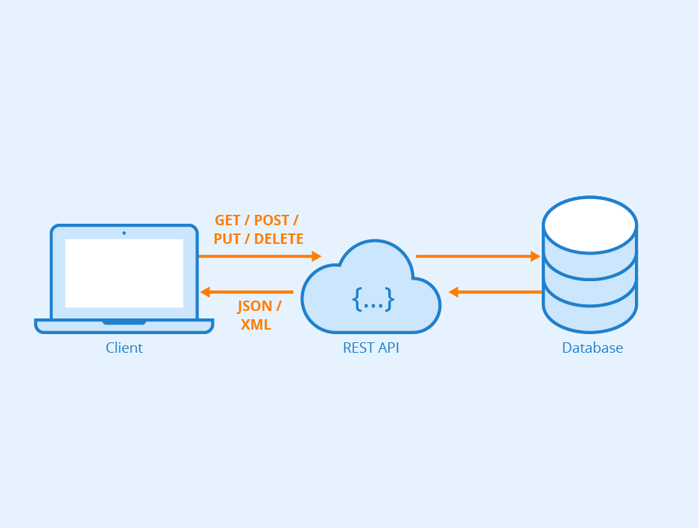
Where comes an API?

Slide 7
Publically Available API’s
Facebook’s Developer Group – Graph API
Twitter Firehose
Google’s APIGee

Slide 8
Types of Application Architecture?
Monolithic Architecture
Micro-services Architecture

Slide 9
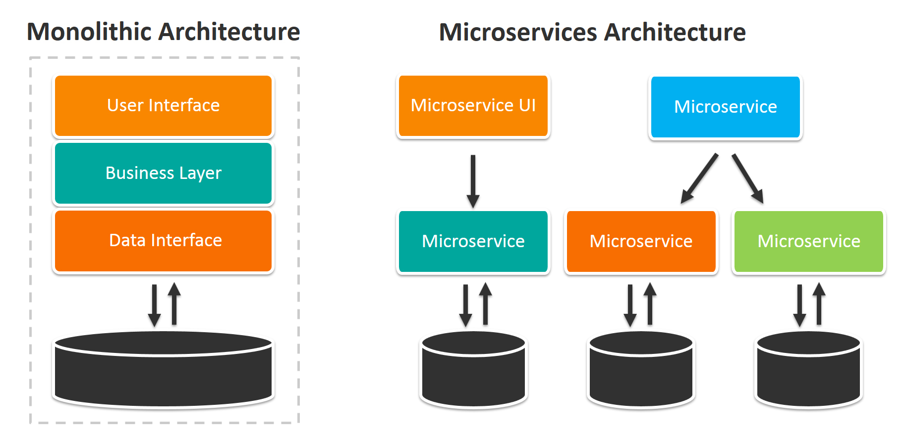
Difference:

Slide 10
Monolithic Architecture Challenge?
Large and Complex Applications
Slow Development
No Continuous Development
Unscalable
Unreliable
Inflexible

Slide 11
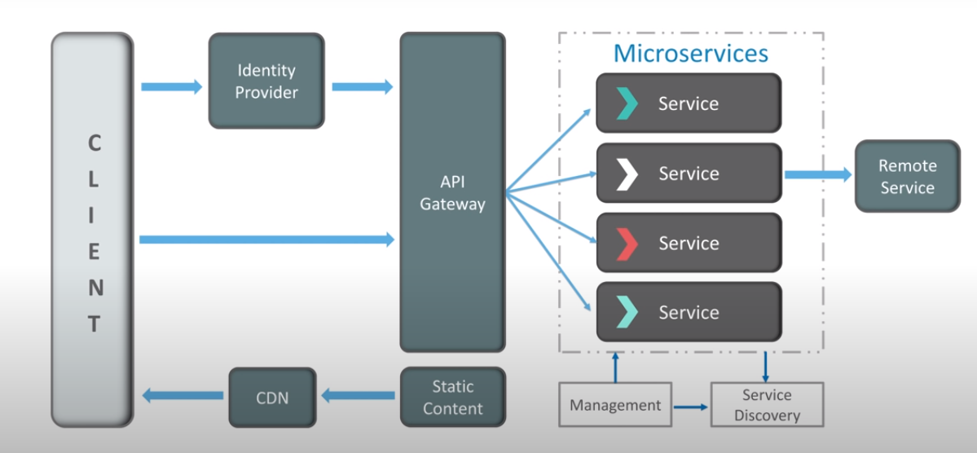
Microservices Application Architecture:

Slide 12
Features of Microservice Architecture
Small Focused
Loosely Coupled
Language Neutral

Slide 13
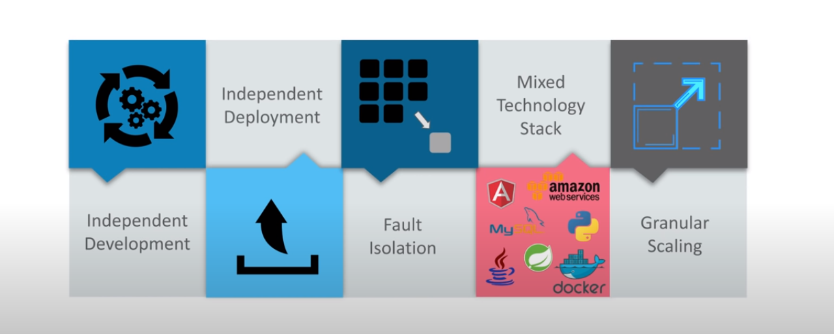
Advantages of Microservices Architecture

Slide 14
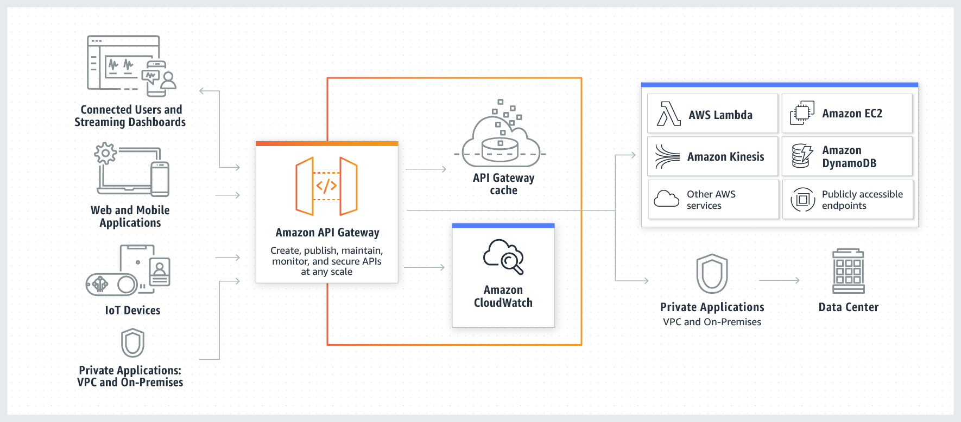
How does Amazon work?

Slide 15

Companies using Microservices

Slide 16
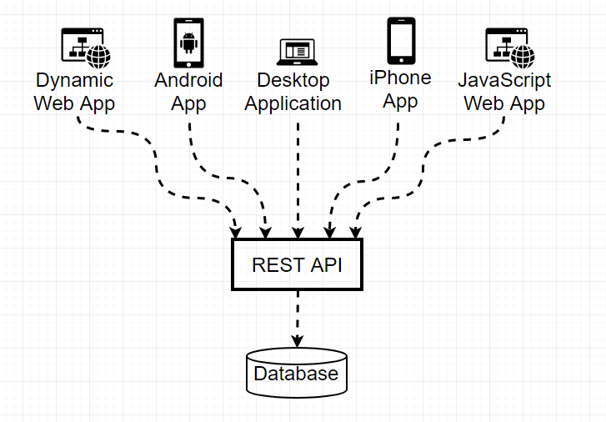
REST API – The REpresentational State Transfer

Slide 17
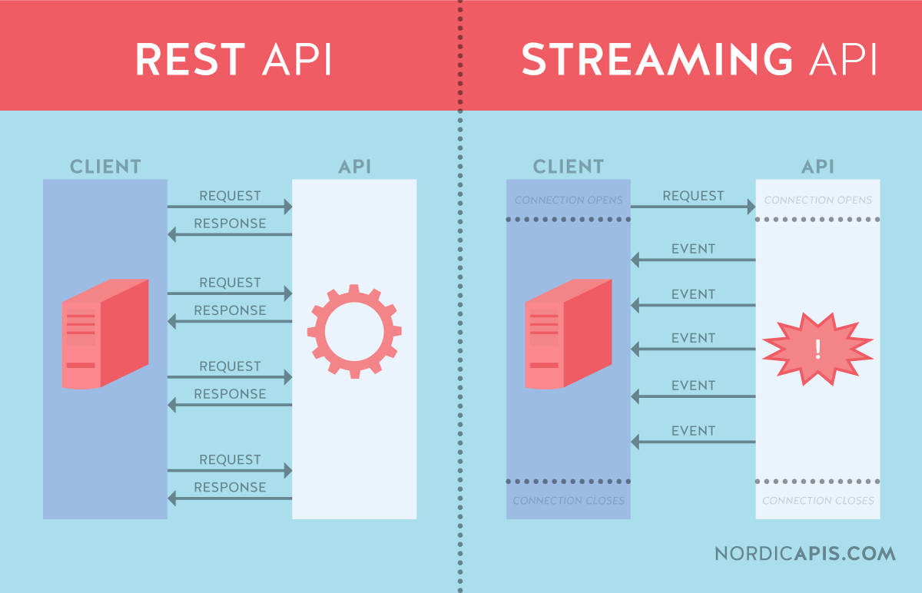
REST vs Streaming API.

