Slide 1

WELCOME TO OUR PRESENTATION

Slide 2
Presentation on Hospital management System
Course Title : Software Development Project-1
Course Code : CCE-310

Slide 3
There are three types of users: 1. Receptionist 2. Admin 3.Finance Manager

Slide 4
Receptionist
Patient Registration
Patient Information
Patient Checkout
Staff Information
Blood Doner Information

Slide 5
Admin
Patient Registration
Patient Information
Patient Checkout
Add New Ward
Staff Information
User Information
Blood Donor Information

Slide 6
Finance Manager
Patient Registration
Patient Information
Patient Checkout
Add New Ward
Finance Management

Slide 7


Slide 8
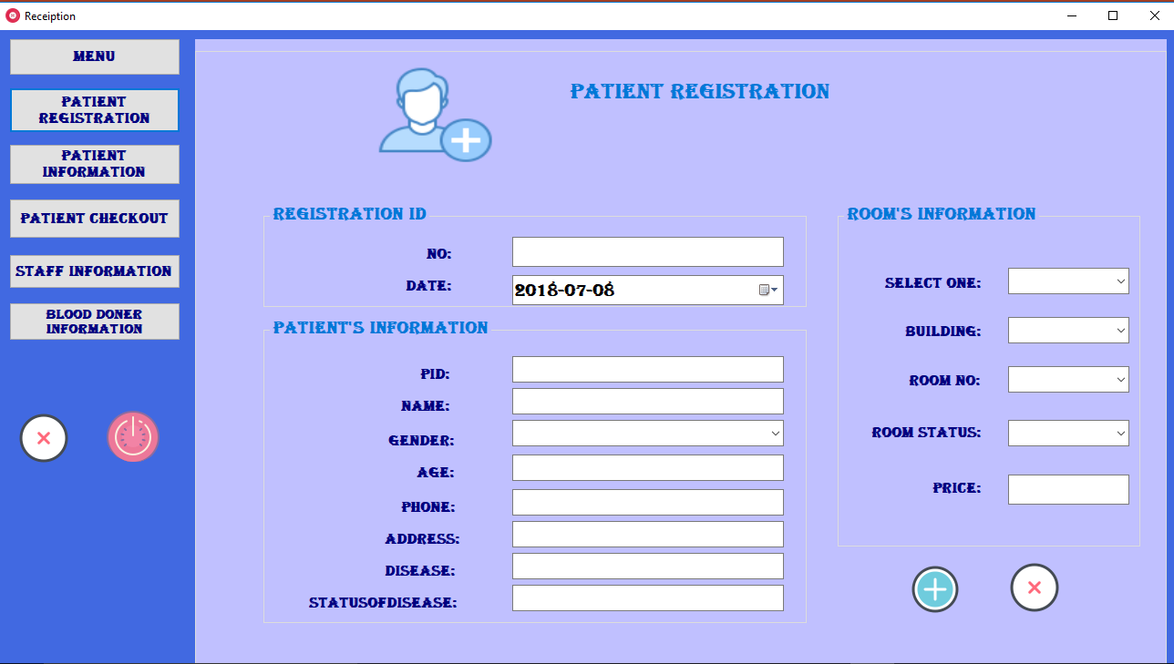

Slide 9
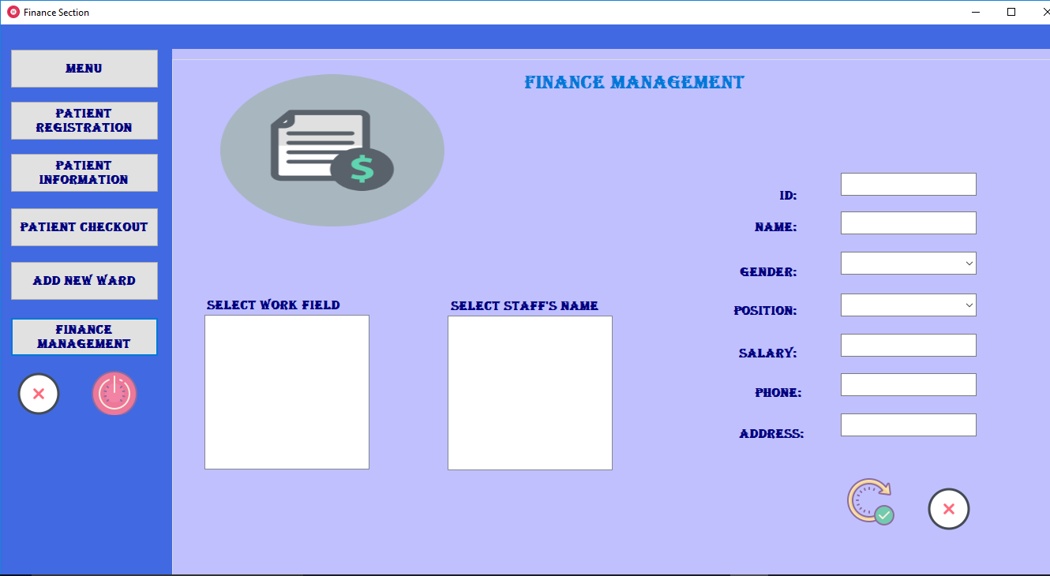

Slide 10
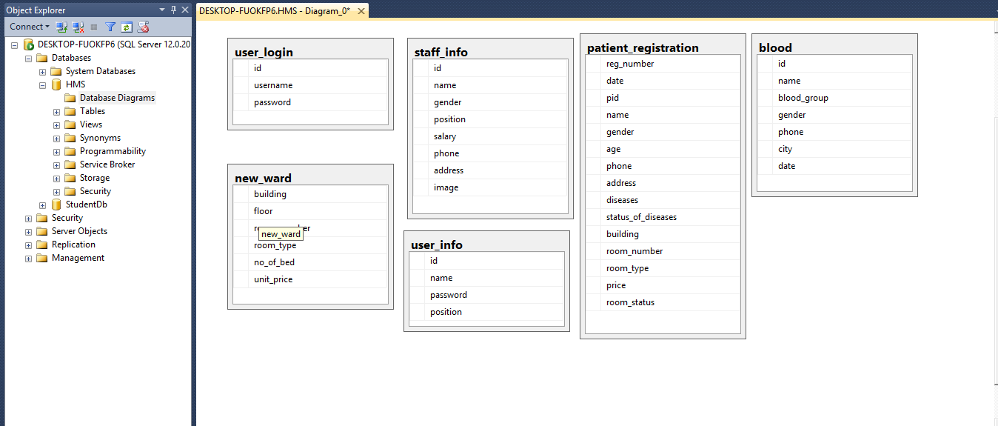
Database schema:

Slide 11
Thank You to all

