Slide 1



Cairo University
Faculty of Engineering
Electronics and Electrical Communications Engineering Department
Fourth Year
Name | BN | Sec | Student Code
عبد النعيم عبد الباسط عبد النعيم | 1 | 3 | 9190875
علي بدري عبد النعيم عبد المالك | 4 | 3 | 9190097
كريم احمد ثابت عبد الرحيم | 22 | 3 | 9190023
كيرلس نشأت نجيب دميان | 25 | 3 | 9190598
محمد ايمن السيد محمود | 33 | 3 | 9190975
نبيل ياسر نبيل محمد | 38 | 4 | 9190943

Slide 2
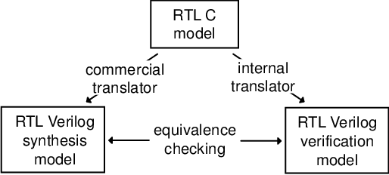
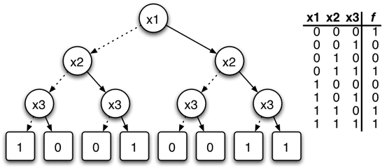
Introduction
Static Formal Verification:
Equivalence Checking: It proves that two designs have the same functionality.
Equivalence checking can be applied at different stages during the design process
e.g design optimization or design synthesis
- Equivalence Checking algoithms:
ROBDD approach
Boolean function parser
ROBDD construction
Graphical representation
ROBDD comparator

Slide 3
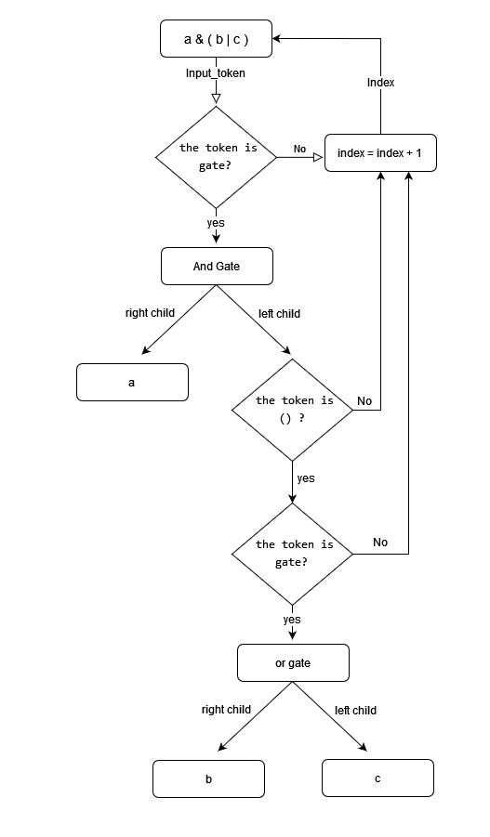
Boolean Function Parser
1 – Insert function as string
2 – Insert order of the variables to construct tree
3 – Form tokens consist of variables and operators
using split functions
4 – Search for one or zero in function
5 – Apply parser function

Slide 4
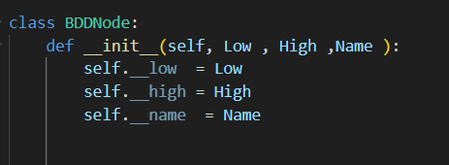
BDD Construction

Slide 5
BDD Construction
f = ac + abc + a’b’c’
f = a)c( + a’(bc + b’c’)
BDD_Root = BDDNode('a')
a
Evaluate if a = 1
Insert a high child
Consider it as root
and use recursion
b
c
bc + b’c’
b
c
c
c
c
Reached
to leaves ?
1
0
0
1
0
1
0
1

Slide 6
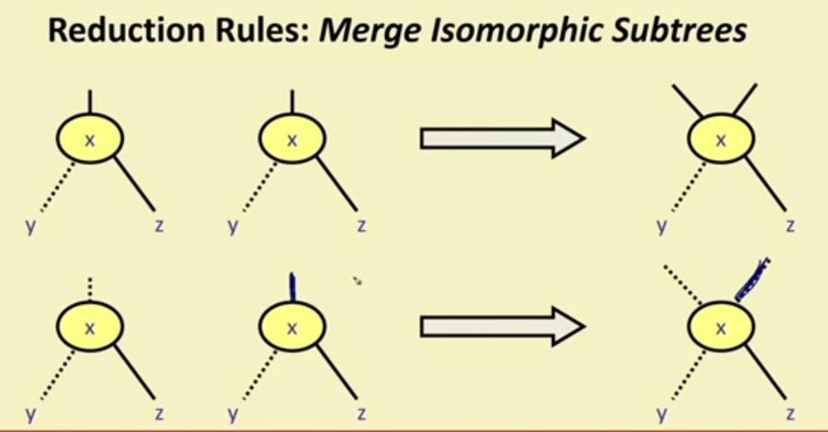
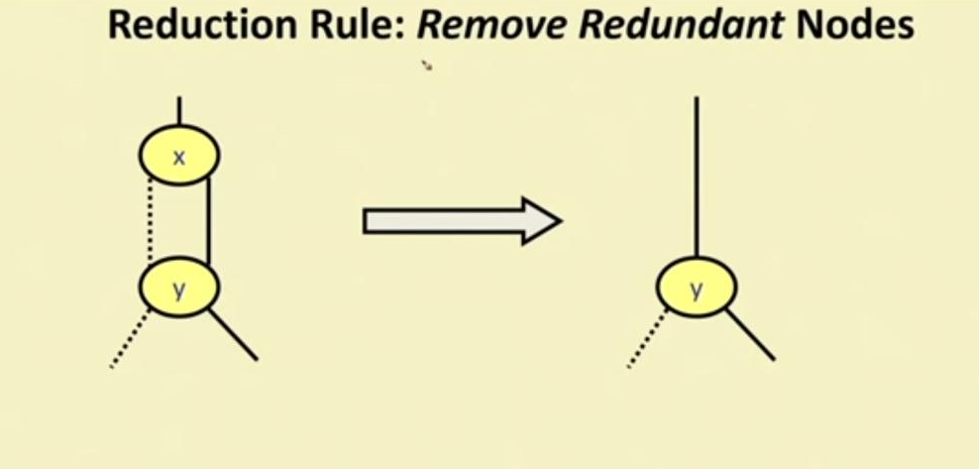
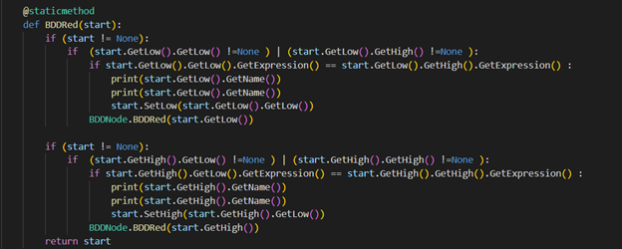
ROBDD Optimization
Optimization occurs in 3 steps:
1 – Remove of duplicate leaves
2 – Removal of redundant nodes
3 – Removal of redundant subtrees

Slide 7
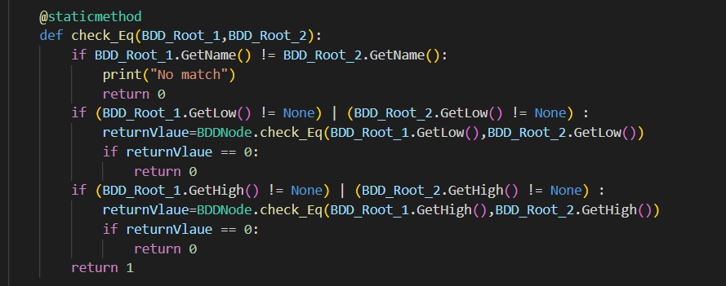
ROBDD Comparator
The function takes two root nodes of ROBDDs as input.
It compares the names of the root nodes, if they do not match, it returns 0.
It recursively checks the low and high edges of the
nodes to determine if they are equivalent.
If all comparisons are successful, the function returns 1
indicating that the two ROBDDs are equivalent.

Slide 8
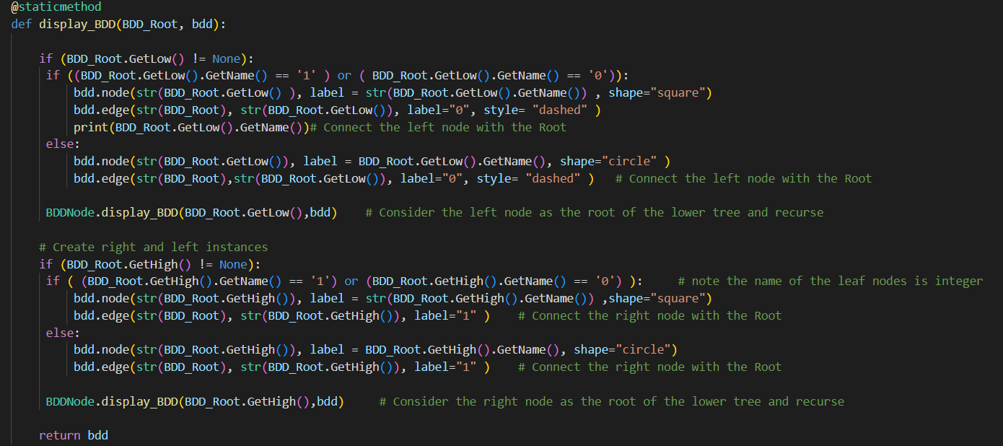
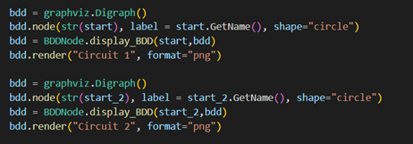
ROBDD Graphical Display
Takes BDD_Root and bdd as input arguments
Recursively traverses the ROBDD from the root node and adds each node and joins between nodes
Sets the label and shape of each node based on whether it is a leaf or decision node
Returns the updated bdd object which can be rendered and displayed using the graphviz library

Slide 9
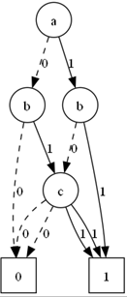
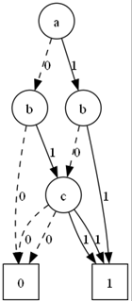
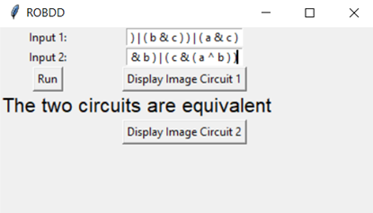

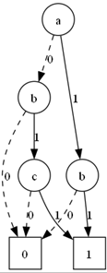
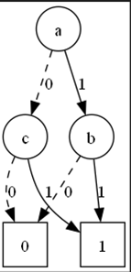
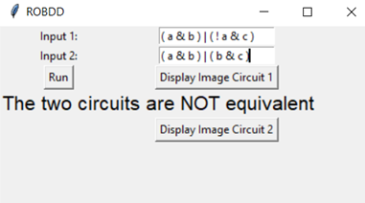
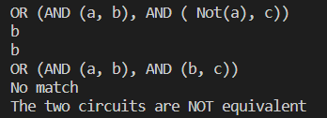
Results
Test case 1 : Full adder Cout
f1 = ( ( a & b ) | ( b & c ) ) | ( a & c )
f2 = ( a & b ) | ( c & ( a ^ b ) )
Test case 2 :
f1 = ( a & b ) | ( ! a & c ) f2 = ( a & b ) | ( b & c )

Slide 10
Thank You!

