Slide 1

MANet: A Context-Aware Attention Network
for Robust Zero-Day Ransomware Detection
Nabila Ferdous · Sadia Sultana Pinky · Oishi Jyoti
Department of Electrical & Computer Engineering
Rajshahi University of Engineering & Technology (RUET), Bangladesh
ECCT 2026
Zero-Day Ransomware · Attention Mechanism · Transformer · Deep Learning · XAI · Behavioral Analysis
ECCT 2026 | MANet: Zero-Day Ransomware Detection | Ferdous, Pinky & Jyoti — RUET, Bangladesh

Slide 2
Problem Statement
2 / 17
1
2
3
Signature Evasion
Tabular Independence Fallacy
Overconfident Misclassification
Polymorphic & metamorphic ransomware bypasses static signature-based detection tools with ease.
RF & GBMs evaluate API calls and registry events in isolation, missing relational context.
Decision trees assign up to 99.99% confidence to misclassified zero-day samples — critical SOC risk.
4
5
6
Temporal Leakage in Evaluation
Scalar-Only Explainability
SOC Alert Fatigue
Standard k-fold cross-validation leaks future families into training, inflating reported accuracy.
SHAP & LIME provide marginal per-feature scores but cannot capture interaction effects between signals.
High false positive rates from poorly calibrated models overwhelm security analysts operationally.
ECCT 2026 | MANet: Zero-Day Ransomware Detection | Ferdous, Pinky & Jyoti — RUET, Bangladesh

Slide 3
Related Work (1/2): Traditional & Sequential Models
3 / 17
Signature-Based
Tabular ML
(RF, LightGBM, SVM)
RNN / LSTM
Core Idea
Match known byte/hash patterns
Tabular features + ensemble classifiers
Key Strength
Fast; low FP for known threats
Widely deployed; interpretable
Core Limitation
Defeated by polymorphism
Feature independence assumption
Zero-Day Gap
Fails completely
High-confidence wrong predictions
ECCT 2026 | MANet: Zero-Day Ransomware Detection | Ferdous, Pinky & Jyoti — RUET, Bangladesh

Slide 4
Related Work (2/2): Attention Models & XAI Comparison
4 / 17
Approach
Relational
Features
Calibrated
Confidence
Temporal
Eval
Interactive
XAI
Random Forest
✗
✗
✗
✗
LightGBM
✗
✗
✗
✗
LSTM
Partial
✗
✗
✗
SHAP + Classifier
✗
✗
✗
✗
TabNet
✓
✗
✗
Partial
MANet (Ours)
✓
✓
✓
✓
MANet is the only approach satisfying all four criteria simultaneously.
ECCT 2026 | MANet: Zero-Day Ransomware Detection | Ferdous, Pinky & Jyoti — RUET, Bangladesh

Slide 5
Research Questions
5 / 17
RQ1
Can relational attention-based feature interaction learning address the high-confidence misclassification errors of zero-day ransomware families that defeat tabular classifiers?
RQ2
Can quantitative F2-score threshold calibration reduce SOC alert fatigue while maintaining high recall for novel ransomware families under strict chronological evaluation?
RQ3
Can Latent Attention Heatmaps and Feature Interaction Networks provide actionable relational explainability that surpasses scalar SHAP attribution for SOC analysts?
ECCT 2026 | MANet: Zero-Day Ransomware Detection | Ferdous, Pinky & Jyoti — RUET, Bangladesh

Slide 6
Objectives
6 / 17
01
02
03
Relational Detection
Threshold Calibration
Relational Explainability
Replace tabular feature independence with multi-head self-attention to capture the contextual grammar of ransomware execution — API calls, registry writes, and file I/O as co-occurring evidence.
Optimise the classification decision boundary via F2-score maximisation on the validation set, producing a SOC-deployable threshold that prioritises recall while controlling false positives.
Generate Latent Attention Heatmaps and Feature Interaction Networks that map pairwise behavioral co-activations, bridging deep learning accuracy with actionable cyber threat intelligence.
ECCT 2026 | MANet: Zero-Day Ransomware Detection | Ferdous, Pinky & Jyoti — RUET, Bangladesh

Slide 7
Outcomes & Impacts
7 / 17
98.26%
0.9817
0.0161
Accuracy (TESSERACT split)
F1-Score
Brier Score (probability calibration)
100%
98.49%
33.5%↓
Akira Zero-Day Detection Accuracy
Recall at F2-Optimised τ*
Brier Score vs. Random Forest
MANet outperforms Random Forest and LightGBM across calibration, zero-day generalisation, and explainability under strict TESSERACT chronological evaluation.
ECCT 2026 | MANet: Zero-Day Ransomware Detection | Ferdous, Pinky & Jyoti — RUET, Bangladesh

Slide 8
Methodology (1/2): Dataset & How MANet Works
8 / 17
The Data We Used
How MANet Works — 3 Steps
What is MLRan?
Behavioral logs from ransomware running in a safe, isolated computer (sandbox)
Step 1
Translation
We start with 483 numbers describing what a program did. MANet first compresses these into a richer 256-number summary — like turning a long receipt into a short financial report. This is called the Embedding Layer.
Total Recordings
4,880 — ransomware + safe software
Ransomware Families
64 different ransomware types, 2,330 samples
Step 2
Relationship Learning ★ Key Idea
Safe Software
2,550 benign samples
Old models ask: is this API call suspicious? MANet asks: do these events become suspicious together?
Example: Opening a file is normal. Encrypting it is normal. But opening → encrypting → deleting → connecting to an unknown server — all together — that is ransomware.
MANet uses 8 parallel investigators, each looking at how every feature connects to every other feature. They combine their findings into one shared understanding.
Training Data
Oldest 80% of recordings — 3,905 samples
Test Data
Newest 20% of recordings — 975 samples
Features Extracted
483 behavioral indicators per recording
Zero-Day Test Family
Akira — never seen during training (14 samples)
Step 3
Decision
Why sort by time?
If we mix old and new data randomly, the model can accidentally learn from future malware. Sorting by time keeps the test completely fair — like a real-world scenario.
The combined understanding passes through shrinking layers (256 → 128 → 64) and produces one number between 0 and 1. Close to 1 = ransomware. Close to 0 = safe.
ECCT 2026 | MANet: Zero-Day Ransomware Detection | Ferdous, Pinky & Jyoti — RUET, Bangladesh

Slide 9
Methodology (2/2): Four Key Design Decisions
9 / 17
01 Fair Data Scaling
02 Penalise Missed Ransomware More
Before training, we scaled all 483 numbers to a common range — using only what the model saw in training. We never touched test data statistics. This ensures no future information sneaks into the learning process.
During training, we told the model: missing a ransomware is a bigger mistake than raising a false alarm. So we applied a higher penalty for those errors. This pushes the model to be more aggressive in catching threats.
Why it matters: Prevents the model from having an unfair advantage during testing.
Why it matters: In real life, one missed ransomware attack can be catastrophic.
03 Smart Decision Threshold
04 Visual Explanation Maps
Normally models use 0.5 as the cutoff — above is ransomware, below is safe. We tested every possible cutoff and found that 0.3198 works best. It catches more ransomware while keeping false alarms low.
Think of it like a security gate — we found the exact sensitivity setting that works for a real security team.
After every detection, we extract what the 8 investigators were focused on. We draw this as a grid map showing which features strongly connected to which others. For Akira ransomware — never seen before — this map showed very clear, structured patterns, confirming the model truly understood the threat.
Why it matters: The right cutoff reduced false alarms to just 9 — same as default — but caught even more ransomware.
Why it matters: Security analysts can see why a decision was made — not just that it was made.
ECCT 2026 | MANet: Zero-Day Ransomware Detection | Ferdous, Pinky & Jyoti — RUET, Bangladesh

Slide 10
Results (1/3): Global Classification Performance
10 / 17
Model
Accuracy
Precision
Recall
F1-Score
Brier Score
AUC-ROC
Random Forest
96.82%
95.97%
97.42%
0.9669
0.0242
0.9956
LightGBM
97.44%
96.22%
98.49%
0.9734
0.0198
0.9970
MANet (Ours)
98.26%
98.07%
98.28%
0.9817
0.0161
0.9970
+1.44%
33.5%↓
18.7%↓
0.9967
Accuracy
vs Random Forest
Brier Score
vs Random Forest
Brier Score
vs LightGBM
Average
Precision
ECCT 2026 | MANet: Zero-Day Ransomware Detection | Ferdous, Pinky & Jyoti — RUET, Bangladesh

Slide 11
Results (2/3): Cost-Sensitive Threshold Optimisation
11 / 17
Strategy
Threshold
Precision
Recall
FP
Default
≥ 0.5000
98.07%
98.28%
9
Strict Recall Max
≥ 0.0001
47.69%
100.00%
510
F2-Optimised ★
≥ 0.3198
98.07%
98.49%
9
Key Insight
F2-optimisation achieves the same 9 false positives as the default threshold while gaining +0.21% recall — avoiding the 5,567% FP explosion of strict recall maximisation.
ECCT 2026 | MANet: Zero-Day Ransomware Detection | Ferdous, Pinky & Jyoti — RUET, Bangladesh

Slide 12
Results (3/3): Zero-Day Detection & Latent Explainability
12 / 17
Zero-Day Akira Family — Detection Results
Latent Attention Heatmaps
Zero-day samples in test set
14
1
256-dim attention-enriched embeddings visualised as 16×16 interaction maps.
Training exposure to Akira
None
2
Each cell = joint activation intensity of a latent dimension pair post self-attention.
MANet detection accuracy
100%
3
Non-uniform patterns for Akira samples confirm specific co-activated feature constellations.
MANet recall
100%
4
Qualitatively distinct from SHAP: captures interaction structure, not marginal scores.
t-SNE boundary (tabular)
Heavily overlapping
5
Aggregated over H=8 heads: Aᵢⱼ = (1/H) Σₕ α⁽ʰ⁾ᵢⱼ
t-SNE boundary (MANet)
Clearly separated
6
Directly links deep learning decisions to actionable cyber threat intelligence.
100% Zero-Day Detection Accuracy
on all 14 Akira samples
ECCT 2026 | MANet: Zero-Day Ransomware Detection | Ferdous, Pinky & Jyoti — RUET, Bangladesh

Slide 13
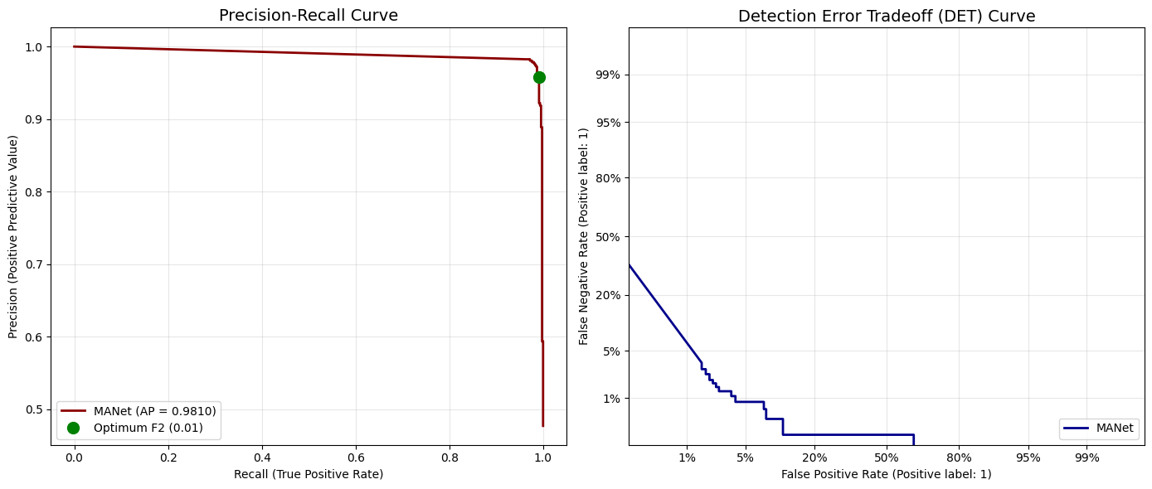

Slide 14
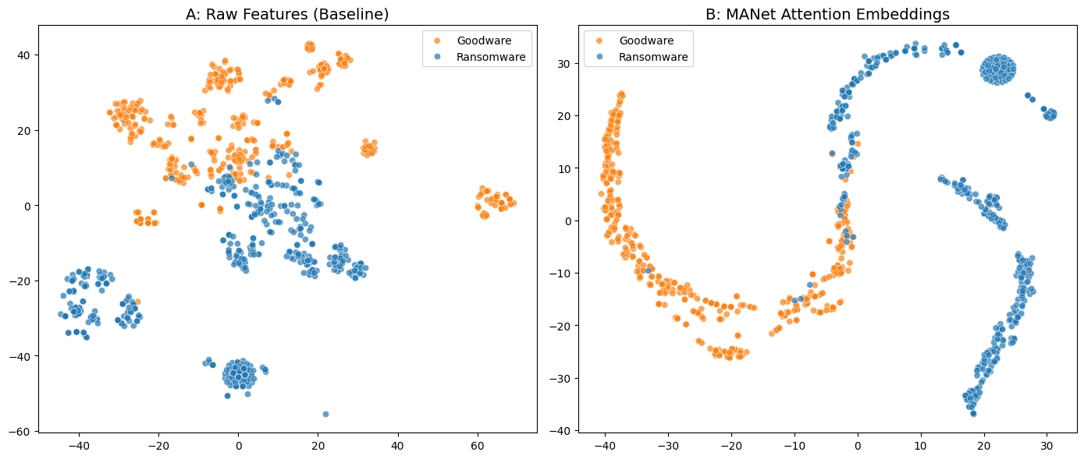

Slide 15
Conclusion
13 / 17
Problem Addressed
Architecture
Zero-day ransomware detection reformulated as a relational feature interaction problem using Multi-Head Self-Attention, overcoming the tabular independence fallacy.
483 RFE-selected features → 256-dim latent space → 8-head attention (512-dim FFN, residual, dropout) → calibrated binary classification.
Classification Performance
Zero-Day Generalisation
98.26% accuracy · F1 = 0.9817 · Brier Score = 0.0161 (33.5% below Random Forest) under strict TESSERACT chronological evaluation.
100% detection accuracy on all 14 Akira samples — entirely absent from training — confirming relational attention generalises to unseen behavioral signatures.
SOC Deployment
Explainability
F2-optimised τ* = 0.3198 achieves 98.49% recall with only 9 false positives, directly reducing security operations centre alert fatigue.
Latent Attention Heatmaps reveal interaction structure of malicious co-activations, bridging deep learning accuracy with actionable cyber threat intelligence.
ECCT 2026 | MANet: Zero-Day Ransomware Detection | Ferdous, Pinky & Jyoti — RUET, Bangladesh

Slide 16
Future Research Directions
14 / 17
01 Real-Time Streaming Inference
02 VLM Threat Intelligence Synthesis
03 Cross-Dataset Generalisation
Replace bidirectional attention with a causal unidirectional variant to enable mid-execution interruption of the encryption lifecycle, supporting inline endpoint prevention.
Feed MANet's 2D Latent Attention Heatmaps into Vision-Language Models (VLMs) to automatically generate natural-language threat intelligence reports for SOC analysts.
Validate MANet on additional dynamic analysis datasets beyond MLRan across different sandbox environments and operating systems to establish broad applicability.
04 Multi-Family Zero-Day Validation
05 XAI User Study
Expand TESSERACT evaluation across multiple temporally disjoint zero-day families beyond the single Akira cohort to further strengthen generalisation claims.
Formally evaluate the operational utility of Latent Attention Heatmaps vs. scalar SHAP attribution through a controlled study with professional security operations analysts.
ECCT 2026 | MANet: Zero-Day Ransomware Detection | Ferdous, Pinky & Jyoti — RUET, Bangladesh

Slide 17
References (1/2)
15 / 17
[1] F. Pendlebury et al., "TESSERACT: Eliminating Experimental Bias in Malware Classification across Space and Time," USENIX Security 2019, pp. 729–746.
[2] A. Vaswani et al., "Attention Is All You Need," NeurIPS, vol. 30, 2017, pp. 5998–6008.
[3] S. M. Lundberg & S.-I. Lee, "A Unified Approach to Interpreting Model Predictions," NeurIPS, vol. 30, 2017, pp. 4765–4774.
[4] M. T. Ribeiro et al., "Why Should I Trust You?: Explaining the Predictions of Any Classifier," ACM SIGKDD 2016, pp. 1135–1144.
[5] A. Barredo Arrieta et al., "Explainable Artificial Intelligence (XAI): Concepts, Taxonomies, Opportunities and Challenges," Information Fusion, vol. 58, pp. 82–115, 2020.
[6] D. Ucci et al., "Survey of Machine Learning Techniques for Malware Analysis," Computers & Security, vol. 81, pp. 123–147, 2019.
[7] A. Continella et al., "ShieldFS: Forging an In-Kernel Privilege Anomaly Framework to Eliminate Ransomware," ACSAC 2016, pp. 737–748.
[8] D. Sgandurra et al., "Automated Dynamic Analysis of Ransomware," arXiv:1609.03020, 2016.
[9] A. Kharaz et al., "UNVEIL: A Large-Scale, Automated Approach to Detecting Ransomware," USENIX Security 2016, pp. 757–772.
ECCT 2026 | MANet: Zero-Day Ransomware Detection | Ferdous, Pinky & Jyoti — RUET, Bangladesh

Slide 18
References (2/2)
16 / 17
[10] G. Ke et al., "LightGBM: A Highly Efficient Gradient Boosting Decision Tree," NeurIPS, vol. 30, 2017, pp. 3146–3154.
[11] M. Vinayakumar et al., "Deep Learning Approach for Intelligent Intrusion Detection System," IEEE Access, vol. 7, pp. 41525–41550, 2019.
[12] C. Elkan, "The Foundations of Cost-Sensitive Learning," IJCAI 2001, pp. 973–978.
[13] A. Martin et al., "The DET Curve in Assessment of Detection Task Performance," Eurospeech 1997, pp. 1895–1898.
[14] S. O. Arik & T. Pfister, "TabNet: Attentive Interpretable Tabular Learning," AAAI, vol. 35, no. 8, 2021, pp. 6679–6687.
[15] X. Huang et al., "TabTransformer: Tabular Data Modeling Using Contextual Embeddings," arXiv:2012.06678, 2020.
[16] L. van der Maaten & G. Hinton, "Visualizing Data Using t-SNE," JMLR, vol. 9, pp. 2579–2605, 2008.
[17] A. Niculescu-Mizil & R. Caruana, "Predicting Good Probabilities with Supervised Learning," ICML 2005, pp. 625–632.
ECCT 2026 | MANet: Zero-Day Ransomware Detection | Ferdous, Pinky & Jyoti — RUET, Bangladesh

Slide 19
Acknowledgement
17 / 17
The authors express sincere gratitude to the Department of Electrical & Computer Engineering, Rajshahi University of Engineering & Technology (RUET), Bangladesh, for providing the computational resources and academic environment that supported this research.
Special thanks to the creators of the MLRan dataset and the TESSERACT evaluation framework for enabling rigorous chronological zero-day evaluation, and to the open-source communities behind PyTorch and PptxGenJS.
Nabila Ferdous
Sadia Sultana Pinky
Oishi Jyoti
ECE Dept. · RUET · Bangladesh
ECE Dept. · RUET · Bangladesh
ECE Dept. · RUET · Bangladesh
ECCT 2026 | MANet: Zero-Day Ransomware Detection | Ferdous, Pinky & Jyoti — RUET, Bangladesh

