Slide 1

MULTIMODAL SOCIAL MEDIA CLASSIFICATION FOR DISASTER RESPONSE UTILIZING CLIP-BASED DEEP FUSION
Course Title: Thesis/Project-I
Course Code: ECE 4000
Presented by:
Nabila Ferdous
  2010035
  Dept. Of ECE, RUET
Supervised by:
Moloy Kumar Ghosh
Lecturer,
Dept. Of ECE, RUET
  Heavens Light is our Guide
  Department of Electrical & Computer Engineering
  Rajshahi University of Engineering & Technology

Slide 2
OUTLINES
01
Introduction
06
Dataset
02
Motivation
07
Proposed Methodology
03
Literature Review
08
Results & Analysis
04
09
Future Work
Research Gap
05
Objectives
10
References

Slide 3
INTRODUCTION
Impact of Disasters: Natural catastrophes such as floods, earthquakes, and hurricanes result in widespread destruction of infrastructure and significant loss of human life.
Need for Rapid Assessment: Following a disaster, immediate damage evaluation is critical for the effective coordination of search and rescue operations and the strategic allocation of emergency resources.
Limitations of Manual Methods: Traditional, manual procedures for assessing damage are frequently time-consuming, inefficient, and often impossible to implement safely in a crisis.

Slide 4
INTRODUCTION(cont’d)
Role of Social Media: Digital platforms like Twitter have become essential sources for gathering real-time, ground-level information during emergencies.
Data Complexity: Information from social media is inherently heterogeneous, comprising a mix of text, images, and video content that requires sophisticated processing.
Requirement for Automation: To effectively process and utilize these diverse data streams, there is an urgent need for advanced, automated multimodal classification systems.

Slide 5

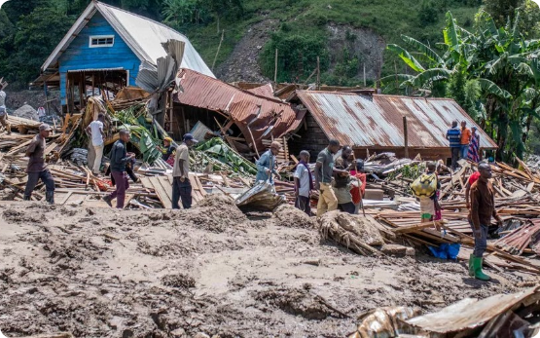
INTRODUCTION
Modern disaster informatics relies on real-time situational awareness. Social media platforms like X act as ubiquitous sensor networks.
Signal-to-Noise Ratio: Millions of posts, but only a minute fraction contains "Actionable Information."
Manual Monitoring: Humanly impossible due to sheer velocity and volume of Big Data.
Research Focus: Developing an advanced AI framework for automatic "Informative" classification.

Slide 6
MOTIVATION
Unimodal analysis (text-only or image-only) often fails to capture the full context of a crisis. For instance, a text post might be vague without its accompanying image, or an image might be non-informative without its caption.
Synergy: Multimodal architectures consistently outperform single-modality models.
According to United States Annual Report, Around 90,000 individuals receive a diagnosis of a primary brain tumor annually.
Magnetic Resonance Imaging (MRI) is frequently used in the medical field to classify brain tumors.
In medical imaging technology, experienced radiologists are using deep learning models to accurately classify brain tumors, enhancing diagnostic accuracy and efficiency.

Slide 7

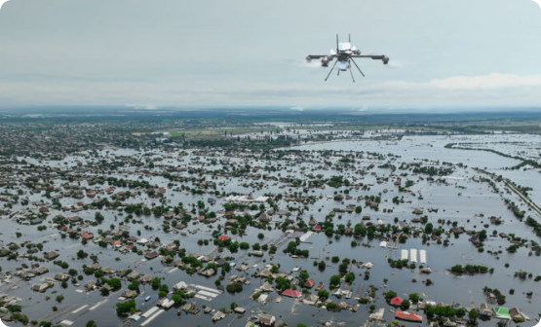
MOTIVATION
Bridging High-Accuracy with Real-World Tools
A rescue drone in a network-destroyed flood zone must process data on-board to identify survivors or road damage.
Computational Heaviness: Existing models require powerful server GPUs (NVIDIA A100s).
Semantic Ambiguity: Text/Image in isolation often fails context. "Water is rising" + (Flood Photo) = Urgent.
The Solution: Efficient Multimodal Learning via CLIP architecture.
04/28/2024
7

Slide 8
LITERATURE REVIEW
01
Title: BanglaMM-Disaster: A Multimodal Transformer-Based Deep Learning Framework for Multiclass Disaster Classification in Bangla
Authors : Ariful Islam, Md. Mahmudul Arif, Md Arifur Rahman, Md Rifat Hossen, Abdullah Al Noman
Dataset: The authors constructed a new dataset of 5,037 Bangla social media posts, each containing an image and a caption, annotated into nine disaster-related categories (e.g., Floods, Agricultural Damage).
Methodology: The framework integrates transformer-based text encoders (BanglaBERT, mBERT, and XLM-ROBERTa) with CNN backbones (ResNet50, DenseNet169, MobileNetV2). It employs early fusion through feature concatenation to enable cross-modal feature interactions, achieving a best accuracy of 83.76%.
Limitations:
Model Weight: The architectural choices prioritized computational efficiency, potentially sacrificing the higher performance offered by heavier models like Vision Transformers (ViT).
Data Scale: The newly created dataset is relatively small (5,037 posts) compared to major global disaster datasets.

Slide 9
LITERATURE REVIEW
02
Title: Disaster Image Classification by Fusing Multimodal Social Media Data
Authors: Zhiqiang Zou, Hongyu Gan, Qunying Huang, Tianhui Cai, Kai Cao
Dataset: The study utilizes the CrisisMMD dataset, which consists of several thousand manually annotated tweets and images collected during seven major natural disasters in 2017 (e.g., Hurricane Irma, Mexico Earthquake).
Methodology: The researchers proposed a multimodal fusion approach integrating visual and textual features. A deep learning method (VGG16) is used for image feature extraction, while a FastText framework is employed for textual features. These features are fused via a concatenating operation and passed through three fully connected layers and a SoftMax layer for final classification.
Limitations:
Simplistic Fusion Logic: The model relies on a basic concatenation strategy for fusing modalities rather than more advanced, cross-modal attention-based fusion.
Architectural Gap: The study does not explore "new age" transformer models for the fusion process, which could more effectively capture the intricate relationships between text and images.

Slide 10
LITERATURE REVIEW
03
Title: The ERMES chatbot: A conversational communication tool for improved emergency management and disaster risk reduction
Authors: Angelica Urbanelli, Antonella Frisiello, Luca Bruno, Claudio Rossi
Dataset: Validation was performed through four in-field demonstration events based on realistic emergency scenarios in Corsica (France), Piedmont (Italy), Catalonia (Spain), and Thessaloniki (Greece). A total of 52 organizations and approximately 240 people participated in the validation process.
Methodology: The research follows a User-Centred Design (UCD) approach, involving end-users in requirement definition, technical design, and final validation. The system, named ERMES Chatbot, is implemented on the Telegram platform to facilitate real-time bidirectional communication between control centers, field forces, and citizens. It includes a gamification strategy (points, badges, leaderboards) to boost citizen engagement and situational awareness.
Limitations:
Target Audience Constraint: The current research primarily focuses on the citizen dimension of the chatbot, leaving the validation of professional emergency practitioner functionalities for future work.

Slide 11
LITERATURE REVIEW
04
Title: Analysis of Multimodal Social Media Data Utilizing VIT Base 16 and GPT-2 for Disaster Response
Authors: Shilpa Gite, Shruti Patil, Biswajeet Pradhan, Madhuri Yadav, Sneha Basak, Arundarasi Rajendra, Abdullah Alamri, Kaustubh Raykar, Ketan Kotecha
Dataset: The study employs the CrisisMMD dataset, focusing on the first task of classifying whether a tweet is informative or not. It includes 16,058 tweets and 18,082 images.
Methodology: This approach uniquely combines two advanced transformer models: Vision Transformer (ViT Base 16) for image modality and GPT-2 for text modality. The predictions from both models are concatenated and passed through an ensemble Random Forest Classifier to determine the final label. This method outperformed traditional CNN-based models by 13.23%.
Limitations:
Lack of Tuning: The researchers did not perform hyperparameter tuning using specified optimization techniques, identifying this as a primary area for future analysis.

Slide 12
LITERATURE REVIEW
05
Title: VLCE: A Knowledge-Enhanced Framework for Image Description in Disaster Assessment
Authors: Md. Mahfuzur Rahman, Marufa Kamal, Sunzida Siddique, Mohd Ariful Haque, Kishor Datta Gupta, Fahad Rahman, Ahmed Rafi Hasan, Roy George
Dataset Utilizes xBD (12,738 satellite images) and RescueNet (4,494 UAV images captured after Hurricane Michael).
Methodology: Introduces the Vision Language Caption Enhancer (VLCE), which integrates semantic knowledge from ConceptNet and WordNet to enrich disaster descriptions. It employs YOLOv8 for object detection to prompt Vision-Language Models (LLaVA and QwenVL). The framework uses two specialized architectures: CNN-LSTM for satellite imagery and a Vision Transformer (ViT) for UAV imagery.
Limitations:
High Dependence on External Knowledge: Performance drops drastically (below 2%) without ConceptNet and WordNet.
Variable Semantic Alignment Gains: Knowledge integration improves informativeness, but effects on CLIPScore vary by model and dataset.

Slide 13
RESEARCH GAP
While Generalist Vision-Language Models (VLMs) show great progress, they often lack the domain-specific expertise required for disaster scenarios.
Semantic Noise: Many models struggle with the "noise" of social media, where images and text may be misaligned.
Fine-Grained Severity: Most existing research focuses on broad classification rather than specific damage severity levels (Mild vs. Severe).
Training Stability: Standard fine-tuning often leads to "model collapse" on imbalanced disaster datasets.

Slide 14
OBJECTIVES
Informativeness: A binary filtering layer to distinguish informative from non-informative data
To apply a "Deep Fusion" strategy that extracts joint feature embeddings, replacing traditional "Late Fusion" ensemble methods (e.g., ViT + GPT-2).
To evaluate the proposed model's performance against the baseline in terms of accuracy, precision, recall, and F1-score.
To assess the computational efficiency of the VLM approach compared to complex deep learning ensembles.
To compare VGG19, EfficientNetB0 and DenseNet121 with other models that have more parameters.
To investigate the performance of designed model in terms of accuracy and respond time and losses.
To overcome the limitations of current algorithms.

Slide 15
PROPOSED METHODOLOGY
Dataset Images
Image Preprocessing
Applying DL models (VGG19, EfficientNetB0,&DenseNet121)
Extracted Feature
  Meningioma Tumor
Classification
Result
  Glioma Tumor
Pituitary tumor
No tumor
Fig.4: Methodology Scheme

Slide 16
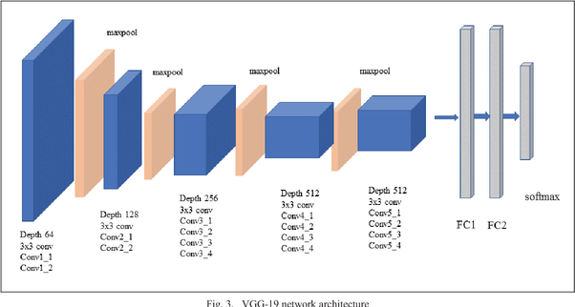
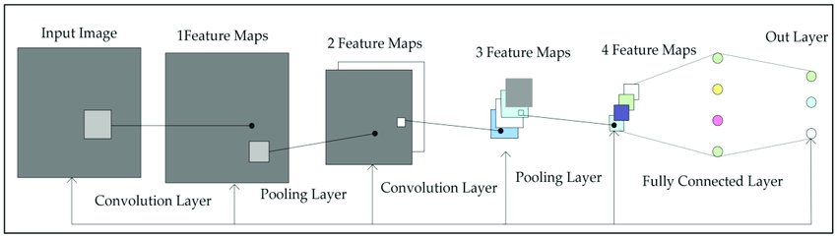
PROPOSED METHODOLOGY
Fig 6: Proposed VGG19 Model Architecture [6]
Fig 7: Proposed DenseNet121 Model Architecture [7]

Slide 17
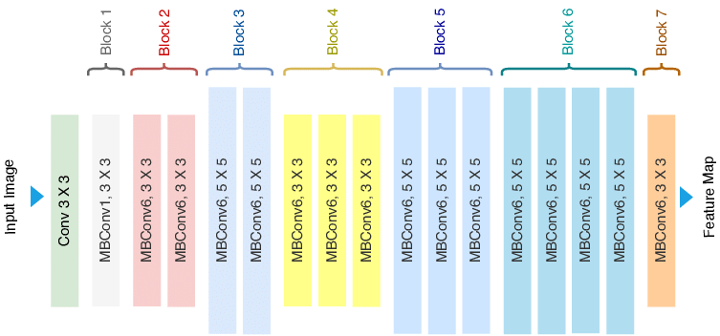
PROPOSED METHODOLOGY
Fig 8: Proposed EfficientNetB0 Model Architecture [8]

Slide 18

DATASET
I have selected The study utilizes the CrisisMMD dataset
Training Set: 14,465 samples for multimodal feature alignment.
Testing Set: 3,617 samples for high-precision 91% benchmark evaluation.
Metric | Value
Total Tweets (Text samples) | 16,058
Total Images (Visual samples) | 18,082
Number of Natural Disasters Covered | 7

Slide 19
PREPROCESSING
Dataset Splitting:
  Training Data (80%)
  Test Data (20%)

Slide 20
PREPROCESSING
One Hot Encoding:
Using this method, each tumor type gets translated into a distinct binary array. Here’s is a way to represent the classes using one-hot encoding:
Glioma cases: [1, 0, 0, 0]
Meningioma cases: [0, 1, 0, 0]
Pituitary cases: [0, 0, 1, 0]
No tumor cases: [0, 0, 0, 1]

Slide 21
PRETAINED MODEL PARAMETER
TABLE 1.1 MODEL PARAMETERS FOR VGG19
Parameter Name | Attribute
No. of convolution layer | 16
No. of pooling layer | 5
Weights | ImageNet
Mode | max
Callbacks | callbacks_checkpoints4
Activation Function | Softmax, Relu
Number of epochs | 50
Batch size | 32
Loss Function | categorical_crossentropy
Optimizer | Adam

Slide 22
PRETAINED MODEL PARAMETER
TABLE 1.2 MODEL PARAMETERS FOR DENSENET121
Parameter Name | Attribute
Block contain no. of convolution layer | 5
No. of pooling layer ( GlobalAveragePooling2D) | 4
Weights | ImageNet
Verbose | 1
Callbacks | TensorBoard, ModelCheckpoint, ReduceLROnPlateau
Mode | Auto
Dropout rate | 0.5
Factor | 0.3
Patience | 2
Min delta | 0.001
Activation Function | Softmax
Number of epochs | 20
Batch size | 32
Loss Function | Categorical cross-entropy
Optimizer | Adam

Slide 23
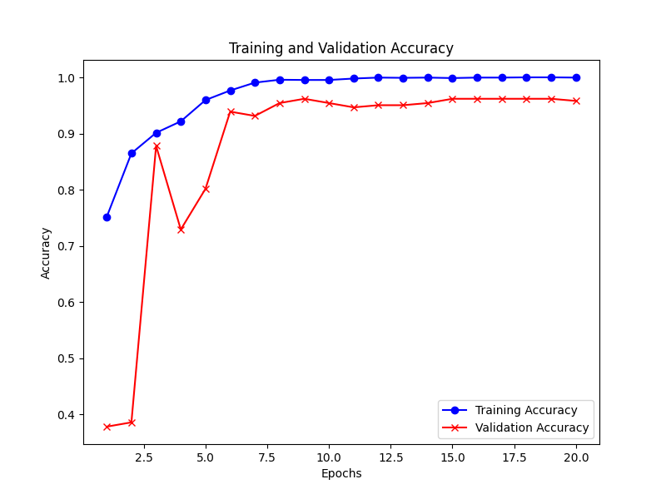
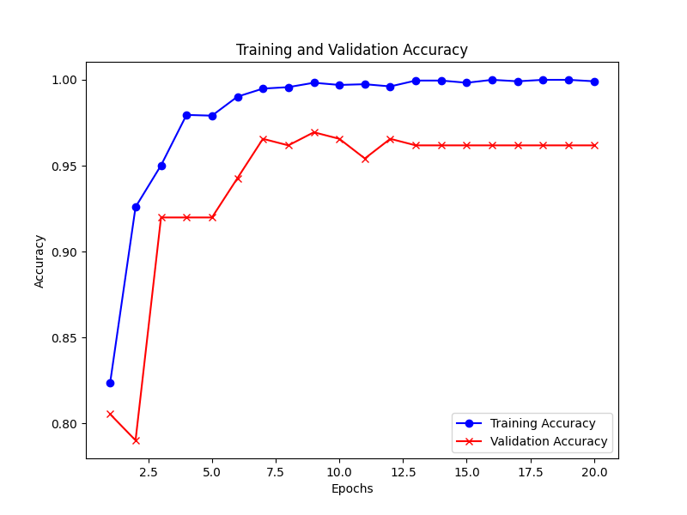
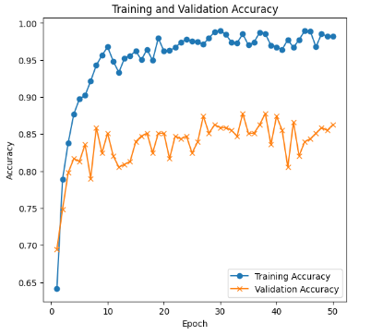
RESULTS & ANALYSIS
Accuracy Graph: Accuracy graph for Training and Validation data
Fig 10: Accuracy graph for VGG19
Fig 11: Accuracy graph for DenseNet121
Fig 12: Accuracy graph for EfficientNetB0

Slide 24
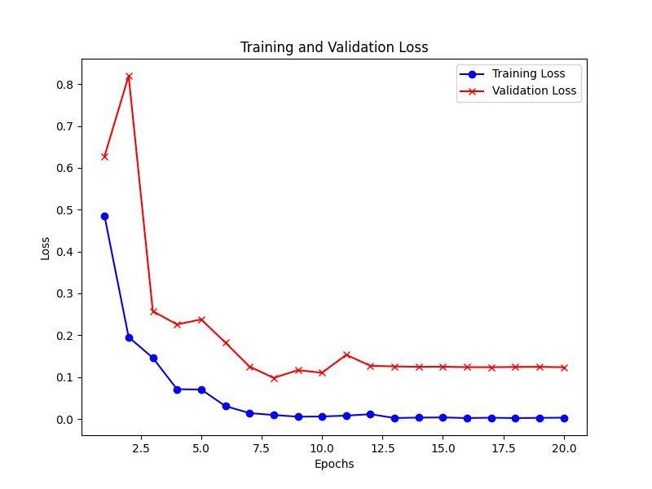
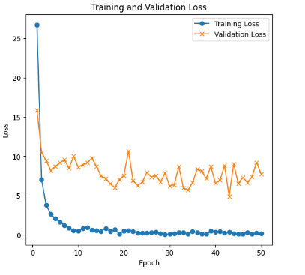
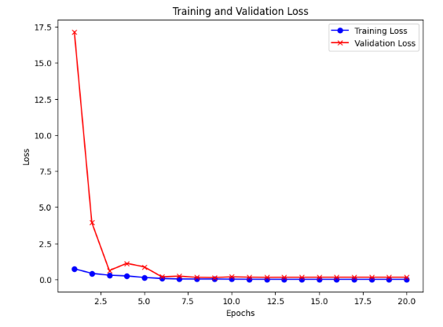
RESULTS & ANALYSIS
Loss Graph: Loss graph for Training and Validation data
Fig 13: Loss graph for VGG19
Fig 14: Loss graph for DenseNet121
Fig 15: Loss graph for EfficientNetB0

Slide 25
RESULTS & ANALYSIS
Classification Report: Classification report for the proposed models
TABLE 1.4 CLASSIFICATION REPORT FOR VGG19
TABLE 1.5 CLASSIFICATION REPORT FOR DENSENET121
TABLE 1.6 CLASSIFICATION REPORT FOR EFFICIENTNETB0
 | Precision | Recall | F-1 score
0 | 0.84 | 0.79 | 0.81
1 | 0.87 | 0.84 | 0.85
2 | 0.83 | 0.87 | 0.85
3 | 0.93 | 0.95 | 0.94
Accuracy |  |  | 0.86
 | Precision | Recall | F-1 score
0 | 0.98 | 0.94 | 0.96
1 | 0.97 | 0.98 | 0.98
2 | 0.96 | 0.97 | 0.97
3 | 0.97 | 0.99 | 0.98
Accuracy |  |  | 0.97
 | Precision | Recall | F-1 score
0 | 0.98 | 0.96 | 0.97
1 | 0.98 | 0.99 | 0.99
2 | 0.97 | 0.97 | 0.97
3 | 0.98 | 1.00 | 0.99
Accuracy |  |  | 0.98

Slide 26
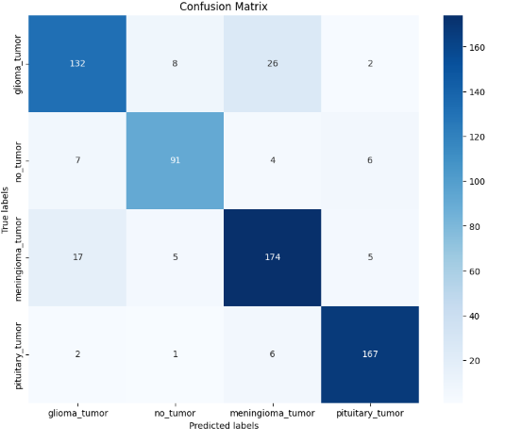
RESULTS & ANALYSIS
Confusion Matrix:
Fig 16: Confusion Matrix for VGG19

Slide 27
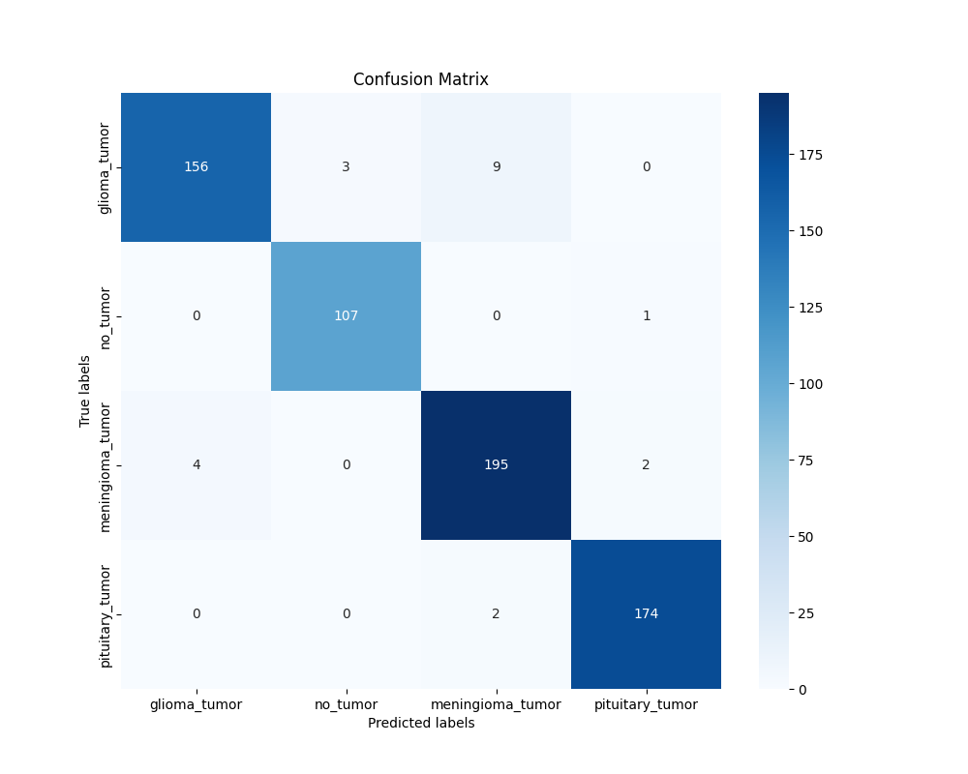
RESULTS & ANALYSIS
Confusion Matrix:
Fig 17: Confusion Matrix for DenseNet121

Slide 28
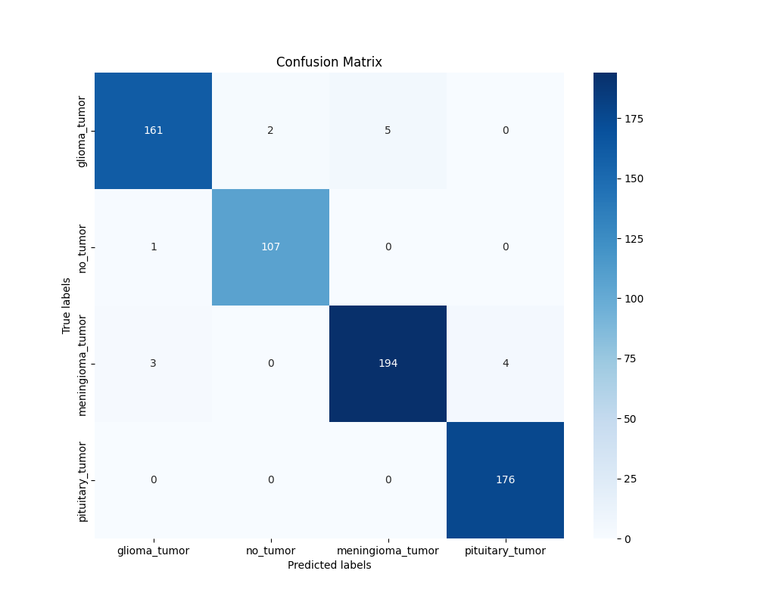
RESULTS & ANALYSIS
Confusion Matrix:
Fig 18: Confusion Matrix for EfficientNetB0

Slide 29
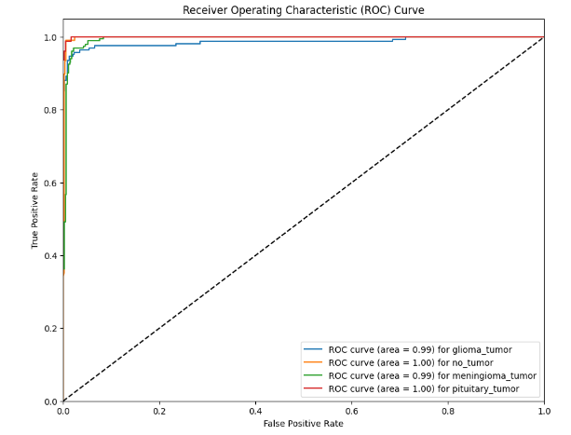
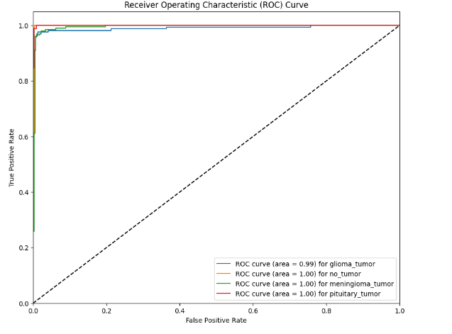
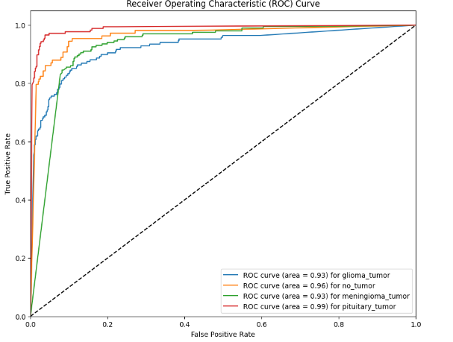
RESULTS & ANALYSIS
ROC Curve:
Fig 19: ROC curve for VGG19
Fig 20: ROC curve for DenseNet121
Fig 21: ROC curve for EfficientNetB0

Slide 30
RESULTS & ANALYSIS
Performance Report:
TABLE 1.7: PERFORMANCE REPORT OF THE PROPOSED MODEL
Model | Precision | Recall | F-1 score | Accuracy
VGG19 | 0.86 | 0.86 | 0.86 | 86.37%
DenseNet121 | 0.97 | 0.97 | 0.97 | 97.24%
EfficientNetB0 | 0.98 | 0.98 | 0.98 | 97.70%

Slide 31
RESULTS & ANALYSIS
State of Art :
TABLE 1.8: COMPARISON OF VARIOUS MODEL AND THE PROPOSED MODEL
Ref. No | Used Models\Methods | Accuracy (%)
[04] | CNN with pretrained VGG19 | 94.82
[09] | Convolutional Neural Networks (ConvNet) based on Transfer Learning (TL) | 96
[10] | SVM | 96.51
[02] | Feature Extraction | 95
[11] | Hybrid Ensemble | 95.2
[12] | CNN Ensemble | 95
 | Proposed VGG19 Model Proposed DenseNet121 Model Proposed EfficientNetB0 Model | 86.37 97.24 97.70

Slide 32
FUTURE WORK
Real-time Deployment: Integrating the model into a mobile chatbot interface similar to the ERMES system.
To develop a mobile app or web-based platform for doctors that allows for real-time updating of patient data
Using other models we can gain high performance.

Slide 33
REFERENCES
[1] Milica M. Badža , Marko C. Barjaktarovi´c, “Classification of Brain Tumors from MRI Images Using a Convolutional Neural Network” Innovation center, School of Electrical Engineering, University of Belgrade , 14 January 2020; Accepted: 12 March 2020; Published: 15 March 2020.
[2] Hamid, Marwan A. A. and Najeed Ahmed Khan. “Investigation and Classification of MRI Brain Tumors Using Feature Extraction Technique.” Journal of Medical and Biological Engineering 40 (2020): 307-317.
[3] Ali pashaei , Hedieh sajedi, Niloofar jazayeri , “Brain Tumor Classification via Convolutional Neural Network and Extreme Learning Machines” Computer and Knowledge Engineering (ICCKE 2018), October 25-26 2018.
[4] Swati, Zar Nawab Khan, Qinghua Zhao, Muhammad Kabir, Farman Ali, Zakir Ali, Saeed Ahmed, and Jianfeng Lu. “Brain tumor classification for MR images using transfer learning and fine-tuning.” Computerized Medical Imaging and Graphics 75 (2019): 34-46.

Slide 34
REFERENCES
[5] Hossam H. Sultan , Nancy M. Salem , And Walid Al-atabany, “Multi-Classification of Brain Tumor Images Using Deep Neural Network”, Digital Object Identifier 10.1109/ACCESS.2019.2919122
[6] Available from: https://blog.techcraft.org/vgg-19-convolutional-neural-network/ [accessed 24 Apr, 2024]
[7] Aditya Chatterjee, Ue Kiao, Geoffrey Z. "Architecture of DenseNet-121" Tokyo-Japan, September 2017
[8] Classification and understanding of cloud structures via satellite images with EfficientUNet - Scientific Figure on ResearchGate. Available from: https://www.researchgate.net/figure/Architecture-of-EfficientNet-B0-with-MBConv-as-Basic-building-blocks_fig4_344410350 [accessed 27 Apr, 2024]
[9] Musa, Usman Ibrahim, Queen Emmanuella Mensah, and Rasheed Falowo. “Intracranial-Tumor Detection and Classification System using Convnet and Transfer Learning.” International Research Journal of Engineering and Technology (IRJET)(Jan2023) e-ISSN: 2395-0056 p-ISSN: 2395-0072.

Slide 35
REFERENCES
[10] Polepaka, Sanjeeva, Ch Srinivasa Rao, and M. Chandra Mohan. “IDSS-based two stage classification of brain tumor using SVM.” Health and Technology 10, no. 1 (2020): 249-258.
[11] Hamid, Marwan A. A. and Najeed Ahmed Khan. “Investigation and Classification of MRI Brain Tumors Using Feature Extraction Technique.” Journal of Medical and Biological Engineering 40 (2020): 307-317.
[12] M. Y. B. Murthy, A. Koteswararao, and M. S. Babu, “Adaptive fuzzy deformable fusion and optimized CNN with ensemble classification for automated brain tumor diagnosis,” Biomed. Eng. Lett., vol. 12, no. 1,pp. 37_58, Feb.2.

Slide 36
THANK YOU

