Slide 1

Test2: Counting Inversions
Presented By
Nabila Shahnaz Khan

Slide 2
INPUT
For input two types of options are given:
Option 1: User can take input from STDIN
Option 2: User can take input from input file
#Command:: $python3 Test2.py <option> <input>
***Using ‘-h’ command, user can also ask for help

Slide 3
INPUT
# Option 1: Input from STDIN
Command:: $python3 Test2.py 1 <input_array>
Example:: $python3 Test2.py 1 [10 9 8 7 6 5 4 3 2 1]
Example:: $python3 Test2.py 1 [10, 9, 8, 7, 6, 5, 4, 3, 2, 1]
Example (where array contains new line)::
$python3 Test2.py 1 $'[620 147 382 872 643 741 491
232 754 464 898 405 179 194 828 895 788 769 30
170 527 301 116 385 108 36 423 797 434 673 517]'
# Option 2: Input from input file
Command:: $python3 Test2.py 2 <file_name>
Example:: $python3 Test2.py 2 test1000000.txt
# HELP:
Command:: $python3 Test2.py
or,
Command :: $python3 Test2.py 2 -h

Slide 4
OUTPUT
#Gives the number of inversions as output in the following format:
"Number of total inversions is:” <total_conversion_number>
Example: Number of total inversions is: 45

Slide 5
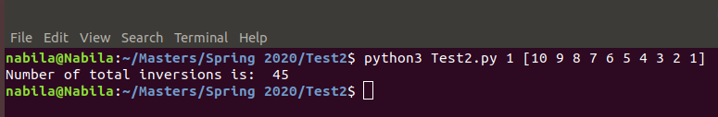
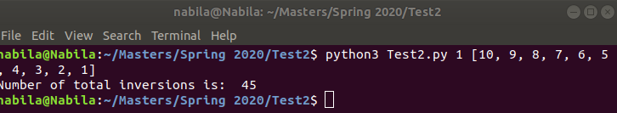
Simple Test Case
#For STDIN input of array [10 9 8 7 6 5 4 3 2 1]

Slide 6
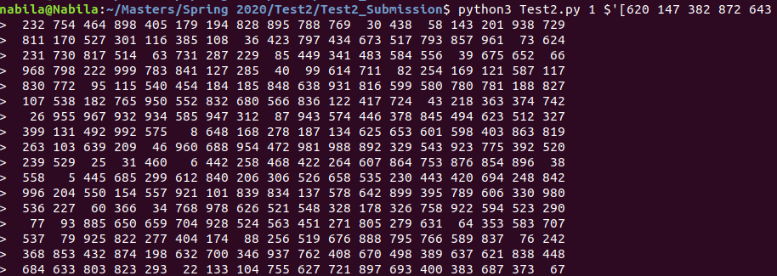
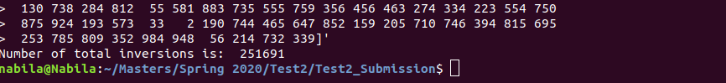
Test Case 1 (From STDIN)
#For input file "test1000.txt” (cropped the images as too large)

Slide 7
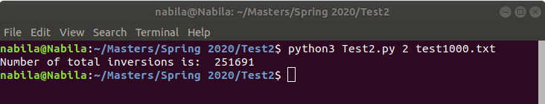
Test Case 1(from input file)
#For input file "test1000.txt”
Running in Personal Laptop (Quad Core, RAM 8GB)
#Runtime:: 0.049411793 s
#Memory:: RSS (resident set size) = 12.357632 MB

Slide 8
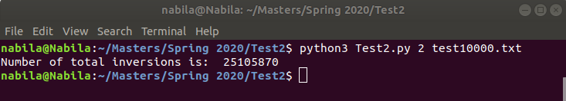
Test Case 2
#For input file "test10000.txt”
#Runtime:: 0.07913768800000001 s
#Memory:: RSS (resident set size) = 13.426688 MB

Slide 9
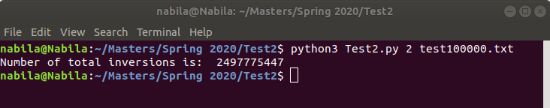
Test Case 3
#For input file "test100000.txt”
#Runtime:: 0.40266794 s
#Memory:: RSS (resident set size) = 18.087936 MB

Slide 10
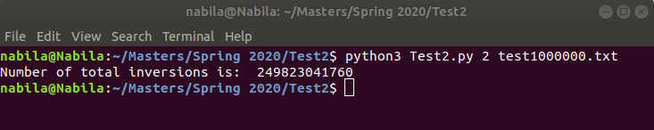
Test Case 4
#For input file "test1000000.txt”
#Runtime:: 4.478657145 s
#Memory:: RSS (resident set size) = 68.28032 MB

Slide 11
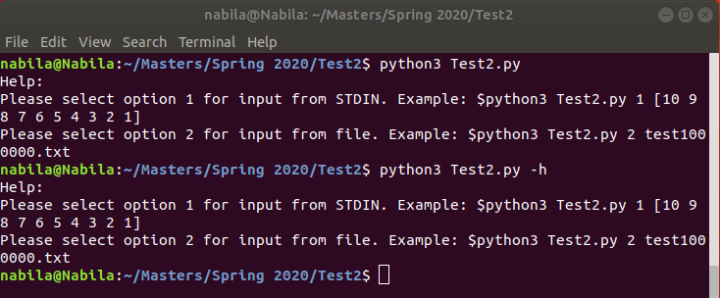
HELP
#For help command

Slide 12
THANK YOU

