Slide 1


Windows OS Malware Prediction Using Machine Learning
Project Group 32
Brandon Gray, William Holdren, Md Sanzid Bin Hossain, Nabila Shahnaz Khan
March 5, 2021

Slide 2
Outline
Background
Objectives
Data
Essential Tasks
Proposed Pipeline
References

Slide 3
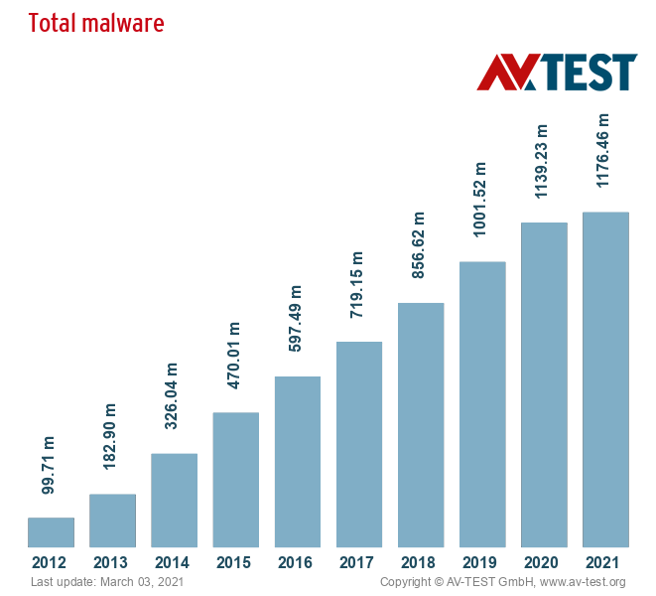
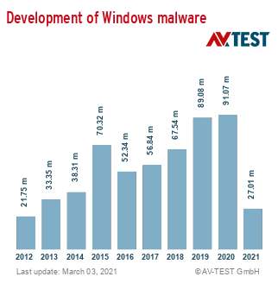
Background
Due to increased public use of the Internet, malware has become more widespread. People have been creating programs for malicious intent
According to AV-Test, there were about 99.71 million malware programs in 2012
In 2020, there were about 1,139.23 million
Now, there are over 350,000 new malware every day
This past February, there was a total of 17.85 million new malware
Indicates adversaries are finding new ways to circumvent existing defenses and measures; the malware industry is continuing to expand

Slide 4
Importance
As the number of existing malware programs continues to increase rapidly, the probability of Windows machines becoming infected has increased dramatically
Computers infected with malware can cause harm to consumers and businesses as well as compromise their private data
As the amount of digital traffic continues to increase, there will be an increasing need for digital security
Predicting the probability of whether a Windows machine is vulnerable to malware is of utmost importance
Being able to predict when a system is about to be infected by malware can help prevent the loss or theft of data
Accurately predicting malware infections can be difficult since it is dependent on many factors; leaving malware unchecked, such as with a false negative or missed scan, can severely damage a system

Slide 5
Objectives
Overall Objective
Binary Classification: Create a machine learning model that can accurately predict whether a Windows machine has been infected with malware
Specific Objectives
Preprocess the data and extract useful features for our models
Experiment with and refine several ML methods for accuracy and robustness to noise
Test and compare the models using cross validation

Slide 6
Data
Data was provided by Microsoft and hosted by Kaggle, derived from heartbeat and threat reports created by Windows Defender
The training dataset is comprised of 8,921,483 objects
Total size of the training data is approximately 4.08 GB, uncompressed
Each data object has up to 83 features
The dataset has two main classes:
Has detected malware
Has not detected malware

Slide 7
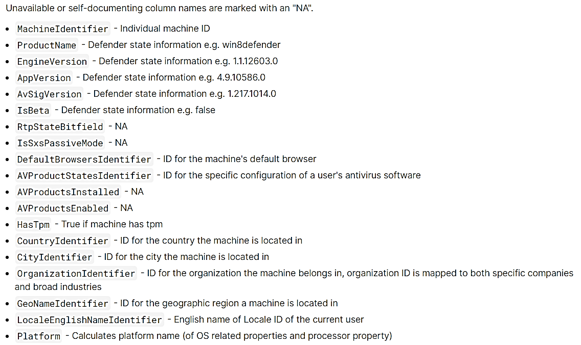
Data
The following images represent some of the features to consider, where each machine is represented by MachineIdentifier:

Slide 8
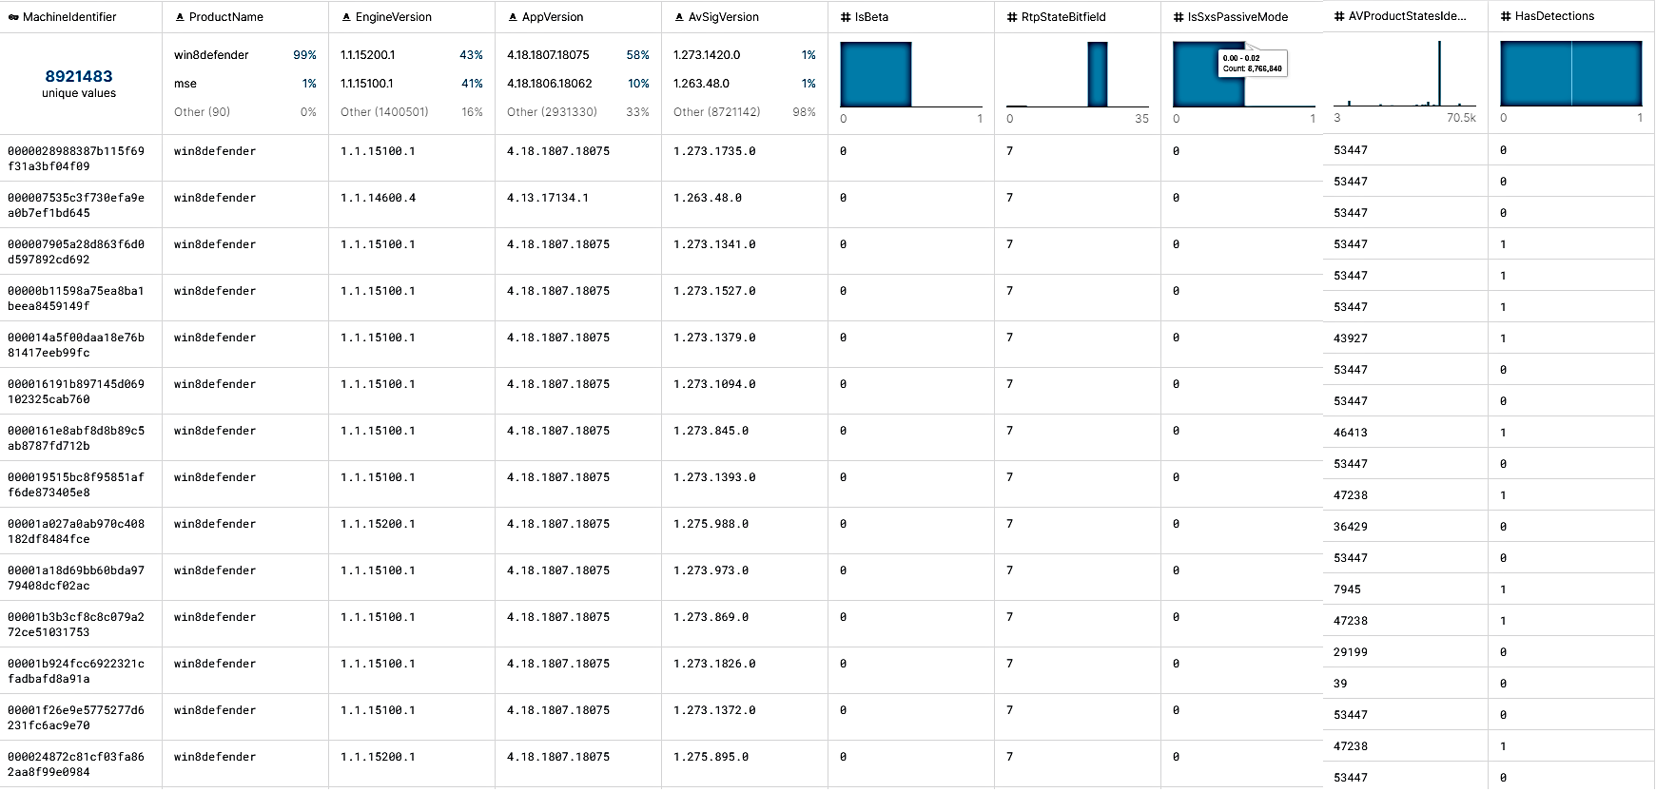
Data

Slide 9
Essential Tasks
Data Preprocessing:
Discarding the non-usable features
Finding Correlation between features and class-label
Handling features containing empty values
Selecting the important features
Predicting whether or not a machine is affected by a virus based on the selected attributes using binary classfier
Determining computers of which location, organization and platform are more prone to get affected by virus

Slide 10
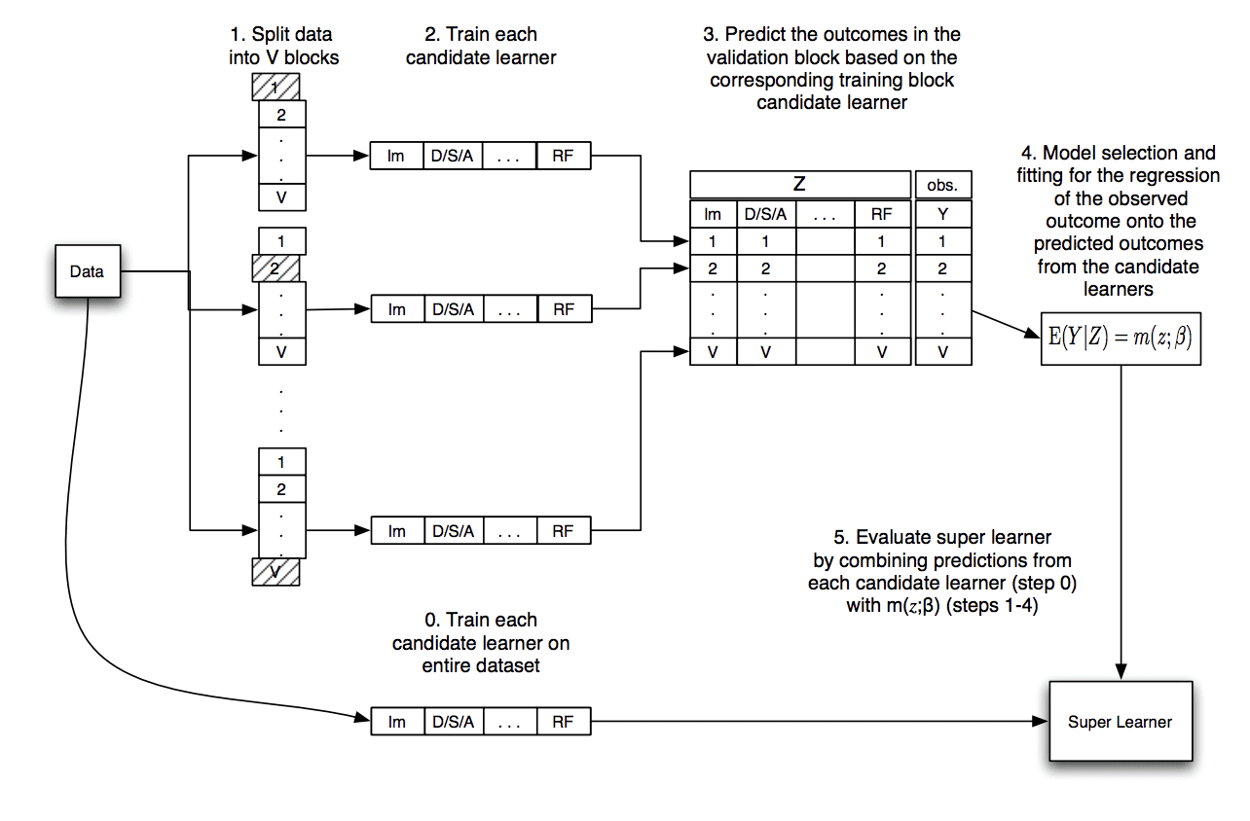
Proposed Pipeline
Implementing a Super Learner based on multiple learner models
Steps:
Splitting the training dataset into V blocks
Selecting m (m = 4) base models as base learners
Evaluate each base learner using k-fold cross-validation
Store all out-of-fold predictions of the base learners
Fit the base learners on the full training dataset and store
Fit a meta-model on the out-of-fold predictions as super leaner
Evaluate the super learner based on the testing dataset
Different Machine Learning Binary Classifier models to be used are: Gradient boosting, SVM, KNN, Random Forest
Figure: Data Flow of Super Learner Algorithm [3]

Slide 11
References
Kaggle Link: https://www.kaggle.com/c/microsoft-malware-prediction/overview
Malware statistics and figures: https://www.av-test.org/en/statistics/malware/
Dataflow of Super Learner Algorithm Figure: https://machinelearningmastery.com/super-learner-ensemble-in-python/?fbclid=IwAR0_s5RWG0cgZ246qA1doQHdloOL9ICjmJeFgzZRhqTdG65Ri8DSg_995gE

Slide 12


