Slide 1
Terrorism Alert System
Notes:
We designed this template so that each member of the project team has a set of slides with its own theme. Members, here’s how you add a new slide to just your set:
Mark where you want to add the slide: Select an existing one in the Thumbnails pane, click the New Slide button, then choose a layout. The new slide gets the same theme as the other slides in your set.
Careful! Don’t annoy your fellow presenters by accidentally changing their themes. That can happen if you choose a different theme from the Design tab, which changes all of the slides in the presentation to that look.

Slide 2
Group Members
Anusha Kabir (201414081)
Naznin Sultana (201414094)
Mehreen Haque (201414098)
Nabila Shahnaz Khan (201414105)
Anika Ibnat (201414109)
Adnan Sharif (201414114)
Ummey Hani (201214018)

Slide 3
Non scripted Test case
The apk file is not installable in all versions of android phones.
The application is not functional yet.
The database id not provided by developers.
If a button is pressed it shows “The page has stopped working.

Slide 4
UI
The color combination is not good
The buttons of app is not responsive
The scaling of input box is not correct.

Slide 5


Development Platform
Front end:
The language for the front end will be java, html, PHP, CSS etc.
Back end:
The language for the back end will be MySQL.

Slide 6
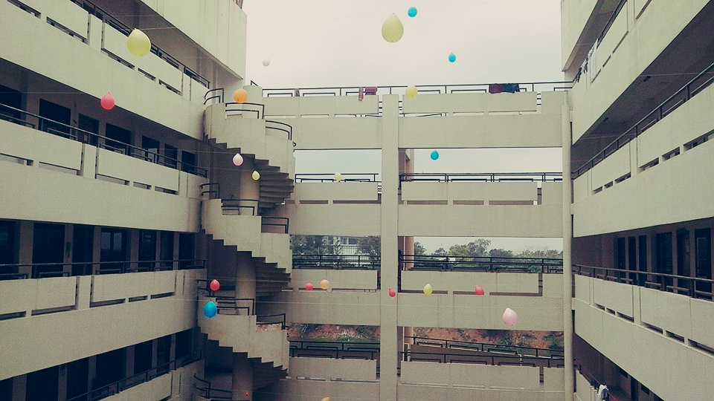
THANK YOU

