Slide 1
Osmani Hall Messing System
Notes:
We designed this template so that each member of the project team has a set of slides with its own theme. Members, here’s how you add a new slide to just your set:
Mark where you want to add the slide: Select an existing one in the Thumbnails pane, click the New Slide button, then choose a layout. The new slide gets the same theme as the other slides in your set.
Careful! Don’t annoy your fellow presenters by accidentally changing their themes. That can happen if you choose a different theme from the Design tab, which changes all of the slides in the presentation to that look.

Slide 2
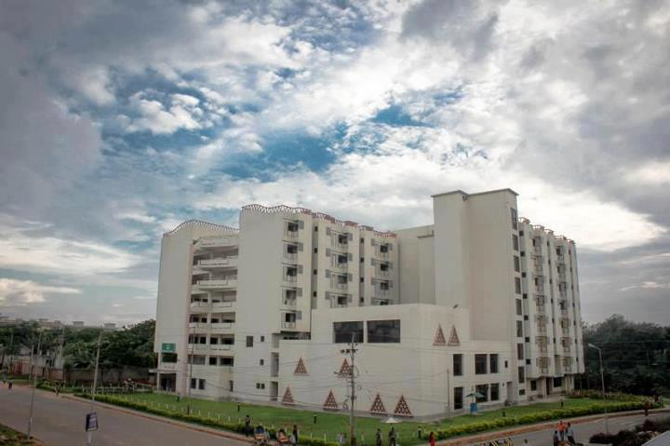

Slide 3
Group Members
Anusha Kabir (201414081)
Naznin Sultana (201414094)
Mehreen Haque (201414098)
Nabila Shahnaz Khan (201414105)
Anika Ibnat (201414109)
Adnan Sharif (201414114)
Ummey Hani (201214018)

Slide 4
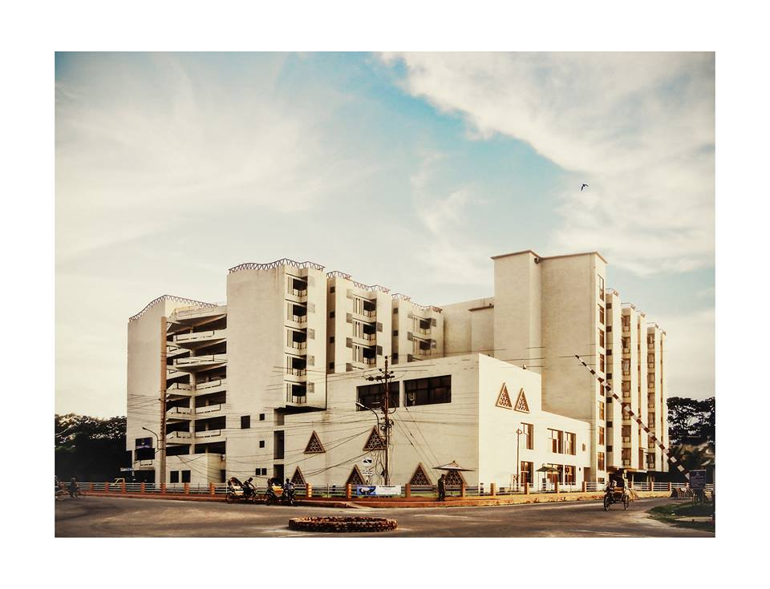
Aim
Make the billing system and meal signing system of Osmany Hall easier
Keep the students up-to-date about their bill payment status

Slide 5
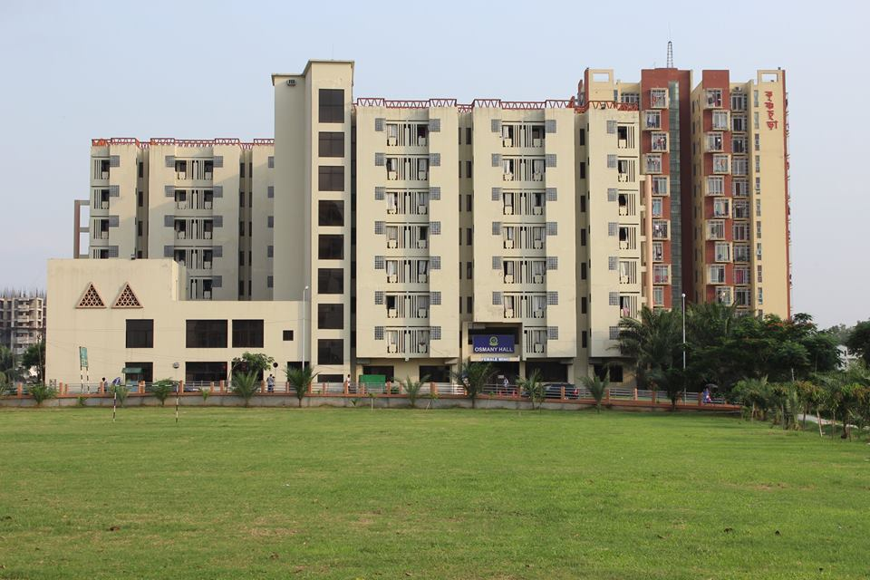
Aim
Let them check their dues and monthly food bill in details
Prevent from someone else signing their meal and prevent wastage of food in the hall.

Slide 6
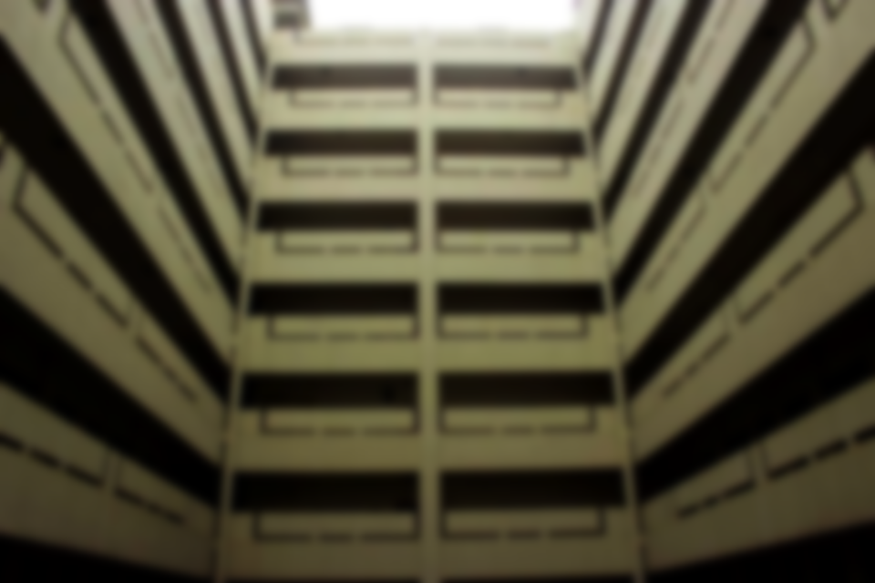
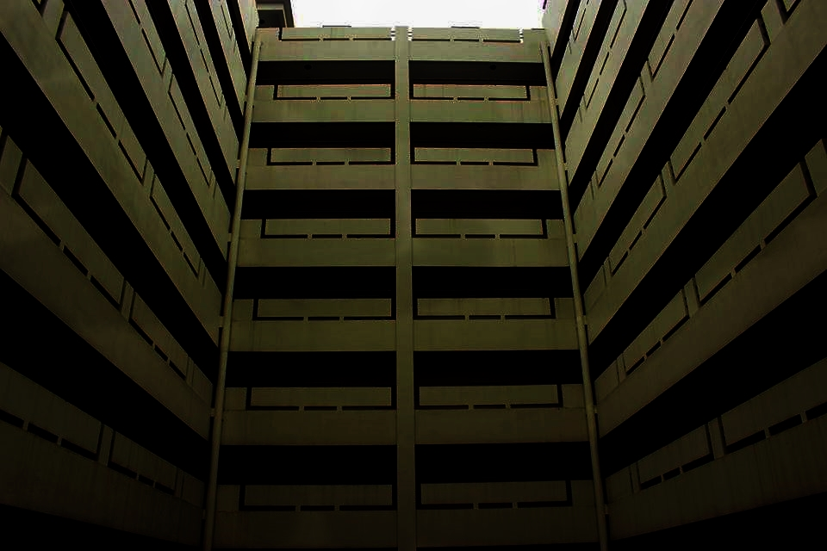
Main Features
Result 1
Result 2
Result 3
1.Our website will let the students check their bills and dues anytime anywhere online.
We will provide them the opportunity to sign their meal online using their own account. Thus they can sign their meal from their own rooms or anywhere and the time given can also be increased till 12 am
2.It will let the students see their food bill in their own account online and that too in details.
3. Hall manager will be able to give necessary notice in the website.

Slide 7
Main Features
Result 1
Result 2
Result 3
4.We will provide them the opportunity to sign their meal online using their own account. Thus they can sign their meal from their own rooms or anywhere and the time given can also be increased till 12 am
We will provide them the opportunity to sign their meal online using their own account. Thus they can sign their meal from their own rooms or anywhere and the time given can also be increased till 12 am
5.Wrongly charged meal due to sign of someone else can be stopped.

Slide 8
Main Features
Result 1
Result 2
Result 3
6.For the hall staffs we are providing them opportunities to include daily consupmtions.
7. The hall manager can open account of any student or hall staff, log in their accounts and edit necessary informations.
8. There will be facilities for the hall manager to turn off meal checking the bill.
We will provide them the opportunity to sign their meal online using their own account. Thus they can sign their meal from their own rooms or anywhere and the time given can also be increased till 12 am

Slide 9

Additional features
Sometimes students sign their meal but are unable to eat their meal, at such cases they will be give their meal to someone he prefers in the hall who hasn't signed his meal but need to eat at hall.
Important hall notices can be updated through this software which students can check online.

Slide 10

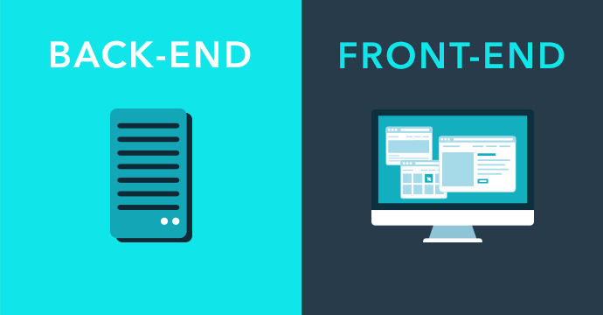
Development Platform
Front end:
The language for the front end will be java, html, PHP, CSS etc.
Back end:
The language for the back end will be MySQL.

Slide 11
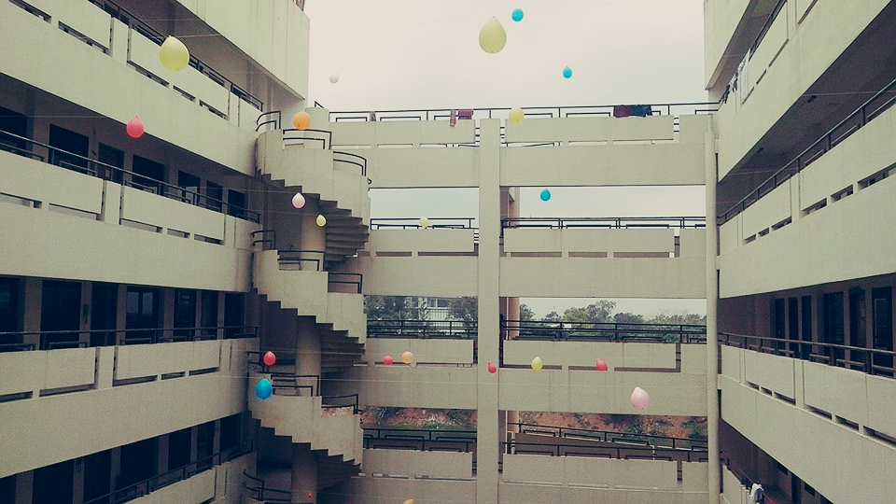
THANK YOU

