Slide 1

“Data wrangling and subsetting: GC content with loop and iteration”
by
Nabil Atallah, PhD
Notes:
Hello my nane is Nabil in this presentation we are going to find the GC content from a DNA sequence using loop and iteration in Python

Slide 2
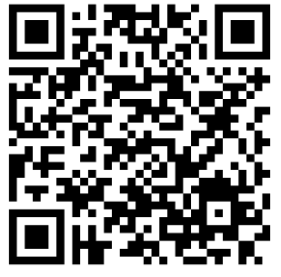
Contextualization: Why is it important to know the GC content ? (1 min)
Solution design: How to find the GC content from a DNA sequence (1 mins)
Coding and syntax: The for loop in Python (5 mins)
Reporting and visualizing results (2 mins)
Questions (1min)
You can access
Python installation instructions
Code used in this class
This PowerPoint presentation
This class transcription to pdf document (available within 1 hour after the presentation)
Nabilatallah/Python-for-Bioinformatics: Class notes (github.com)
Notes:
Hello my nane is Nabil in this presentation we are going to find the GC content from a DNA sequence using loop and iteration in Python

Slide 3

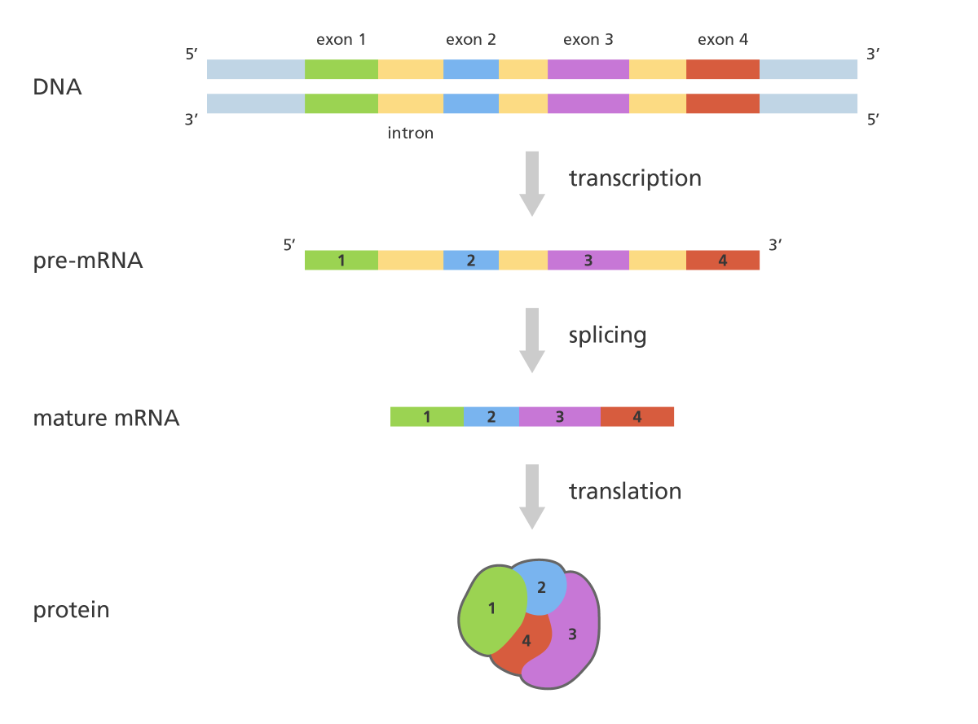
Why do we need to know the GC content percentage in a DNA sequence?
High GC content predicts a coding region (Exon)
In this stage, non-coding regions (Introns) are removed, and
coding regions (Exons) are joined together to form the mature mRNA
An illustration showing the process of RNA splicing. Image credit: Genome Research Limited
Notes:
DNA sequences with higher GC content generally have a higher melting temperature. Knowing the GC content helps In primer design for PCR (polymerase chain reaction) experiments, because primers with similar GC content can enhance specificity and efficiency.
It is also useful in gene prediction algorithm.
TeHigh GC content predicts a coding region.

Slide 4
How to find the GC content percentage in a DNA sequence?
An illustration showing the process of RNA splicing. Image credit: Genome Research Limited

Slide 5
How to find the GC content percentage in a DNA sequence?
DNA sequence:
CATGCTACGGTGCTAAAAGCATTACGCCCTATAGTGATTTTCGAGACATACTGTGTTTTTAAATATAGTATTGCC
An illustration showing the process of RNA splicing. Image credit: Genome Research Limited

Slide 6

How to find the GC content percentage in a DNA sequence?
DNA sequence:
CATGCTACGGTGCTAAAAGCATTACGCCCTATAGTGATTTTCGAGACATACTGTGTTTTTAAATATAGTATTGCC
Count the occurrences of C base: countc
Count the occurrences of G base: count g
Sum of countc and countg: sumgc
Find sequence length: sequence_length
Report results
An illustration showing the process of RNA splicing. Image credit: Genome Research Limited

Slide 7
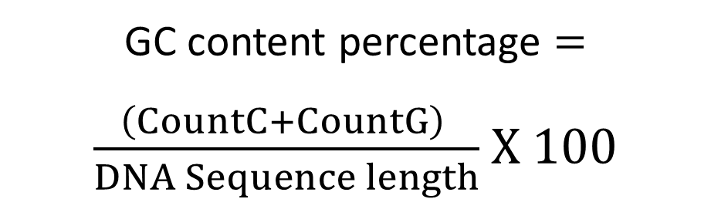
How to find the GC content percentage in a DNA sequence?
DNA sequence:
CATGCTACGGTGCTAAAAGCATTACGCCCTATAGTGATTTTCGAGACATACTGTGTTTTTAAATATAGTATTGCC
Count the occurrences of C base: countc
Count the occurrences of G base: count g
Sum of countc and countg: sumgc
Find sequence length: sequence_length
Report results
GC content percentage $=$
$\frac{\left(CountC+CountG\right) }{DNA Sequence length}$ $X 100$
An illustration showing the process of RNA splicing. Image credit: Genome Research Limited

Slide 8
How to find the GC content percentage in a DNA sequence?
base
#We store the sequence in a string variable . Let’s #name it sequence
sequence = “CATGCTACGGTGCTAAAAGCATTACGCCCTATAGTGATTTTCGAGACATACTGTGTTTTTAAATATAGTATTGCC”
#We determine the sequence’s length
sequence_length = len(sequence)
base is already in dictionary?
NO
Add base as a new key
YES
Increment base value count by +1
More bases in the sequence?
NO
Calculate GC content by getting the values from the dictionary
YES
END
Report results

Slide 9
How to find the GC content percentage in a DNA sequence?
base
#We store the sequence in a string variable . Let’s #name it sequence
sequence = “CATGCTACGGTGCTAAAAGCATTACGCCCTATAGTGATTTTCGAGACATACTGTGTTTTTAAATATAGTATTGCC”
#We determine the sequence’s length
sequence_length = len(sequence)
base is already in dictionary?
NO
Add base as a new key
YES
#We define d as dictionary
#We can also use d = {}
d = dict()
#To update the dictionary d we use the get() method
d[base] = d.get(base, 0) + 1
Increment base value count by +1
More bases in the sequence?
NO
Calculate GC content by getting the values from the dictionary
YES
END
Report results
base is the key
This the value

Slide 10
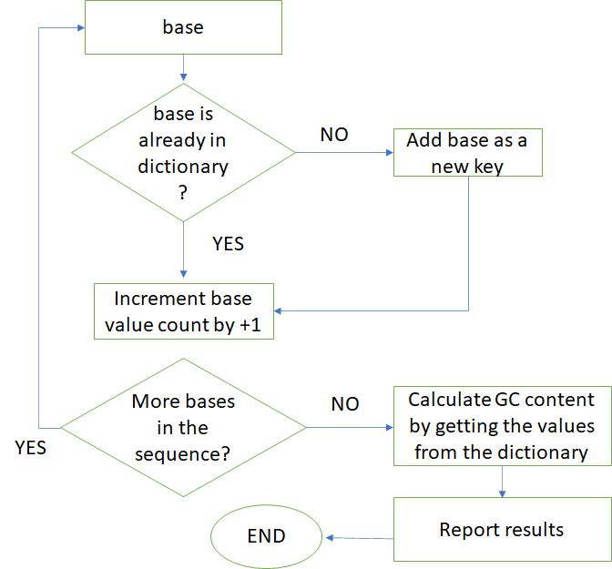
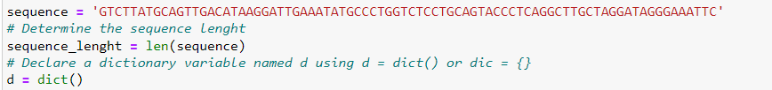
How to find the GC content percentage in a DNA sequence?
#We store the sequence in a string variable . Let’s #name it sequence
sequence = “CATGCTACGGTGCTAAAAGCATTACGCCCTATAGTGATTTTCGAGACATACTGTGTTTTTAAATATAGTATTGCC”
#We determine the sequence’s length
sequence_length = len(sequence)
#We define d as dictionary
#We can also use d = {}
d = dict()
#To update the dictionary d we use the get() method
d[base] = d.get(base, 0) + 1

Slide 11
How to find the GC content percentage in a DNA sequence?
#We store the sequence in a string variable . Let’s #name it sequence
sequence = “CATGCTACGGTGCTAAAAGCATTACGCCCTATAGTGATTTTCGAGACATACTGTGTTTTTAAATATAGTATTGCC”
#We determine the sequence’s length
sequence_length = len(sequence)
#We define d as dictionary
#We can also use d = {}
d = dict()
#To update the dictionary d we use the get() method
d[base] = d.get(base, 0) + 1
We need a Loop

Slide 12
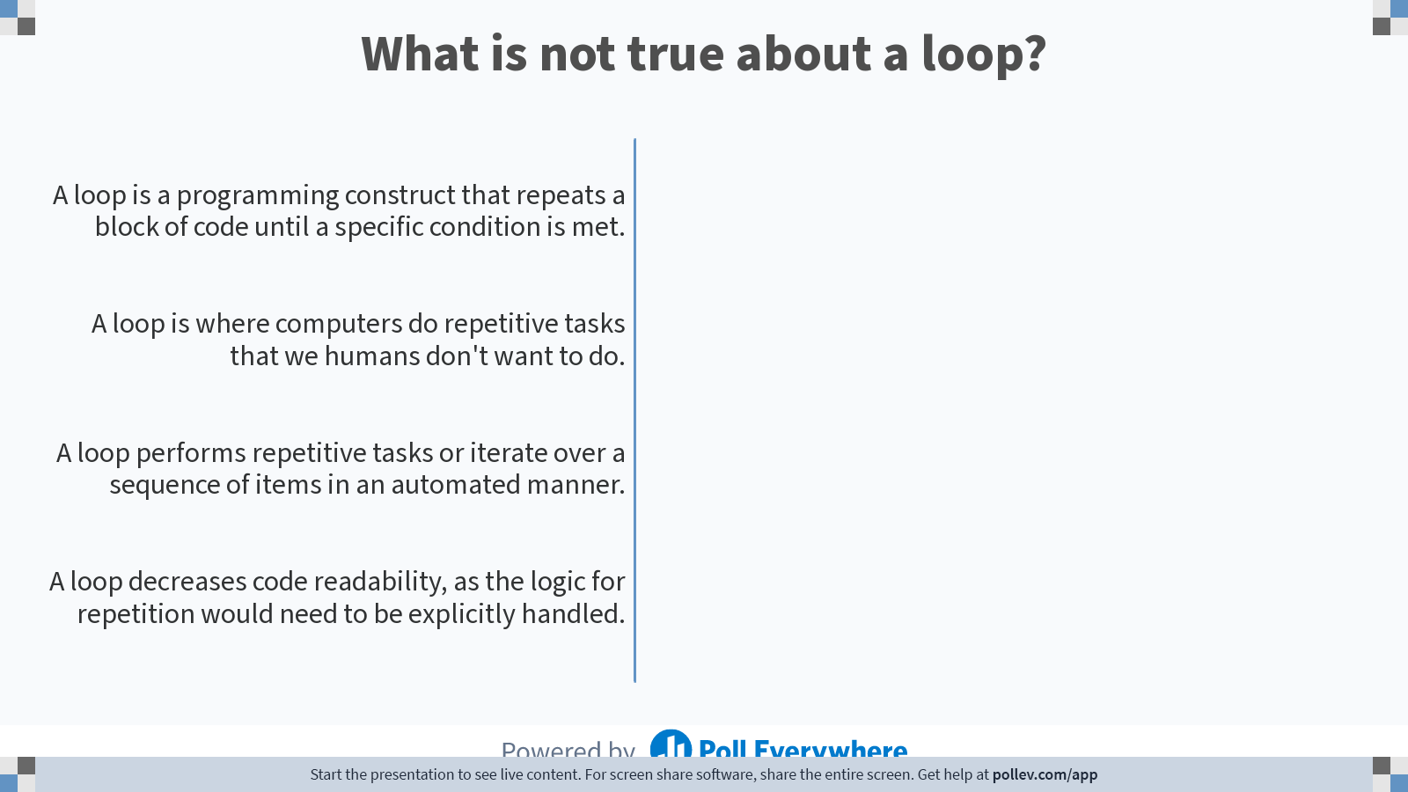
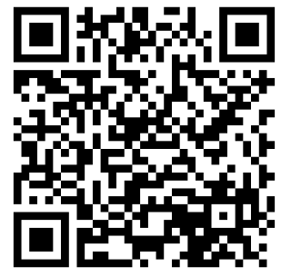
2 answers are allowed
Scan to participate
Participation is anonymous and not graded
Notes:
Poll Title: Do not modify the notes in this section to avoid tampering with the Poll Everywhere activity. More info at polleverywhere.com/support What is a loop? https://www.polleverywhere.com/multiple_choice_polls/2MLSKdvS2mf1UJ5f4Cq3e?state=opened&flow=Default&onscreen=persist

Slide 13
Python syntax: while and for loops
With the while loop we can execute a set of statements as long as a condition is true.

Slide 14

Python syntax: while and for loops
With the while loop we can execute a set of statements as long as a condition is true.

Slide 15
Python syntax: while and for loops
With the while loop we can execute a set of statements as long as a condition is true.

Slide 16
Python syntax: while and for loops
With the while loop we can execute a set of statements as long as a condition is true.
With the for loop, we can execute a set of statements, once for each item in a sequence.

Slide 17

Python syntax: while and for loops
With the while loop we can execute a set of statements as long as a condition is true.
With the for loop, we can execute a set of statements, once for each item in a sequence.

Slide 18

Python syntax: while and for loops
With the while loop we can execute a set of statements as long as a condition is true.
With the for loop, we can execute a set of statements, once for each item in a sequence.

Slide 19
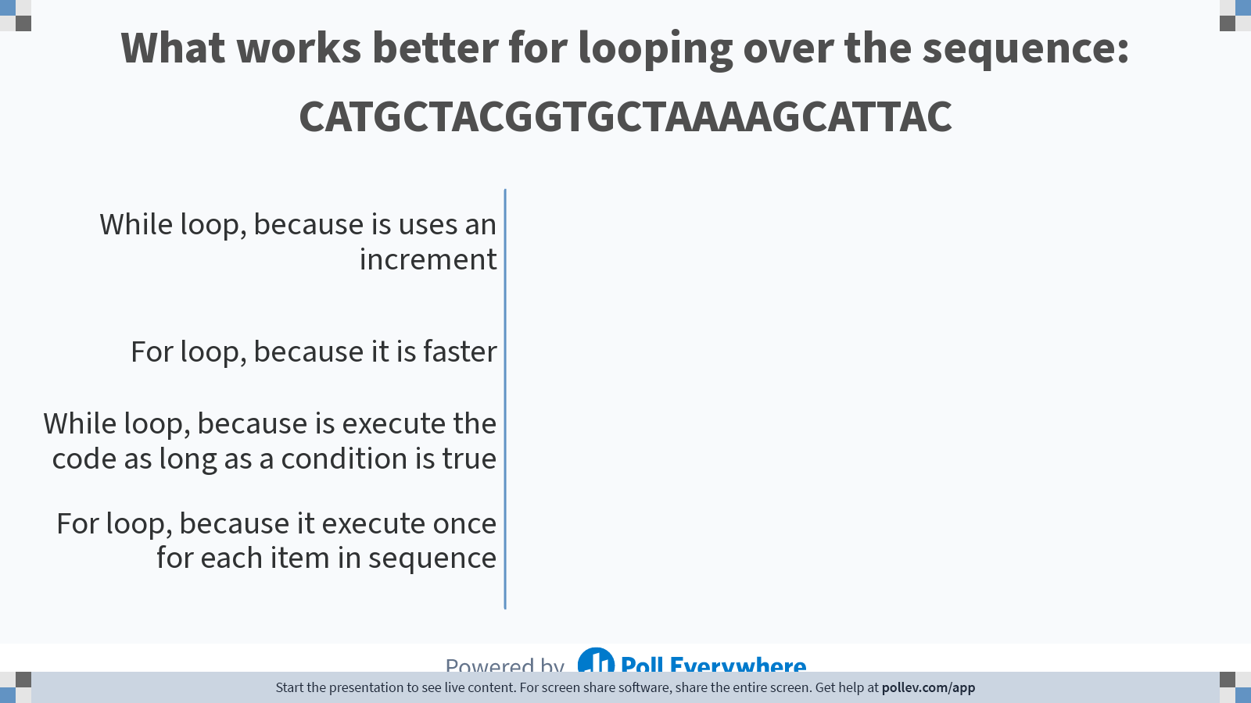
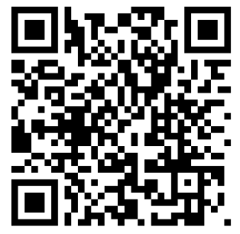
2 answers are allowed
Scan to participate
Participation is anonymous and not graded
Notes:
Poll Title: Do not modify the notes in this section to avoid tampering with the Poll Everywhere activity. More info at polleverywhere.com/support What works better for looping over the sequence: CATGCTACGGTGCTAAAAGCATTAC https://www.polleverywhere.com/multiple_choice_polls/8Wl4XKCVYoNdbWYOt2MgN?state=opened&flow=Default&onscreen=persist

Slide 20

Python syntax: for loops

Slide 21
Python syntax: for loops
for : all for loops start with the keyword for

Slide 22
Python syntax: for loops
for : all for loops start with the keyword for
Loop Variable “base”: the word after for is called the Loop Variable in this case we named it "base". With the in operator, it acts as a cursor going from position 0 to the last position of the sequence.

Slide 23
Python syntax: for loops
in is a membership operator that checks if an element is present in a sequence, and
in is used to iterate over elements in a sequence.
for : all for loops start with the keyword for
Loop Variable “base”: the word after for is called the Loop Variable in this case we named it "base". With the in operator, it acts as a cursor going from position 0 to the last position of the sequence.

Slide 24
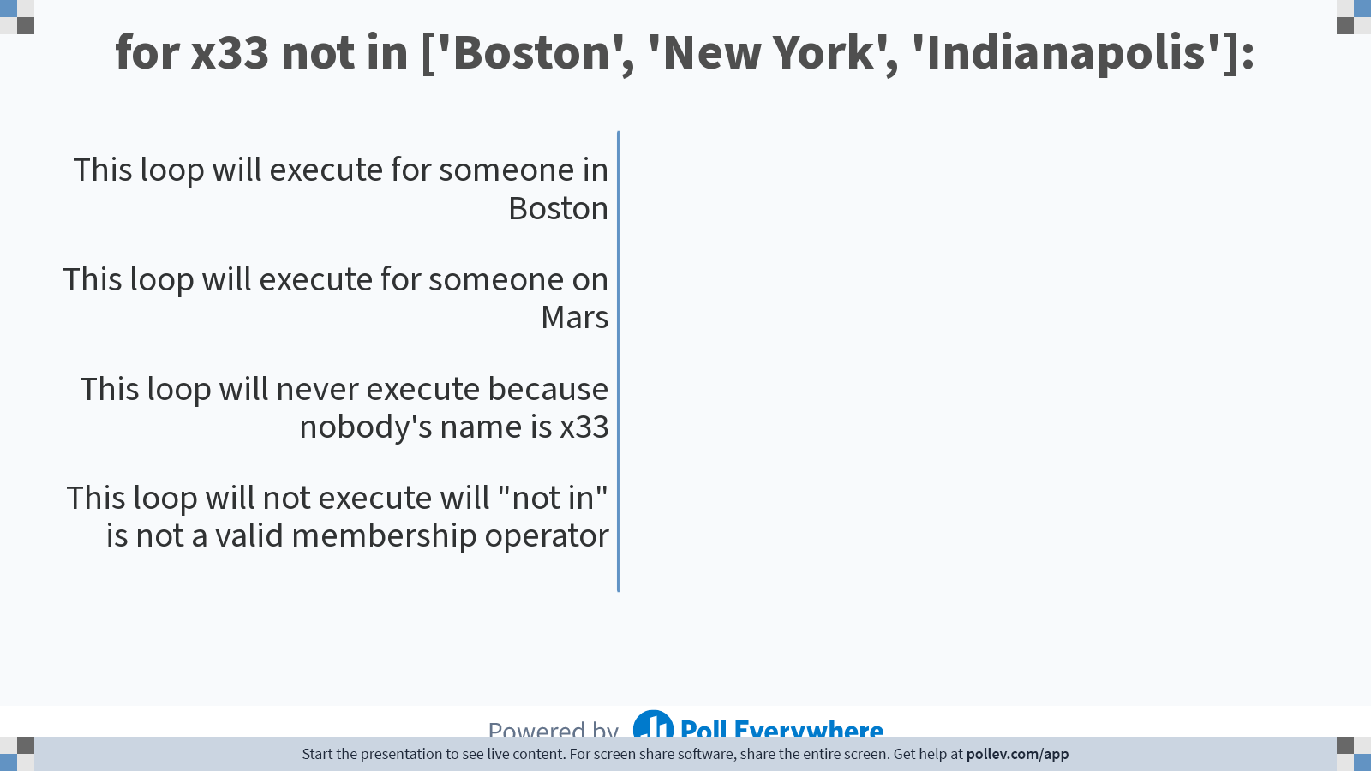
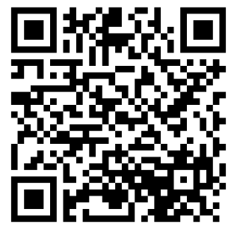
2 answers are allowed
Scan to participate
Participation is anonymous and not graded
Notes:
Poll Title: Do not modify the notes in this section to avoid tampering with the Poll Everywhere activity. More info at polleverywhere.com/support for x33 not in ['Boston', 'New York', 'Indianapolis']: https://www.polleverywhere.com/multiple_choice_polls/iXZaQSpis72gS9J19JYLo?state=opened&flow=Default&onscreen=persist

Slide 25
in is a membership operator that checks if an element is present in a sequence, and
in is used to iterate over elements in a sequence.
for : all for loops start with the keyword for
Looping Object “sequence”:
Also called the iterable object.
Loop Variable “base”: the word after for is called the Loop Variable in this case we named it "base". With the in operator, it acts as a cursor going from position 0 to the last position of the sequence.

Slide 26
in is a membership operator that checks if an element is present in a sequence, and
in is used to iterate over elements in a sequence.
for : all for loops start with the keyword for
Looping Object “sequence”:
Also called the iterable object.
Loop Variable “base”: the word after for is called the Loop Variable in this case we named it "base". With the in operator, it acts as a cursor going from position 0 to the last position of the sequence.

Slide 27
in is a membership operator that checks if an element is present in a sequence, and
in is used to iterate over elements in a sequence.
the colon (:) is a syntax element used in for to signify the start of the code block within the loop.
for : all for loops start with the keyword for
Looping Object “sequence”:
Also called the iterable object.
Loop Variable “base”: the word after for is called the Loop Variable in this case we named it "base". With the in operator, it acts as a cursor going from position 0 to the last position of the sequence.

Slide 28
in is a membership operator that checks if an element is present in a sequence, and
in is used to iterate over elements in a sequence.
the colon (:) is a syntax element used in for to signify the start of the code block within the loop.
for : all for loops start with the keyword for
indentation is used to indicate which statements are part of the loop body and should be executed on each iteration.
Looping Object “sequence”:
Also called the iterable object.
Loop Variable “base”: the word after for is called the Loop Variable in this case we named it "base". With the in operator, it acts as a cursor going from position 0 to the last position of the sequence.

Slide 29
in is a membership operator that checks if an element is present in a sequence, and
in is used to iterate over elements in a sequence.
the colon (:) is a syntax element used in for to signify the start of the code block within the loop.
for : all for loops start with the keyword for
indentation is used to indicate which statements are part of the loop body and should be executed on each iteration.
Looping Object “sequence”:
Also called the iterable object.
Loop Variable “base”: the word after for is called the Loop Variable in this case we named it "base". With the in operator, it acts as a cursor going from position 0 to the last position of the sequence.
Loop body: includes the code to be executed with each iteration.

Slide 30
in is a membership operator that checks if an element is present in a sequence, and
in is used to iterate over elements in a sequence.
the colon (:) is a syntax element used in for to signify the start of the code block within the loop.
for : all for loops start with the keyword for
indentation is used to indicate which statements are part of the loop body and should be executed on each iteration.
Looping Object “sequence”:
Also called the iterable object.
Loop Variable “base”: the word after for is called the Loop Variable in this case we named it "base". With the in operator, it acts as a cursor going from position 0 to the last position of the sequence.
Returning to no -indentation means that we exited the loop. All the loop iteration are completed.
Loop body: includes the code to be executed with each iteration.

Slide 31
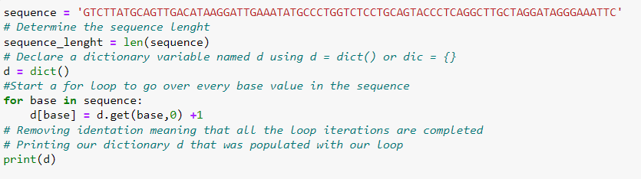

Slide 32
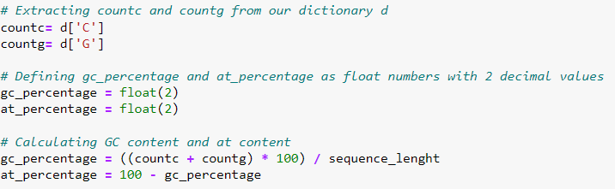

Slide 34

Reporting our results: printing and visualizing with Matplotlib

Slide 35
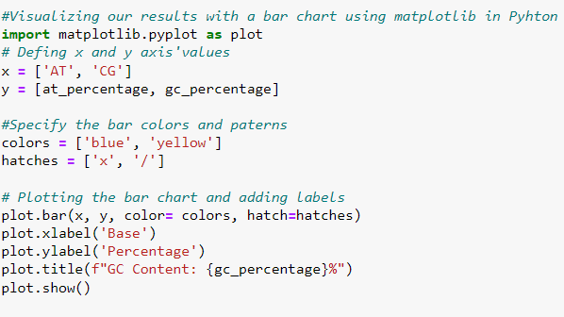
Reporting our results: printing and visualizing with Matplotlib

Slide 36
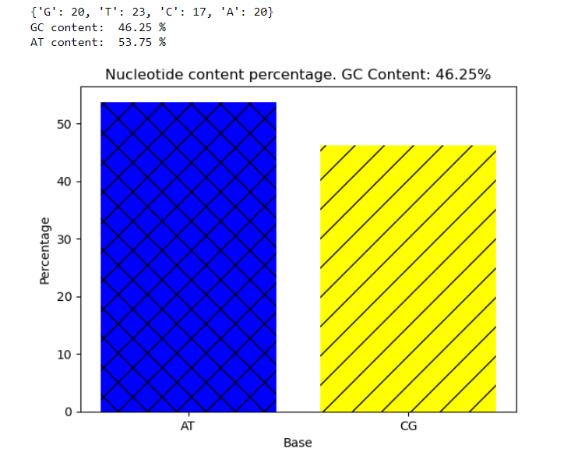

Slide 37

Questions ?
You can access
Python installation instructions
Code used in this class
This PowerPoint presentation
This class transcription to pdf document (available within 1 hour after this presentation)
Nabilatallah/Python-for-Bioinformatics: Class notes (github.com)

