Slide 1
Embedded System for Control and Data Acquisition of NLO Experiments
Presented by
Syed Razwanul Haque(Nabil)
Reg. no: 2011122011
Session: 2011-12
Supervised by
Prof. Yasmeen Haque
Department of Physics, SUST
Department of Physics, Shahjalal University of Science and Technology
Sylhet-3114, Bangladesh

Slide 2
Abstract
Two devices have been developed to control the laser and rotational stage.
AVR Microcontroller has been used where the programming language was C++.
The remote control has been developed for the laser controller and external mechanical device has been designed to mount a stepper motor with the rotational stage
The measured Accuracy for the controller of laser and rotational stage has been found to be 0.004% and 9% respectively.
Open Source Arduino Platform has been used

Slide 3
Outline of the Presentation
Title | Slide no.
The Embedded Systems | 1
Embedded System Architecture | 2
Microcontroller & Arduino | 3
Advantages of Embedded System | 4
Laser Controller | 5-14
Rotational Stage | 15-25

Slide 4
Embedded Systems
1
An embedded system is a microcontroller/microprocessor based system that is built to control a function or a range of functions.
Embedded Systems talk with the outside world via peripherals, such as:
>Serial Communication Interfaces (SCI)
>Synchronous Serial Communication Interface
>Universal Serial Bus (USB)
>Multi Media Cards
> Field buses: CAN-Bus, LIN-Bus,
>Timers: Capture/Compare and Time Processing Units
>Discrete IO: aka General Purpose Input/output (GPIO)
>Analog to Digital/Digital to Analog (ADC/DAC)

Slide 5
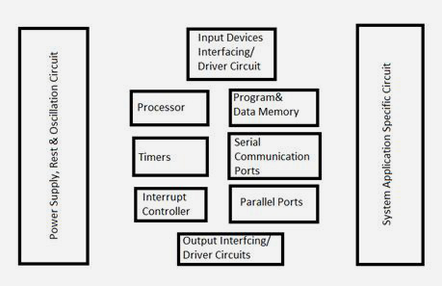
Embedded System Architecture
2
M1

Slide 6
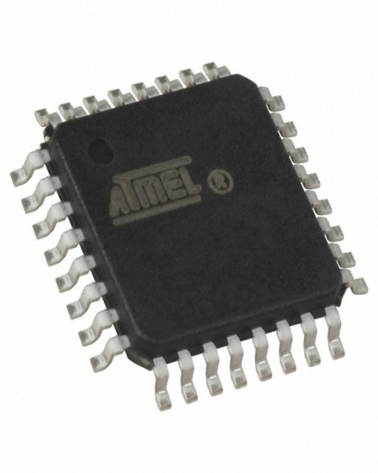
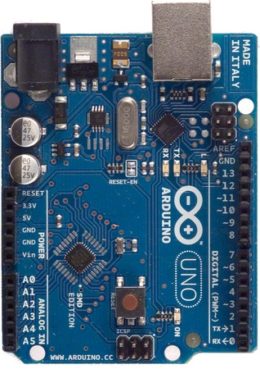
Microcontroller & Arduino
3
Micro
controller
A microcontroller is a small computer on a single integrated circuit containing a processor core, memory, and programmable input/output peripherals
Arduino
Arduino is an open-source electronics prototyping platform based on flexible, easy-to-use hardware and software. It's intended for artists, designers, hobbyists and anyone interested in creating interactive objects
or environments.

Slide 7
Advantages of Embedded System
4
1) No external memory is required as the memory is embedded with the hardware.
2) It gives the enhanced speed because there is no switching as memory is embedded in it.
3) Due to less or no switching, power dissipation is also less.
4) Traditional Digital Circuits are not Programmable but MCU is Programmable
5) They allow the system hardware to be simplified so costs are reduced
6) Artificial Intelligence can be implemented in the Device
7) It is Standalone and circuit size is small

Slide 8
Laser Controller
5
Problem With Existing Laser Controller:
Analog Control Method
Huge Time Consumption during Experiment
Laser Power Controlling Knob is not Precise
Lack of Safety
External Illumination Source is Required
Laser Power Increaser Exponentially With Knob
Touching the laser physically is not convenient
User cannot give numerical inputs
There is no display to show its operating data
Analog controller is not configurable

Slide 9
How Embedded System Makes it Better
6
Digital Control Mechanism
Time Consumption Reduces by 50 Times than Previous One
Wireless Remote Control System
On Board Operating System
Menu System for Interactive User Interface
Password Locking System
Laser Intensity Can be Controlled Precisely
LCD Display Interface
SD Card for Data Saving
Real Time Clock Interface
Protection Algorithm for Safe Operation
Increase or decrease power linearly
Ports for installs different kinds of modules
External Light Source is Not Required

Slide 10
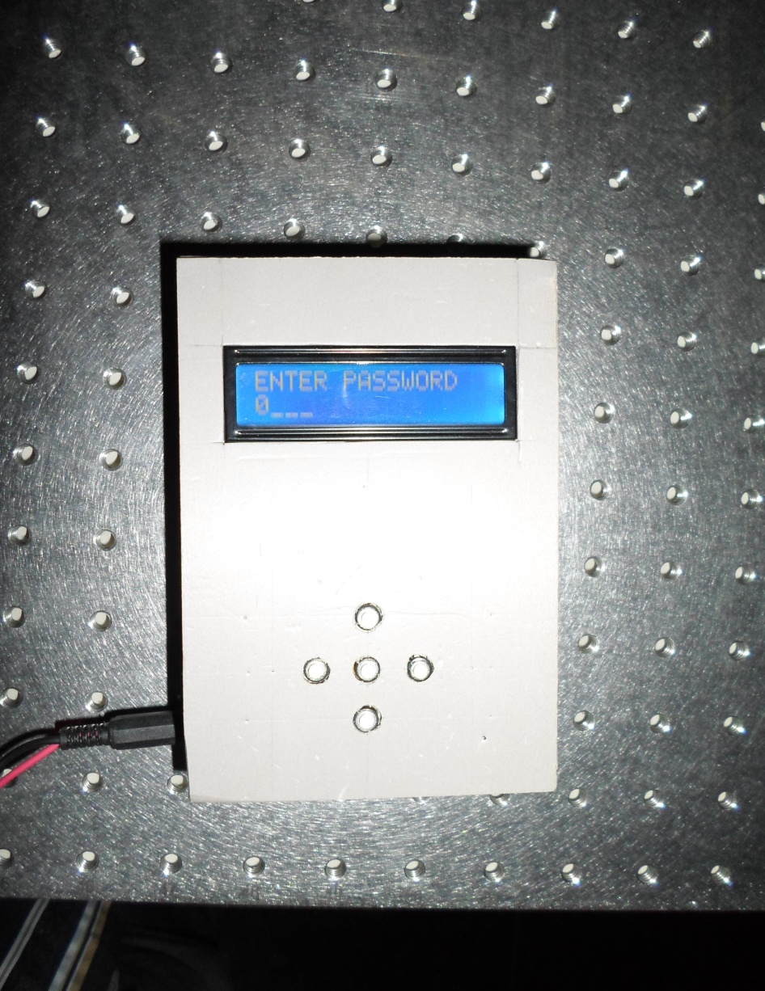
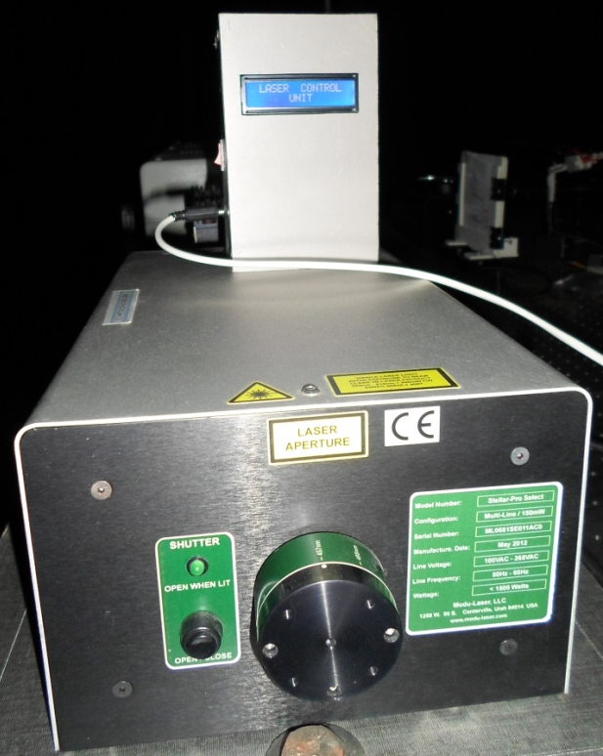
Developed Laser Controller
7
Photograph of Laser Remote Unit
Photograph of Laser Control Unit

Slide 11
System Architecture of Laser Controller
8
User Input
&
Display
Command
Processing
Wireless
Transceiver
Fig: Remote Control Unit
Laser
Laser
Control
Circuit
Command
Processing
Wireless
Transceiver
Fig: Laser Control Unit

Slide 12
Menu System
9
Remote Unit
(When ON/OFF switch pressed)
Remote ON
(Initial Screen)
Enter Password
0----
(4 digit password)
Wrong Password
Unlocked
(If password correct)
(If password wrong)
Press OK For Menu
(If OK pressed)
A1
Laser Control
Settings Back
A3
[Laser Control]
A2
[SH-OFF] POW-0
LAS_1_OFF LOCK
Back
Are You Sure Yes No
Laser 1 Running
!! LOCKED !!
Power Must Be Zero
Laser OFF
(If Power>0)
(If Power Zero)

Slide 13
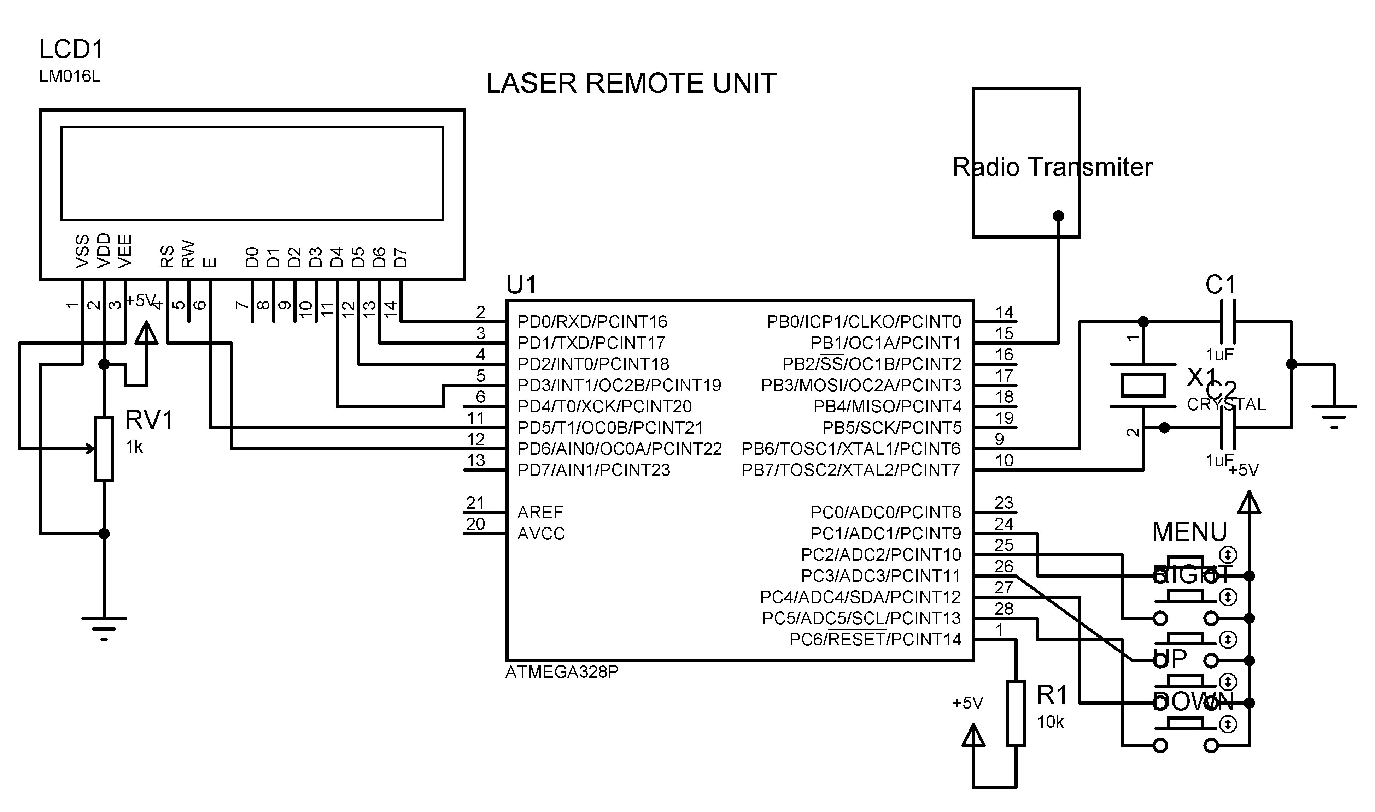
Laser Controller Circuit
10
Fig: Laser Remote Unit Circuit

Slide 14
Experiments Using Laser Controller
11
For λ= 457nm
Controller Indicator (%) | Laser Power(mw) | Std. dev(µw )
0 | 0.368 | 2.9784
10 | 0.630 | 0.3265
20 | 1.086 | 1.8903
30 | 1.533 | 1.4437
40 | 1.982 | 2.2236
50 | 2.425 | 1.1493
60 | 2.868 | 1.0683
70 | 3.317 | 1.4082
80 | 3.761 | 1.9118
90 | 4.208 | 2.2376
100 | 4.643 | 2.0995

Slide 15
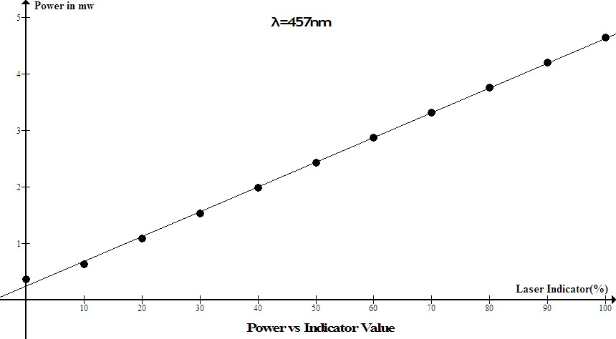
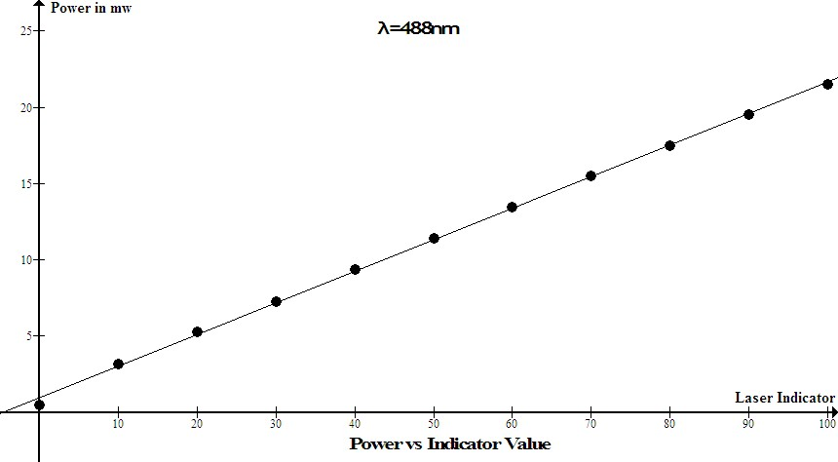
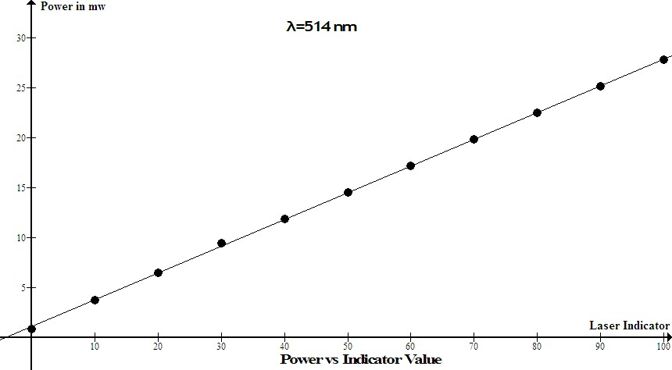
The Graphs (Laser Controller)
12

Slide 16
Conclusion (Laser Controller)
13
The developed device can be controlled remotely using radio signal thus reducing human touch related error
Time consumption for changing intensity manually was approximately fifty times greater than the newly implemented remote control system
The using remote control intensity controller change in intensity can be controlled precisely unlike the manual process
Error margin for the measurement using laser controller is 0.004%

Slide 17
Future Works (Laser Controller)
14
Xbee module for more reliable wireless communication.
Wi-Fi module for smart phone interfacing.
Touch screen display to show graph in remote control unit.
Ethernet communication to interface laser with central network.
GSM/GPRS module to monitor and transfer data from a remote distance.
Digital charging system
PC interfacing
Power meter interfacing with laser controller
Rotational stage controller interfacing with laser controller
Temperature sensor, humidity sensor, gas sensor for more safety

Slide 18
Rotational Stage
15
The rotational stage is a mechanical device which can hold and rotate an optical component to perform many optical experiments
The optical element is secured inside the central aperture of the platform of the holder by the threaded retaining ring
This enables the user to set the current position on the scale to any chosen angle independently of the position of the holder
The position is marked in degree from 0 to 360 degrees
Angular position is read on the 360° graduated scale on the platform, which is marked every 2°
It can be rotated either manually or by means of a motorized system
In this Research work a microcontroller based system converts a manual rotational stage into a motorized rotational stage

Slide 19
Problem with Manual Rotational Stage
16
A manual rotational stage has no control unit and it is also not motorized
Rotating this stage by hand is time consuming in addition to being a waste time during experimentation
External Light Source is Required to Operate
If data is taken for every 2° rotation the knob needs to be touched and the flash light switched on and off 180 times
Digital Input is Not Possible
Wireless Control is Not Possible
Automation is not possible
Interfacing with External Device is not Possible
Manual Rotational Stage Consumes at least 3 Hours for a single experiment if resolution is 2 degree

Slide 20
How Embedded System Makes it Better
17
Digital Control Mechanism
Onboard Operating System
Automatic Error Correction
Interfacing with External Device
External Light Source is Not Required
Quick Operation
Remote Control
Stable Operation
User Friendly
Digital Calibration System

Slide 21
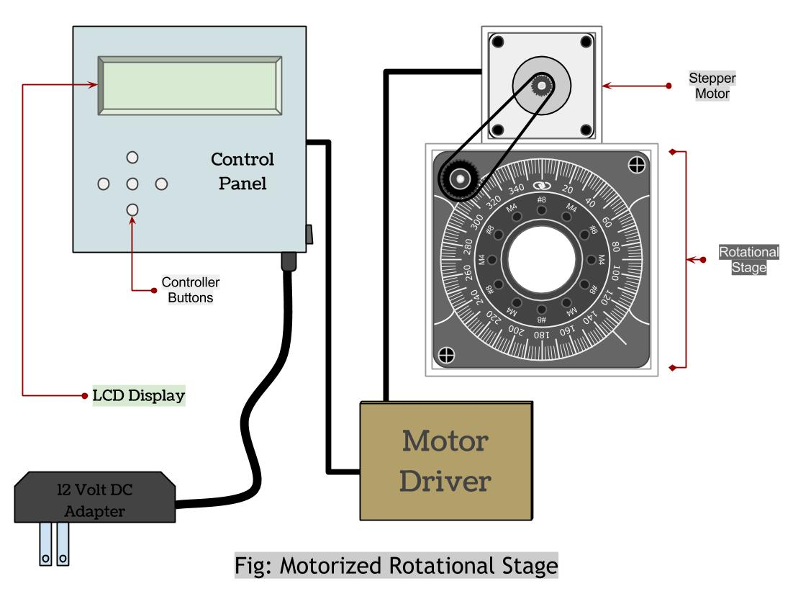
Block Diagram of Developed Rotational Stage
18

Slide 22
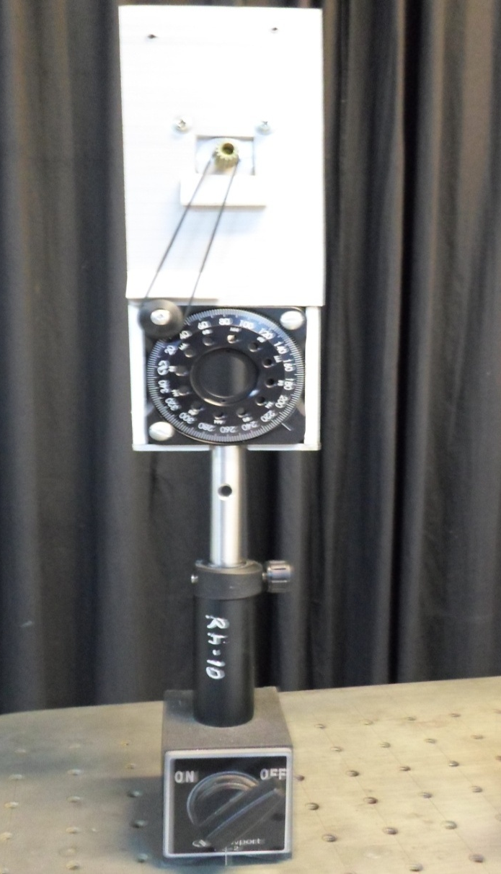
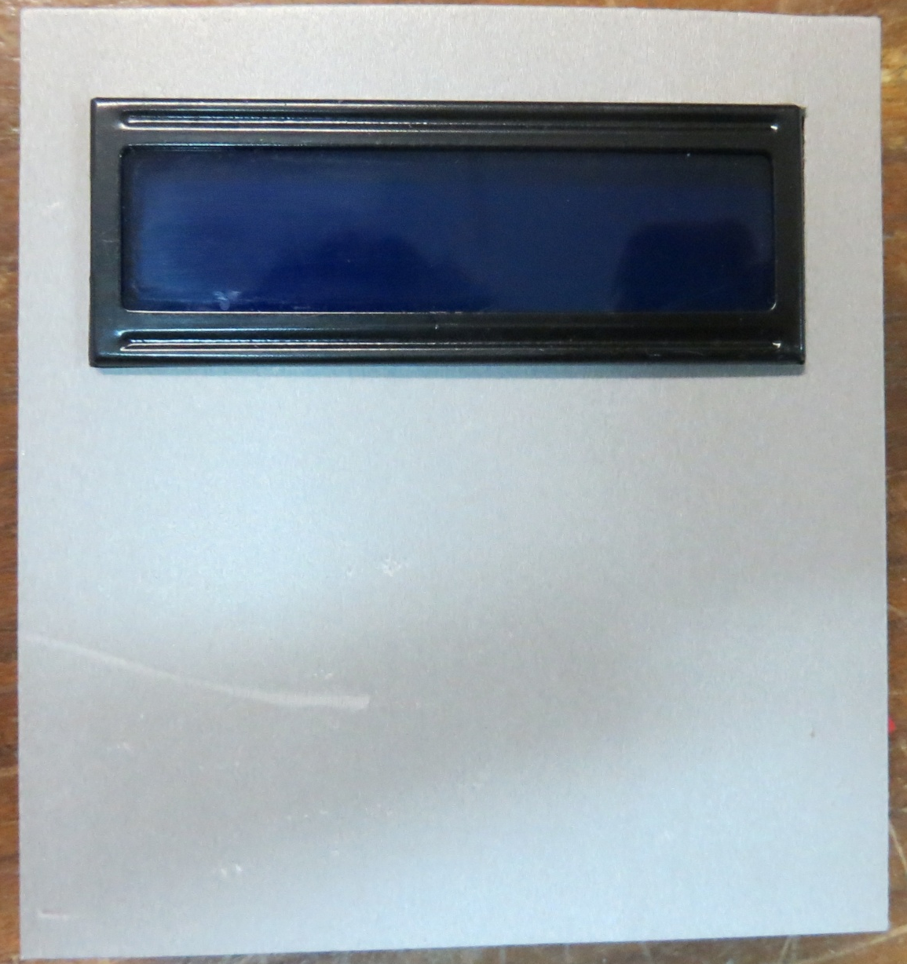
Photograph after Motorized
19
Fig: Mechanical Unit
Fig: Remote Unit

Slide 23
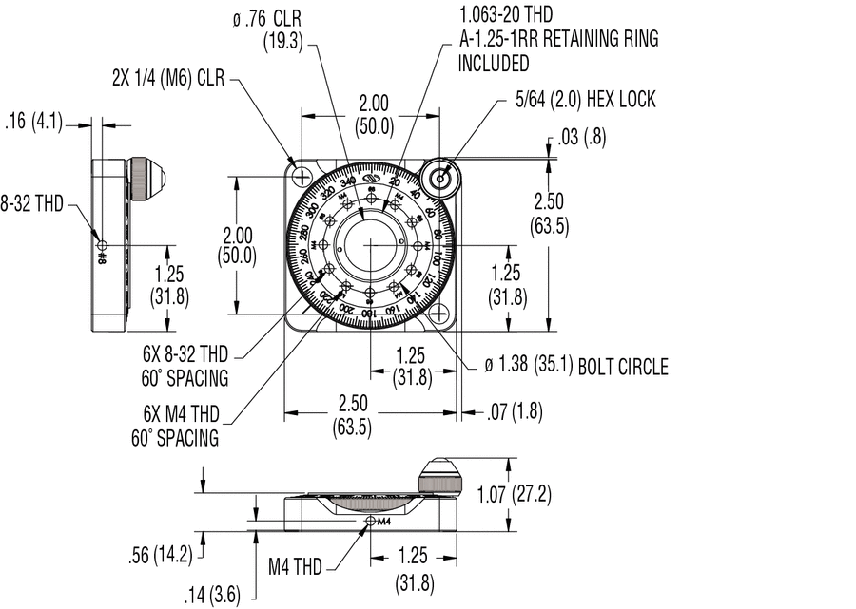
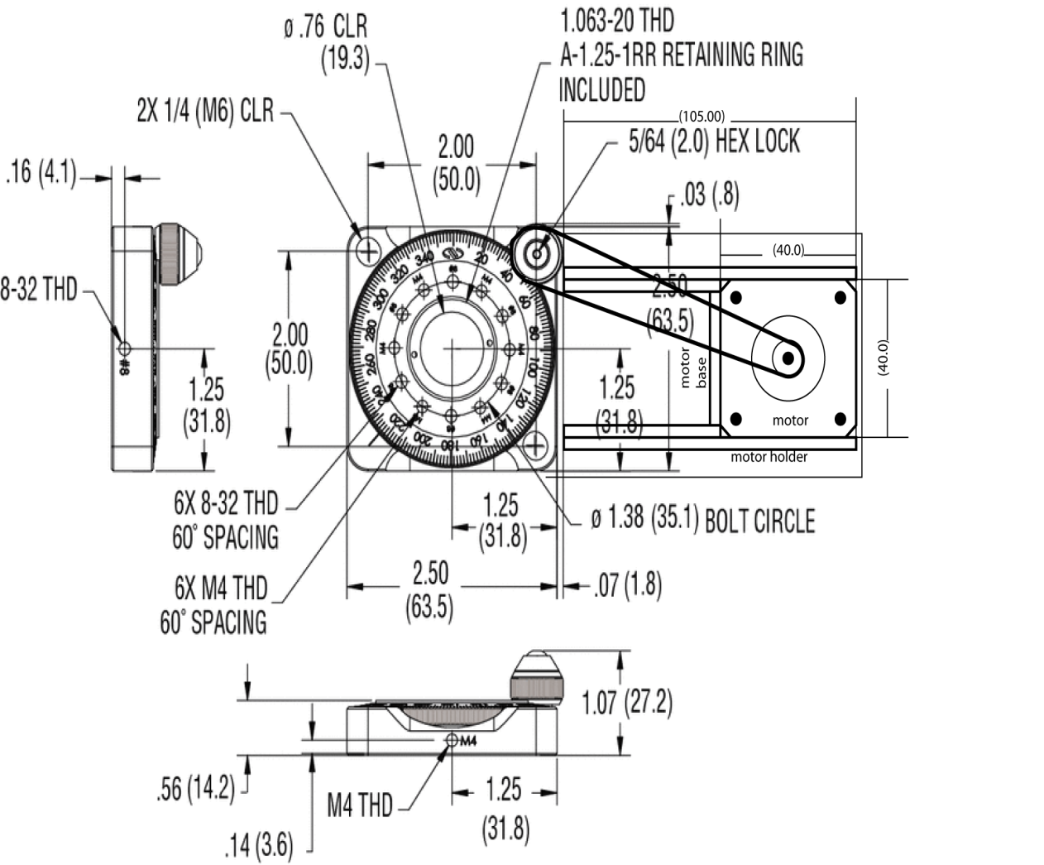
Engineering Drawing
20
Fig: Before Motorized
Fig: After Motorized

Slide 24
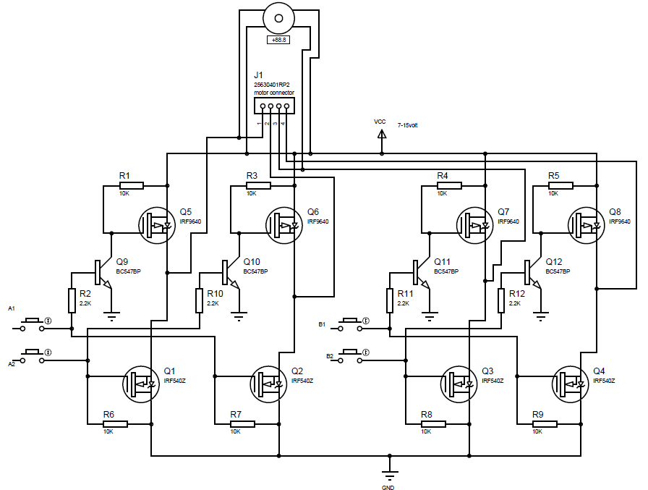
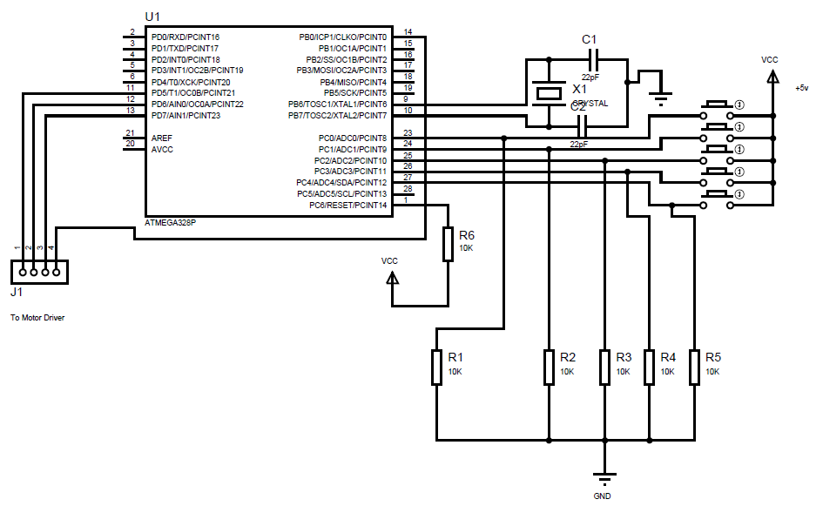
Circuit Diagram
21
Fig: MOSFET H-Bridge
Fig: Control Unit Circuit

Slide 25
Experimental Data
22
Angle of Rotation | Actual Rotation | Error | Error Percentage
(in degrees) | (in degrees) | (in degrees) | %
360 | 393.00 | 33.00 | 9.17%
 | 393.00 | 33.00 | 9.17%
 | 390.00 | 30.00 | 8.33%
 | 393.00 | 33.00 | 9.17%
 | 391.00 | 31.00 | 8.61%
270 | 294.00 | 24.00 | 8.89%
 | 293.00 | 23.00 | 8.52%
 | 294.00 | 24.00 | 8.89%
 | 294.00 | 24.00 | 8.89%
 | 294.00 | 24.00 | 8.89%
180 | 195.00 | 15.00 | 8.33%
 | 197.00 | 17.00 | 9.44%
 | 195.00 | 15.00 | 8.33%
 | 197.00 | 17.00 | 9.44%
 | 195.00 | 15.00 | 8.33%
120 | 131.00 | 11.00 | 9.17%
 | 132.00 | 12.00 | 10.00%
 | 131.00 | 11.00 | 9.17%
 | 131.00 | 11.00 | 9.17%
 | 131.00 | 11.00 | 9.17%
90 | 98.00 | 8.00 | 8.89%
 | 97.00 | 7.00 | 7.78%
 | 98.00 | 8.00 | 8.89%
 | 98.00 | 8.00 | 8.89%
 | 98.00 | 8.00 | 8.89%

Slide 26
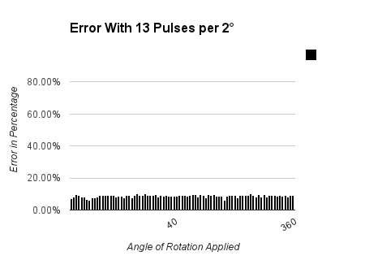
Error Graph
23

Slide 27
Conclusion (Rotational Stage)
24
Changing rotation manually for rotational stage needs extra light source and also needs human touch which is time consuming and also includes measurement error. Developed digitally controlled rotational stage saves significant time and makes experimentation more precise.
Previous Time Consumption
Current Time Consumption
180 minutes
5 minutes

Slide 28
Future Works (Rotational Stage)
25
Wireless control feature
Artificial Intelligence
Graphical LCD to show more information during operation
Automatic error reduction system
Computer interfacing option
Internet based control system
Interfacing with Laser Controller Device
Smartphone Interfacing

Slide 29
26
Thanks

