Slide 1

1

Slide 2

Ko Banchha Asianpatee
C- Project
(KB-AP)
By G-5 Team
Manoj Paudel
Muna Ghishing
Nabin Lopchan
2

Slide 3
Introduction
We have studied c-programming, now through this project we are applying our theoretical knowledge of programming to build a simple real life project using different components of the C.
3

Slide 4
Features
This program will be highly productive for the people who want to increase their IQ level. Moreover it can be further explained as:
This program contains three rounds.
Participants should register first to play the game.
Each round consists of ten questions from different topics.
Only those who have their IQ level greater or equals to four will be able to play this quiz.
The IQ level is determined by asking five questions.
Each correct answer will reward the prize money of RS. 100.
Participants can play this quiz until they answer all the questions correctly or can quit the game anytime they like.
Their data will be stored in the file which can be accessed easily.
No life line (help line) will be provided.
4

Slide 5
Objectives Of The Project
To test the general knowledge
To increase/know the level of IQ
To be updated with the current circumstances
To know about the politics, geography, history, sports etc.
For entertainment purpose also.
5

Slide 6
C-Components Used
Switch Statement
If Statements
Loops
Functions
File Handling
6

Slide 7
Program Flow (Function Flow)
Show
Show Data
Start
IQ
Prizes
Play
One More
Play 1
New Quiz
Test Again
Registration
7

Slide 8
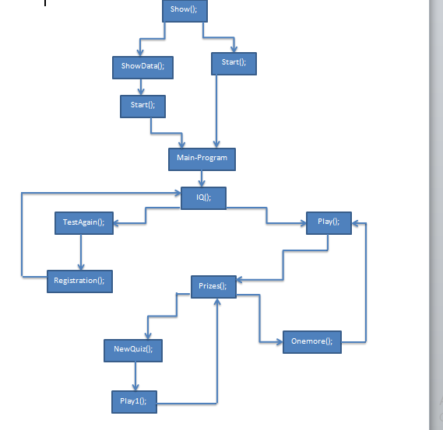
Work Flow (Program Flow)
//Every Function contains termination conditions
/*The function call depends on the condition output
from previous statement*/
Fig: Function Flow
8

Slide 9
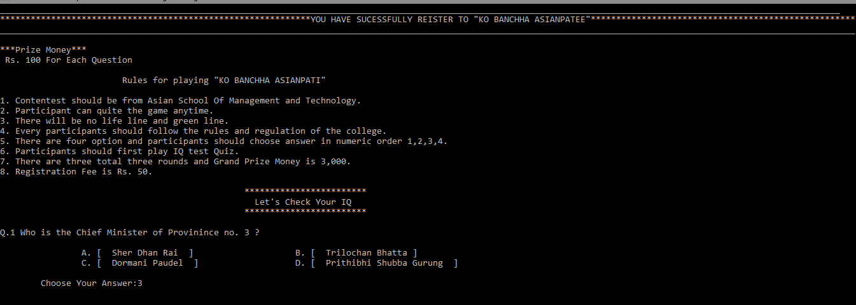
Demo Output
9

Slide 10
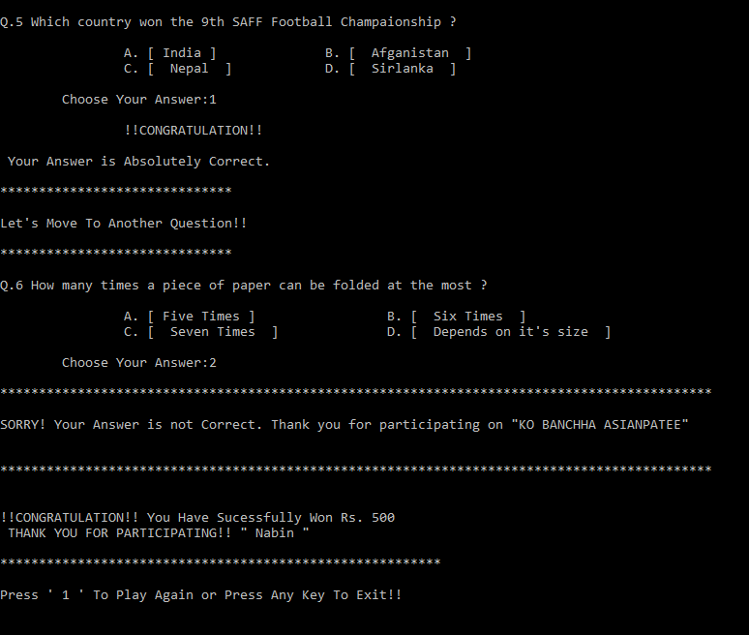
Demo Output
10

Slide 11
Conclusion
During this project we came across different problems which we handle carefully.
It helps us to understand the c-programming language in better way.
Group discussion leads for the better understanding of the problem encountered.
11

Slide 12

Any Query?
12

