Slide 1
Car Crash Analysis
Nabin Kattel

Slide 2
Table of contents
INTRODUCTIONS
DASHBOARD
KEY INSIGHTS
THANK YOU

Slide 3
INTRODUCTIONS
CAR CRASH ANALYSIS
In this analysis, i delve into the intricacies of car crash data spanning from 2014 to 2024, uncovering significant insights. With a total of 150,000 injuries recorded, our examination reveals temporal variations, predominant collision types, and the influence of weather and traffic conditions. Understanding these patterns is essential for informed policymaking and targeted interventions to enhance road safety.

Slide 4
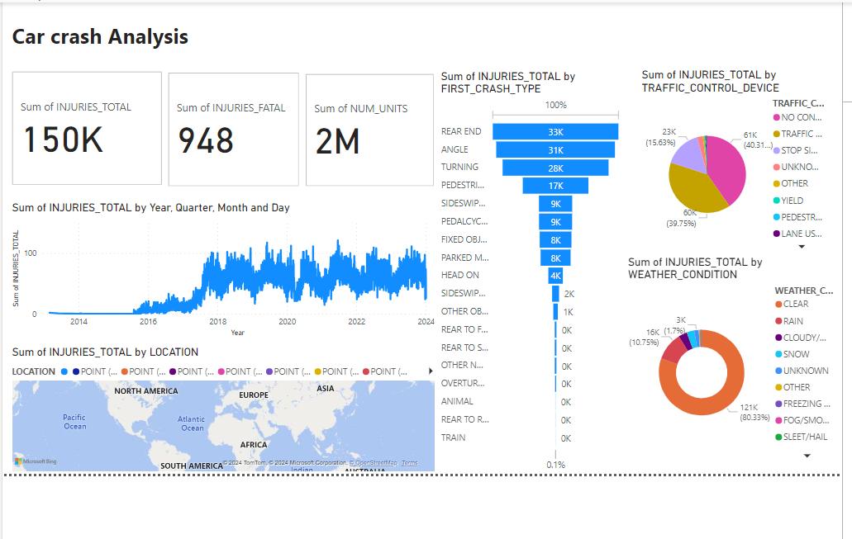
DASHBOARD

Slide 5
KEY INSIGHTS
Total injuries recorded so far: 150,000.
From 2014 to 2024, the minimum number of injuries occurred in 2014, while the maximum number of injuries occurred in 2021 Q2.
The most common first case type of injury is Rear end, followed by Angle and Turning.
Approximately 80% of accidents occur in clear weather, 10% occur in rain, and the remaining in other conditions.
When dividing the total number of accidents, 40% occur with no traffic, and another 40% occur with traffic conditions.
The highest total sum of injuries occurred at the location (0,0).

Slide 6
Conclusion and THANK YOU
In conclusion, my analysis of car crash data has provided valuable insights into the dynamics of road accidents. By understanding temporal trends, collision types, and environmental factors, we can better inform interventions to improve road safety.
We extend our heartfelt thanks to Mentorness Company for their invaluable mentorship and support throughout this project. Your guidance has been instrumental in our analysis and findings.

