Slide 1
High Throughput Cluster
Nabin Paudyal (075MSCSK010)
Prabin Acharya (075MSCSK012)
Saurav Prajapati (075MSCSK018)
Yashasvi Raj Pant (075MSCSK020)

Slide 2
Cluster that serves large amount of computing but for much longer times (months and years, rather than hours and days).
It is not mainly concerned about operations per second, , but rather operations per month or per year.
More interested in how many jobs can be completed over a long period of time instead of how fast.

Slide 3
Focuses on the efficient execution of a large number of loosely-coupled tasks
Performs independent, sequential jobs that can be individually scheduled on many different computing resources across multiple administrative boundaries.
Requires large amount of computing power

Slide 4
allows many copies of the same program to run at the same time
ability to use different data for each program copy
The multiple copies are referred to as jobs
Applications might involve jobs processing
Eg: different patient data in large scale biomedical trials

Slide 5
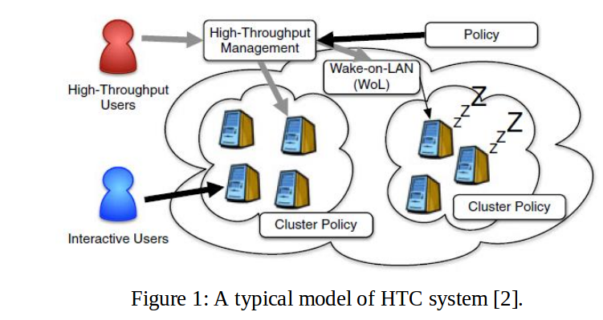

Slide 6
HTC vs HPC
HPC tasks are characterized as needing large amounts of computing power for short periods of time, whereas HTC tasks also require large amounts of computing, but for much longer times (months and years, rather than hours and days)
HTC field is more interested in how many jobs can be completed over a long period of time instead of how fast.
HPC- Tightly Coupled Parallel Jobs, HTC- Loosely Coupled Jobs
HPC- execute within a particular site with low-latency interconnects, HTC-scheduled on many different computing resources across multiple administrative boundaries

Slide 7
Applications
Scientific and engineering research in the analysis of vast amounts of data
Best suited for problems that can be divided among CPUs without the need for communication of intermediate results between CPUs.
Effective tools for computationally intensive optimization problems such as those found in predictive biomechanics simulations.
HTCondor(developed at the University of Wisconsin) and BOINC (developed at the University of California, Berkeley), which are typically used to help solve scientific problems at all scales

Slide 8
HTCondor
Deployed over a decade at the University of Wisconsin-Madison Computer Science Department
HTCondor takes this wasted computation time and puts it to good use.

Slide 9
HTCondor
Consists of customer agent, which manages a queue of application descriptions and send resources requests to match maker
Resource agent, which implements policies of resource owner and send resource offer to match maker
Matchmaker, responsible for finding matches between resource requests and resource offer and notifying a agent when the match is found

Slide 10
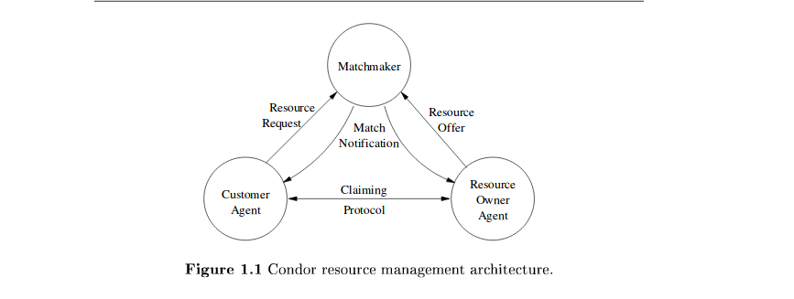

Slide 11
References:
https://en.wikipedia.org/wiki/High-throughput_computing
https://www.researchgate.net/publication/226533607_Cluster_Computing_High-Performance_High-Availability_and_High-Throughput_Processing_on_a_Network_of_Computers
https://link.springer.com/chapter/10.1007%2F0-387-27705-6_16
http://condor.liv.ac.uk/htc.htm
https://research.cs.wisc.edu/htcondor/doc/hpcc-chapter.pdf

Slide 12
Thank You

