Slide 1
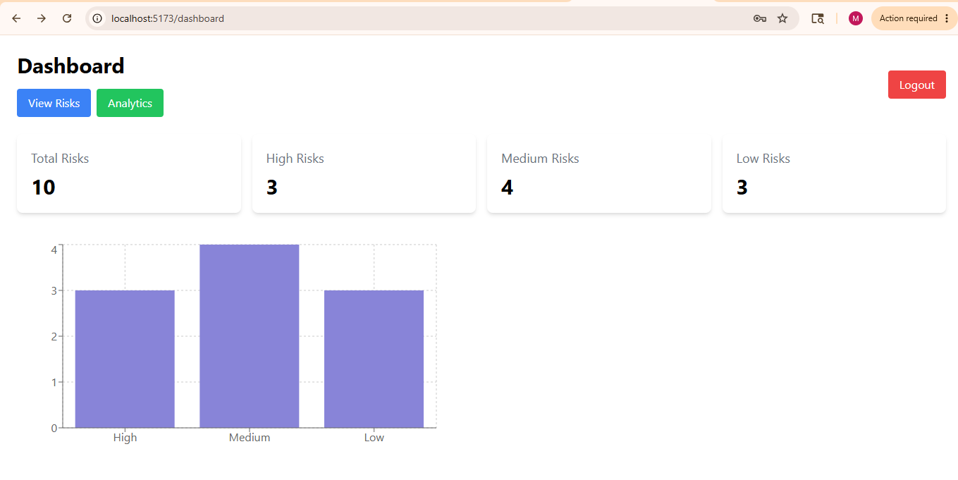
Demo Flow
User Login
Dashboard Displays Risk KPIs
Risk Data Retrieved from Backend API
Analytics Page Shows Charts
Responsive UI for Mobile and Desktop

