Slide 1

SECURE DATA HIDING IN IMAGE USING STEGANOGRAPHY
edunet
f<1vri<1;1t1C111

Slide 2
OlITLINE
Problem Statement Technology used Wow factor
End users Result Conclusion
... Git-hub Link Future scope
edun,,....e.,.._t

Slide 3
PROBLEM STATEMENT
Steganography enables secure and private communication by embedding encrypted messages within images. However, ensuring both security and accessibility without data loss is a challenge. This project develops a user­ friendly steganography system with encryption,allowing users to securely hide and retrieve sensitive information . By integrating strong encryption and efficient encoding techniques, it ensures confidentiality while preventing unauthorized access. The solution balances privacy and security. making covert communication both safe and effective
edunet
Fv1.1r11;1 1(111

Slide 4
TECHNOLOGY USED
Python
OpenCV (cv2)
Cryptography (Fernet Encryption) NumPy
Tkinter (GUI Framework)
Hashlib & Base64 (for key generation and encoding)

Slide 5
WOW FACTORS
Custom Password-Based Encryption - This code dynamically generates an encryption key from a user­ provided password, ensuring each encoded message is uniquely protected and cannot be decrypted without the exact key.
Optimized Pixel Manipulation - The code efficiently modifies only the necessary pixels in the image using NumPy,ensuring minimal alteration while embedding the encrypted message.
User-Centric GUI Integration - It provides a seamless, interactive experience using Tkinter,allowing users to encode and decode messages with just a few clicks, making secure communication effortless
edunet
'"'"'' ,..11....

Slide 6
END USERS
Cybersecurity Professionals - To securely exchange sensitive information while preventing unauthorized access.
Journalists - For discreet communication in high-risk environments where information leaks can be dangerous . Government & Intelligence Agencies - To protect classified information and covertly share critical messages.
Corporate Organizations - For secure internal communication and intellectual property protection. Privacy-Conscious Individuals - To safeguard personal messages from surveillance and cyber threats.
edun.,_et

Slide 7
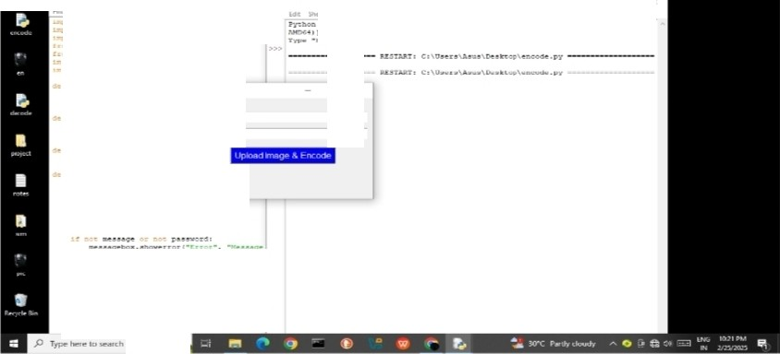

RESULTS
..... -
- -
c:::....::=-.:.,,;:...=--==-=::::::=-..;::.===-...:.::L-
...
Ii. :; tiP
.-.-----
)d..l,t (t••-' 'l'lolloil J.iOfl:.f ,
7 4:.:21, iliil.)'l'. (tGo\: T,:.9Jt 11 l;J.T; (
....... ....,
.....
AK:)C.•11 ...... -.-t -)•
:.. i:.•- •• --
-....
--lp •, _. Y-"-*cr.f!<\_•, •.._.-.._ .. .oo ••._.,_.-()' loir-
• ....... .-.-..._-•
-l)>t:i:":iv.tni.c-:; JS' • f':.i: t
"-"e t
..... b
;- i-•tc_h7
x
^{ltey -} -.....^{l}..^{b}.....
0
t
i-t _-.....-0
'"''r••- - r - ·
OU...... ..
te•t_11:_t:.s..::...r1f
.. •......1
c.a.::de 1-.«() 1
;e_j.e·-e• -₋tJ.l.i_{.i}'
-••••;:• - _,.,.,..,,.._•-rry.Q •>;-0 •.•t·tr-0
.----.•d • .,...........,.d .... .y....t. )•t.••P(I
1"•y • CJ'"'"-'"'"""'- Yfr.JUL.,.."""l
ypf._- -- - - ......_.YI'-.. ---,__._._
t....-..\'_... t-:;_t ... l.)'(..;.a<.l)"J;t -·
t· ·- r.T'.' •••-.....1,,.....,..
· .
_r •'")
- •-
:acor t•t.••·' ·•r.u..a
edunet
'-.,.,.,.-b"...

Slide 8
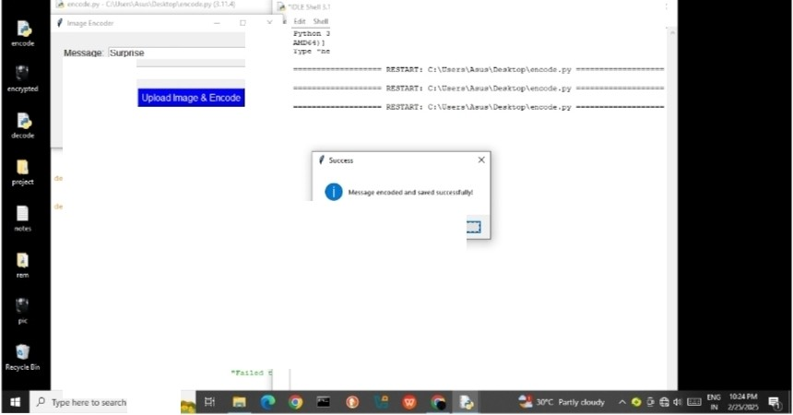
..
...
,..'"t.be J.11.t (ta:;;9(TJ.l..l,t;CUJt.;. • .1".".:i. "I' l2J, Ol 1l;J7) ():.A T,.9Jt C.t l:.' l.t C
"'°"" 1 ei: ,..-..J:i)l
•
1-, t;.oe1$:.-. - :yr-:i.¢:1o::·. c:rei:,- r -1.1.c. -f!n.>e1 1- :i:i- .:.i-e :u:i.r:>::.uia.•
Password ... ..
c-ItM.r • t!!et(fi7J
a;:t.e:r.=.:r;'i':: (at::.!J-' .
()).d.e::
.,.
::• b1.M.!"f (C•t) !
- ••.,ot•(r ra&t.(e>rclf clMrJ ,
.
.UW-<i't() :
_;.\Jl ... f.a..1•109.-
tl (\.1.ll
etb:
"'
- .eqe - ..U$•;e ::r/'.<Je:; It •.s:::ra()
p.a.>.-rd - .s- .:i.:a_en::rf . O..strlPO
_{-•}--
JM-"-"'Ord:
be"•·•"' :.,; rror f •T •,
• •_{::ff_}:r•,,e,,_.,key•oi-•.....ordJ
""""e ue
......
./ .-.:' ' - t:; u;..e... (e t::-);;te:t a
-
C'T:i.t.are•,2(U14e P:•!:hl
__,,bc.•
erro..f"&. r ",
^{edun}.._.^{e}.....^{t}.

Slide 9
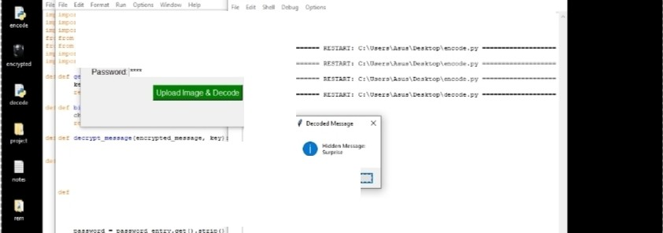
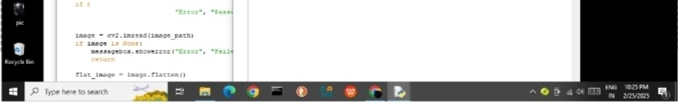
- -
._, ..
.,...
P'yUl- oft s.11.• 1,-l•S.11. :c12.S•')l>C• .z.."
7 2'G". 0.5:4S:S7) IK.1C ..-. 103c f.4 bu. I
tli.Q:::e.r aJ C11:
•>) c. V1&JJ:
t "'- - 1 t.dJ...._. _
o; , «-
..._-- "-
:r; :-t . '""COViTl@t •, ·ed1':.>.. or •
ce o ·tlJr a:r: 1.1:.!'
':loa.
L
.'
c.1.ph-r • F•u..\.(k'")'I
...
clpaw.r.4-erWtf....cs •
•
t.l::ie: -
()L
_a.veu:
J'"I • (J.lri.1.•109--'-
1.. _Jw.UI:
(J.le
pe..s-S"l' r:
---•:wr t
edun,,...e...._t

Slide 10
CONCLUSI ON
This project successfully addresses the security challenges of steganography by integrating encryption and steganalysis to ensure both privacy and protection against misuse.By using password-based encryption and LSB-based encoding,the system enables secure message hiding and retrieval while maintaining image
integrity.Unlike traditional methods,our approach ensures that even if a hidden message is extracted,it
remains unreadable without the correct password. Additionally,the user-friendly GUI makes secure
communication accessible to both technical and non-technical users.This project strikes a balance between privacy and cybersecurity,making it a powerfultool for confidential communication while preventing unauthorized or malicious use.
edunet

Slide 11
GITHUB LINK
httpsJ/github.com/Nabishs/Project01.g1t
edunet

Slide 12
FUTURE SCOPE{OPTIONAL)
: The project can be expanded by integrating Al-powered steganalysis to detect hidden data and prevent misuse. Support for multi-format steganog raphy (audio, video, and documents) can enhance its versatility. A cloud-based secure communication platform can be developed for real-time encrypted messaging. Adaptive encoding techniques can further reduce detectability,making hidden data more secure.
edunet
fqvn<1;1t1C111

Slide 13
THANK YOU
edun₋e.t.

