Slide 1
Secure data hiding in Image using steganography
Presented By: N. Abisha
College Name & Department : Udaya School of Engineering,
MCA

Slide 2
OUTLINE
Problem Statement
Technology used
Wow factor
End users
Result
Conclusion
Git-hub Link
Future scope

Slide 3
Problem Statement
Steganography enables secure and private communication by embedding encrypted messages within images. However, ensuring both security and accessibility without data loss is a challenge. This project develops a user-friendly steganography system with encryption, allowing users to securely hide and retrieve sensitive information. By integrating strong encryption and efficient encoding techniques, it ensures confidentiality while preventing unauthorized access. The solution balances privacy and security, making covert communication both safe and effective

Slide 4
Technology used
Python
OpenCV (cv2)
Cryptography (Fernet Encryption)
NumPy
Tkinter (GUI Framework)
Hashlib & Base64 (for key generation and encoding)

Slide 5
Wow factors
1.Custom Password-Based Encryption – This code dynamically generates an encryption key from a user-provided password, ensuring each encoded message is uniquely protected and cannot be decrypted without the exact key.
2. Optimized Pixel Manipulation – The code efficiently modifies only the necessary pixels in the image using NumPy, ensuring minimal alteration while embedding the encrypted message.
3. User-Centric GUI Integration – It provides a seamless, interactive experience using Tkinter, allowing users to encode and decode messages with just a few clicks, making secure communication effortless

Slide 6
End users
Cybersecurity Professionals - To securely exchange sensitive information while preventing unauthorized access.
Journalists - For discreet communication in high-risk environments where information leaks can be dangerous.
Government & Intelligence Agencies - To protect classified information and covertly share critical messages.
Corporate Organizations - For secure internal communication and intellectual property protection.
Privacy-Conscious Individuals - To safeguard personal messages from surveillance and cyber threats.

Slide 7
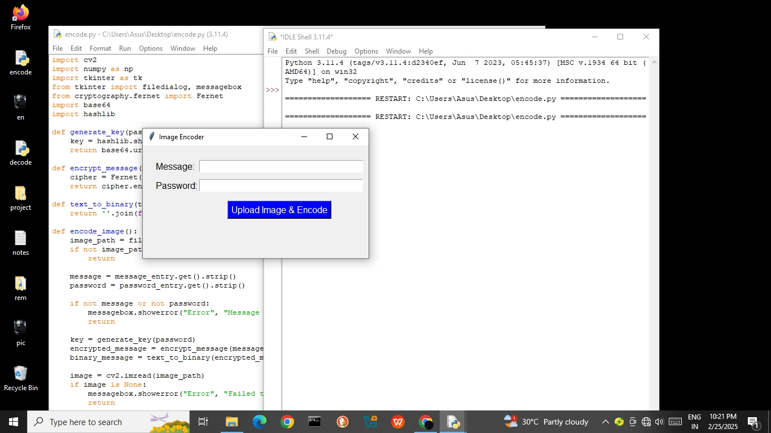
Results

Slide 8
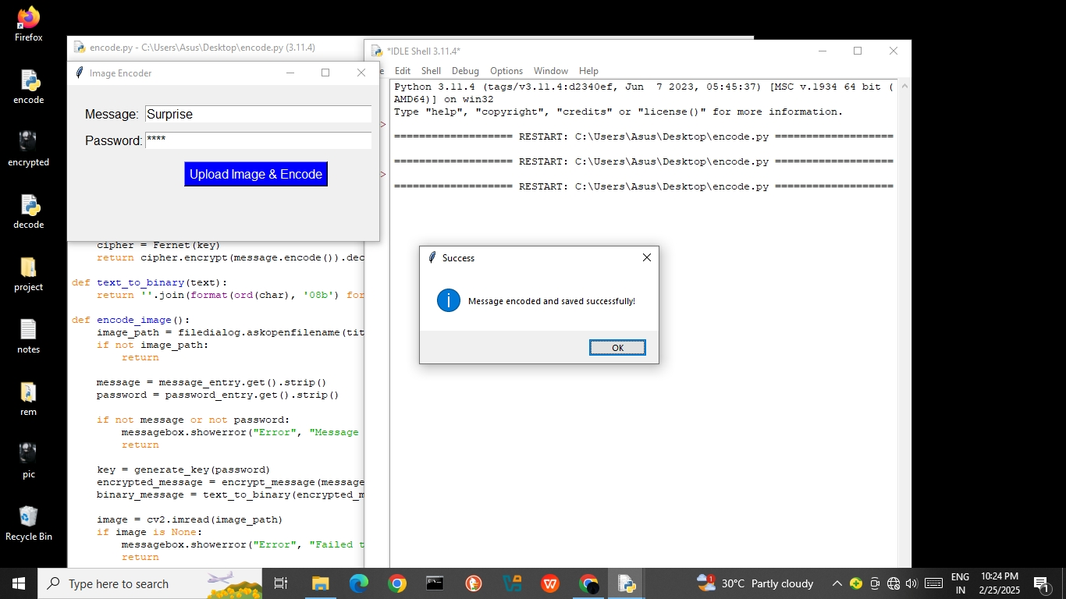

Slide 9
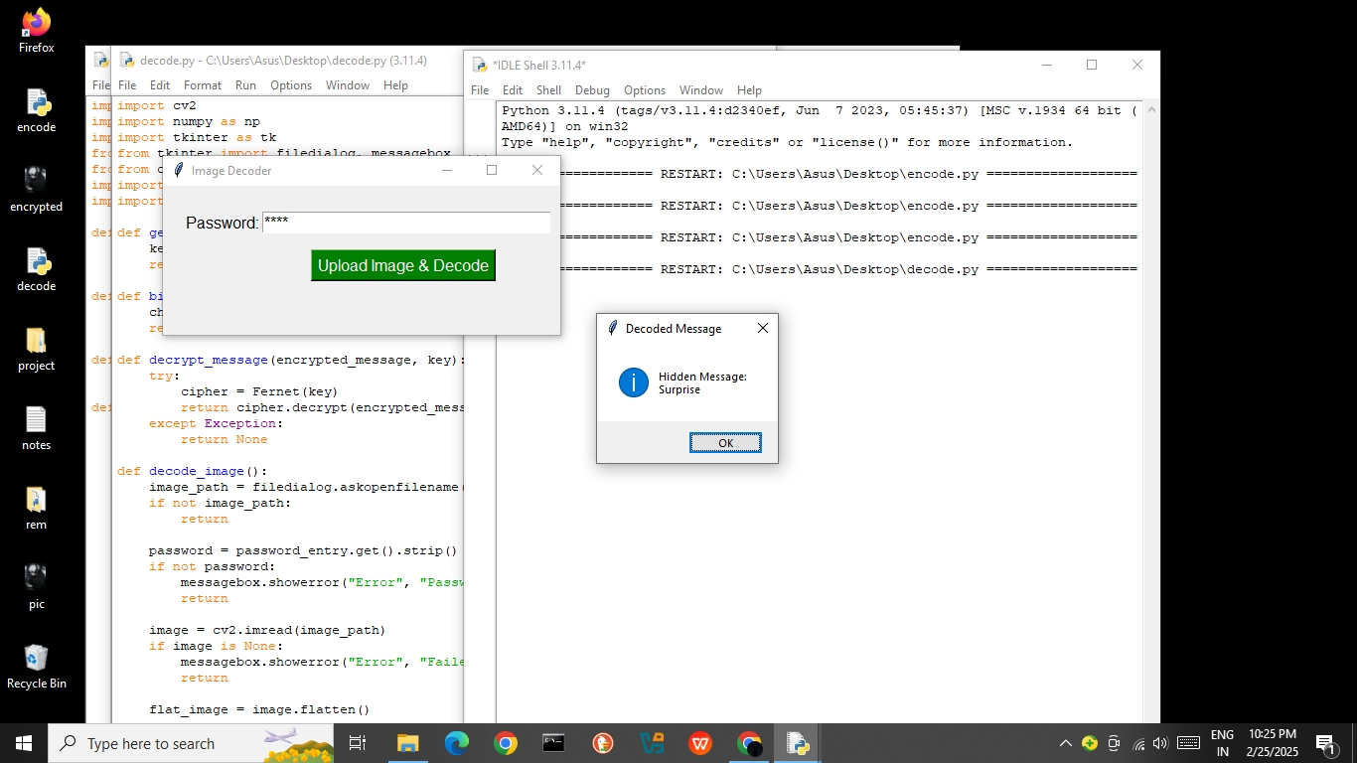

Slide 10
Conclusion
This project successfully addresses the security challenges of steganography by integrating encryption and steganalysis to ensure both privacy and protection against misuse. By using password-based encryption and LSB-based encoding, the system enables secure message hiding and retrieval while maintaining image integrity. Unlike traditional methods, our approach ensures that even if a hidden message is extracted, it remains unreadable without the correct password. Additionally, the user-friendly GUI makes secure communication accessible to both technical and non-technical users. This project strikes a balance between privacy and cybersecurity, making it a powerful tool for confidential communication while preventing unauthorized or malicious use.

Slide 11
GitHub Link
https://github.com/Nabishs/Project01.git

Slide 12
The project can be expanded by integrating AI-powered steganalysis to detect hidden data and prevent misuse. Support for multi-format steganography (audio, video, and documents) can enhance its versatility. A cloud-based secure communication platform can be developed for real-time encrypted messaging. Adaptive encoding techniques can further reduce detectability, making hidden data more secure.
Future scope(optional)

Slide 13
THANK YOU

