Slide 1

User-training on Uncertainty mode
Innovative Systems Software

Slide 2
Typical PWR, small break LOCA (SBLOCA)
Model description
4-loop pressurized reactor undergoing a small break LOCA.
Broken loop (1) is modeled as a single loop. CCC=2XX
Intact loops (3) are merged in to one triple-loop, CCC=1XX
Vessel components, CCC=3XX
Break is modeled using
Variable Trip 506 (time condition)
Trip valve CCC=505 connecting cold leg volume 212 (between reactor coolant pump and vessel) with containment.
Time dependent volume simulating containment conditions CCC=500

Slide 3
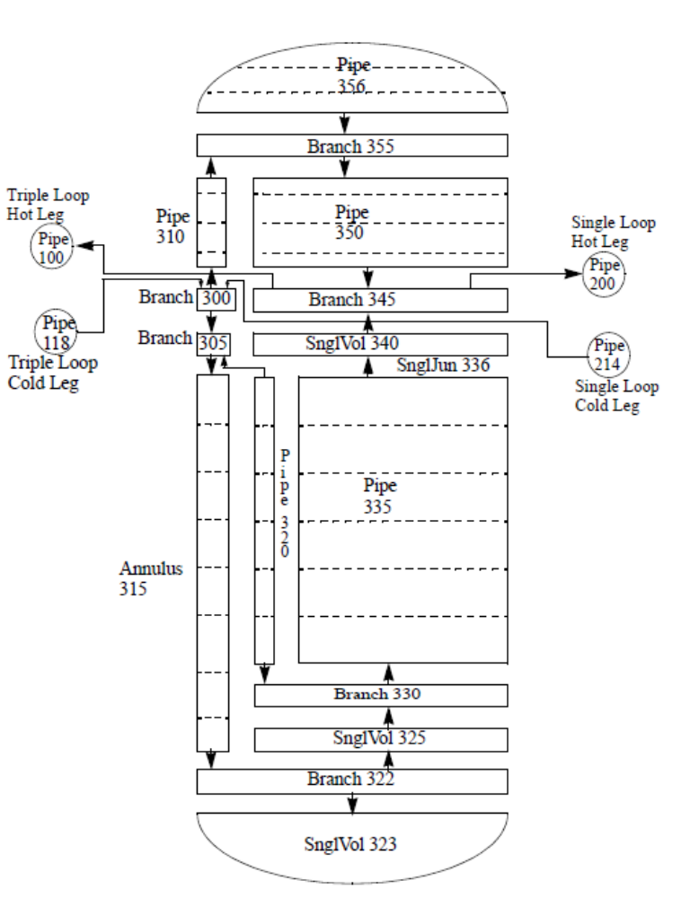
Typical PWR, small break LOCA (SBLOCA)
Vessel nodalization

Slide 4
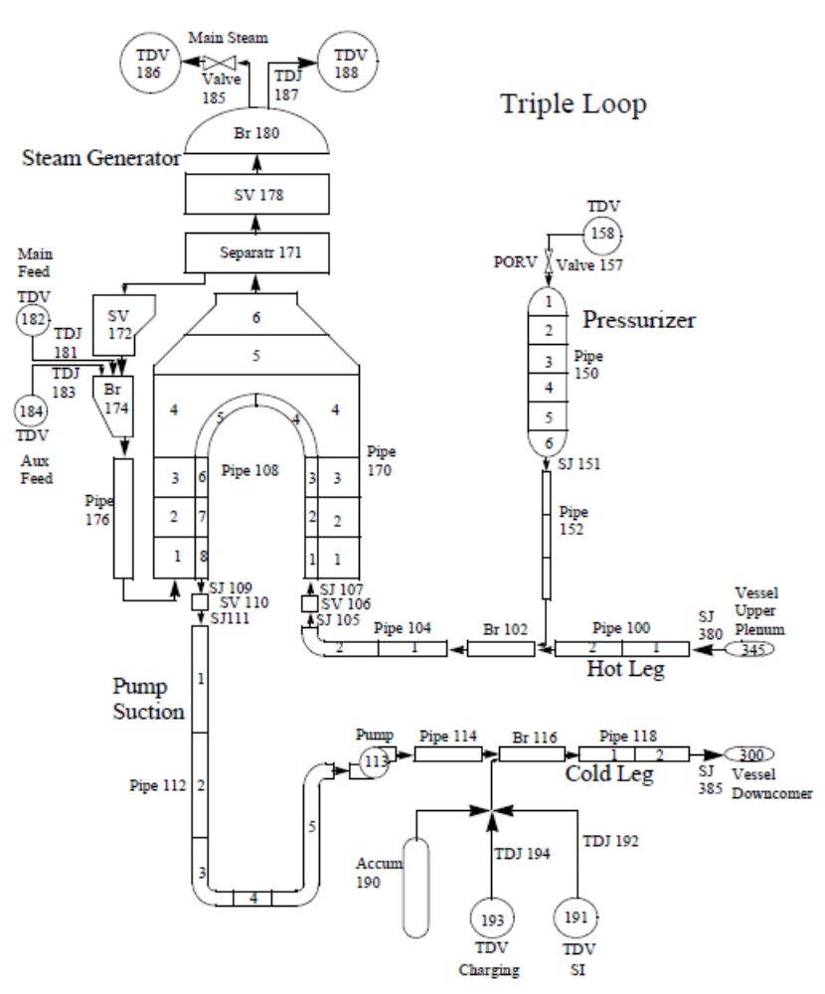
Typical PWR, small break LOCA (SBLOCA)
Intact loop nodalization

Slide 5
Uncertainty analysis of a
Typical PWR, small break LOCA (SBLOCA)
File sb.bat
Execute sb.bat, which contains:
  Execution line for setup phase
  Execution lines for 59 code runs
  Execution line for post-processing phase
  Field -Q at the end of each line, automatically closes the simulation window without user interaction, and allows to proceed to next execution line in sb.bat.

Slide 6
Setup phase
Input file
File sb.is
Identify input parameters with uncertainty associated.
  Which Source correlation parameters?
  Which Input treatable parameters?
  Identify pdf’s and their characteristic parameters.
  Uniform, UD (minimum, maximum)
  Normal, ND (mean, standard deviation)
  Log-normal, LD (mean, standard deviation)
  Polynomial/trapezoidal, TD (p1, p2, p3, p4)
Analyze options in input-treatable cards:
Cards 29101XXX
Cards 29102XXX
Cards 29107XXX

Slide 7
Setup phase
Output files
File sb.os
Analyze different sections in output-print file:
Input processing
Wilks’ formula related information
General information on input parameters and uncertainty data.
Sampled values for each run.
Files sbNNN.w, sb.rs

Slide 8
Post-processing phase
Input file
File sb.ip
Identify code runs from which upper and lower one-sided tolerance limits will be computed.
  Identify selected parameters, for which rank and run matrices, and bounds will be computed.

Slide 9
Post-processing phase
Output files
File sb.op
File sb*.m :
Build upper and lower one-sided tolerance limits
Identify PCT
  File sb*.mruns :
  Identify uncertainty run number that produced PCT over all runs
  Can you relate that PCT with its associated sampled values?

Slide 10
Additional exercises
Increase Wilks’ order to 3
  How many code runs are needed to generate a 95/95 one-sided tolerance limit?
  Modify sb.bat file and execute the added code runs.
  Build 95/95 and 5/95 one-sided tolerance limits from *.m file
  Identify run number producing PCT and analyze sampled values for that run.
  Analyze sample-size effect comparing 2 sets of 59 code runs (1st order)
Perform the following changes and analyze the impact on the results:
Change Wilks’ order / confidence level / percentile
Add/remove uncertain input parameters
Modify pdf’s characteristic parameters

