Slide 1

SILIGURI GOVERNMENT POLYTECHNIC
Government of West Bengal • TechVista 2026
INTER-DEPARTMENT TECHNICAL MODEL COMPETITION
EcoScan
AI-Powered Smart Waste Sorting & Recycling Assistant
Theme: "From Ideas to Impact: Building a Sustainable Future"
Think Green • Build Better • For a Sustainable Tomorrow
STUDENT TEAM (Dept. of Computer Science & Technology):
1. Dhruba Bachhar 2. Nabojeet Biswas 3. Subrata Roy
Mentor: Faculty Advisor, Department of CST | Date: 9th October 2026

Slide 2
ECOSCAN • TECHVISTA 2026
Introduction & Project Overview
About EcoScan
Inspiration & TechVista Alignment
• AI-Assisted Waste Identification: Users snap a photo or upload an image to identify materials instantly.
• 4-Bin Municipal Standard: Recommends precise municipal disposal bins (Recyclable, Organic, Hazardous, General).
• Actionable Preparation: Delivers simple disposal advice like rinsing containers, detaching caps, and toxic alerts.
• Gamified Civic Learning: Tap-to-sort challenge reinforces memory with real-time score points and daily streaks.
• Exhibition-Proof Demo Mode: 9 pre-analyzed demo items guarantee 100% booth uptime even without Wi-Fi.
• Engineering Domain: Environmental Informatics, Multimodal Computer Vision, and Modern Full-Stack Web.
• Addressing Landfill Overflow: Over 60% of recyclable plastic ends up in landfills due to incorrect consumer sorting.
• Bridging the Awareness Gap: Most citizens find municipal color coding confusing; EcoScan answers 'Which bin?' in seconds.
• Competition Theme: Directly answers TechVista 2026: 'From Ideas to Impact: Building a Sustainable Future'.
EcoScan AI | TechVista 2026 | Siliguri Government Polytechnic (CST Dept.)

Slide 3
ECOSCAN • TECHVISTA 2026
Problem Statement: The Municipal Waste Crisis
Current Manual Issues & Bottlenecks
Why an AI-Powered Software Solution?
• High Contamination Rates: Recyclable dry paper & plastic get contaminated by wet organic kitchen waste.
• Ambiguous Visual Clues: Multi-layer packaging (chips packets, coffee cups) look recyclable but are composite landfill trash.
• Toxic Household Hazards: Batteries, aerosol cans, and e-waste improperly discarded into municipal bins leach toxic lead.
• Zero Real-Time Feedback: Citizens have no feedback or guidance at the exact second they discard an item.
• Instant Vision AI Inference: Multimodal Gemini Vision classifies polymers and items from a single image.
• Zero Hardware Expense: Works on any existing smartphone, tablet, or laptop browser without buying expensive sensors.
• Plain-Language Guidance: Translates complex waste disposal manuals into 3 clean, step-by-step instructions.
• Gamified Habit Formation: Points, streaks, and sorting mini-games convert passive citizens into proactive eco-champions.
EcoScan AI | TechVista 2026 | Siliguri Government Polytechnic (CST Dept.)

Slide 4
ECOSCAN • TECHVISTA 2026
Project Objectives & Scope
Functional Scope
Non-Functional Scope
Planned for Phase 2
✔ Live Camera & Upload scanning
✔ Multimodal AI item detection
✔ 4-Bin municipal allocation
✔ Multi-waste batch detection (detects 3 items in 1 photo)
✔ Gamified tap-to-sort challenge
✔ Persistent browser Eco Points
✔ Zero-Wi-Fi Demo Mode catalog
⚡ Speed: Sub-2 second scan responses
🔒 Security: Google API key safely stored on Spring Boot backend
📱 Responsive: Flawless layout on mobile, tablet, and PC
🛡️ Resilience: Seamless fallback to demo catalog if AI limits exceed
🧹 Clean Code: Modular Redux slices and Spring services
⏳ User accounts & cloud DB sync
⏳ Smart-bin robotic servo lids
⏳ Ultrasonic fill-level hardware
⏳ Bengali & Hindi audio guidance
⏳ Municipal GIS pickup heatmap
⏳ Offline on-device TensorFlow Lite model
EcoScan AI | TechVista 2026 | Siliguri Government Polytechnic (CST Dept.)

Slide 5
ECOSCAN • TECHVISTA 2026
Proposed System Architecture: Client-Server-AI
1. Client Frontend
(React 19 + RTK Query)
2. Backend API Server
(Spring Boot 3.4 on :8080)
3. Vision AI
(Google Gemini)
• Camera / File Upload UI
• Redux Toolkit State Engine
• LocalStorage (Eco Points)
• Tailwind CSS v4 Responsive
• Interactive 4-Bin Sort Game
HTTP POST /api/scan
FormData (Image)
──────►
◄──────
JSON WasteResult
• ImageValidator (Type & 5MB)
• GeminiService (Prompt Builder)
• DemoService (Offline Catalog)
• Global Exception Handler
• Secure API Key Storage
Spring WebClient
Prompt + Base64
──────►
◄──────
AI JSON Schema
• Gemini Vision
• Structured JSON
• Zero Client Key
• 4-Bin Matching
ARCHITECTURAL RESILIENCE & SECURITY GUARANTEE:
• Security: Gemini credentials stay isolated on Spring Boot — zero API key leakage in browser dev tools.
• Offline Exhibition Mode: If Internet/API limits fail during TechVista presentation, EcoScan gracefully routes requests to /api/demo.
EcoScan AI | TechVista 2026 | Siliguri Government Polytechnic (CST Dept.)

Slide 6
ECOSCAN • TECHVISTA 2026
Technology Stack & Development Tools
Frontend Web
Backend Core
AI & Cloud
Dev & QA Tools
• React 19 (Hooks)
• Redux Toolkit (RTK)
• RTK Query (caching)
• Tailwind CSS v4
• Lucide React icons
• Redux Persist
• Vite 8 Build Tool
• Java 21 LTS
• Spring Boot 3.4.3
• Spring WebClient
• Jackson JSON Parser
• Multipart Validation
• Maven Build System
• CORS Configuration
• Google Gemini Vision
• Prompt Engineering
• Structured Output
• 4-Bin Waste Schema
• Low-latency inference
• Multi-item detection
• Fallback catalog
• Git & GitHub
• VS Code / IntelliJ
• pnpm Package Mgr
• Chrome DevTools
• Edge Headless CLI
• JUnit 5 / Maven Test
• REST Client (.http)
EcoScan AI | TechVista 2026 | Siliguri Government Polytechnic (CST Dept.)

Slide 7
ECOSCAN • TECHVISTA 2026
System Data Models & REST Endpoints
Core Data Models (POJO & JSON)
Spring Boot REST Endpoints
WasteResult (Single Item Contract):
• itemName: String (e.g. 'Plastic Water Bottle')
• category: String (e.g. 'Plastic', 'Organic', 'E-Waste')
• bin: String ('recyclable' | 'organic' | 'hazardous' | 'general')
• tip: String (disposal advice and rinsing guide)
• warning: String (toxic hazard instructions)
• recyclable: boolean
MultiWasteResult (Batch Envelope):
• totalDetected: int (e.g. 3)
• items: List<WasteResult>
• primaryItem: WasteResult
GET /api/status
Returns server status & Gemini AI availability boolean.
POST /api/scan [Multipart/form-data]
Payload: 'image' (JPEG/PNG/WebP, max 5MB)
Returns: Structured WasteResult or MultiWasteResult JSON.
GET /api/demo
Returns catalog of 9 pre-analyzed demo waste items.
GET /api/demo/{id}
Returns detailed single demo item classification.
GET /api/demo/multi
Returns 3-item multi-waste picnic combo.
EcoScan AI | TechVista 2026 | Siliguri Government Polytechnic (CST Dept.)

Slide 8
ECOSCAN • TECHVISTA 2026
End-to-End Workflow: Capture to Eco Points
01
02
03
04
05
Capture Image
Route & Validate
AI Vision Analysis
3-Layer Result Card
Tap-to-Sort Game
User snaps camera photo or uploads JPEG/PNG/WebP (<5MB).
Spring Boot checks file size, format headers & MIME type.
Gemini Vision detects item, polymer, bin & prep instructions.
Clean UI shows bin color, degradation years & disposal tips.
User tests memory: taps 1 of 4 bins to earn +10 Eco Points.
Camera Snap ➔ ImageValidator ➔ Gemini Vision ➔ 3-Layer Visual Card ➔ 4-Bin Game ➔ LocalStorage Points
EcoScan AI | TechVista 2026 | Siliguri Government Polytechnic (CST Dept.)

Slide 9
ECOSCAN • TECHVISTA 2026
Core Application Modules & Engineering Highlights
1. AI Waste Scanner
2. 3-Layer Result Visualizer
3. Multi-Waste Detection
Live webcam viewfinder, camera switching, drag-and-drop file upload with animated multi-step analysis indicators.
Clean visual architecture: Layer 1 (Bin recommendation), Layer 2 (Fast facts & degradation time), Layer 3 (Disposal prep instructions).
Detects multiple items simultaneously from complex scenes (e.g., plastic bottle + soda can + banana peel) with an interactive batch selector.
4. Gamified 4-Bin Sort Game
5. Municipal Bin Knowledge Hub
6. Resilient Exhibition Demo Engine
Educational tap-to-sort challenge awarding +10 Eco Points per correct answer with persistent browser streaks and feedback audio.
Comprehensive guide for municipal color standards (Green, Blue, Brown, Purple) with accepted materials and forbidden contaminants.
Self-contained pre-analyzed demo catalog guaranteeing zero downtime during technical exhibitions, even if internet connection drops.
EcoScan AI | TechVista 2026 | Siliguri Government Polytechnic (CST Dept.)

Slide 10
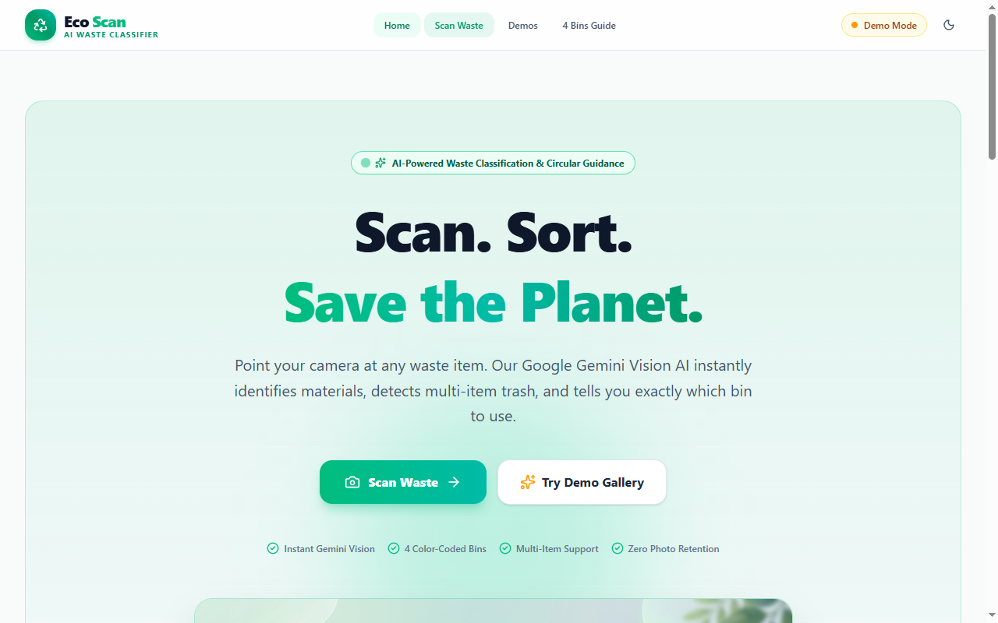
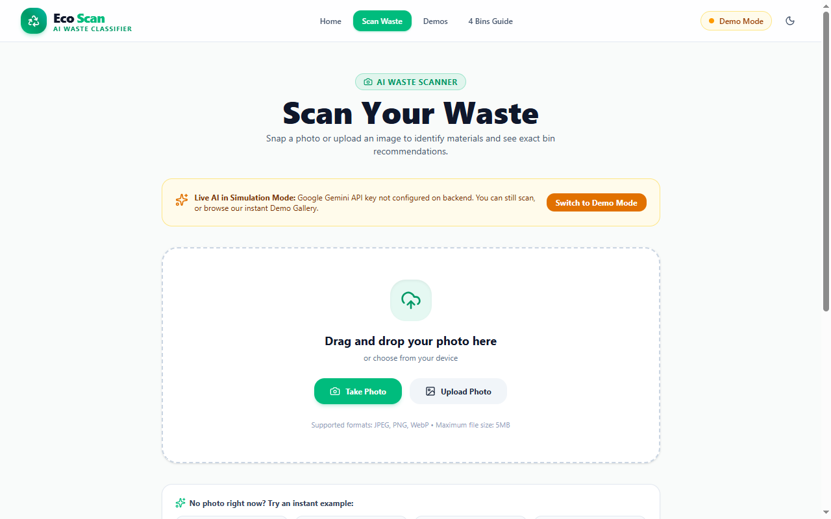
ECOSCAN • TECHVISTA 2026
Live UI Walkthrough: Landing Page & AI Scanner
Homepage & Mission Portal (/) : Modern nature-inspired hero, live civic statistics badge, quick 3-step explainer card, and instant scan CTA.
Live Waste Scanner (/scan) : Drag-and-drop zone, camera snapshot support, authentic preset sample images (bottle, can, peel, battery), and auto demo fallback.
EcoScan AI | TechVista 2026 | Siliguri Government Polytechnic (CST Dept.)

Slide 11
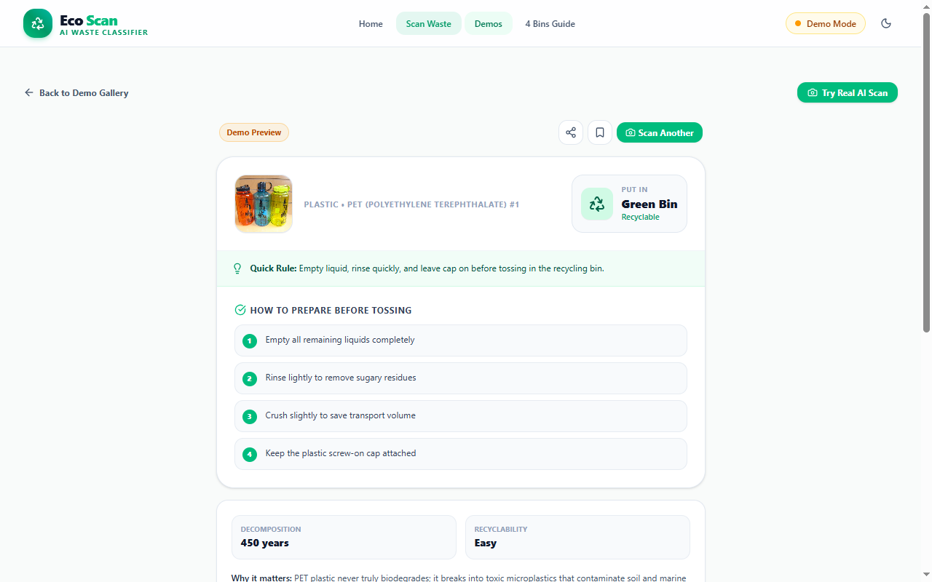
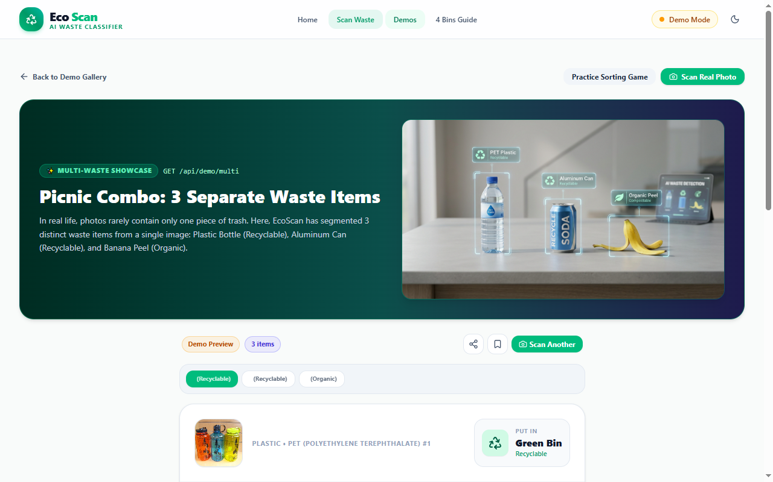
ECOSCAN • TECHVISTA 2026
Live UI Walkthrough: 3-Layer Result & Multi-Waste Detection
3-Layer Result Visualizer (/demo/plastic-bottle) : Clean layer 1 (Green Bin classification), layer 2 (PET facts & 450-yr degradation), layer 3 (cap separation guide).
Multi-Waste Detection (/demo/multi) : Detects 3 separate items in a single photo (Plastic Bottle, Soda Can, Banana Peel) with interactive batch selector and sorting queue.
EcoScan AI | TechVista 2026 | Siliguri Government Polytechnic (CST Dept.)

Slide 12
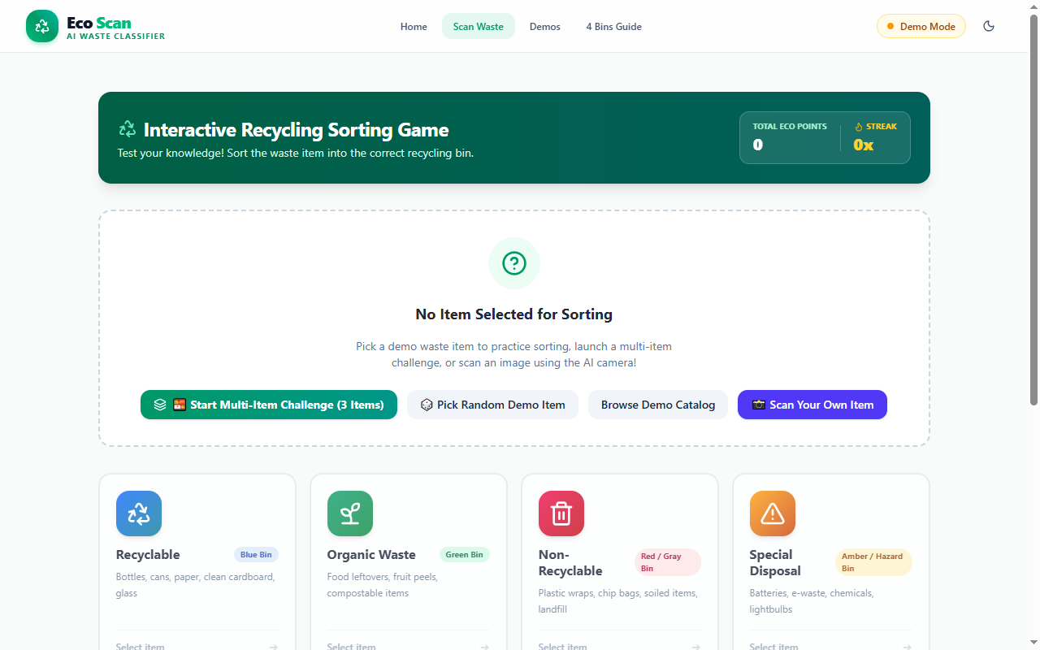
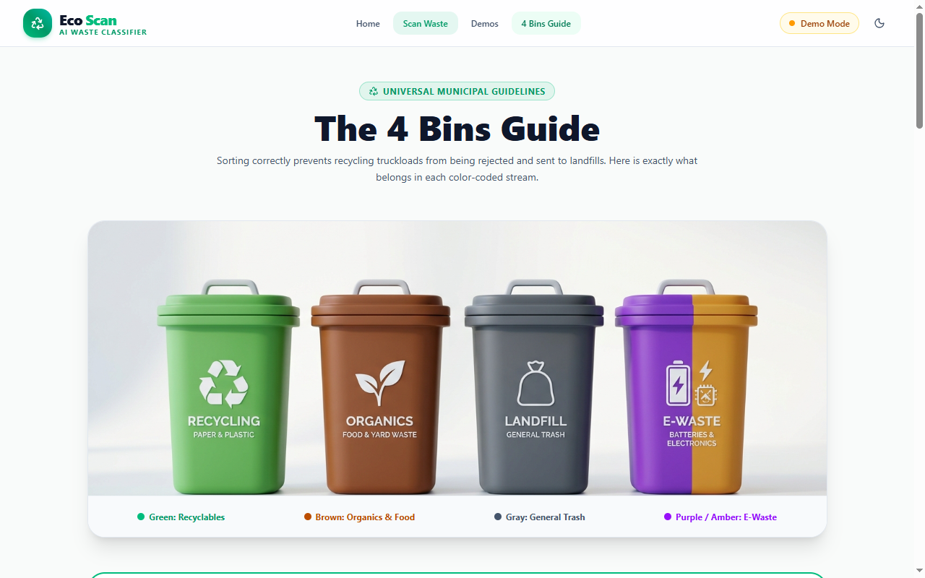
ECOSCAN • TECHVISTA 2026
Live UI Walkthrough: Gamified Sorting & Bin Guide
Interactive Sorting Game (/game) : 4 color-coded municipal bins, real-time score tracker, dynamic streak counters, and instant feedback audio + animations.
Municipal Bins Guide (/bins) : Comprehensive guide for 4 bins: Green (Dry Recyclables), Blue (Landfill), Brown (Organic Compost), and Purple (Hazardous/E-Waste).
EcoScan AI | TechVista 2026 | Siliguri Government Polytechnic (CST Dept.)

Slide 13
ECOSCAN • TECHVISTA 2026
Methodology & Development Approach: Agile Sprints
Sprint 1
Sprint 2
Sprint 3
Sprint 4
Sprint 5
Plan & Design
Frontend UI
AI Vision
Backend Bridge
QA & Exhibition
• Requirement engineering
• UI/UX wireframes
• Municipal bin research
• Architecture planning
• React 19 app setup
• Tailwind CSS v4 styling
• Webcam & file upload
• Redux Toolkit store
• Google Gemini Vision
• Prompt optimization
• Structured JSON parsing
• Confidence scoring
• Spring Boot 3 setup
• Secure API gateway
• CORS & multipart rules
• Demo catalog service
• 37 Maven unit tests
• Multi-waste feature
• Performance tuning
• TechVista readiness
Agile Principles: Continuous Integration, Weekly Demo Testing, and Zero-API-Key Exposure on Frontend
EcoScan AI | TechVista 2026 | Siliguri Government Polytechnic (CST Dept.)

Slide 14
ECOSCAN • TECHVISTA 2026
Testing, Verification & Quality Assurance
Test Dimension | Component Tested | Methodology & Tools | Outcome & Status
Backend Unit Testing | ImageValidator, GeminiResultParser, DemoService | JUnit 5, Mockito, Maven Test Runner | ✔ 37 / 37 Tests Passing (100% Pass)
Image Validation Testing | Invalid files, text notes, >5MB images | HTTP 400 Bad Request error assertions | ✔ Secure rejection of invalid MIME formats
Integration Testing | React RTK Query ➔ Spring Boot ➔ Gemini AI | Full multipart payload upload & JSON check | ✔ End-to-end classification in < 2.0s
Offline Resilience Testing | Demo catalog fallback mechanism | Simulated network disconnect & 502 mock | ✔ Zero downtime: Seamless switch to demo
Responsive & Cross-Device | Webcam viewfinder, sorting cards, touch | Chrome DevTools, Edge, Mobile viewports | ✔ 100% Mobile & Desktop compatible
EcoScan AI | TechVista 2026 | Siliguri Government Polytechnic (CST Dept.)

Slide 15
ECOSCAN • TECHVISTA 2026
Engineering Challenges & Implemented Solutions
CHALLENGE 1: API Key Exposure in Browser
ENGINEERING SOLUTION: Calling Gemini directly from React would expose the API key in client network logs. Solution: Migrated all AI logic into a Spring Boot gateway where credentials remain strictly server-side.
CHALLENGE 2: Exhibition Connectivity & Rate Limits
ENGINEERING SOLUTION: College exhibitions have unpredictable Wi-Fi. Solution: Built an offline Demo Catalog (`/api/demo`) with 9 pre-analyzed items and a multi-waste picnic combo for 100% reliable live demonstrations.
CHALLENGE 3: Spring 7 Colon URI Template Encoding Bug
ENGINEERING SOLUTION: Google's endpoint uses `:generateContent`. Spring's WebClient encoded the colon into `%3A`, causing HTTP 404 errors. Solution: Re-engineered with `URI.create()` to preserve exact RFC compliance.
CHALLENGE 4: Multi-Item Garbage Discards in Single Photo
ENGINEERING SOLUTION: Real-world waste photos frequently contain multiple items (e.g., bottle + can). Solution: Built `MultiWasteResult` schema with dynamic AI array parsing and interactive item-by-item sorting.
EcoScan AI | TechVista 2026 | Siliguri Government Polytechnic (CST Dept.)

Slide 16
ECOSCAN • TECHVISTA 2026
Impact & Sustainability: Link to TechVista Theme
SDG 11
SDG 12
SDG 13
Sustainable Cities & Communities
Responsible Consumption
Climate Action
• Cleaner urban & campus spaces
• Less open dumping and street littering
• Encourages local civic segregation habits
• Enhances municipal collection efficiency
• Diverts clean recyclables from landfills
• Prevents recycling stream contamination
• Promotes circular economy reuse practices
• Educates on single-use plastic reduction
• Reduces methane gas emissions in landfills
• Prevents hazardous battery chemical leaching
• Saves energy required to produce virgin plastic
• Supports national Swachh Bharat mission
TechVista Motto: "From Ideas to Impact: Building a Sustainable Future" — Small Steps, Big Change!
EcoScan AI | TechVista 2026 | Siliguri Government Polytechnic (CST Dept.)

Slide 17
ECOSCAN • TECHVISTA 2026
Future Roadmap: IoT Smart-Bin Integration
Phase 1 (Accomplished)
Phase 2 (Next 6 Months)
Phase 3 (Long-Term Vision)
Web & Vision Core
IoT Hardware Smart Bin
Civic & Municipal Deployment
✔ Full multimodal Gemini AI Vision scanner
✔ Spring Boot 3 secure gateway proxy
✔ React 19 responsive UI with gamification
✔ Multi-waste detection & offline exhibition mode
✔ Physical bin prototype with Raspberry Pi / ESP32
✔ Servo-actuated motorized lids opening automatically
✔ Ultrasonic fill-level sensors reporting bin capacity
✔ On-device TensorFlow Lite model for zero-latency
✔ Regional voice guidance in Bengali and Hindi
✔ Municipal Corporation ward analytics dashboard
✔ GPS geotagging for smart collection route optimization
✔ Reward integration with municipal eco-coupons
EcoScan AI | TechVista 2026 | Siliguri Government Polytechnic (CST Dept.)

Slide 18
Thank You!
Small Steps, Big Change • Be a Sustainable Innovator
PROJECT SUMMARY & IMPACT:
EcoScan demonstrates how modern web engineering (React 19 + Spring Boot 3) coupled with Google Gemini Vision AI can eliminate waste segregation confusion, promote lifelong civic recycling habits through gamification, and build a sustainable green future for Siliguri Government Polytechnic and our broader community.
We invite the respected Judges & Faculty to test our Live Camera Scanner at our project stall!
Team: Dhruba Bachhar • Nabojeet Biswas • Subrata Roy | Department of Computer Science & Technology | TechVista 2026

