Slide 1


Buying a PC On-line

Slide 2
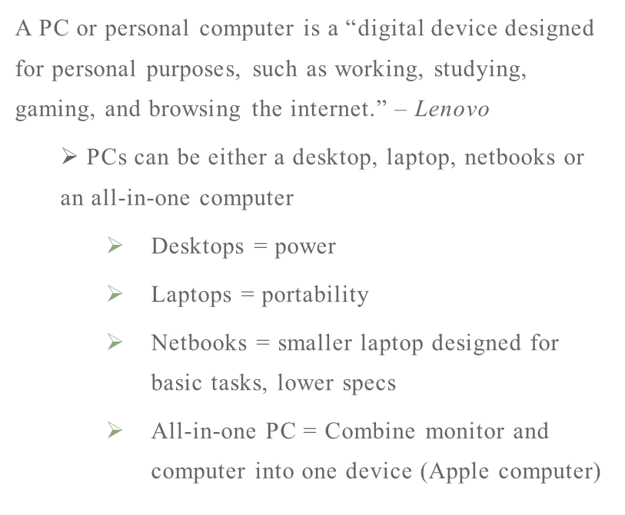
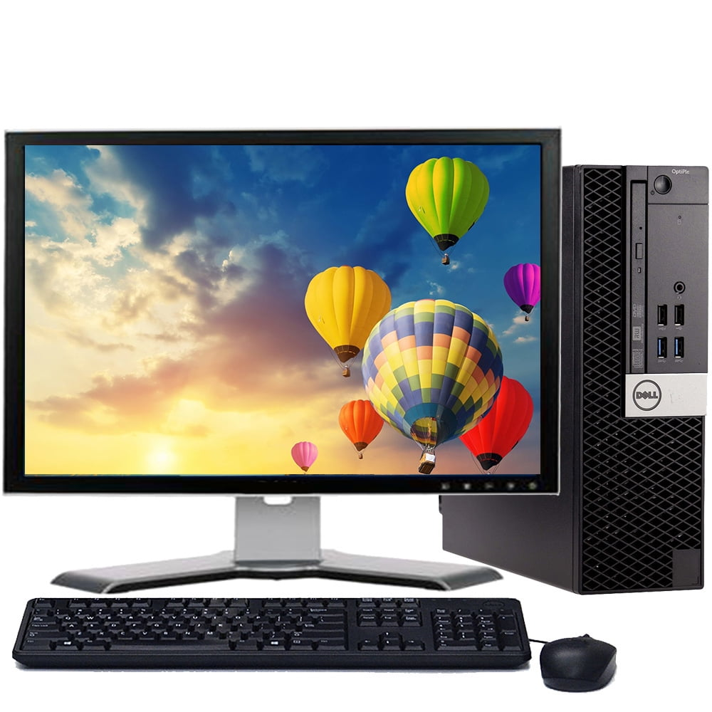
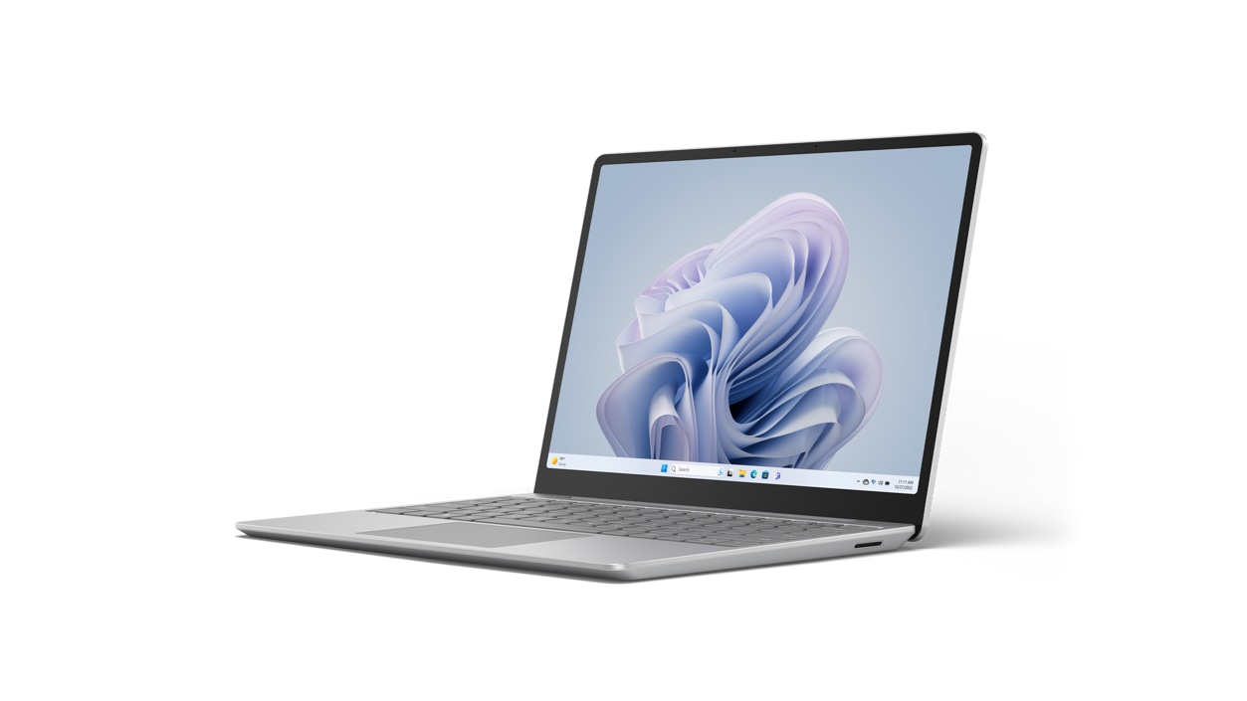
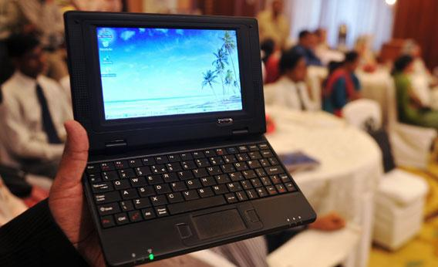
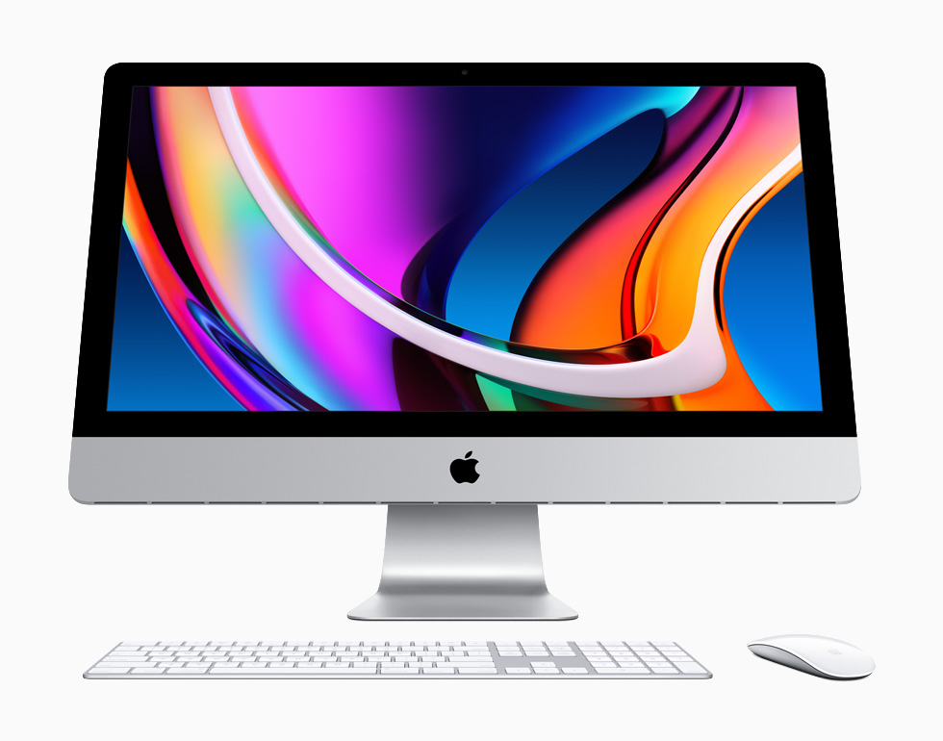
What is a PC?
By Walmart
By Microsoft
By Slate
By Apple

Slide 3
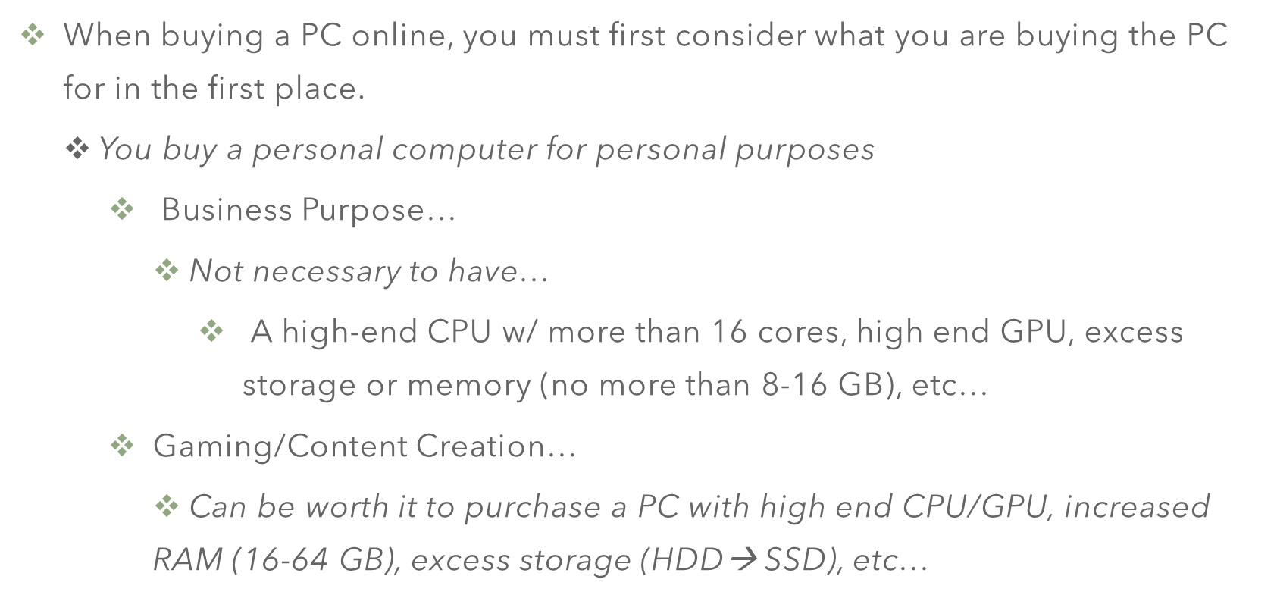
Why Buy a PC in the First Place?

Slide 4

Reasons for Purchasing a PC Online…

Slide 5
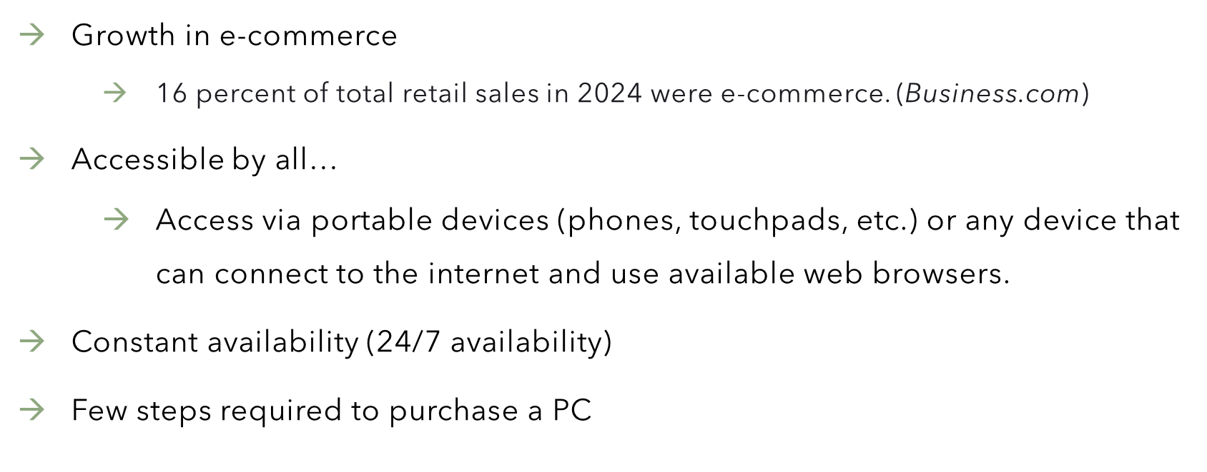
How is Buying a PC Online Convenient?

Slide 6
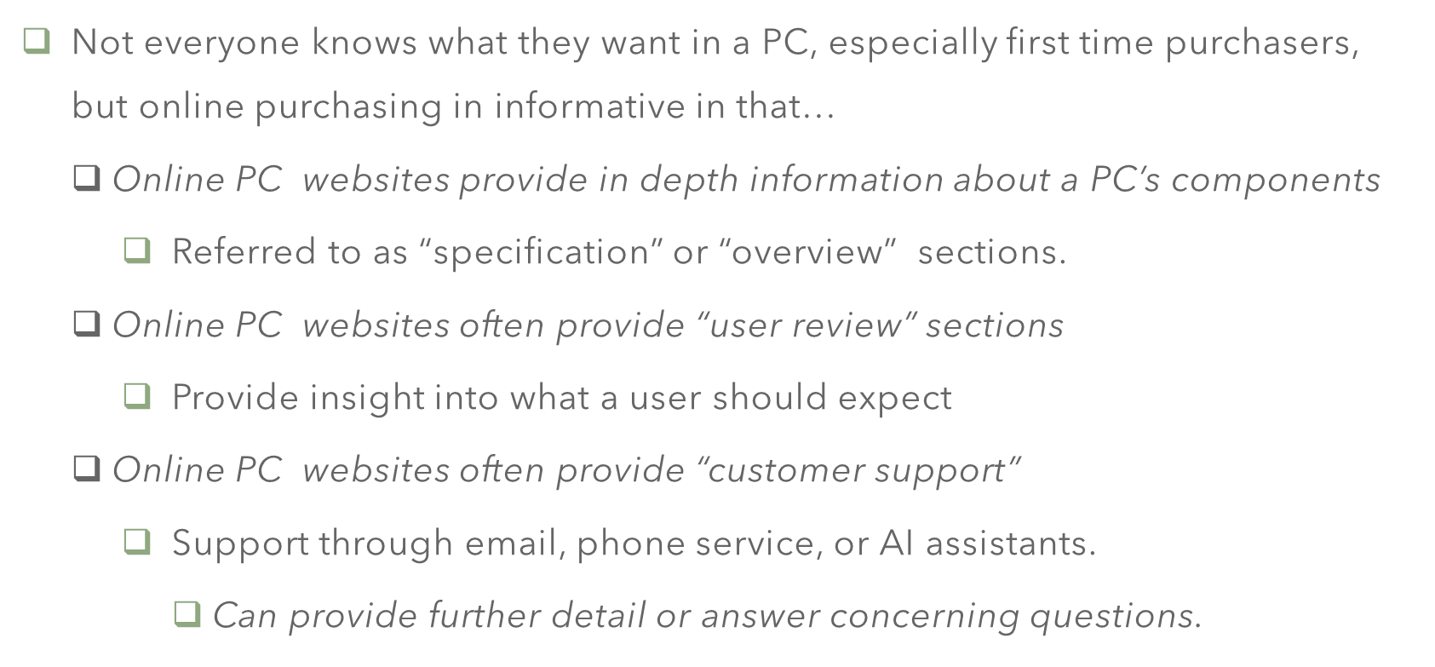
Buying PC’s Online IS Informative.

Slide 7
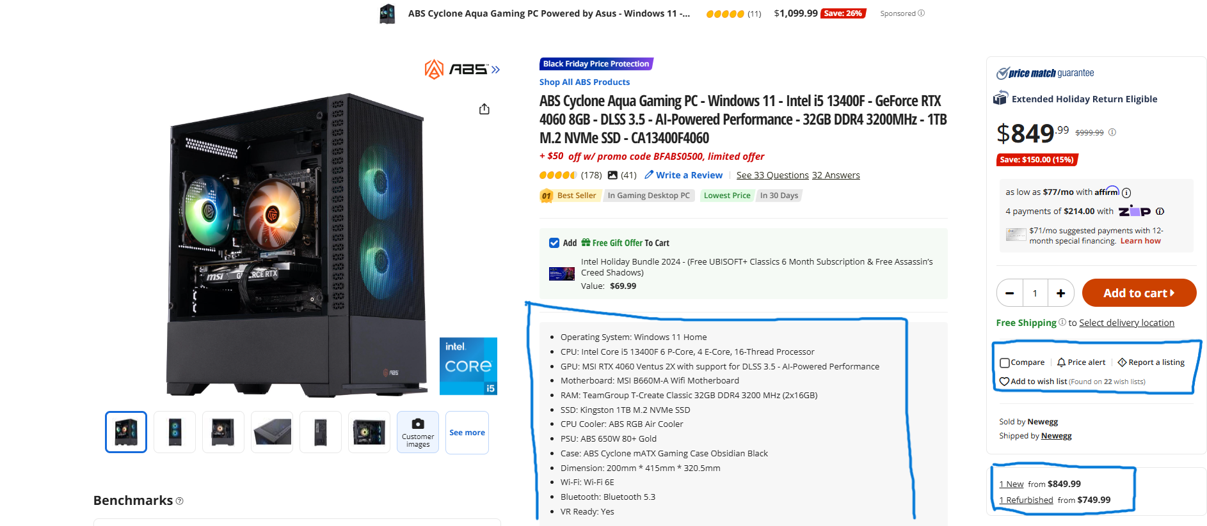
Informative Aspects…
By Newegg

Slide 8
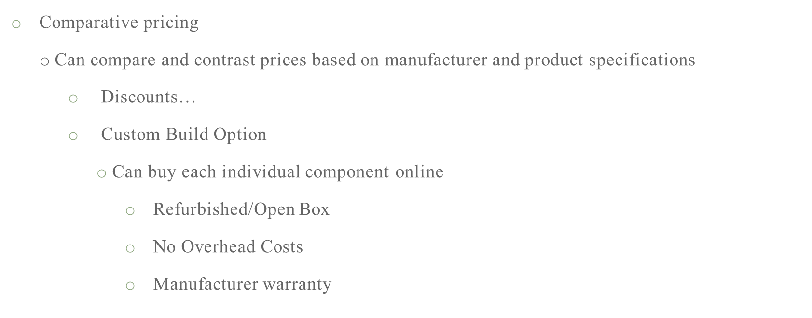
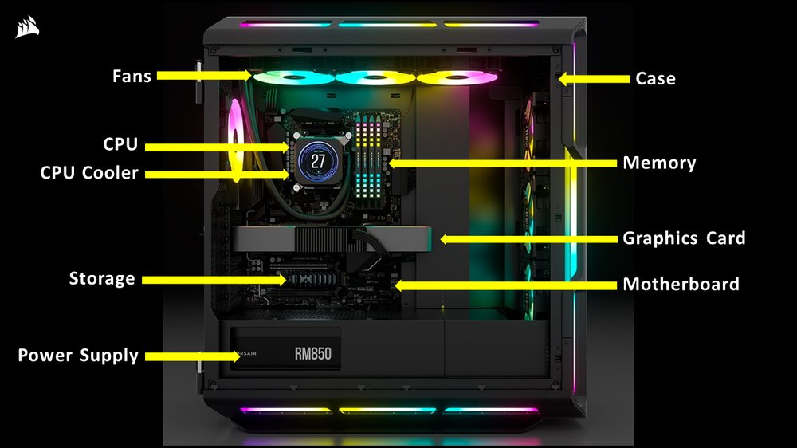
Buying a PC Online is Cost-Effective...
By Corsair

Slide 9


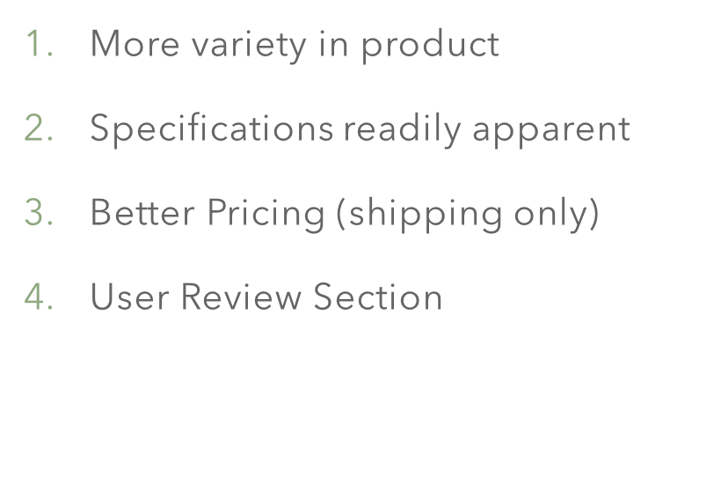
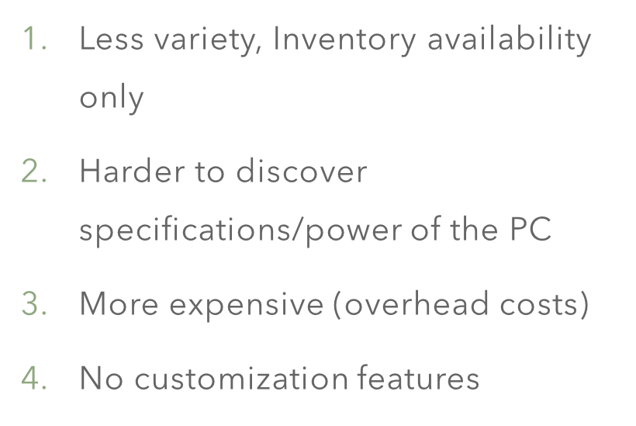
Online PC Purchasing v. In Store PC Purchasing…

Slide 10


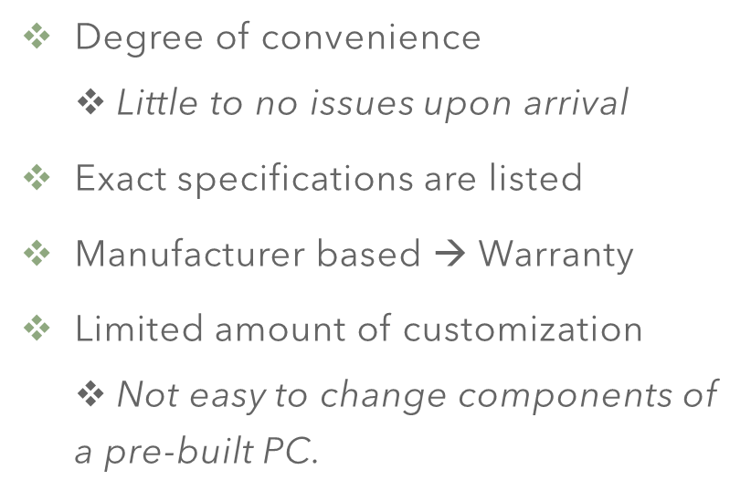
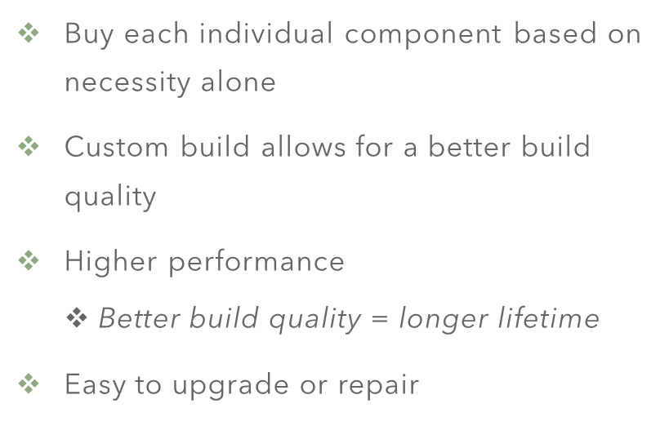
Pre-Built v. Custom Online PC Purchasing…

Slide 11
Importance of PC customization…
Each component of a PC relies on another component to get maximum power and efficiency.
  High end GPU is only useful if paired with a good CPU.
    Buying a PC online allows you to choose the specifications that work best for the purpose you want it to serve.
      Pre-built computers may have components that do not pair with others.

Slide 12
Conclusion…
Purchasing a PC online is the most convenient, informative, and cost-effective method.
  Buying a PC online is simple and effective
  Buying a PC online offers variety
  Buying a PC online offers customizability
  Buying a PC online is easily accessible
  Buying a PC online offers in depth detail about the personal computer
  Buying a PC online is reliable.

