Slide 1
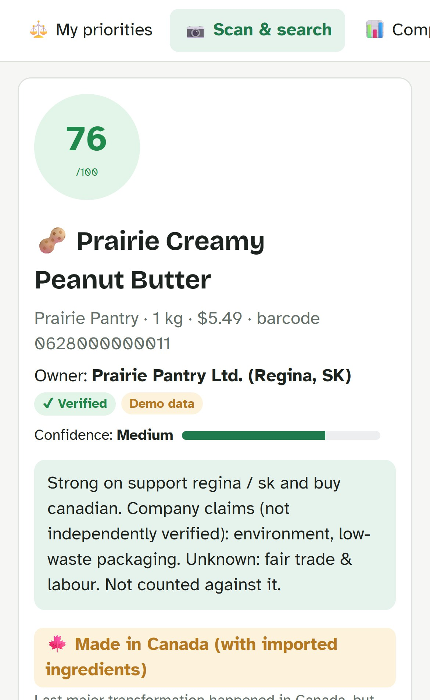
RODS TECH SKILLS SHOWCASE 2026
TruthShift
Shop by your values.
See what’s true.
[Team name] · [Member 1], [Member 2], [Member 3], [Member 4], [Member 5]
Notes:
Hi, we are [team name]. Our project is TruthShift, our answer to the RODS challenge The Ethical Consumer Compass. In one line: you tell the app what matters to you, scan a product, and it tells you how well that product fits your values, and how sure it is. This is the real app on a phone.

Slide 2
94%
of real products don’t say where they’re made
68 of 72 Canadian products in Open Food Facts
Notes:
We imported 72 real products sold in Canada from Open Food Facts, the largest open food database. 68 of them, 94 percent, do not say where they are made. None list a fair-trade label. This is the problem: shoppers want to buy Canadian and ethically, but the facts are simply not there. And a tool that treats missing facts as bad would call almost everything unethical.

Slide 3




Shoppers can’t see the facts
Made where?
Owned by whom?
Fair to workers?
Packaging waste?
Notes:
Four questions every ethical shopper asks, and none are easy to answer on a shelf. Where is it made? Made in Canada can still mean imported ingredients. Who owns the company? A familiar brand may have a foreign parent. Is it fair to workers and animals? Certifications, company claims and silence all look alike. And what happens to the packaging? Recycling rules differ by city, and Regina has its own.

Slide 4



Built for newcomers to Regina
3 languages
Real budgets
Regina stores
English · Français · ગુજરાતી
Price is a priority too
Local shops on a map
Notes:
RODS serves newcomers, so we designed for them. Their language: English, French and Gujarati screens, and the AI answers in the chosen language. Their budget: affordability is a priority like any other, and every better option shows the price difference. Their city: Regina stores on a map, local businesses, and Regina’s blue and green cart recycling rules.

Slide 5
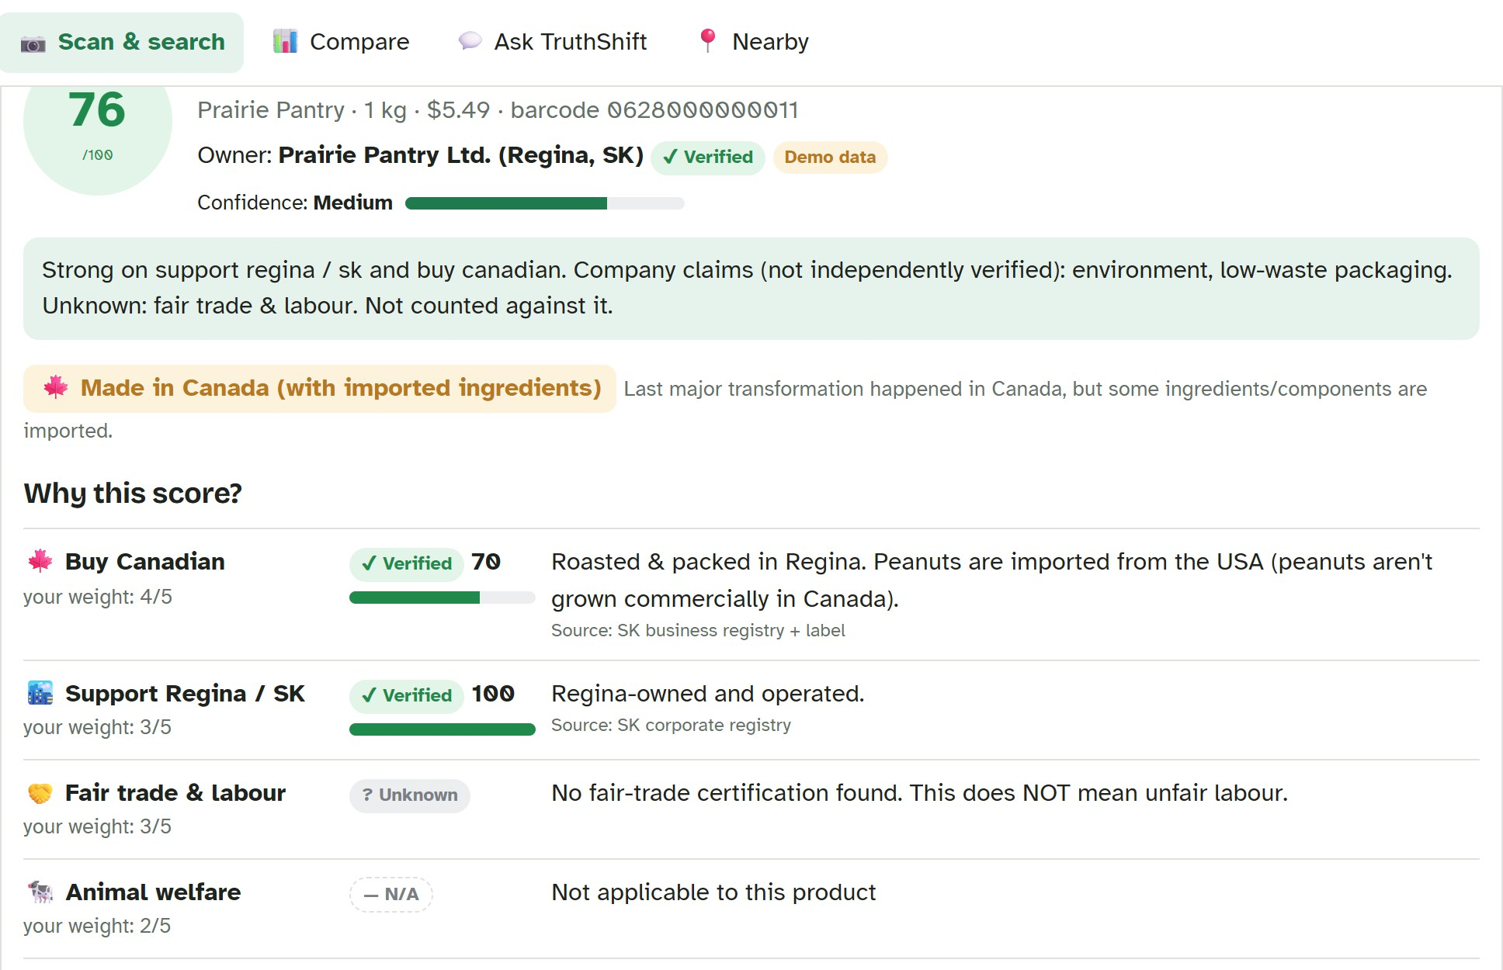



Scan. See the score. See the proof.
Scan or search
Evidence on every fact
Better options nearby
Notes:
This is the product screen. Prairie Creamy Peanut Butter scores 76 out of 100 for the default priorities, with Medium confidence. Every fact shows its evidence: verified, claimed or unknown, with the source. Below, it shows where to buy it in Regina and how to recycle the jar.

Slide 6



Every fact shows its evidence
Verified
Claimed
Unknown
counts 100%
counts 60%
not counted
Unknown ≠ bad
Notes:
The part of the challenge we took most seriously: communicate uncertainty and do not mislead. Verified means a certifier, government or registry confirmed it, and it counts fully. Claimed means the company or a community database says so, and it counts at 60 percent. Unknown is left out of the score completely and lowers the confidence meter instead. So a product with no labour information is not called unfair. It is called unknown.

Slide 7
Different shopper, different winner
Notes:
Ethical means different things to different people, so the score is personal. These are three coffees from our demo data, scored for three shopper types using the app’s presets. A Buy Canadian shopper gets Queen City Dark Roast, roasted in Regina, at 61. A fair-labour shopper gets Fairway Organic, Fairtrade certified, at 68. A shopper on a tight budget gets Big Bean Instant at 68. Same products, same facts, different priorities.

Slide 8
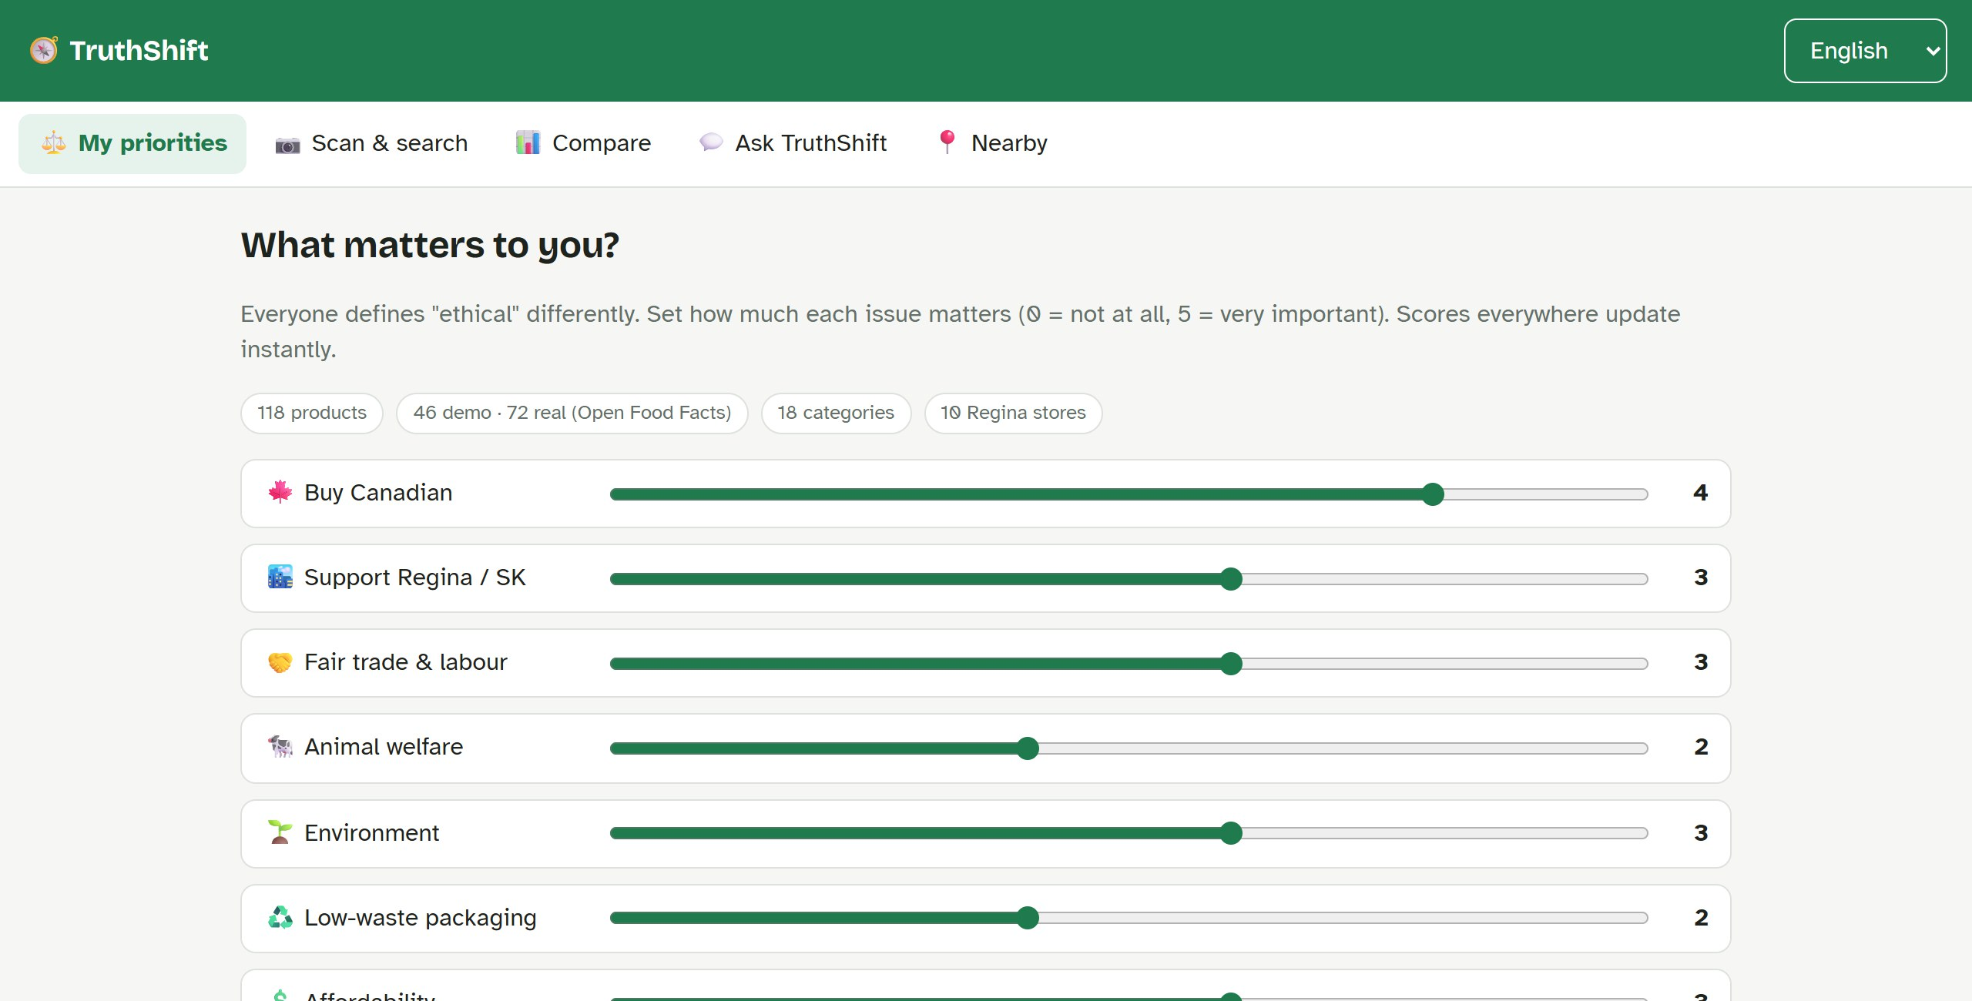
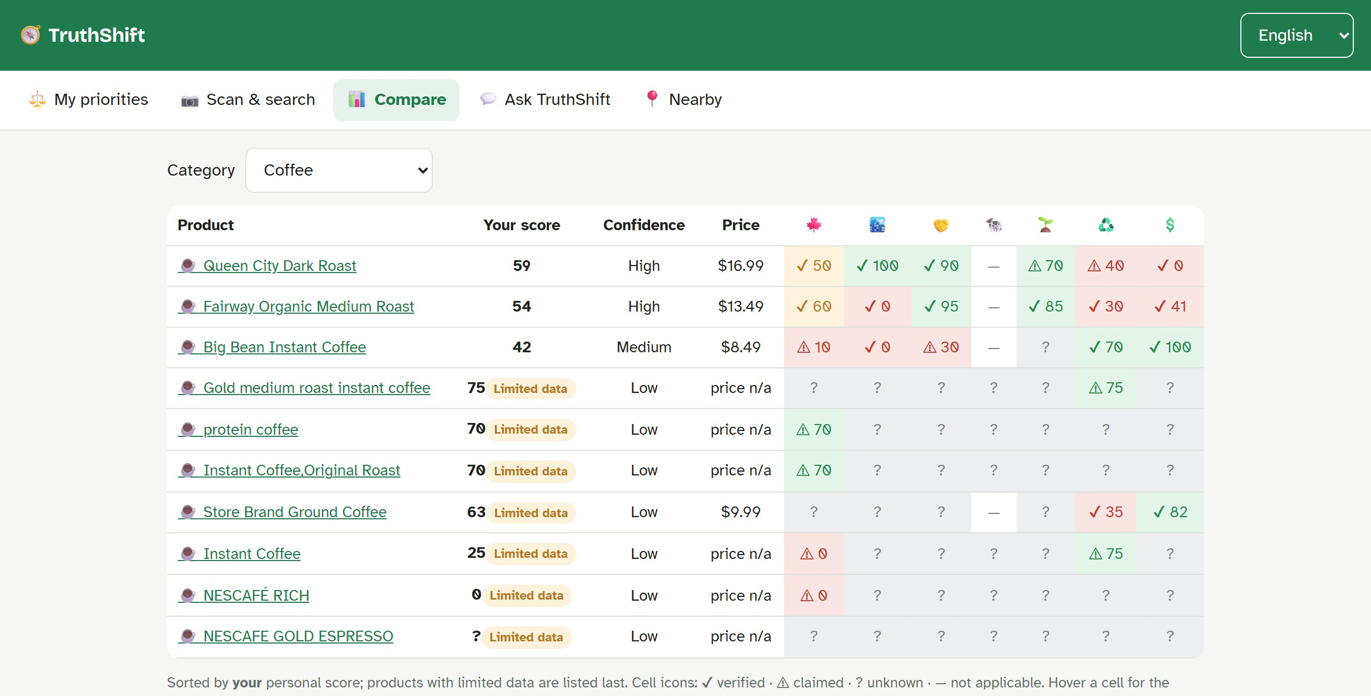
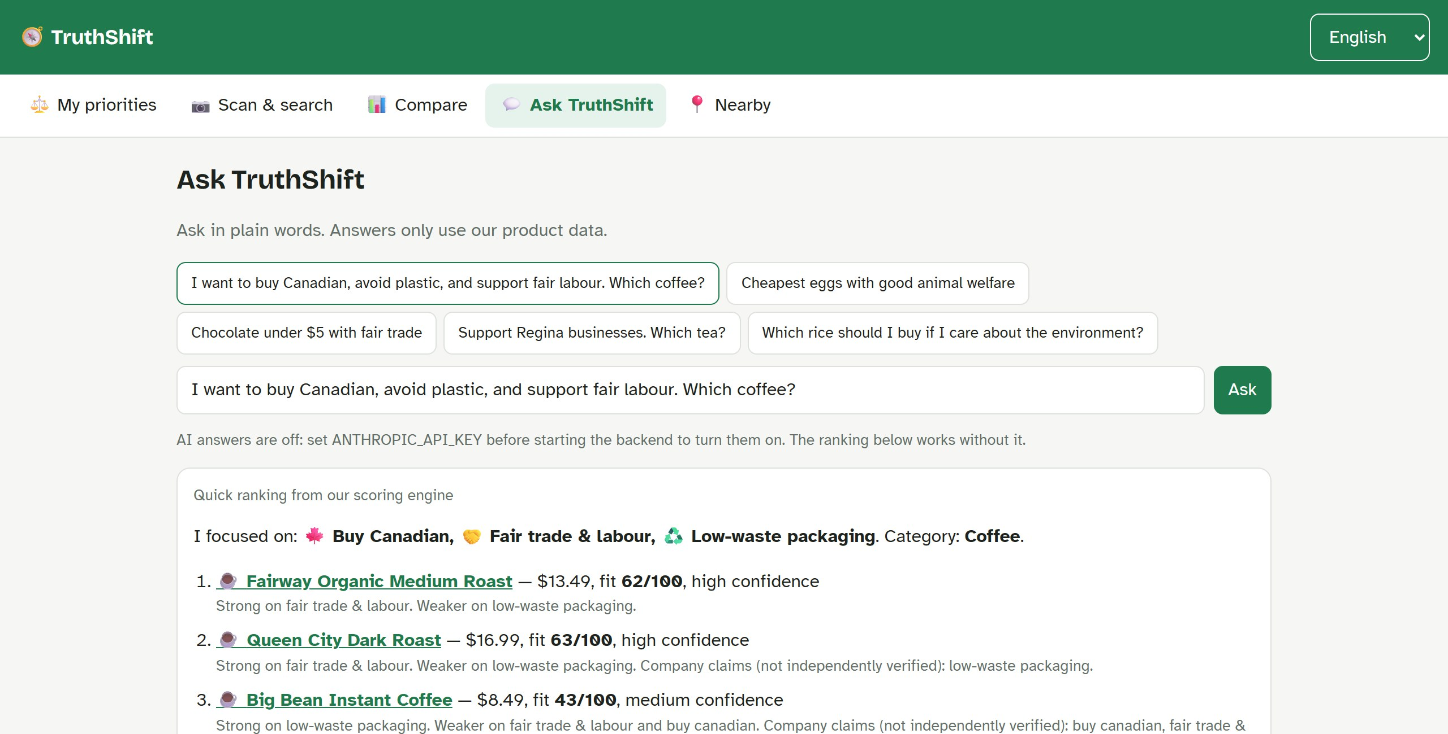
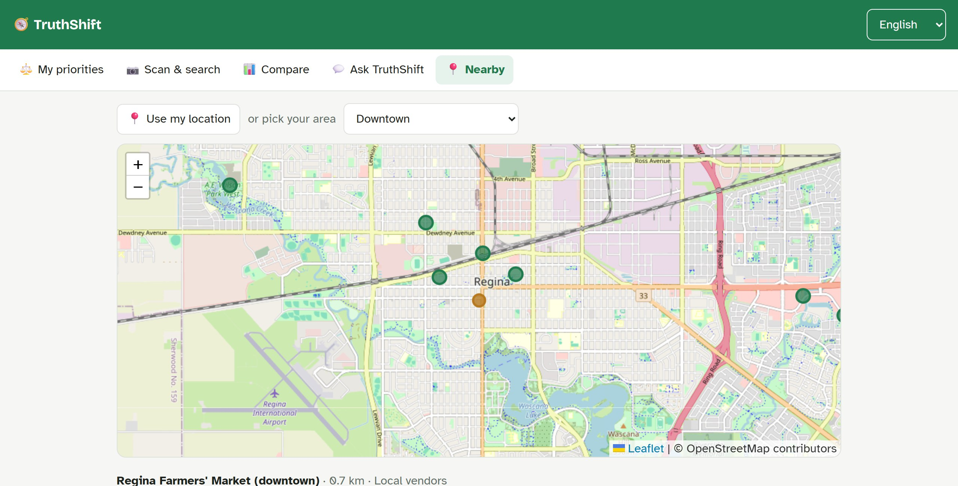
Live demo
Priorities
Compare
Ask
Nearby
Notes:
Demo script. 1: Priorities tab, Buy Canadian preset, switch language to Gujarati. 2: Scan tab, search peanut, open Prairie Creamy Peanut Butter: 76, medium confidence, point at the evidence badges and the Made in Canada tier. 3: Compare tab, Coffee: well-documented products first, limited-data products last. 4: Ask tab: Canadian, no plastic, fair labour, which coffee? 5: Nearby tab: stores and distances. 6: type the real barcode 3017620422003 for a live Open Food Facts lookup. Backup if the internet fails: everything except the live lookup runs locally.

Slide 9





How it works
Our data
118 products
React app
FastAPI
phone or laptop
scoring engine
Open Food Facts
real products
Claude
AI answers
Notes:
The React frontend never scores anything itself; it asks the FastAPI backend. The backend owns the scoring rules and the dataset, looks up real products on Open Food Facts, and asks Claude for written answers when an API key is set. Map tiles load from OpenStreetMap straight into the browser. FastAPI gives us interactive API docs for free at localhost:8000/docs.

Slide 10
118 products, honestly labelled
46
demo products
72
real products
10
Regina stores
Notes:
We used two kinds of data. 46 synthetic products with fictional brands, which the challenge allows, so we could show every kind of evidence. And 72 real products sold in Canada, from Open Food Facts. The chart shows how often a fact is known. In real data, origin, fair trade and packaging are almost always missing; only the Eco-Score is usually there. That is why unknown must never count as bad. Plus 10 Regina stores on the map.

Slide 11




What’s next
Real Regina labels
Verified certifications
Flyer prices
More languages
Notes:
Today the demo products use fictional brands and store locations are approximate. Next: photograph 20 to 30 real products in Regina stores; check certifications against Fairtrade Canada and organic registries; add real prices from store flyers and a weekly price tracker; and add more languages used by RODS clients, such as Arabic, Ukrainian, Tigrinya and Dari.

Slide 12

Thank you
Questions?
github.com/Nachiket-96/truthshift
Notes:
Thank you. The code, this presentation and the documentation are on GitHub. We are happy to take questions, or let you try the app.

