Slide 1
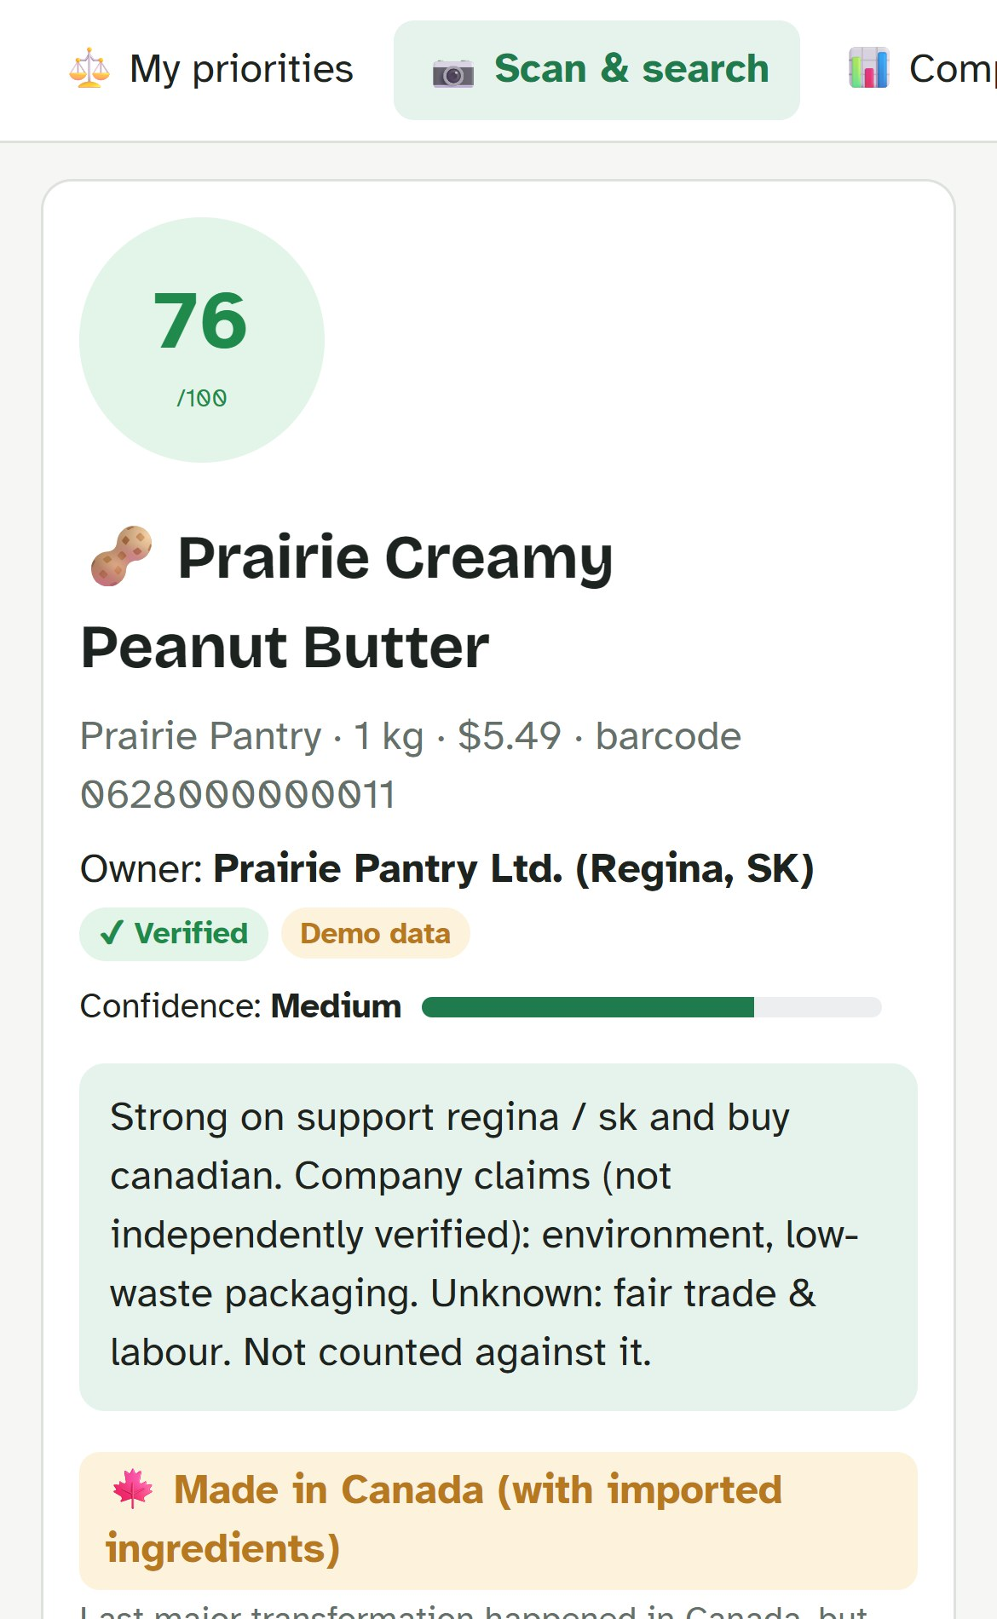
RODS TECH SKILLS SHOWCASE 2026
TruthShift
Shop by your values.
See what’s true.
[Team name] · [Member 1], [Member 2], [Member 3], [Member 4], [Member 5]
Notes:
Hi, we are [team name]. Our project is TruthShift, our answer to the RODS challenge The Ethical Consumer Compass. In one line: you tell the app what matters to you, scan a product, and it tells you how well that product fits your values, and how sure it is. This is the real app on a phone.

Slide 2
94%
of real products don’t say where they’re made
68 of 72 Canadian products in Open Food Facts
Notes:
We imported 72 real products sold in Canada from Open Food Facts, the largest open food database. 68 of them, 94 percent, do not say where they are made. None list a fair-trade label. This is the problem: shoppers want to buy Canadian and ethically, but the facts are simply not there. And a tool that treats missing facts as bad would call almost everything unethical.

Slide 3




Shoppers can’t see the facts
Made where?
Owned by whom?
Fair to workers?
Packaging waste?
Notes:
Four questions every ethical shopper asks, and none are easy to answer on a shelf. Where is it made? Made in Canada can still mean imported ingredients. Who owns the company? A familiar brand may have a foreign parent. Is it fair to workers and animals? Certifications, company claims and silence all look alike. And what happens to the packaging? Recycling rules differ by city, and Regina has its own.

Slide 4



Built for newcomers to Regina
3 languages
Real budgets
Regina stores
English · Français · ગુજરાતી
Price is a priority too
Local shops on a map
Notes:
RODS serves newcomers, so we designed for them. Their language: English, French and Gujarati screens, and the AI answers in the chosen language. Their budget: affordability is a priority like any other, and every better option shows the price difference. Their city: Regina stores on a map, local businesses, and Regina’s blue and green cart recycling rules.

Slide 5
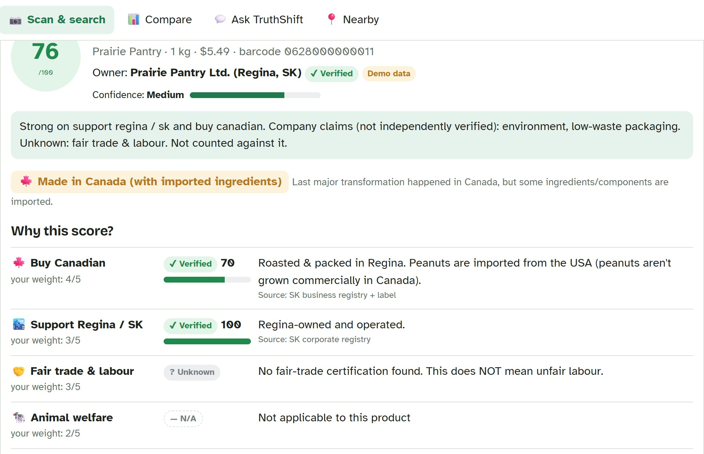



Scan. See the score. See the proof.
Scan or search
Evidence on every fact
Better options nearby
Notes:
This is the product screen. Prairie Creamy Peanut Butter scores 76 out of 100 for the default priorities, with Medium confidence. Every fact shows its evidence: verified, claimed or unknown, with the source. Below, it shows where to buy it in Regina and how to recycle the jar.

Slide 6



Every fact shows its evidence
Verified
Claimed
Unknown
counts 100%
counts 60%
not counted
Unknown ≠ bad
Notes:
The part of the challenge we took most seriously: communicate uncertainty and do not mislead. Verified means a certifier, government or registry confirmed it, and it counts fully. Claimed means the company or a community database says so, and it counts at 60 percent. Unknown is left out of the score completely and lowers the confidence meter instead. So a product with no labour information is not called unfair. It is called unknown.

Slide 7
Different shopper, different winner
Notes:
Ethical means different things to different people, so the score is personal. These are three coffees from our demo data, scored for three shopper types using the app’s presets. A Buy Canadian shopper gets Queen City Dark Roast, roasted in Regina, at 61. A fair-labour shopper gets Fairway Organic, Fairtrade certified, at 68. A shopper on a tight budget gets Big Bean Instant at 68. Same products, same facts, different priorities.

Slide 8
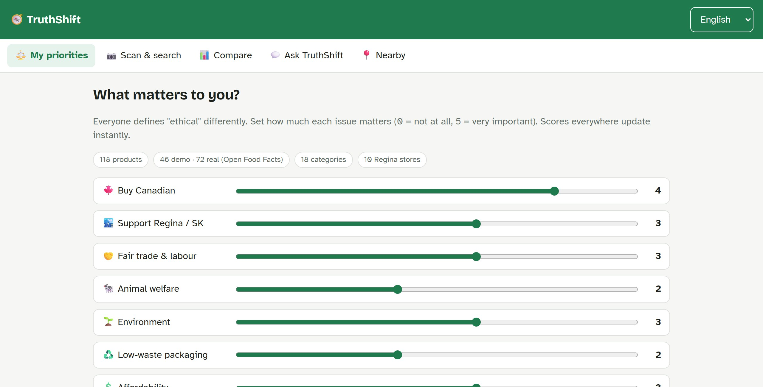
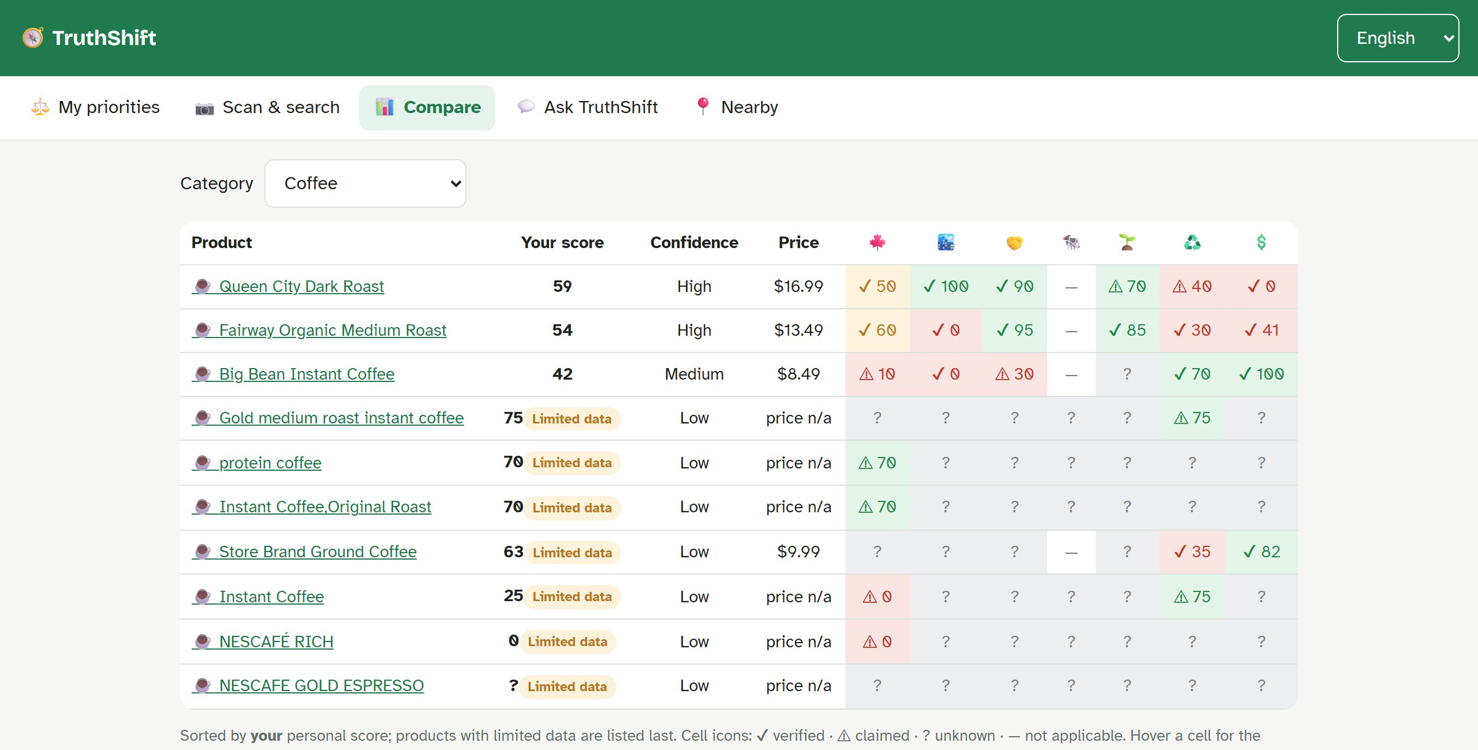
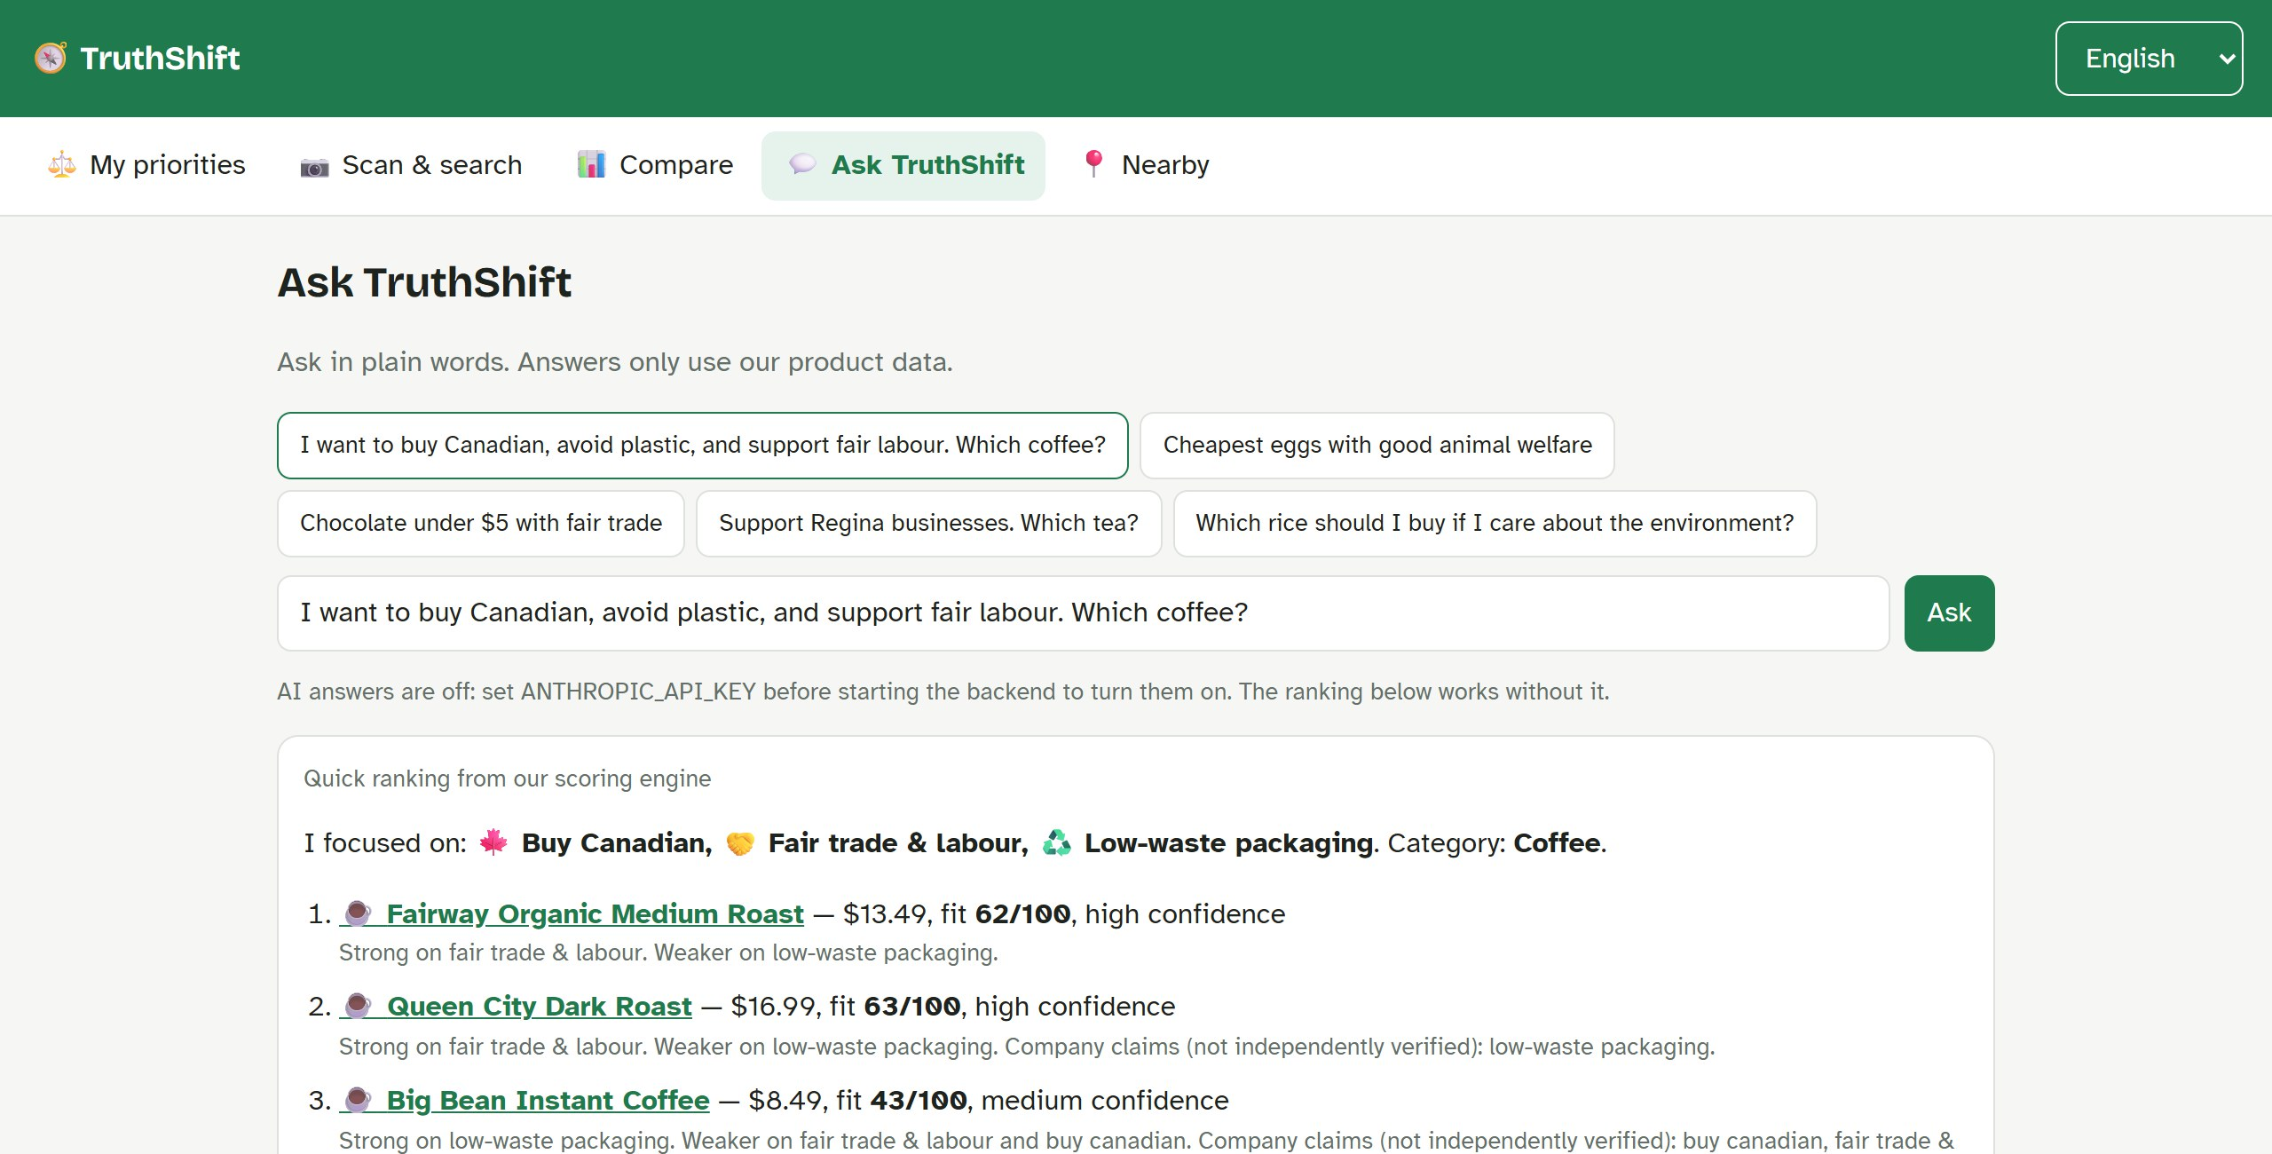
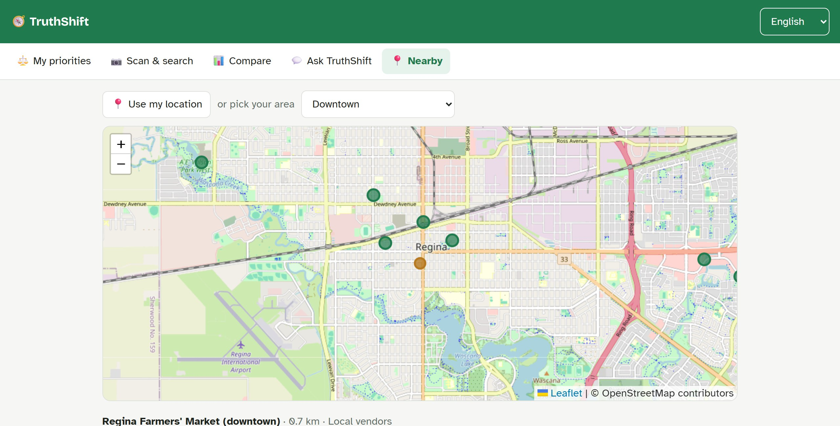
Live demo
Priorities
Compare
Ask
Nearby
Notes:
Demo script. 1: Priorities tab, Buy Canadian preset, switch language to Gujarati. 2: Scan tab, search peanut, open Prairie Creamy Peanut Butter: 76, medium confidence, point at the evidence badges and the Made in Canada tier. 3: Compare tab, Coffee: well-documented products first, limited-data products last. 4: Ask tab: Canadian, no plastic, fair labour, which coffee? 5: Nearby tab: stores and distances. 6: type the real barcode 3017620422003 for a live Open Food Facts lookup. Backup if the internet fails: everything except the live lookup runs locally.

Slide 9





How it works
Our data
118 products
React app
FastAPI
phone or laptop
scoring engine
Open Food Facts
real products
Claude
AI answers
Notes:
The React frontend never scores anything itself; it asks the FastAPI backend. The backend owns the scoring rules and the dataset, looks up real products on Open Food Facts, and asks Claude for written answers when an API key is set. Map tiles load from OpenStreetMap straight into the browser. FastAPI gives us interactive API docs for free at localhost:8000/docs.

Slide 10




[Model name]: what it does
[Input: what goes in]
[Output: what comes out]
Replace with a diagram, chart or screenshot of the model
[Why it helps shoppers]
Notes:
[Teammate name] presents the model. Explain in plain words what the model takes in, what it produces, and how that helps a shopper.

Slide 11
How the model works
[Step 1]
[Step 2]
Replace with the model's steps or architecture
[Result or accuracy]
Notes:
[Teammate name]: walk through the steps of the model, the data it was trained or tested on, and how well it works. Mention one limitation honestly.

Slide 12
118 products, honestly labelled
46
demo products
72
real products
10
Regina stores
Notes:
We used two kinds of data. 46 synthetic products with fictional brands, which the challenge allows, so we could show every kind of evidence. And 72 real products sold in Canada, from Open Food Facts. The chart shows how often a fact is known. In real data, origin, fair trade and packaging are almost always missing; only the Eco-Score is usually there. That is why unknown must never count as bad. Plus 10 Regina stores on the map.

Slide 13


Free for every shopper
Grants
Verified listings
TruthShift Plus
Settlement & city funding
Local businesses pay for checks
Optional premium features
Money never changes a score
Notes:
TruthShift stays free for shoppers, because our users are newcomers on tight budgets. Three ways to pay for it. One: grants from settlement agencies, the City of Regina and community foundations, because the app supports newcomer integration and local business. Two: verified listings, where a local Regina business pays to have its claims checked, for example its ownership or a certification. If the evidence holds, the fact turns from Claimed to Verified. Paying never raises a score; only evidence does. Three: an optional TruthShift Plus subscription for extra features. The rule on the slide is the one that matters: money never changes a score.

Slide 14








Free today. Plus tomorrow.
Free
$0
TruthShift Plus
~$3/mo
for everyone, always
proposed · free for RODS clients
Scan & personal scores
Unlimited AI assistant
Evidence on every fact
Best-store shopping list
Compare & store map
Price-drop alerts
5 AI questions a day
Family profiles
Notes:
Everything in the app today stays free: scanning, personal scores with evidence, compare, the store map, all languages, and a few AI questions a day. A future TruthShift Plus, proposed at about 3 dollars a month, would add unlimited AI questions, a shopping-list planner that finds the best store, price-drop alerts from flyers, and family profiles. RODS clients could get Plus free through a sponsorship. The price is a proposal, to test with users.

Slide 15
About $8 a month to launch
~$8
per month to launch
~$28
with 1,000 AI questions
Free
Open Food Facts · OpenStreetMap
USD, October 2026 prices. Estimates; check before launch.
Notes:
Running costs in US dollars per month, checked October 2026. Hosting: the React app as a free static site, the FastAPI backend on a Render Starter instance at 7 dollars a month. A .ca domain is about 10 dollars a year, so about 1 dollar a month. Open Food Facts and OpenStreetMap data are free; for heavy map traffic we would move to a map provider such as MapTiler, which is free up to 5,000 sessions a month for non-commercial use. The AI is the only cost that grows with use: about 2 cents per question on Claude with prompt caching, because each question sends about 12,000 tokens of product data. So 1,000 AI questions a month cost about 20 dollars, 10,000 about 200. That is why unlimited AI is the Plus feature.

Slide 16



What’s next
Real Regina labels
Verified certifications
Flyer prices
More languages
Notes:
Today the demo products use fictional brands and store locations are approximate. Next: photograph 20 to 30 real products in Regina stores; check certifications against Fairtrade Canada and organic registries; add real prices from store flyers and a weekly price tracker; and add more languages used by RODS clients, such as Arabic, Ukrainian, Tigrinya and Dari.

Slide 17

Thank you
Questions?
github.com/Nachiket-96/truthshift
Notes:
Thank you. The code, this presentation and the documentation are on GitHub. We are happy to take questions, or let you try the app.

