Slide 1
Task Offloading in Distributed Systems for Matrix Multiplication
Mid Review
Nachiket Patel

Slide 2
Recap
Objective
Challenges
Split the matrix multiplication into sub-tasks and offload to neighboring nodes
Detect failed operations and re-offload
Experiment with granularity of sub-tasks
Dealing with subtask failures due to node failure
Balancing granularity task splitting with overhead of splitting
Efficiently transporting matrix data across nodes

Slide 3
Selecting a language
Python
Can take advantage of numpy
Automatically uses multi threading for floating point values
Need to manually implement multi threading for integer values
Python is very popular with ML, and scientiic work because of its ease of use

Slide 4
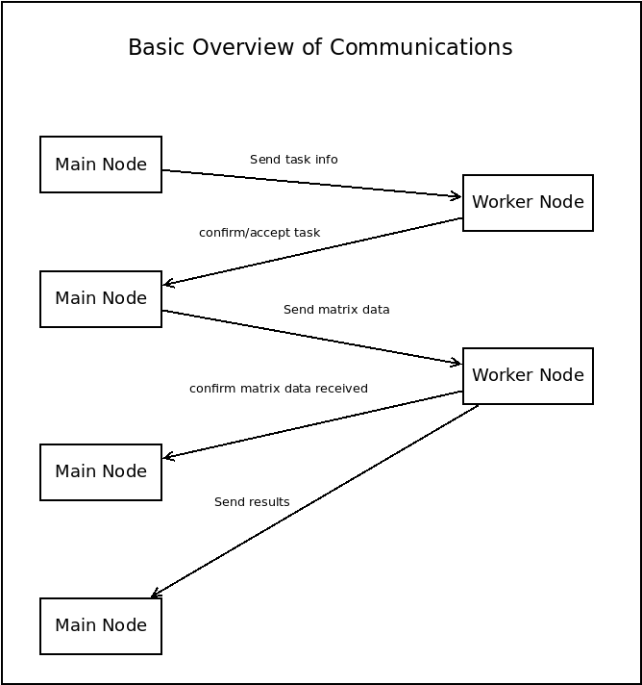
Initial Communication Design
Initially the main Node sends the task request to the worker node
The worker node confirms it by returning the message
Main node sends matrix data to worker
No guarentee of data integrity yet
Worker confirms receipt of appropriate dimensions of matrix data
Worker sends results

Slide 5
Premilinary analysis metrics
Measured time for to send and confirm task
Insignificant
Measure time to send data
Uncompressed
Compressed (high & low bandwidth)
Measure time to send results
Uncompressed
Compressed (high & low bandwidth)

Slide 6
Findings
Google Cloud Compute Engine VM’s
4 virtual cores @ 2GHz
16GB ram
The compression benifits are ~10x
The overall time benifit is ~6x
Compressing the data takes up some time
Something to further consider is how will larger number of splitting affect benifits of compressing data
Notes:
Uncompressed - betweem my pc and a google compute engine VM
Compresses - betweem my pc and a google compute engine VM
Compressed Google - between local VM’s on same google cloud compute engine

Slide 7
Findings
The compute time in oragne is lower because
My laptop has a higher clock speed
3.4GHz compared to 2GHz
All computation were utilizing all 4 cores thanks to numpy.matmult()
Only for floating point values

Slide 8
The Numbers
For (8000,8000)x(8000,8000) matrix multiplication: Split into 4 subtasks
Time to compute on single node ~15s
Time to send all the data: ~8s
Time to compute (4000,8000)x(8000,4000): ~3s
Time to retrieve results: ~4s
Total Savings = 15 - (8 + 3 + 4) = 0s
For (16000,16000)x(16000,16000) matrix multiplication: Split into 4 subtasks
Time to compute on single node ~120s
Time to send all the data: ~34s
Time to compute (8000,16000)x(16000,8000): ~20s
Time to retrieve results: ~18s
Total Savings = 120 - (34 + 20 + 18) = 48s
x

Slide 9
Whats Next?
Collect more data/metrics
Multi-threaded approach on main node already implemented (Just need to collect data)
Implement re-offloading with for failed nodes
Analyze the time savings
Analyze the max node failure amount before loss of computation advantage

Slide 10
Questions

