Slide 1
Task Offloading in Distributed Systems for Matrix Multiplication
Nachiket Patel

Slide 2
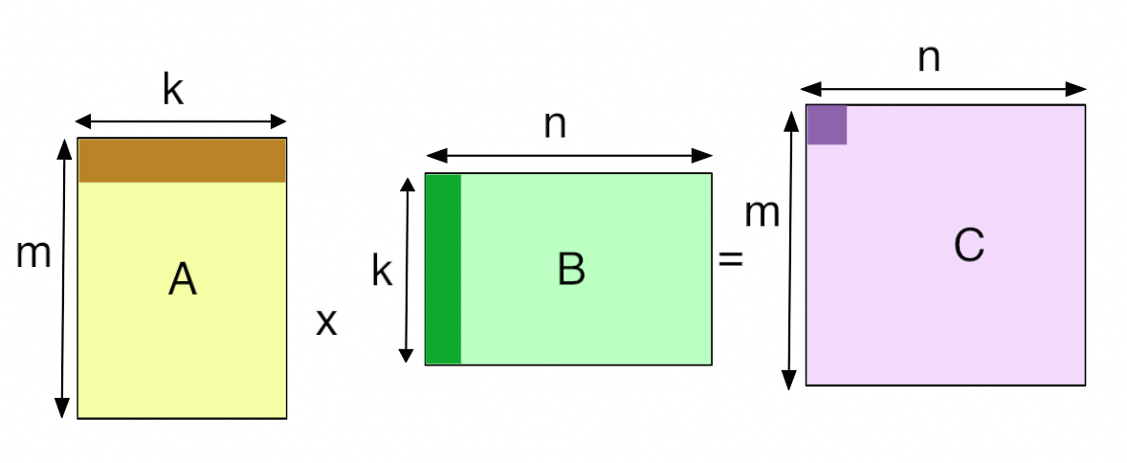
Outline
Motivation
Objectives & Challenges
Design
System Architecture
Example Execution
Evaluation
Sub-task granularity
Node Failures
Caching Vs No Caching
Time saved
How to use?
Summary

Slide 3
Objectives
Challenges
Split the matrix multiplication into sub-tasks and offload to worker nodes
Detect failed operations and re-offload
Experiment with granularity of sub-tasks
Dealing with subtask failures due to node failure
Balancing granularity task splitting with overhead of splitting
Efficiently transporting matrix data across nodes

Slide 4
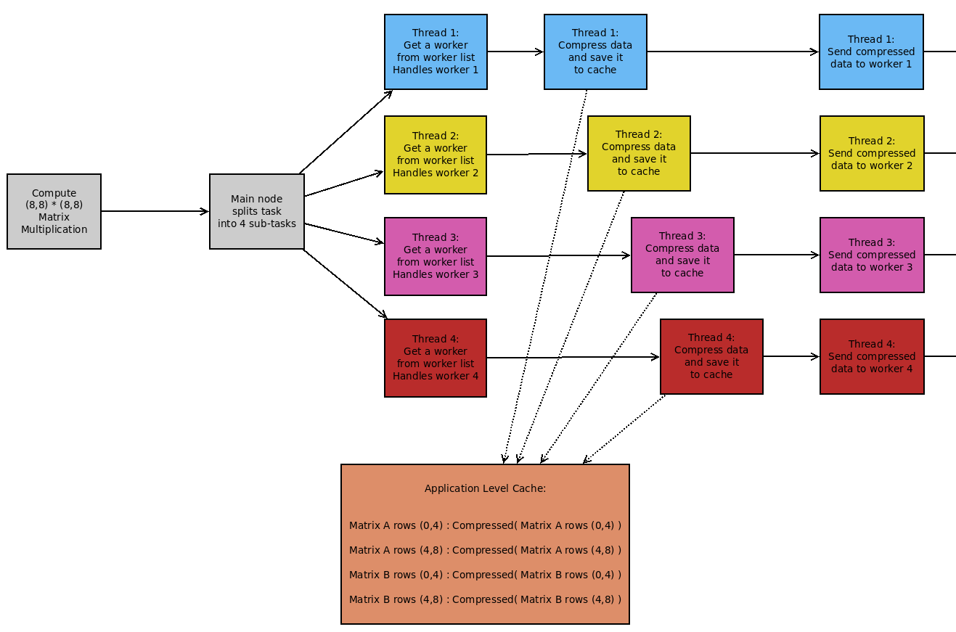
Design : Main Node
Split multiplication into 4 sub tasks
Dispatch threads to handle each worker
Compress portions of matrix data required for each worker
Send data to worker
1 1
2 2
3 3
4 4
1 2
3 4
1 2
3 4
1 2
3 4
x
=

Slide 5
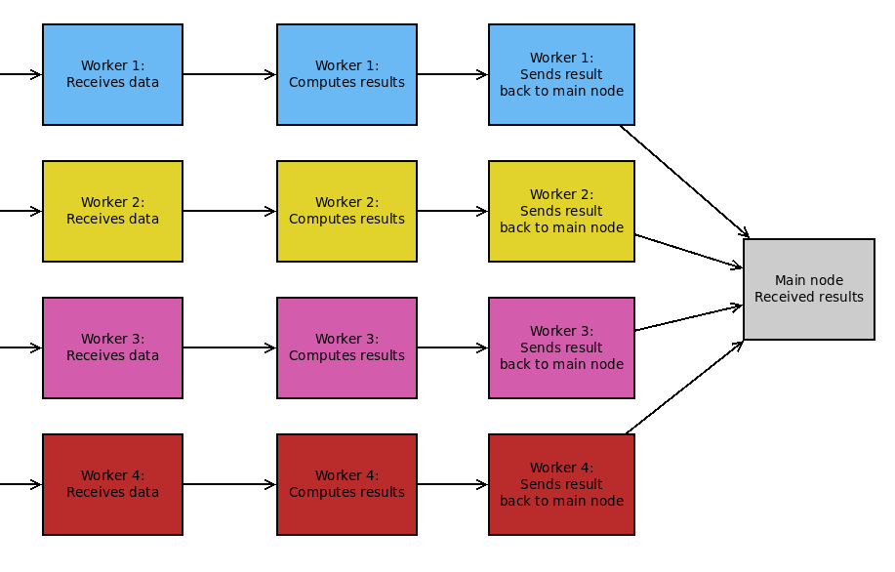
Design : Worker Side
Receive matrix data
Compute results
Send results back

Slide 6
Evaluations
Testing Hardware
Main Node & Worker Nodes
Google Cloud Compute Engine VM’s
4 virtual cores @ 2GHz
16GB ram
Sub-task Granularity
Node Failures
Caching Vs No Caching
Time Saved

Slide 7
Sub-task Granularity
As the numbe of sub-tasks increase the amount of time saved decreases
Leads to asymptotic behavior
Tested with two different matrix sizes to confirm this trend
Leads me to beleive its down to the specs of the main node

Slide 8
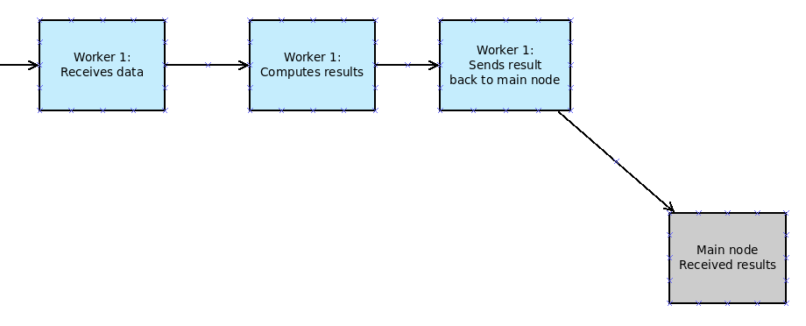
Node Failures
Results from multiplication of 2 (10000,1000) matrices
Task split size is 6

Slide 9
Caching Vs. No Caching
Main purpose is to reduce overhead in the event of a node failure
The point point at which the node was terminated is shown below
Results from multiplication of 2 (10000,1000) matrices
Task split size is 6

Slide 10
Time Saved
Comparing how much time local compute takes vs distributed compute
$Time Saved = \frac{Local Time − Distributed Time}{Local Time}$ * 100

Slide 11
How to use?
The main can be configures with the following parameters

Slide 12
Conclusion
The number of node failures before the distributed approach becomes more time consuming than local computation depends on:
When the worker fails
Is there is a reserve nodes to which the sub-task can be offloaded
The granularity of sub-task size depends seems to depend on the hardware specification of the main node
Due to multi-threaded approach
More sub-tasks = smaller sub-task size which leads to more threads
The high level caching mechanism saves a small amount of time if sub-task fails
With a small storage overhead
Without any noticable impact when there are no node failures

Slide 13
Thank You
Questions?

