Slide 1
Task Offloading in Distributed Systems for Matrix Multiplication
Nachiket Patel

Slide 2
Motivation
Increase in ML and AI applications
Scientific simulations
CPU time occipied by matrix multiplication
Not all machines have GPU compute power to perform these calculations

Slide 3
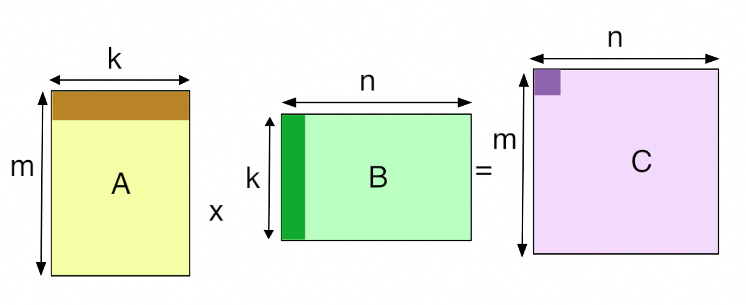
Objectives
Split the matrix multiplication into sub-tasks and offload to neighboring nodes
Detect failed operations and re-offload
Experiment with granularity of sub-tasks

Slide 4
Challenges
Dealing with subtask failures due to node failure
Balancing granularity task splitting with overhead of splitting
Efficiently transporting matrix data across nodes

Slide 5
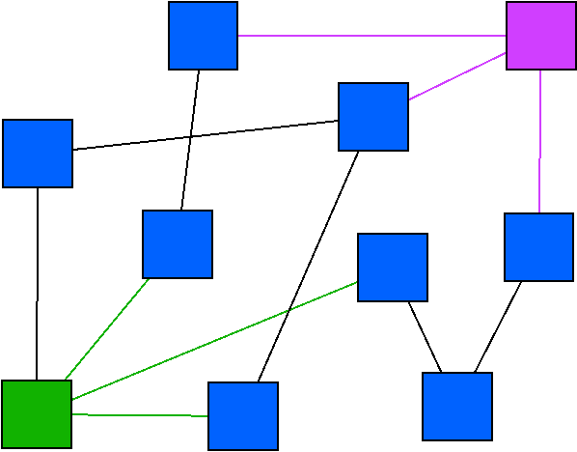
Design
Centeralized point monitoring all offloaded tasks
Keeping some redundency/backup connections
Split task based on hardware of connected nodes
Limitations
Only effective for large matrices
If main node fails everything is lost

Slide 6
Evaluation Metrics
Perform computation on single machine and compare with distributed approach
Measure overhead of distributing task
Plot curve of overhead with number of subtasks
Perform curve fitting
Measure extra overhead of failed operations
How do node failures affect overall time of of computation?
What is the limit of practicality?

Slide 7
Questions

