Slide 1
Combinatorial Optimization for Graph Coloring
Carl Klier and Nachiket Patel

Slide 2
Graph Coloring Problem
Graph coloring is an assignment of colors to vertices so that no two adjacent vertices are the same color
Applications include scheduling and register allocation
We specifically look at finding a 3-coloring which is NP-Complete
✅
✖
Notes:
The combinatorial optimization problem we choose to examine for this project was the Graph Coloring problem. Combinatorial optimization involves finding an optimal object, in this case a coloring of the nodes of a graph, from a large set of objects, in this case every possible coloring of the nodes. In the application of scheduling, we want to solve the problem of assigning a set of tasks to specific time slots where some tasks may conflict if they need the same shared resource. You can think of the vertices as jobs and edges as conflicting jobs that both want to use the same resource and the colors as the available time slots. Thus, a valid coloring shows what jobs to complete in what timeslots so that no conflicts arise.

Slide 3
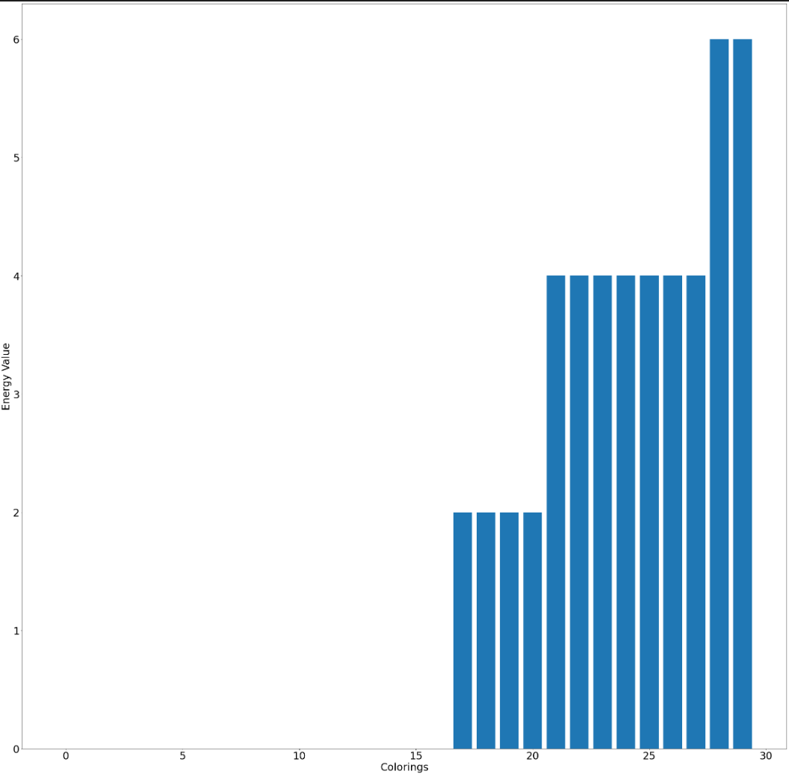
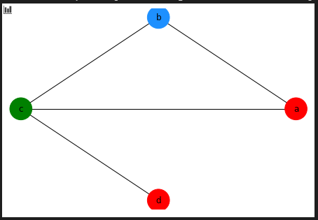
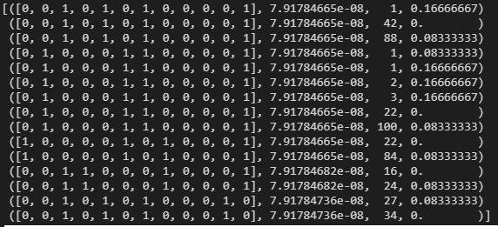
D-Wave Annealing
Created a constraint satisfaction problem with two constraints
A node could only be labeled with a single color
A node could not have the same color as one of its neighbors
Converted the CSP into a Binary Quadratic Model
Sample: {'a0': 0, 'a1': 0, 'a2': 1, 'b0': 0, 'b1': 1, 'b2': 0, 'c0': 1, 'c1': 0, 'c2': 0, 'd0': 0, 'd1': 0, 'd2': 1}
Notes:
We used an implicit embedding and let the Dwave Sampler to perform 8000 reads. In the graph on the left, you can see the range of energy values that we get from the samples. The majority are almost zero and then we get some higher energy values for worse graph colorings. In the middle you can see the sample that had the lowest energy value. The letters correspond to nodes and the number correspond to colors. So you can see that node a was chosen to have color 2 based on the fact that it was assigned a value of 1. Below the sample you can see the other lowest energy value samples we got as output. The first 3 lowest energy values actually represent the graph of a valid coloring which you see on the right. The reason they are split up is because of that far right value which is the chain break fraction which is due to the implicit embedding.

Slide 4
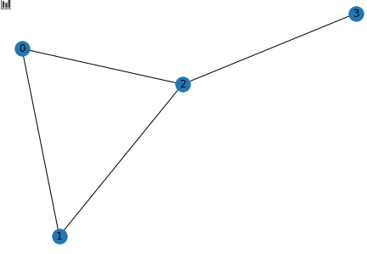
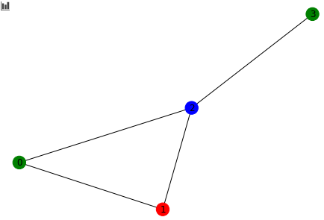
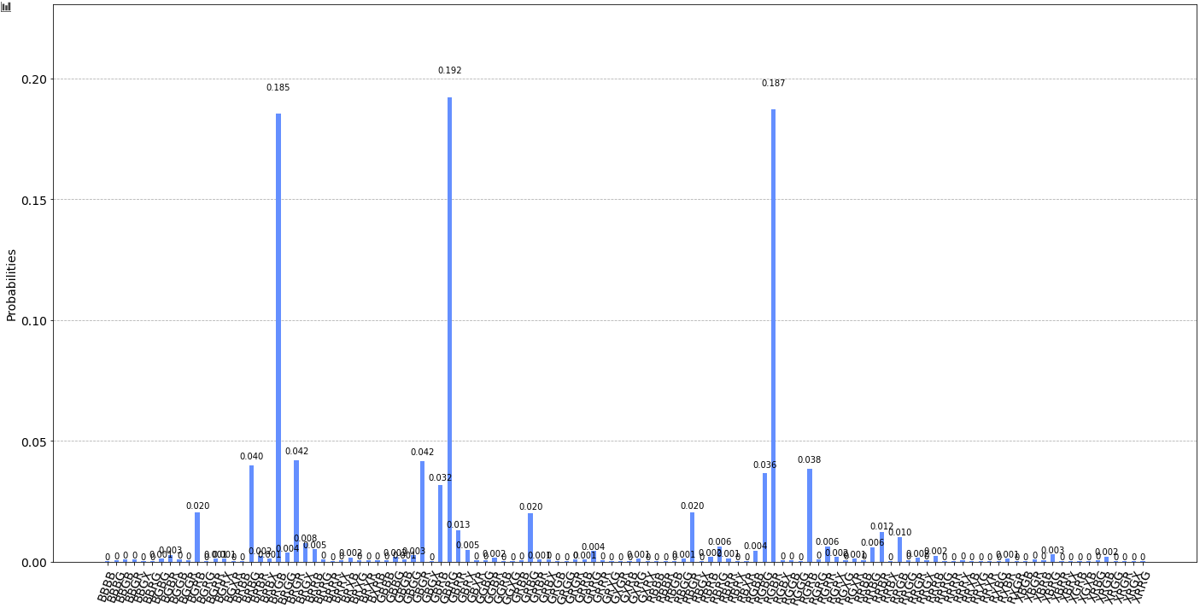
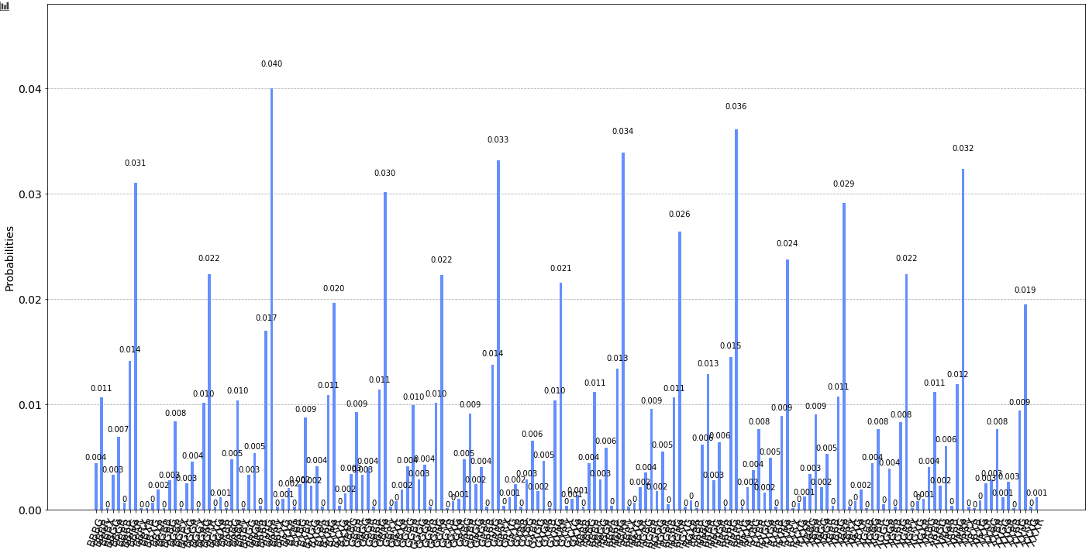
IBM Q Gate Based
[1] https://hal.archives-ouvertes.fr/hal-02891847/document
A generalized method for k-coloring was used_{[1]}
Initially 2 coloring was performed
3 coloring requires using 2 qubits to represent color
Unitary matrix used to eliminate |11> state
Simulated with noise (left), real (right)
Notes:
Constraint satisfaction problem
2 is easy to map because 1 and 0 can represent the two unique colors whereas 3 qubit you require 2 qubits to represent each color
|00>, |01> and |10> used as three colors
We do not need the 4th color/state so we use a unitary to eliminate the |11> state
Simulator with noise has much better results compared to real hardware

Slide 5
Compare and Contrast
Results
D-Wave - sample with highest count was a valid coloring, 2nd highest count was not a valid coloring
Qiskit - highest probability was not a valid coloring, but after removing obviously wrong results (i.e vertices with same adjacent colors) highest probability was a valid coloring
Runtime
D-Wave 8000 reads- 'qpu_access_time': 1922449 microseconds or ~1.9 seconds
Qiskit 8000 shots - ‘Running time’: ~25 s
Design
D-Wave - straightforward design of a constraint satisfaction problem that gets converted into a BQM
Qiskit - edges are used as constraints on the graph to enforce unique coloring
Scalability
D-Wave - easy to scale to an arbitrary number of nodes and colors
Qiskit - easy to scale nodes but restricted by hardware limitations
Notes:
The graph is input the same way as a set of nodes and edges.
The results on D-wave always returned a valid coloring for the highest count, whereas the qiskit did not.
To get the valid coloring on qiskit we had to filter out invalid results which had two adjacent nodes with the same color. Although the valid coloring was always present in the top 10 highest probabilities.
Scaling up on the D-Wave is easier when trying to increase the number of colors compared to qiskit
The main limitation on both machines is the hardware limitation of not having enough qubits, but again the D-wave machine is less restricted compared to qiskit as you will see on the next slide.

Slide 6
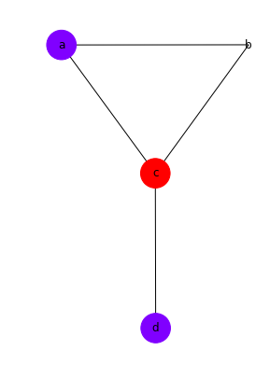
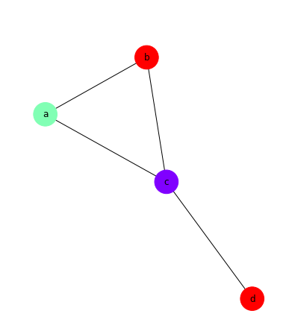
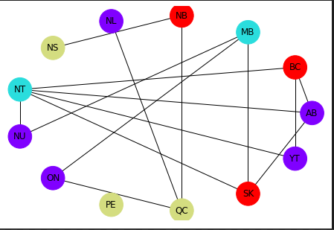
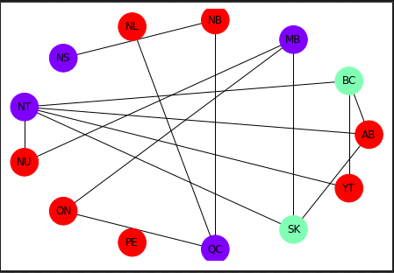
D-Wave Annealing Extensions
Program to handle any k-coloring
Defined a new method to create the single color constraint
Need to be careful with the size of the problem since the number of qubits = # of nodes * # of colors
Program to find the chromatic number
Finds the smallest k value such that a valid k-coloring exists
Program to color the 13 provinces of Canada
We were able to find a 4 coloring and a 3 coloring
Notes:
13 nodes 15 edges

Slide 7
Gate Based Extensions
Qubit requirements scale with O(log₂(k)*(V + E)). k is number of colors.
Scaling up to 4 coloring will not increase number of qubits to represent color
But additional constraints will require more qubits
Results with simulated noise are much better than with real hardware
Likely down to noise model not accounting for errors which occur on real hardware
More vertices & edges results in less consistent results
Implications of removing unitary which prevents |11> state
On simulation the results are not affected
On real hardware invalid results accumulate higher results
Transpiler optimization results in worse results
Notes:
Qubits scale up quite quickly
The main reason the simulated results with noise were better than the real hardware is because the noise model does not include error rates.
We observed that larger graph yield worse results which suggests the error rates are creating a compounding effect
We looked at the effects of removing the unitary which eliminates the |11> stat on both simulator and hardware;
The results of the simulator did not change but the real hardware yielded higher probabilities for incorrect results
Another area we explored was using transpiler optimization on real hardware but this actually resulted in worse results which higher levels of optimization

Slide 8
Further Research
Explore an explicit embedding and see how that reduces the chain break fraction
Research and implement a more efficient algorithm for handling the chromatic number problem
Explore using D-Wave’s hybrid sampler to solve problems with more variables
Attempt to reduce the number of qubits for Qiskit model
Explore a custom coupling map to try and reduce noise/error rates
Add error rates to noise model for simulator and compare to real hardware
Notes:
Finding 1 valid coloring really means finding 3 valid colorings since the colors can be interchanged with each other.
Finding an explicit embedding would involve chaining and cloning which is necessary as sometimes unit cells maped to nodes don’t have physical couplers between them.
For computing the chromatic number, there are some quantum algorithms that would speed up this process. One involves splitting up the graph into maximum independent sets and using grover’s algorithm to search those for the minimum chromatic number which is then used to dervive the overall chromatic number for the graph.
With larger problems, more nodes and more colors, they can’t be mapped entirely to the D-Wave system since the number of variables is too high. Using a hybrid approach, a combination of classical and quantum resources, could enable us to solve these types of problems and is something I want to explore.

