Slide 1
Simulation Masterclass Assignment 2
Group 6 Lukas Ciunaitis,
Yehor Furtsev,
Nachiket Kondhalkar,
Anne Stehouwer

Slide 2
Design Process
Changes made to assignment 2:
Number of floors extended to 12 + ground floor
Number of employees extended to 396
Customers added, another 180 people spawned uniformly over 10 hours
Elevator count extended to 2
People choose the elevator that is closest to their floor
Staircase added if person moves for less than 3 floors and waiting line is more than 8
Elevator time moving is monitored

Slide 3
Design Process
Changes in Process Flows and Interactions:
Arrival Process: Same as previously. Arriving to the building -> choosing desired floor
Waiting Process: Same as previously. If waiting line is more than 8 people (one elevator capacity), people that have to move less than 3 floors choose the stairs.
Boarding Process: People choose the elevator that is closest to their floor.
Travel Process: No changes here.
Exiting Process: No changes here.

Slide 4
Design Process
Break Down Conceptualized Model into Smaller Modules/Components:
Passenger Module: Handles the behavior and attributes of passengers, such as their desired floor. Includes the elevator choice
Elevator Module: Manages the behavior and attributes of the elevator, such as current floor, direction, and whether it's currently moving or stationary. Staircase logic was added here for the ease of monitoring of the waiting line.
Floor Module: Might represent each floor in the building, including the queue of passengers waiting there. Easily scalable with no changes.

Slide 5
Design Process
Define Input Variables and Their Distributions:
Arrival Rate: The rate at which passengers arrive at the building, which could be modeled as a Poisson distribution (this is an assumption). For now, the arrival process is uniform and spawns a new person at an equal amount of ticks.
Floor Selection: The probability distribution representing a passenger's desired floor. Could be uniform (equal chance for every floor) or another distribution if some floors are more popular. For now is randomized.
Elevator Capacity: Maximum number of passengers the elevator can carry, set to 8.
Elevator Travel Time: Time taken to move between floors, which might be constant or have some variability. For now is constant.

Slide 6
Design Process
Implement Model in Salabim Sequentially Based on Passenger's Sequence:
First, simulate the arrival of passengers.
Then, handle the choosing, waiting and boarding process.
Simulate the elevator's movement and passenger drop-offs.
Repeat these steps until the simulation duration is reached.

Slide 7
Design Process
Add Monitors Where Necessary to Measure Model KPIs:
Average Waiting Time: How long passengers wait for the elevator on average.
Average Travel Time: How long passengers spend inside the elevator.
Elevator Efficiency: Perhaps the number of stops made versus the number of passengers served. In current simulation, the total time spent travelling for each elevator is monitored, to ensure that logic of elevator choice is sound.
Floor Occupancy: Average number of people on each floor over time.

Slide 8
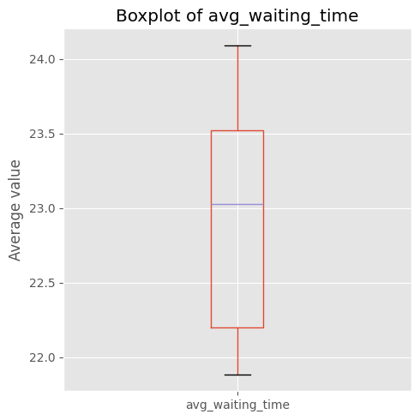
Average Time spent waiting for an elevator (same as in Assignment 1)

Slide 9
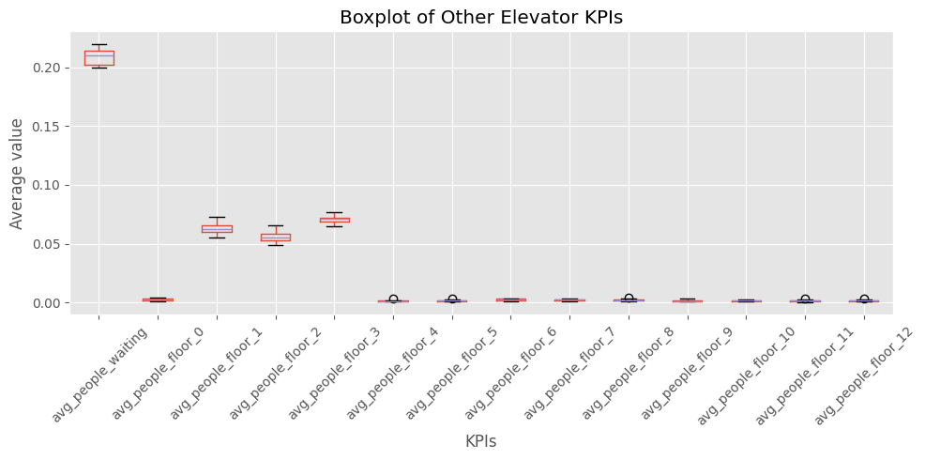
Average Waiting time distribution across floors (Same as Assignment 1)

Slide 10
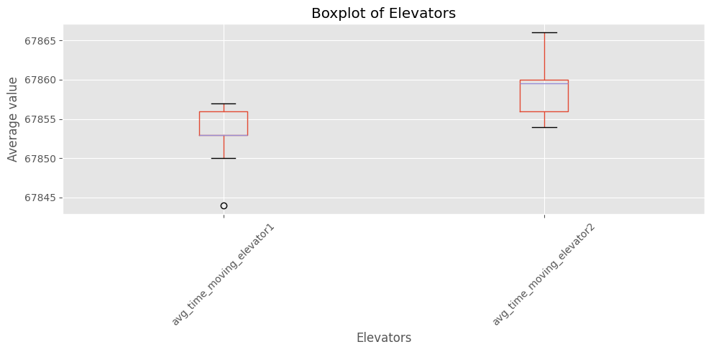
Average Elevator Moving Time (in seconds)

Slide 11
Advantages and Disadvantages
The event-driven nature suited this project since the system could be effortlessly outlined using events.
It demonstrated higher efficiency, especially when compared to agent-based models.
The system's linear and predictable behavior streamlined its scheduling.
Staircase logic is not necessarily rational. Some people may choose to climb longer, or without checking for waiting line. Otherwise, some people may choose to climb based on waiting time, not necessarily the presence of people.
Managing the synchronized interaction between Visitor, Elevator and Floor proved challenging.
There's a constraint in portraying unique behaviors for individuals; it assumes uniform behavior across all visitors.
Capturing interactions amongst different classes and visitors isn't straightforward.
Elevator choice logic is based on proximity. It is unclear and randomized when two elevators are on the same floor.

Slide 12
Challenges of Using Salabim
Event Description Focus: Salabim excels in Discrete Event Simulation, with a significant emphasis on describing events and processes. While this made outlining the behavior of individual agents straightforward, synchronizing these behaviors with other agents was a complex task.
Measurement Limitations: Out of the box, Salabim offers limited capabilities for performance measurement. This might necessitate additional tools or adjustments for comprehensive analytics. In this case, monitoring of elevator data proved most tricky to implement, requiring a few additional intermediary parameters to be introduced.
Module Separation: Salabim doesn't easily allow for the separation of its Python modules, which can make the code structure less clear. However, given the relatively simple nature of the elevator model, this wasn't a significant concern for this particular assignment.

Slide 13
Advantages
User-Friendly Classes: Salabim's core classes, including component, resource, and queue, are intuitive and perfectly suited for detailing the elevator system.
Open-Source Advantage: Being free-to-use and open-source, Salabim offers the benefit of both community and developer support, ensuring consistent assistance and improvements.
Comprehensive Documentation: Salabim boasts substantial documentation, complemented by practical examples, making it more accessible for users to grasp its functionalities.
Ideal for Queue-Based Systems: Salabim is tailor-made for modeling systems that rely on queues and straightforward processes, enhancing the accuracy and efficiency of such simulations.
Unit Specification and Conversion: Salabim not only allows users to specify units but also adeptly manages certain unit conversions automatically, simplifying the modeling process.

Slide 14
Instructions for executing model
Package dependencies:
Salabim (and its associated dependencies)
Matplotlib, pandas, numpy
Execution:
Install all libraries in requirements.txt
Go to the assignment1.ipynb notebook and run all cells.

