Slide 1
Simulation Masterclass Assignment 3
Group 6 Lukas Ciunaitis,
Yehor Furtsev,
Nachiket Kondhalkar,
Anne Stehouwer

Slide 2
Animation paradigm
The env.animation_parameters() method was used to turn on the animation with a title "Elevator Simulation".
Each Floor instance has an associated visual representation using the sim.AnimateRectangle() method.
Every instance of the Person class has a visual representation using the sim.AnimateCircle() method.
Each Elevator has an associated visual rectangle using the sim.AnimateRectangle() method.

Slide 3
Animation paradigm
Person:
Gets generated at respective floor at x=10. Stays there till activated
When activated, moved to x=20 and starts the walking process.
When it reaches, x=150, breaks out of walking sequence and creates request for elevator.
Queuing is displayed using x=150 + sim.random.uniform(-15, 15)
When elevator arrives, loaded using x = 350 + sim.random.uniform(-25, 25) to demonstrate realistic loading inside elevator
When unloading set x=500 (can be improved later with realistic deboarding)

Slide 4
Animation paradigm
Elevator:
Starts at floor 0 with a rectangle at x=350
Every time floor changes, y is changed to match the floor coordinate; x stays constant.
Each person currently in the lift also has their y coordinate updated to match the elevator.

Slide 5
Animation Paradigm
Information about No. of persons per floor, KPIs and graphs is possible using sim.AnimateMonitor() function in Salabim.
However, we were unable to implement it due to lack of time.
Saving the animation was also not a part of the Salabim package. Other packages like ffmpeg might be useful.
Including KPI monitoring in animation was not implemented due to lack of time but is included in the package.

Slide 6
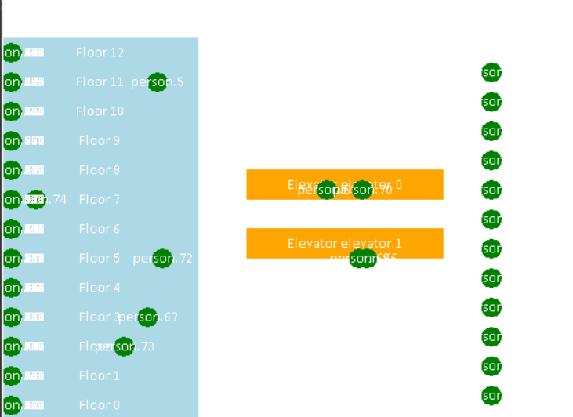
Animation Paradigm

Slide 7


Walking and Queuing
A "walking" effect is implemented for each Person by continuously updating the x-coordinate as they approach the elevator.
When queuing, persons are displayed in a staggered manner to resemble a realistic queue. This is achieved by adding slight randomization to their positions.

Slide 8
Design Modification
Expanded elevator logic to passivate elevators when no requests are sent.
Separate requests for each elevator being passed
Person class modified to choose an elevator when they make a request. The request variable chooses an elevator an sends the request to the elevator
Warmup time was adjusted to 30.
Customers will enter only from ground floor

Slide 9
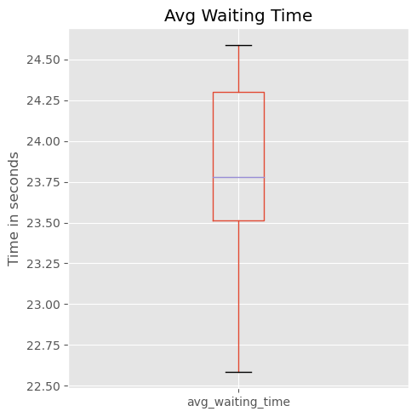
Average Time spent waiting for an elevator

Slide 10
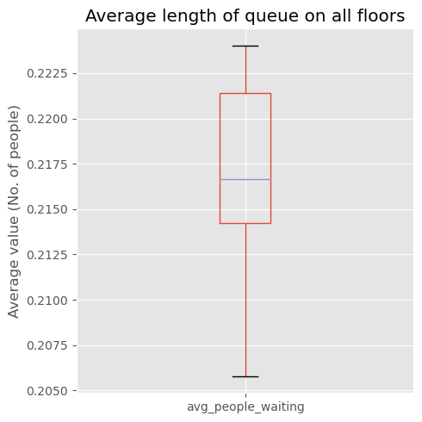
Average length of Queues

Slide 11
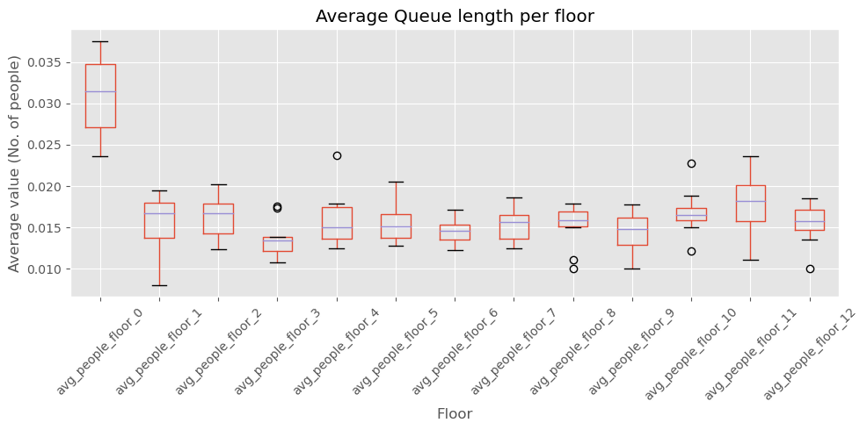
Average Queue length per floor

Slide 12
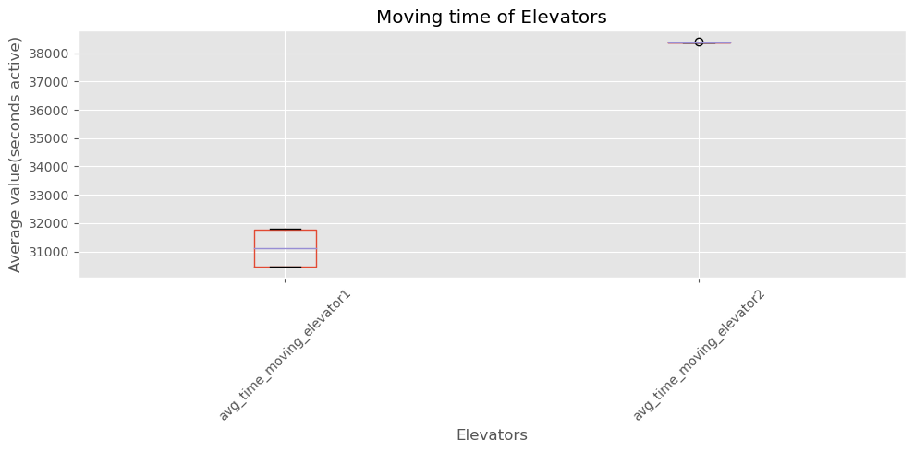
Comparison of Moving time of both elevators

Slide 13
Challenges
Lack of Built-in Video Export: Salabim does not have a direct, built-in method for exporting animations to a video format. This requires users to resort to external methods such as screen recording, which can be inconvenient and may not provide optimal quality.
Granular Animation Control: The animation in Salabim, while functional, requires users to manually update positions and states of objects. This means a lot of micromanagement for complex animations, making the process tedious.
Limited Graphical Capabilities: Salabim's graphical capabilities are somewhat limited compared to dedicated animation or graphical software. This might restrict users from creating visually rich or complex graphical representations. This may also lead to performance concerns.

Slide 14
Advantages
Integrated Simulation and Animation: Salabim provides both simulation and animation capabilities within the same environment.
Dynamic Real-time Visualization: Animation can be viewed in real-time as the simulation progresses. This dynamic visualization can provide immediate feedback, allowing users to spot patterns, issues, or interesting behaviors as they occur.
Customizable Visual Components: Salabim offers a range of visual components such as circles, rectangles, lines, and polygons. Users can customize the appearance, position, and movement of these components, giving a fair degree of flexibility in representing different entities and states in the system.
Interactivity: Salabim's animations can be made interactive, allowing users to pause, resume, or change the speed of the animation.
Useful for Debugging: Visualization through animation can be instrumental in debugging complex simulation models.

Slide 15
Instructions for executing model
Package dependencies:
Salabim (and its associated dependencies)
Matplotlib
Pandas
Numpy
Execution:
Install all libraries in requirements.txt
Go to the assignment3.ipynb notebook and run all cells.

