Slide 1
Simulation Masterclass Assignment 1
Group 6 Lukas Ciunaitis,
Yehor Furtsev,
Nachiket Kondhalkar,
Anne Stehouwer

Slide 2
Design Process
Conceptualize the Assignment Using a Flow Chart:
Begin with people arriving at the building and deciding which floor to go to.
Illustrate how passengers decide to wait for the elevator and how they board the elevator when it arrives.
Show the elevator's decision process: when to stop at a floor, when to pick up passengers, when to drop off passengers, and so on.
Indicate the end point, which might be when passengers reach their desired floor and leave the elevator.

Slide 3
Design Process
Describe Process Flows and Interactions:
Arrival Process: People arrive at the building and decide on their desired floor.
Waiting Process: Passengers wait for the elevator at their current floor.
Boarding Process: When the elevator arrives, passengers board based on certain rules (e.g., elevator capacity).
Travel Process: The elevator moves to the desired floors, stopping to pick up or drop off passengers.
Exiting Process: Passengers leave the elevator once they reach their desired floor.

Slide 4
Design Process
Break Down Conceptualized Model into Smaller Modules/Components:
Passenger Module: Handles the behavior and attributes of passengers, such as their desired floor.
Elevator Module: Manages the behavior and attributes of the elevator, such as current floor, direction, and whether it's currently moving or stationary.
Floor Module: Might represent each floor in the building, including the queue of passengers waiting there.

Slide 5
Design Process
Define Input Variables and Their Distributions:
Arrival Rate: The rate at which passengers arrive at the building, which could be modeled as a Poisson distribution (this is an assumption).
Floor Selection: The probability distribution representing a passenger's desired floor. Could be uniform (equal chance for every floor) or another distribution if some floors are more popular.
Elevator Capacity: Maximum number of passengers the elevator can carry.
Elevator Travel Time: Time taken to move between floors, which might be constant or have some variability.

Slide 6
Design Process
Implement Model in Salabim Sequentially Based on Passenger's Sequence:
First, simulate the arrival of passengers.
Then, handle the waiting and boarding process.
Simulate the elevator's movement and passenger drop-offs.
Repeat these steps until the simulation duration is reached.

Slide 7
Design Process
Add Monitors Where Necessary to Measure Model KPIs:
Average Waiting Time: How long passengers wait for the elevator on average.
Average Travel Time: How long passengers spend inside the elevator.
Elevator Efficiency: Perhaps the number of stops made versus the number of passengers served.
Floor Occupancy: Average number of people on each floor over time.

Slide 8
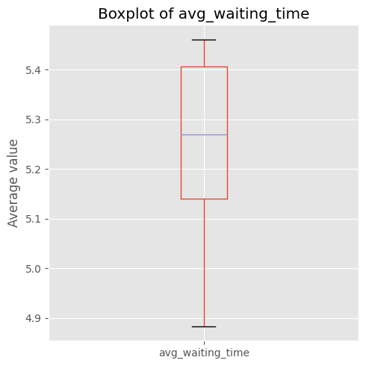
Average Time spent waiting for an elevator

Slide 9
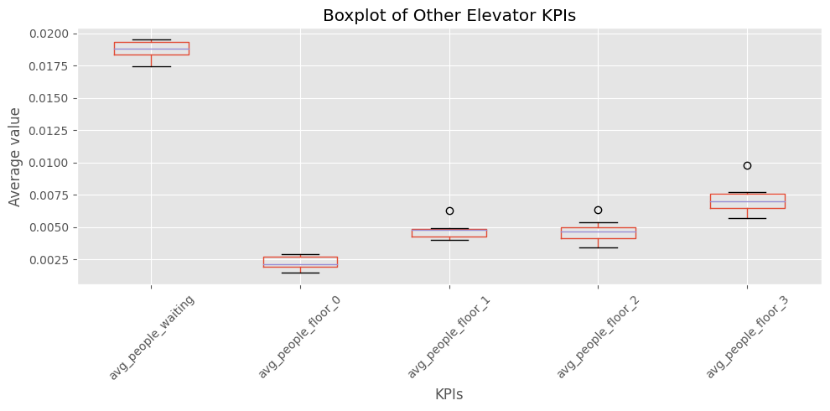
Average Waiting time distribution across floors

Slide 10
Advantages and Disadvantages
The event-driven nature suited this project since the system could be effortlessly outlined using events.
It demonstrated higher efficiency, especially when compared to agent-based models.
The system's linear and predictable behavior streamlined its scheduling.
Managing the synchronized interaction between Visitor, Elevator and Floor proved challenging.
There's a constraint in portraying unique behaviors for individuals; it assumes uniform behavior across all visitors.
Capturing interactions amongst different classes and visitors isn't straightforward.

Slide 11
Challenges of Using Salabim
Event Description Focus: Salabim excels in Discrete Event Simulation, with a significant emphasis on describing events and processes. While this made outlining the behavior of individual agents straightforward, synchronizing these behaviors with other agents was a complex task.
Measurement Limitations: Out of the box, Salabim offers limited capabilities for performance measurement. This might necessitate additional tools or adjustments for comprehensive analytics.
Module Separation: Salabim doesn't easily allow for the separation of its Python modules, which can make the code structure less clear. However, given the relatively simple nature of the elevator model, this wasn't a significant concern for this particular assignment.

Slide 12
Advantages
User-Friendly Classes: Salabim's core classes, including component, resource, and queue, are intuitive and perfectly suited for detailing the elevator system.
Open-Source Advantage: Being free-to-use and open-source, Salabim offers the benefit of both community and developer support, ensuring consistent assistance and improvements.
Comprehensive Documentation: Salabim boasts substantial documentation, complemented by practical examples, making it more accessible for users to grasp its functionalities.
Ideal for Queue-Based Systems: Salabim is tailor-made for modeling systems that rely on queues and straightforward processes, enhancing the accuracy and efficiency of such simulations.
Unit Specification and Conversion: Salabim not only allows users to specify units but also adeptly manages certain unit conversions automatically, simplifying the modeling process.

Slide 13
Instructions for executing model
Package dependencies:
Salabim (and its associated dependencies)
Matplotlib, pandas, numpy
Execution:
Install all libraries in requirements.txt
Go to the assignment1.ipynb notebook and run all cells.

