Slide 1
DigiLib
Skills Development Lab
Team members :
Maitraya Kakade - 31429
Pranav Kulkarni - 31432
Nachiket Erlekar - 31436
Ashay Koradia - 31431

Slide 2
DigiLib
What it is?
How it works.
Conclusion.
Future Scope.

Slide 3
INTRODUCTION
•“Wouldn’t it be great if you can check the availability of a book in the library without physically going there?”
•“You can reserve a book from your phone sitting at your home!”
•The perks of Digitalization have now made it a need to ease the work. Everyone wants their work to get done at the fingertips. Our application provides similar benefits to the staff and students.
•The DigiLib app provides you the ease of checking the availability, demanding a book, paying fine and reserving a book from the college library through your phone itself.

Slide 4
MOTIVATION
Digitizing PICT library for students and teachers.
Need of physical presence in the library for every activity is a hassle.
Ease of access, checking the status of books, generation of demand slip for books, fine system for late submission of the issued book.
Making the process of issuing, fine and request of book is made completely paperless and process is taken online.

Slide 5
SURVEY
Current library system in Pune Institute of Computer Technology requires each student to physically visit the library just to check the availability of the books.
Each day after the date of submission costs fine of Rs. 10. Many a times students just forget about the book issued which results in piling up of huge fine.
Currently no system is available to remind students of the same.
Demand slips and payment receipts are currently on paper which leads to a huge wastage of paper when such tasks can be done digitally.

Slide 6
REQUIREMENT GATHERING AND ANALYSIS
There should be an easy way to get access to the complete list of books which are available in the library.
Students should be easily be able to keep a track of the fine to be paid by them.
The payment at accounts section is a lot of hassle for students.
Till now the demand slips are to be filled on paper. The app enables the user to directly demand the book which is unavailable, to the librarian through phone.

Slide 7
PROBLEM STATEMENT
Current management of libraries in most of the colleges require physical presence of students in the library for majority of tasks and all the monetary transactions and slip system require use of paper as receipts and bills.
This idea aims to make the libraries smart. It is needed to make the transactions smart and completely paperless. Use of library will be simplified for students and majority of processes can be done right from their phones.

Slide 8
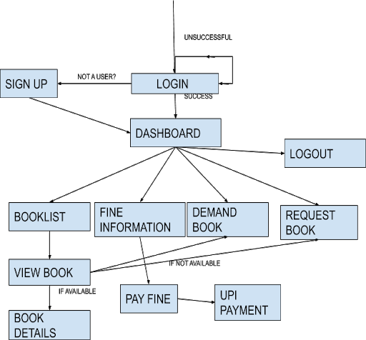
ARCHITECTURE DIAGRAM

Slide 9
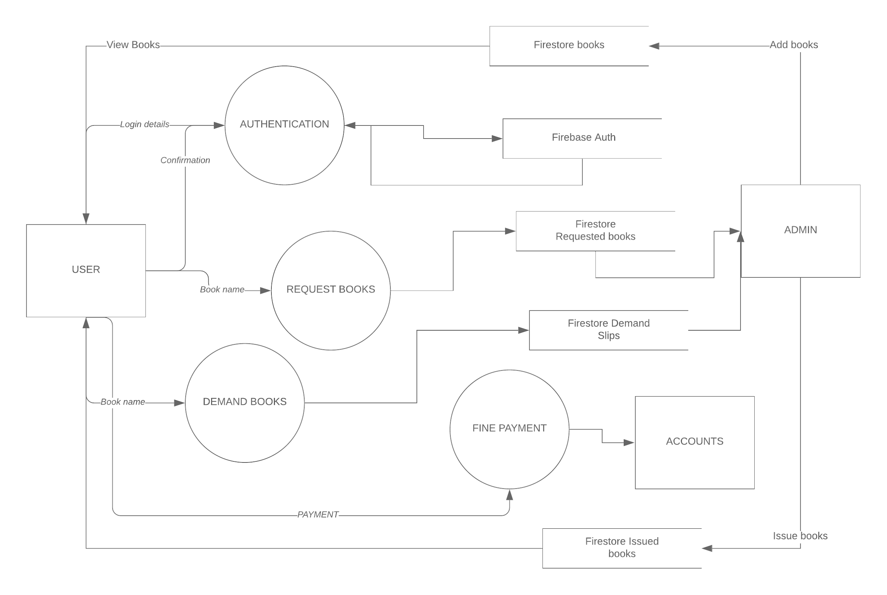
DFD for DigiLib

Slide 10
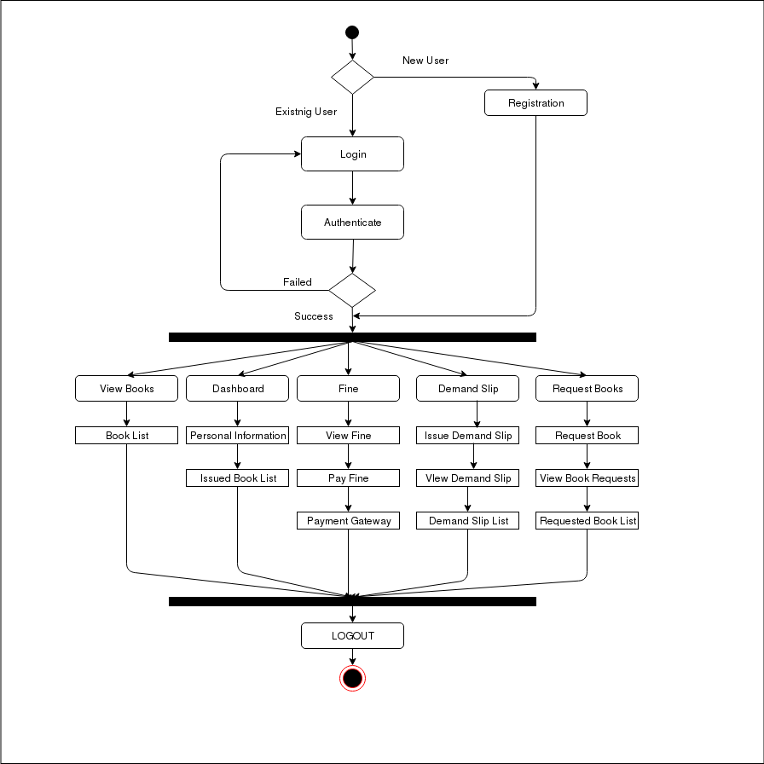
ACTIVITY DIAGRAM

Slide 11
HARDWARE/SOFTWARE REQUIREMENTS ( DEVELOPER )
HARDWARE REQUIREMENTS
Computer with intel i5 or greater processor.
Minimum 8 GB RAM.
A smartphone with android lollipop or greater ( For Testing )
SOFTWARE REQUIREMENTS
Operating System : Linux or Windows
Android Studio by IntelliJ
Java SDK
Firebase account
Node.js

Slide 12
HARDWARE/SOFTWARE REQUIREMENTS ( USER )
HARDWARE REQUIREMENTS
A Mobile phone
Minimum 500 MB RAM ( recommended 1GB or greater )
Minimum 50 MB free space.
SOFTWARE REQUIREMENTS
Operating System: Android.
Android Lollipop ( API 21 ) or greater.

Slide 13
ALGORITHMS/API USED
ANDROID COMPONENTS USED:
Card View
Drawer Layout
Recycler View
Notification Manager
API use:
UPI payment api
Firestore API
Firebase API

Slide 14
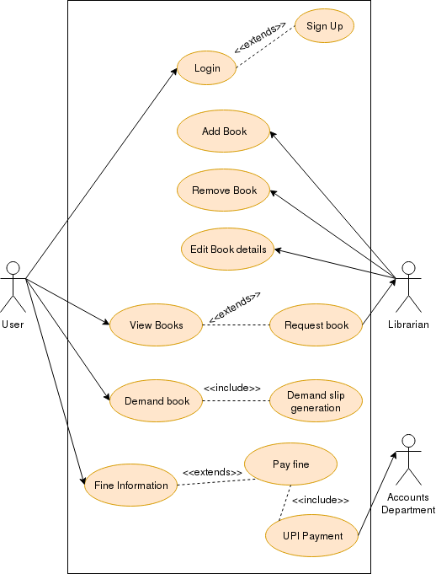
HIGH LEVEL DESIGN (USE CASE)

Slide 15
DigiLib
What it is?
How it works.
Conclusion.
Future Scope.

Slide 16
FEATURES OF THE APP
User can view the complete database of the available books in the library.
User can suggest the book if it is not available in the library.
User can demand a book if there are no copies left.
User can check their profile to know about the books currently issued and fine to be payed.
User can receive notifications when the book of which they submitted the demand slip is available.

Slide 17
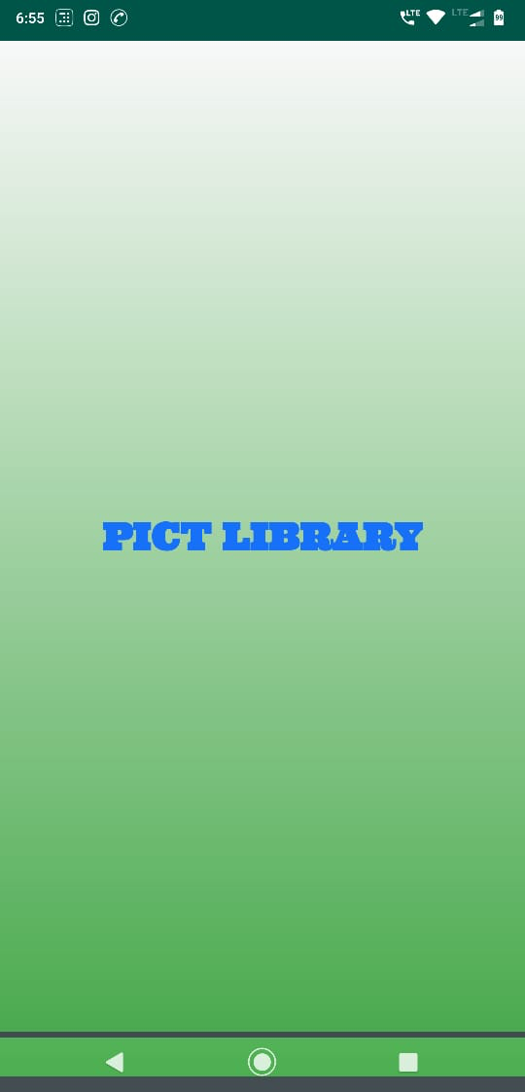
SPLASH SCREEN
It is the graphical control introduction activity element for the app.

Slide 18
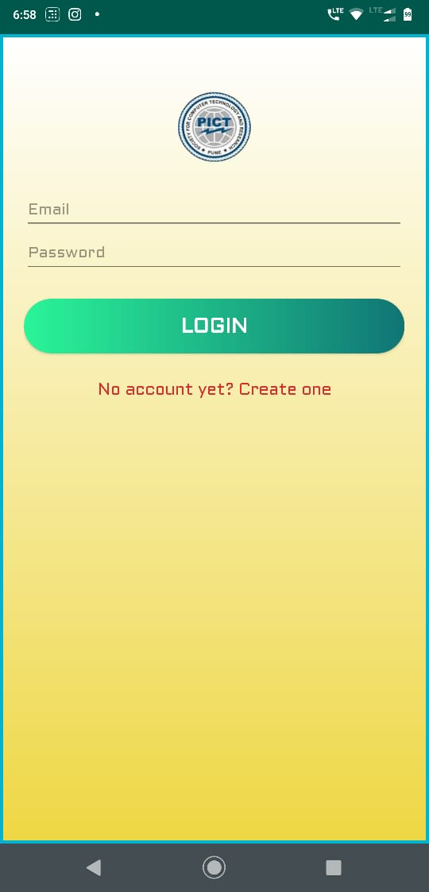
LOGIN
The users have to put their email address and the password to login.

Slide 19
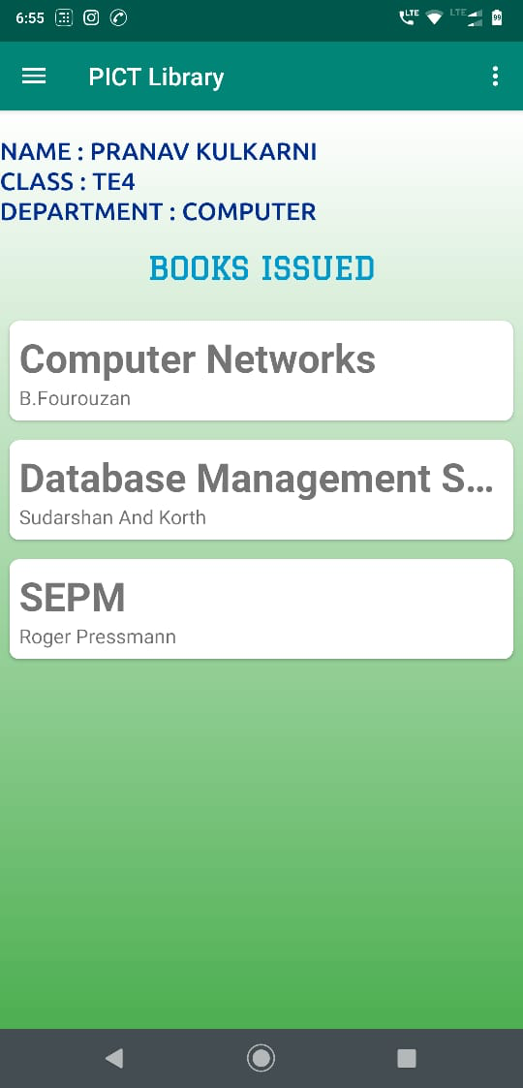
DASHBOARD
Dashboard gives the overall information of the logged in user viz. Name, class department and the list of books issued.

Slide 20
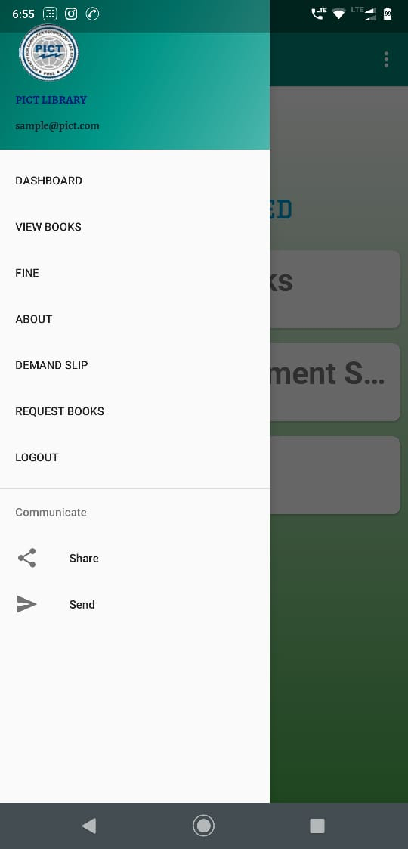
SLIDING NAVIGATOR
It assists to easily navigate through the different app modules.

Slide 21
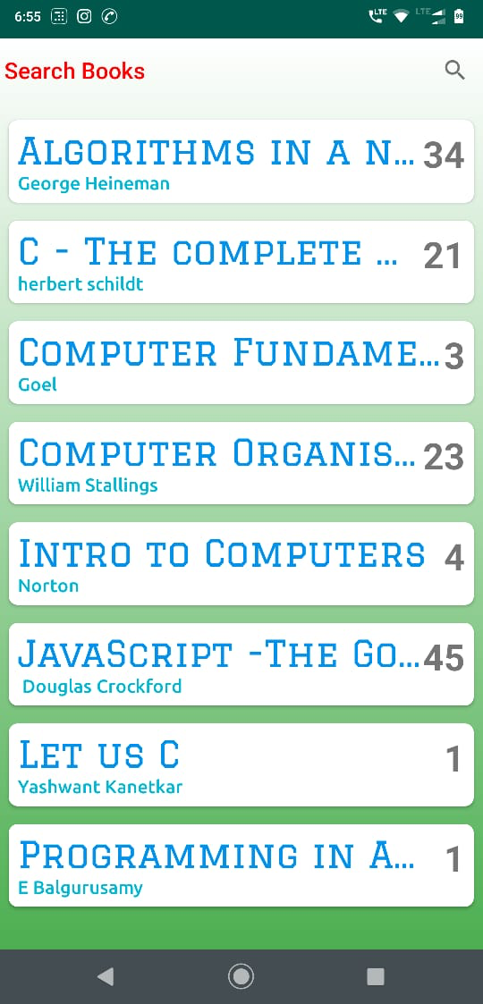
VIEW BOOKS
The view books section provides the read view of the database of the college library books.

Slide 22
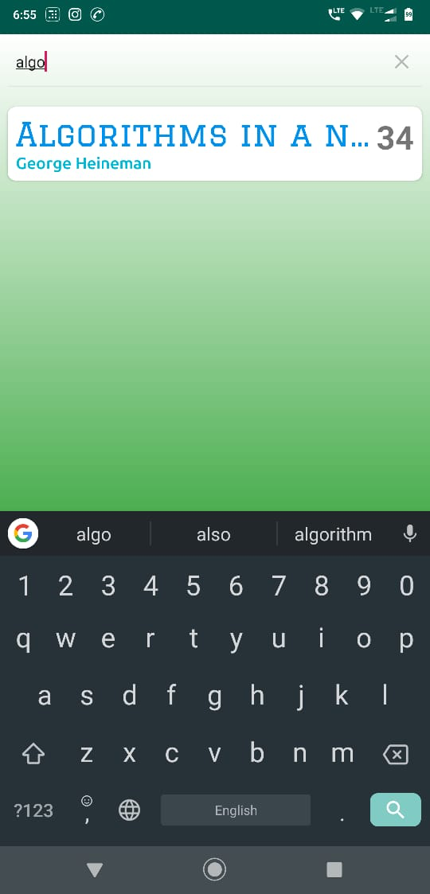
BOOK SEARCH
Entering the keyword in the search bar for the desired book will filter the book list accordingly, handing the book the user wanted.

Slide 23
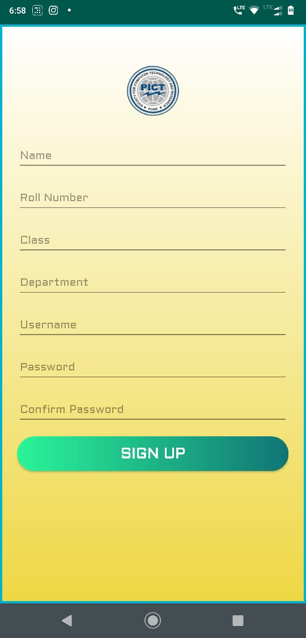
SIGN UP FOR DEMAND SLIP
The students have to provide the details before issuing a demand slip.

Slide 24
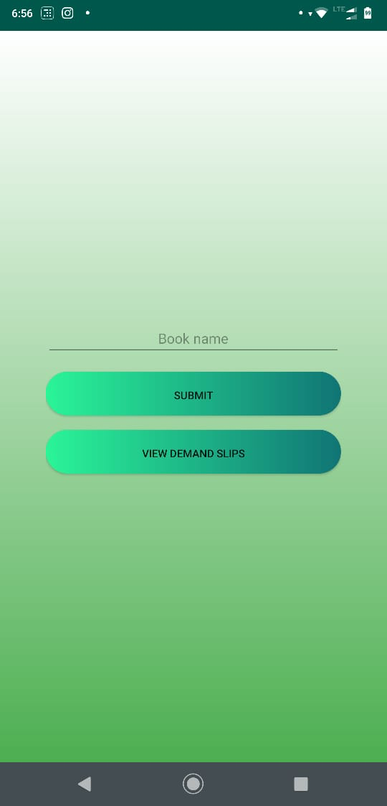
REQUEST DEMAND SLIP
After providing the details the user can request for the book which is not available in the library.

Slide 25
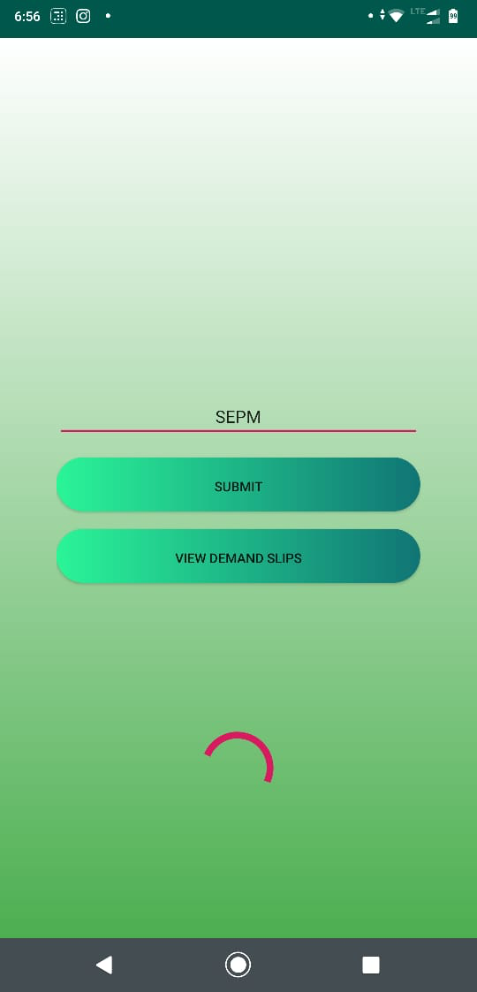
DEMAND SLIPS
Just type in the name of the book and click submit to submit the demand slip. To view the demand made click on view demand slips button.

Slide 26
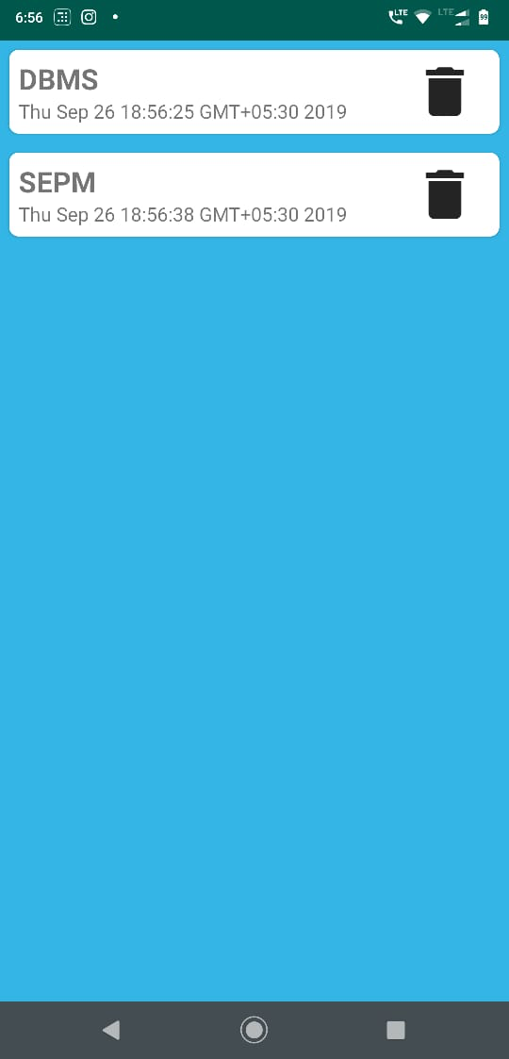
VIEW/DELETE DEMAND SLIP
The requested demand slips can be viewed or deleted by the user if needed.

Slide 27
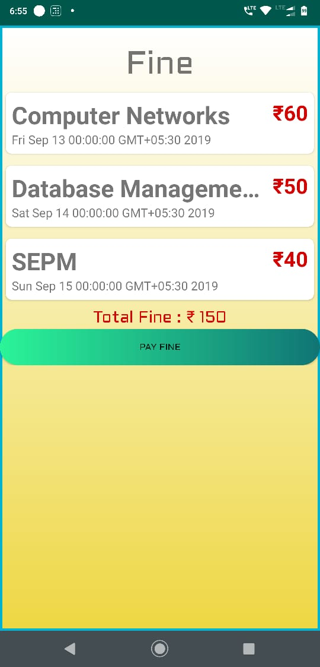
FINE PAYMENT
The Fine activity shows the amount to be paid if the book is not returned in time and notifies user accordingly on the individual books.

Slide 28
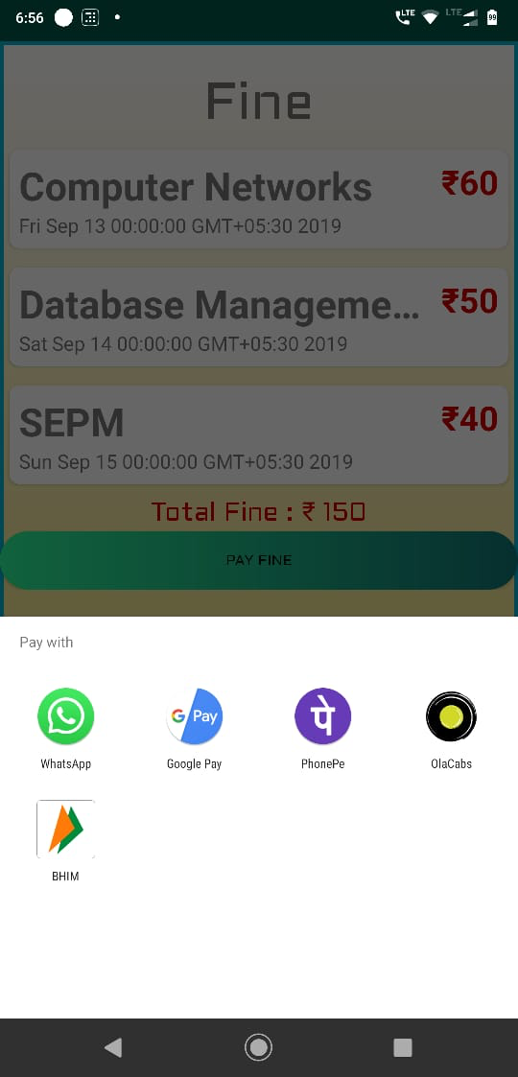
PAYMENT GATEWAY
The payment can be directly made through online transaction.

Slide 29
DigiLib
What it is?
How it works.
Conclusion.
Future Scope.

Slide 30
CONCLUSION
DIGILIB app was intended to simplify various library tasks for the users. With this application, user can perform numerous library tasks from his phone itself. This application will make the process of viewing, demanding, requesting and payment related to the books digital and very simplified. The GUI provided is so simple that any novice can also learn to use it.
This application will also be useful to library workers as the number of students visiting the library will only be limited to students issuing or returning books. The fine can be paid online and demand slips need not be physical , hence, this app will encourage eco-friendly paperless transactions.

Slide 31
DigiLib
What it is?.
How it works.
Conclusion.
Future Scope.

Slide 32
FUTURE SCOPE
Admin level interface in the app.
Optimized search algorithm for the app using recommender system.
Barcode scanner system: User sends request to the librarian, the librarian accepts the request of the book and scan the barcode thereby, reserving the book for the user.
Introduction of an e-book section for users.

Slide 33
REFERENCES
[1] Youtube. “ FirebaseUI - Firestore + RecyclerView (FirestoreRecyclerAdapter) - Android Studio Tutorial”.
[Online] Available: https://www.youtube.com/playlist?list=PLrnPJCHvNZuAXdWxOzsN5rgG2M4uJ8bH1
[2] Youtube. “ Custom Buttons Design - Android Studio Tutorial”.
[Online] Available: https://www.youtube.com/watch?v=nlPtfncjOWA
[3] Cloud Firestore Documentation [Online] Available: https://cloud.google.com/firestore/docs/
[4] Android Documentation [Online] Available: https://developer.android.com/docs
[5] John Horton, Android Programming for Beginners ,Packt Publishing Ltd.
[6] Lucas Moyer, “Importing JSON into Firestore” [Online] Available: https://medium.com/lucas-moyer/how-to-import-json-data-into-firestore-2b370486b622

