Slide 1
InsightXpert
AI-Powered Data Analyst for Business Leaders
Ask questions in plain English. Get data-backed answers from 250K payment transactions — no SQL required.
Techfest 2025-26 | IIT Bombay | Leadership Analytics Challenge
Team: Nachiket Kandari & Arush
March 8, 2026

Slide 2
The Problem
Data-rich but insight-poor
Today's Reality
Questions Leaders Ask
Organizations generate millions of transactions daily
"Which merchant categories show the highest failure rates during peak hours?"
— Head of Product
Business leaders need quick answers but can't write SQL
"How do transaction patterns differ between age groups on weekends?"
Data teams become bottlenecks — every question is a ticket
— VP Operations
Insights arrive days later, decisions are already made
"Flag any merchant categories with unusually high fraud review rates."
— Chief Risk Officer
Analytics tools require training most leaders don't have time for
"Are 5G users more likely to complete high-value transactions?"
— Growth Lead
InsightXpert
2 / 16

Slide 3
Our Solution
InsightXpert translates natural language into SQL, executes it safely against 250,000 transactions, and synthesizes layered, cited answers — in seconds.
1
2
3
4
Natural Language to SQL
Multi-Agent Enrichment
Self-Improving RAG
Explainable Insights
Ask in plain English. The AI writes & runs the query for you.
Agentic mode adds comparative context, trends & root causes.
Every good query is learned. Accuracy improves over time.
Every answer includes evidence, provenance, caveats & next steps.
Live at: insightxpert-ai.web.app
InsightXpert
3 / 16

Slide 4
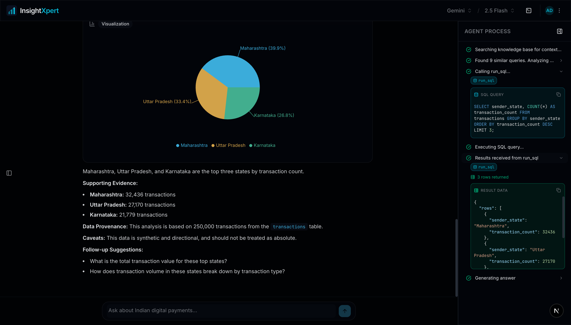
The Product
What the user actually sees
InsightXpert
4 / 16

Slide 5
How It Works: Basic Mode
Question to insight in under 5 seconds
1
2
3
4
5
User Question
→
RAG Retrieval
→
LLM + Tools
→
SQL Execution
→
Answer Synthesis
Plain English natural language
ChromaDB finds similar past queries
Gemini generates SQL, calls tools iteratively
Read-only SQLite row-limited, guarded
Evidence + caveats + follow-up suggestions
SSE Streaming
Force-Tool-Use Guardrail
Real-time chunks delivered as the LLM generates them — user sees progress instantly.
The LLM must query the database before answering — zero hallucinated insights.
InsightXpert
5 / 16

Slide 6
How It Works: Agentic Mode
Multi-agent pipeline for deep, cited insights
Phase 1
Phase 2
Phase 3
Analyst
→
Evaluator
→
DAG Executor
Answers the question immediately. User sees results right away.
Scores the answer. Decides which enrichment categories add value.
Runs sub-agents in parallel: SQL Analyst + Quant Analyst.
Enrichment Categories
Comparative Context
Temporal Trend
Root Cause
Segmentation
Benchmarks vs. related groups
Growing, shrinking, or stable?
Why does this pattern exist?
Break down by age, device, region
Phase 4: Response Synthesizer merges all results into a single cited insight with [1] [2] numbered references.
InsightXpert
6 / 16

Slide 7
Architecture & Tech Stack
Backend
Frontend
Infrastructure
Framework
FastAPI (async, SSE streaming)
Framework
Next.js 15/16 + React 19
Hosting
Firebase + Cloud Run
Runtime
Python 3.11 + uv
UI
Shadcn/ui + Radix (accessible)
CI/CD
GitHub Actions
LLM Primary
Google Gemini 2.5 Flash
Styling
Tailwind CSS 4
Auth
Workload Identity (keyless)
LLM Local
Ollama (runtime switchable)
State
Zustand (4 stores)
DB Backup
Litestream → GCS
Prompts
Jinja2 templates
Animation
Framer Motion
Container
Docker on Cloud Run
Vector Store
ChromaDB (4 collections)
Charts
Recharts (auto-detected)
Preview
PR preview deployments
Database
SQLite, 250K rows, 8 indices
Streaming
Custom SSE client
Auth
JWT + bcrypt (httpOnly cookies)
Build
Turbopack + Firebase Hosting
7,000+ LOC backend | 4,000+ LOC frontend | 30+ modules | 50+ components | 16 test files
InsightXpert
7 / 16

Slide 8
The Dataset
250,000 synthetic Indian digital payment transactions
250K
17
4
10
8
10
Transactions
Columns
Txn Types
Categories
Banks
States
Transaction
Demographics
Banking
Technology
Risk & Time
transaction_id, timestamp, transaction_type, amount_inr, transaction_status, merchant_category
sender_age_group, receiver_age_group, sender_state
sender_bank, receiver_bank
device_type, network_type
fraud_flag, hour_of_day, day_of_week, is_weekend
fraud_flag = 1 means flagged for review, NOT confirmed fraud. All insights are directional — synthetic data.
InsightXpert
8 / 16

Slide 9
Query Coverage
6 query types — from simple lookups to statistical inference
Descriptive
Comparative
"What is the average transaction amount for bill payments?"
"How do failure rates compare between Android and iOS?"
Temporal
Segmentation
"What are the peak transaction hours for food delivery?"
"Which age group uses P2P transfers most frequently?"
Correlation
Risk Analysis
"Is there a relationship between network type and success?"
"What % of high-value transactions are flagged for review?"
Ambiguous queries trigger a clarification pre-check — the system asks a targeted follow-up before analyzing.
InsightXpert
9 / 16

Slide 10
RAG & Self-Improvement
The system gets smarter with every question
Q→SQL Pairs
DDL Schemas
Documentation
Findings
Past questions + their SQL. Auto-learned from every successful interaction.
Table definitions so the LLM knows data structure.
Business context & column descriptions. Domain rules.
Previously detected patterns & anomalies.
5 retrieved
3 retrieved
3 retrieved
2 retrieved
Auto-Learning Loop
User asks question → LLM generates SQL → Query succeeds → Q→SQL pair saved to ChromaDB → Future similar queries retrieve it
SHA-256 deduplication ensures no duplicate entries. Over time, the vector store accumulates organization-specific phrasing, improving retrieval accuracy for recurring question patterns.
InsightXpert
10 / 16

Slide 11
Feature Highlights
Chat & Analysis
Conversation Mgmt
• Two answer modes: Basic (fast) & Agentic (deep)
• Full conversation history with search
• SSE streaming with real-time progress
• Star / rename / delete conversations
• Auto-generated charts (bar, pie, line, grouped)
• Multi-turn context retention
• Thinking trace showing agent reasoning
• Lazy message loading for performance
Admin Panel
SQL Executor
• Feature toggles per organization
• Direct SQL panel with read-only guard
• Branding editor (logo, colors, name)
• Results as data table with stats
• Prompt template editor (live Jinja2)
• Streaming CSV export for any result
• User monitoring + conversation viewer
• Dataset viewer with column docs
InsightXpert
11 / 16

Slide 12
Guardrails & Safety
Trust through transparency and constraint
Read-Only SQL
No Hallucination
Regex blocklist + SQLite PRAGMA query_only. No writes ever.
Force-tool-use: LLM must call run_sql before answering.
Row Limits
Query Timeouts
MAX_ROWS cap (1,000) applied to every query result.
30-second timeout per execution. No runaway queries.
No Causal Claims
Fraud Flag Accuracy
System prompt enforces correlation-only language.
Always 'flagged for review,' never 'confirmed fraud.'
Error Sanitization
Synthetic Caveats
Stack traces never surfaced to the LLM or end user.
Every insight notes findings are directional.
InsightXpert
12 / 16

Slide 13
Insights from the Data
Real findings generated by InsightXpert
4.95%
₹5,097
6.6%
Overall failure rate
Highest avg ticket
Web + 3G failure
12,376 failed transactions across 250K — statistically robust across all segments.
Education has the highest average ticket but lowest volume — a clear expansion opportunity.
Worst-performing combo at 6.6% vs 4.95% avg — product team can target with retry logic.
0.19%
7 PM
26-35
Fraud flag rate
Peak hour
Dominant cohort
480 flagged events. Shopping category highest at 0.260%. Confidence intervals are essential.
Transaction volume peaks at 19:00 — consistent with post-work usage patterns.
35% of volume (87K txns). The 36-45 group drives highest ticket size at ₹1,415.
InsightXpert
13 / 16

Slide 14
Evaluation Criteria Alignment
30%
Insight Accuracy
Force-tool-use guardrail eliminates hallucination. Every answer is backed by an actual SQL query against the 250K-row dataset. Statistical tools validate significance.
25%
Query Understanding
6 query types handled: descriptive, comparative, temporal, segmentation, correlation, risk. Clarification system handles ambiguity. RAG provides few-shot context.
20%
Explainability
5-layer response structure: finding → evidence → provenance → caveats → follow-ups. Agent process timeline shows every step. Citations link to sources.
15%
Conversational Quality
Multi-turn context retention. Streaming responses feel instant. Clarification pre-check for vague queries. Thumbs up/down feedback loop.
10%
Innovation & Tech
Custom agent engine (not off-the-shelf). Multi-agent DAG executor. Self-improving RAG. Runtime LLM switching. Protocol-based architecture.
InsightXpert
14 / 16

Slide 15
What Sets Us Apart
Custom Engine, Not Off-the-Shelf
1
We replaced Vanna with a purpose-built ~600-line agent engine. Full control over the tool-calling loop, explainability, streaming, and extension points.
Production-Deployed, Not a Notebook
2
Live at insightxpert-ai.web.app — Firebase Hosting + Cloud Run. CI/CD with GitHub Actions. Keyless GCP auth via Workload Identity Federation.
Multi-Agent Depth, Not Just NL2SQL
3
Agentic mode runs evaluator + DAG executor + response synthesizer. Statistical sub-agent does hypothesis testing with scipy. Cited, numbered references.
Self-Improving RAG
4
Every successful Q→SQL pair is auto-saved. SHA-256 deduplication. The system accumulates organizational phrasing and gets smarter over time.
Enterprise-Ready Architecture
5
Multi-org support, feature toggles, live prompt editing, user monitoring, conversation viewer, admin panel, runtime LLM switching — not just a demo.
InsightXpert
15 / 16

Slide 16
Thank You
InsightXpert — AI-Powered Data Analyst for Business Leaders
Team
Nachiket Kandari
Arush
Architecture, UI/UX, LLM Pipeline
Data Layer, SQL Engine, Deployment
Live Demo: insightxpert-ai.web.app
Techfest 2025-26 | IIT Bombay | Leadership Analytics Challenge

